Slide 1
Evading Anomarly Detection through Variance Injection Attacks on PCA
Benjamin I.P. Rubinstein, Blaine Nelson, Anthony
D. Joseph, Shing-hon Lau, NinaTaft, J. D. Tygar
RAID 2008
Presented by: Dong-Jae Shin

Slide 2
Outline
Background
Machine Learning
PCA (Principal Component Analysis)
Related Work
Motivation
Main Idea
Evaluation
Conclusion
Future work

Slide 3
Machine Learning
1. Background
Machine learning (ML)
Design and develop algorithms by machine using patterns or predictions
Benefits
Adaptability
Scalable
Statistical decision-making
http://1.bp.blogspot.com/-tn9GwuoC45w/TvtQvP6_UFI/AAAAAAAAAHI/ECpLGjyH6AI/s1600/machine_learning_course.png

Slide 4
PCA (Principal Component Analysis)
1. Background
PCA (Principal Component Analysis)
Orthogonal transformation to reduce dimension
Most data patterns are captured by the several principal vectors
$$\begin{matrix}a11 & a12 & a13 \\ a21 & a22 & a23 \\ a31 & a32 & a33\end{matrix}$$
$$\begin{matrix}b11 & b12 \\ b21 & b22\end{matrix}$$
Data preservation (not perfectly)
PCA
Deriving principal vectors
Deriving the principal vector which captures the maximum variance
Find next component

Slide 5
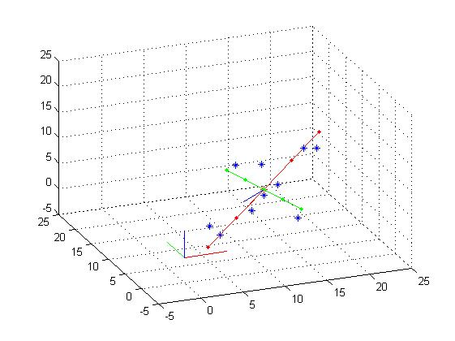
PCA (Principal Component Analysis)
1. Background
PCA
PCA Example
Original coordinates
New coordinates
Projection to 1st basis
(maximum variance)
Projection to 2nd basis
(next maximum variance)
>
More preserved data
Maximum variance means good preservation of information
Dimension reduction using important bases
http://kimhj8574.egloos.com/5632409
Notes:
Have more distance between data

Slide 6
Diagnosing Network-Wide Traffic Anomalies, SIGCOMM 2004
2. Related Work
Anomaly
A pattern in the data that does not conform to the expected behavior
Goal
Diagnosing network-wide anomalies
Problem
Detecting anomalies are difficult because of large amount of high-dimensional and noisy data
?
Src. | Dest. | Data
1.2.3.4 | 5.6.7.8 | DDos
Src. | Dest. | Data
4.3.2.1 | 5.6.7.8 | Mail
Attack
Normal Data
Notes:
Anomalies vs attack

Slide 7
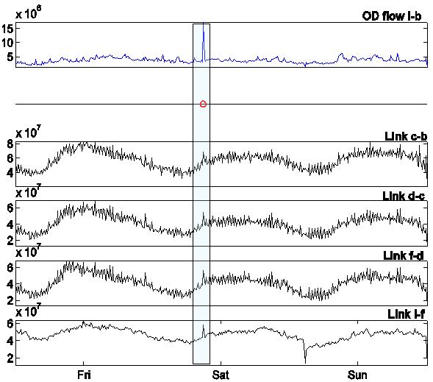
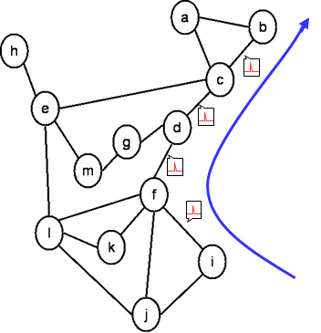
Diagnosing Network-Wide Traffic Anomalies, SIGCOMM 2004
2. Related Work
OD flow
Origin-Destination flow between PoPs
Example of Link Traffic
b end
Network anomaly
i start
Too much complexity to monitor every links
Notes:
Too much complexity.

Slide 8
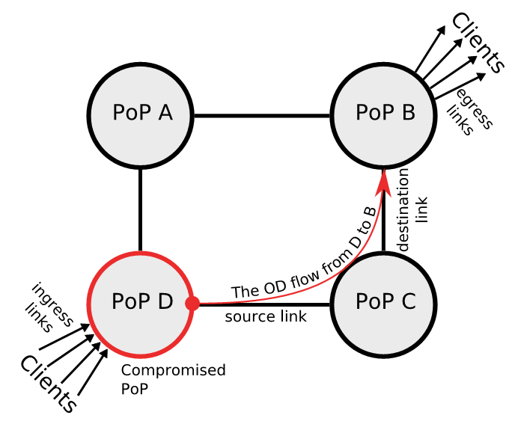
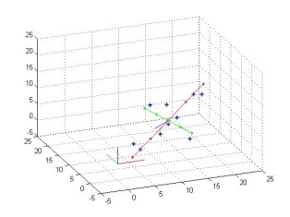
Diagnosing Network-Wide Traffic Anomalies, SIGCOMM 2004
2. Related Work
Volume Anomaly
A sudden positive(+) or negative(-) change in an Origin-Destination flow
Solution
Separate normal & anomalous traffic using Volume Anomaly with PCA
Information : Volume Anomaly → Simple measure
Method : PCA → Simplify vectors
Measure Volume Anomaly
Detecting using PCA
PCA
Normal
Measured Volume anomaly
Anomalous
PoP
Node of backbone network

Slide 9
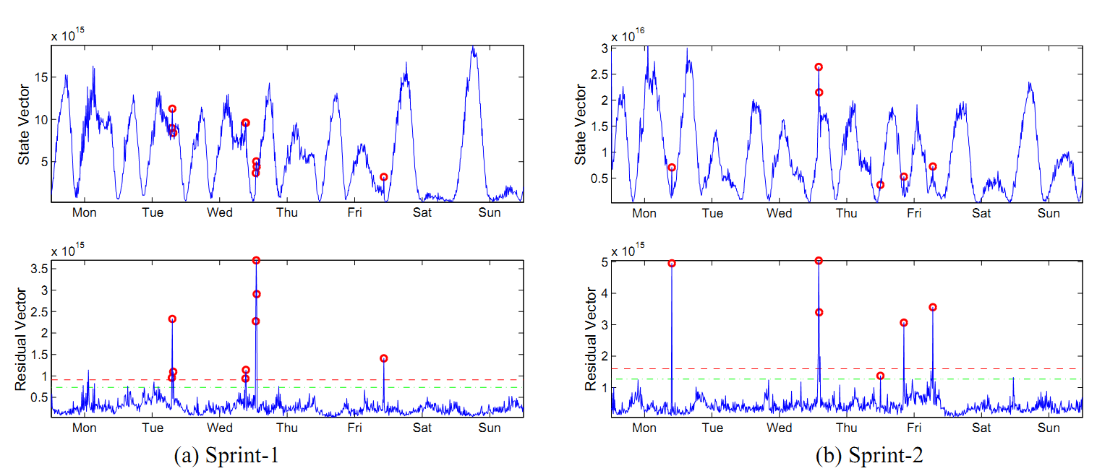
Diagnosing Network-Wide Traffic Anomalies, SIGCOMM 2004
2. Related Work
Result
Comparison between traffic vector of all links and residual vector
: Projection vector using PCA
Traffic
vector
Anomaly Detected
Residual
Easy to detect, identify, quantify traffic anomalies
Heuristic method can be subverted

Slide 10
Vulnerabilities of PCA
3. Motivation
PCA-based Detection can be easily poisoned when only using single compromised PoP
System uses only Volume Anomaly
Machine learning techniques can be deceived in learning phase
Adversary can put poisoned data in learning phase to deceive the system
Poisoned Data

Slide 11
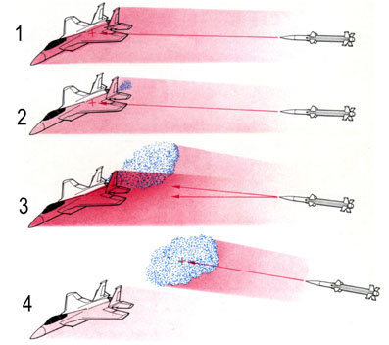
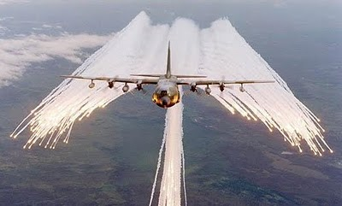
Chaff
3. Motivation
Chaff?
Original mean : Disturbing equipment for radar countermeasure
This paper : Disturbing data against anomaly detection
http://www.ordtech-industries.com/2products/Chaff/Chaff.html http://2.bp.blogspot.com/_NyXGIFk_jjk/TFEYxWSNFoI/AAAAAAAAAuo/MFldb0_h7_0/s400/chaff.jpg

Slide 12
Attack Method
4. Main Idea
Chaff
Half normal chaff
Zero-mean Gaussian distribution
Scaled Bernoulli chaff
Bernoulli random variables
Add-Constant-If-Big
Add constant if traffic exceeds a threshold
Add-More-If-Bigger
Adds more chaff if traffic exceeds a threshold
Boiling Frog Attacks
Slowly increasing (θ) the chaffs
θ : Attack parameter
c_{t} : Chaff traffic
Various spoiled traffic to deceive machine learning based decision process.
False negative rate ↑

Slide 13
What they want
5. Evaluation
Detecting is based on rapid change of residual
Chaff and Boiling frog attack makes
The normal traffic big
The residual traffic of anomaly small

Slide 14
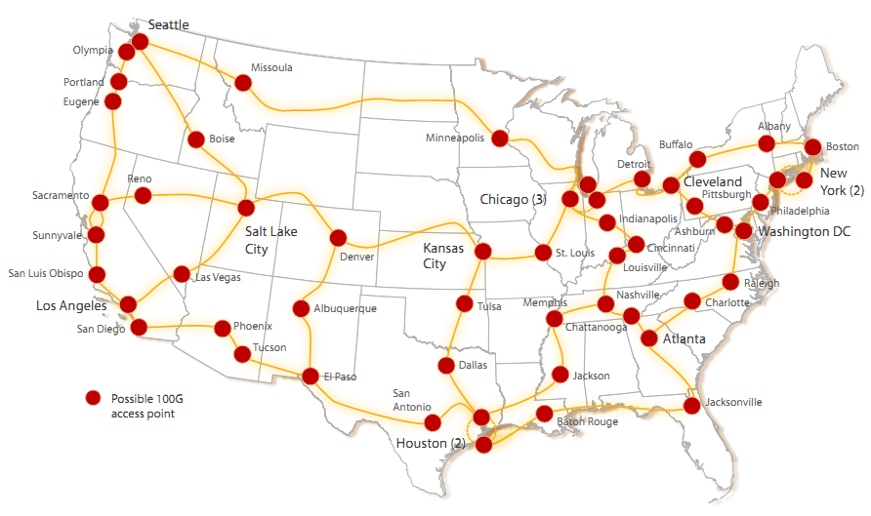
Environments
5. Evaluation
System
Abilene’s backbone network with 12 PoPs
15 bi-directional inter-PoP links
Sampling
2016 measurements per week
5 minute intervals
Abilene’s backbone network

Slide 15
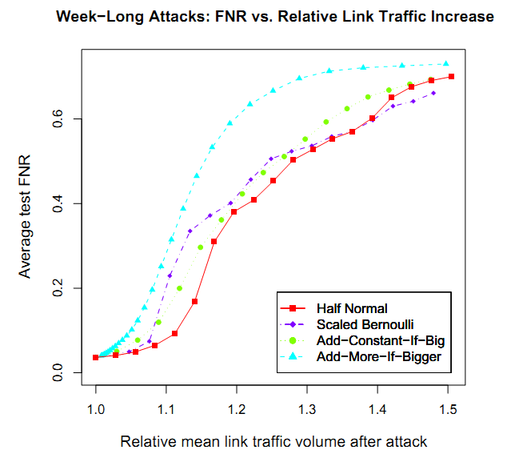
Evaluation
5. Evaluation
FNR
False Negative Rate
Rate of evading
Attacks with chaffs and its FNR
X-axis : How many chaffs to PoP
Y-axis : False Negative Rate
Chaffs (18% Total traffic) using Add-More-If-Bigger method
record over 50% of FNR

Slide 16
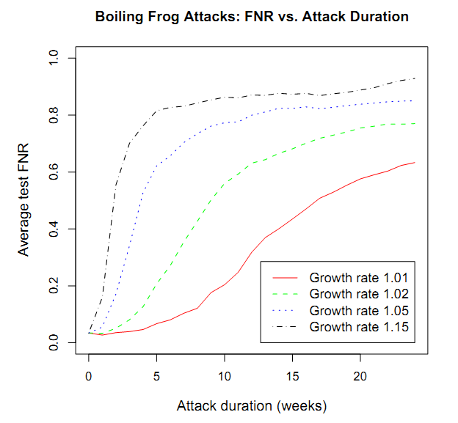
Evaluation
5. Evaluation
Attacks with Boiling Frog and Add-More-If-Bigger
X-axis : Attack duration (weeks)
Y-axis : False Negative Rate
Boiling Frog method is effective on even small growth rates
Growth rate : Multiplied factor of θ

Slide 17
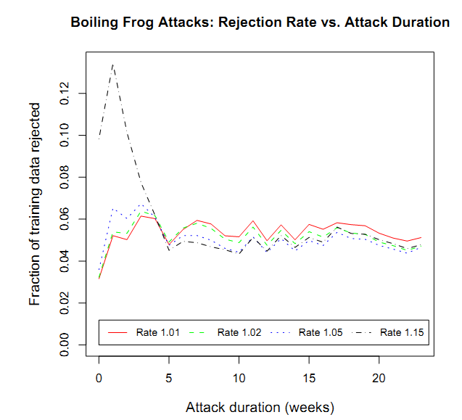
Evaluation
5. Evaluation
Attack Rejection Rate for Boling Frog Attacks
X-axis : Attack duration (weeks)
Y-axis : Chaff rejection rate
Boiling Frog method effectively poison PCA-based system
Rate : Multiplied factor of θ

Slide 18
Conclusion & Future Work
6. Conclusion & Future Work
Conclusion
PCA-based anomaly detectors can be compromised by simple data poisoning strategies
Chaffs
Boiling frog attacks
Increase the chance of evading DDoS attacks detections by sixfold
Future Work
Counter-measure based on Robust formulations of PCA
Poisoning strategies for increasing PCA’s false positive rate
50% of success with 18% of adding traffic, 5% traffic increase

Slide 19
References
B. I. P. Rubinstein et. al., “Evading anomaly detection through variance injection attacks on PCA
B. I. P. Rubinstein et. al. “Compromising PCA-based anomaly detectors for network-wide traffic”
Lakhina, et. al., “Diagnosing network-wide traffic anomalies”

