Slide 1
Attacking Kad Network
20090304 Hongil Kim
E. Chan-Tin, P. Wang, J. Tyra, T. Malchow, D. Foo Kune, N. Hopper, Y. Kim, "Attacking the Kad Network - Real World Evaluation and High Fidelity Simulation using DVN -", Wiley Security and Communication Networks 2009
Notes:
Hi, I’m Hong il Kim. Today, the topic of this presentation is about attacking the Kad Network.

Slide 2
P2P Applications
File Sharing : Napster, Gnutella, BitTorrent, etc
Recent Commercial Applications
Skype
BitTorrent becomes legit
P2P TV by Yahoo Japan
Research community
P2P File and archival systems: Ivy, Kosha, Oceanstore, CFS
Web caching: Squirrel, Coral
Multicast systems: SCRIBE
P2P DNS: CoDNS and CoDoNS
Internet routing: RON
Next generation Internet Architecture: I3
Notes:
I think most of you have experienced with using any kinds of P2P program. Or as you can see here, there are a lot of P2P applications like file sharing, Skype, bitTorrent. And also it is used for research area.
How many of you have used P2P systems?
Motivation to be part of network is there!
Resulting good is more than simple aggregation!
Skype!

Slide 3
P2P Systems
How to find the desired information?
Centralized structured: Napster
Decentralized unstructured: Gnutella
Decentralized structured: Distributed Hash Table
Content Addressable!
A DHT provides a hash table’s simple put/get interface
Insert a data object, i.e., key-value pair (k,v)
Retrieve the value v using key k
Napster.com
Napster
Match
Match
O
K V
O
K V
K V
K V
K V
P
K V
K V
K V
Query
QueryHit
Download
P: a node looking for a file
O: offerer of the file
…
A
B
K V
X
K V
K V
retrieve (K₁)
Notes:
In P2P system, we can separate it into two methods. First one is centralized structured system. It is used by Napster. And it is controled by one center of system. So as you can easily think, single point of failure can be serious problem in this system.
Next one is decentralized unstructored system, it is used by Gnutella, there are no controlling center and each distributed node is used for contents sharing. In this case, we can avoid the single point of failure problem, but bandwidth usage between peers can be very inefficient. So, to solve the problems of both system, we use decentralized structured system, that is Decentralized Hash Table. So each node have a piece of key and value pair routing table, and using this querier can easily get the peer information who can have the wanted content.
Peer-to-peer systems are popular. We all know the following peer-to-peer systems. …
The popularity of these systems signified a revolutionary paradigm shift of building large-scale distributed systems.
A main question these systems need to address is how to find the desired information.
Solutions evolved from Centralized à decentralized from Unstructured à structured.
The Decentralized structured solution is also referred as DHT.
DHT provides hash-table like functionality. Nodes in a DHT network can efficiently store and retrieve data objects.

Slide 4
DHT: Terminologies
Every node has a unique ID: nodeID
Every object has a unique ID: key
Keys and nodeIDs are logically
arranged on a ring (ID space)
A data object is stored at its root(key)
and several replica roots
Closest nodeID to the key (or successor of k)
Range: the set of keys that a node is responsible for
Routing table size: O(log(N))
Routing delay: O(log(N)) hops
Content addressable!
C
A
Q
X
D
B
Y
R
k
(k,v)
Notes:
If we see more specifical things in DHT, Every node has a unique ID like hash of IP, and also key value like hash of contents. Then keys ans node pair object is logically arranged on a ring topology and data object is stored at its root(key) and replica roots are neighbor nodes of root(key). And it works for the case root(key) node is attacked by adversary. So if A queries this k content then so each node can get the answer of query recursively in O(log(N)) time complexity.

Slide 5
Target P2P System
Kad
A peer-to-peer DHT based on Kademlia
Kad Network
Overnet: an overlay built on top of eDonkey clients
Used by P2P Bots
Overlay built using eD2K series clients
eMule, aMule, MLDonkey
Over 1 million nodes, many more firewalled users
BT series clients
Overlay on Azureus
Overlay on Mainline and BitComet
Notes:
So Kad is a peer-to-peer DHT based on Kademlia.
And Kad Network has three kinds of system.
This paper targeted this system, and so we wiil see the attack of this system.

Slide 6
Kademlia Protocol
10101100
11001011
01001011
123.24.3.1
K bucket
00100101
23.37.12.13
0
01011010
311.1.3.4
11000100
…
1
01000001
129.5.3.1
10101100
11011011
0
11001100
11000100
1
11111110
…
11010001
11001010
0
Find/store
10001011
1
10010100
10001110
…
10000001
0
1
d(X, Y) = X XOR Y
An entry in k-bucket shares at least k-bit prefix with the nodeID
k=20 in overnet
Add new contact if
k-bucket is not full
Parallel, iterative, prefix-matching routing
Replica roots: k closest nodes
Notes:
Before attacking the Kad network, I’ll explain the concept of Kademlia and Kad protocol. Because Kad network is based on DHT but the routing alorithm and topology used in Kademlia is different from DHT.
So the whole node is structured like this tree structure something like biased. And each node has a k bucket routing table. Usually 20 buckets in 1million nodes. And the rule of the distance of two nodes is calculated by ‘bitwise XOR’ using the two node IDs.
Then suppose my nodeID is 10101100 and my node wants to find 11001011 node.
So using the prefix-matching algorithm, first bit xor goes 0 and second bit 택 goes 1.
And in this node’s routing table, find the most prefix-matched nodeID, it is 11000100 and in this node’ routing table finds iteratively.
In real network, node queries to each three nodes in parrallel, so we call Kademlia protocol as parallel, iterative, prefix-mathcing

Slide 7
Kad Protocol
10101100
0
1
0
1
1
0
1
0
1
0
1
0
1
0
1
0
0
1
1
0
1
0
1
0
1
0
1
0
1
0
15
14
13
12
11
10
9
8
7
6
5
4
3
2
1
0
0
1
0
1
Wide routing table ➔ short routing path
K bucket in i-th level covers 1/2^{i} ID space
A knows new node by asking or contact from other nodes
Hello_req is used for liveness
routing request can be used
No restriction on nodeID
Replica root: |r, k| < δ
K buckets with index [0,4] can be split if new contact is added to full bucket
Notes:
And the Kad protocol uses wide tree structured routing table, so the number of prefix-matched bit will increase and this will make shorter routing path.

Slide 8
Vulnerabilities of Kad
No admission control, no verifiable binding
An attacker can launch a Sybil attack by generating an arbitrary number of IDs
Eclipse Attack
Stay long enough: Kad prefers long-lived contact
(ID, IP) update: Kad client will update IP for a given ID without any verification
Termination condition
Query terminates when A receives 300 matches.
Timeout
When M returns many contacts close to K, A contacts only those nodes and timeouts.
Notes:
So the vulnerabilities of Kad is simple,
No verifiable binding means, in Kad protocol, there’s no relation between host and its ID
So attacker can generate an arbitrary number of IDs to collect the whole routing table.
And Kad prefers not to change node’ ID. So in the case, peer who is downlaoding some file moves another network then Kad node simply sends the message like “node’s IP is changed” then it works without any verification.
If node A receives more than 300 matches, then query terminates. So if an attacker sends more than 300 faulty matches earlier, that peer would have no meaningful results

Slide 9
Actual Attack
Preparation phase
Backpointer Hijacking: 8 A, attacker M
Learns A’s Routing Table by sending appropriate queries
Then, change routing table by sending the following message.
Execution phase
Provide many non-existing contacts
Fact: Query will timeout after trying 25 contacts.
Hello, B, IP_{M}
0xD00D
IP_{B}
IP_{M}
A
M
Notes:
Using those vulnerabilities of Kad, Actual Attack is divided into two parts.
In Preparation phase, simply attacker M sends the hello message to A that node B’s IP address is changed to IP of node M. Then node A will update its routing table like this.
So attacker sends this message to all nodes that exists in its routing table.
After that, In Execution phase, if query message comes to node M, then answer with non-existing contacts. Then, querier node can’t get any appropriate results.

Slide 10
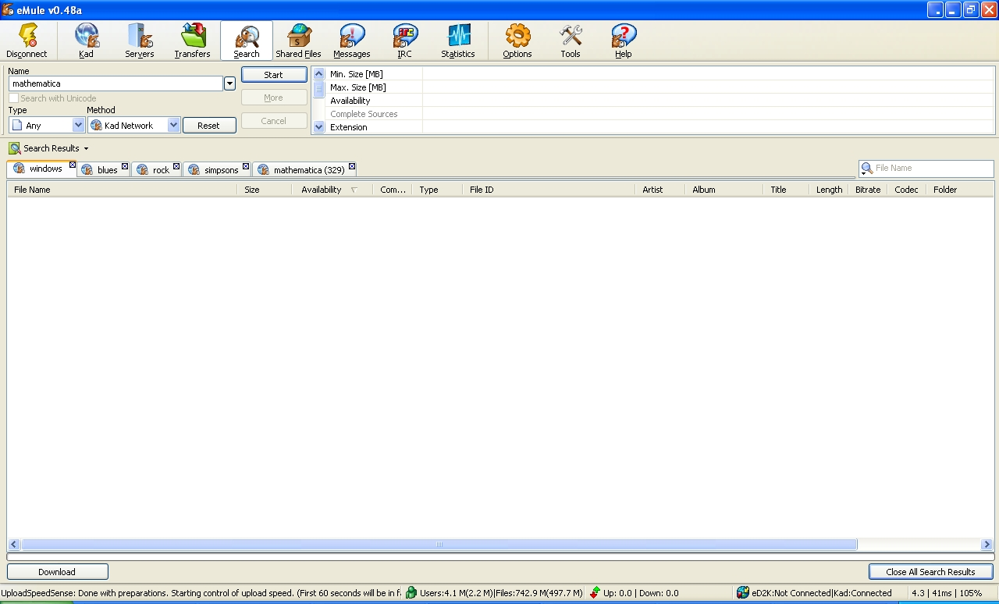
Screen Shots
Notes:
This is the experimental results in those attack in eMule.
As you can see, this node can’t get any result of windows , blues, rock, simpsons…..

Slide 11
Summary of Estimated Cost
Assumption
Total 1M nodes
800 routing table entries
100 Mbps network link
Preparation cost
41.2GB bandwidth to hijack 30% of routing table
Takes 55 minutes with 100 Mbps link
Query prevention
100 Mbps link is sufficient to stop 65% of WHOLE query messages.
Notes:
Doing large scale simulation, this paper assume that there are total 1M nodes,….

Slide 12
Large scale simulation
11,303 ~ 16,105 Kad nodes running on ~500 PlanetLab machines
Comparison between expected and measured
keyword query failures
Number of messages used to attack one node
Bandwidth usage
Notes:
Simply we can see that if hijacked contacts increases, then also the percentage of query failure is increased.

Slide 13
Self reflection attack
Fill node A’s routing table with A itself.
A
A
C
C
C
IP_{C}
C
…
Hello, X, IP_{A}
…
G
IP_{G}
G
Attack
G
G
≈ 100% queries failed after attack
Nodes can recover slowly
Second round of attack
Notes:
We can simply think that ,to reduce the ongoing cost of the attack, just change the victim’s routing table with A’s IP itself. This is called Self reflection attack. If we see this figure, at the point of attack, we can see that 100% queries failed. And nodes are recovered slowly. And its because in routing table, some other normal nodes could send the Hello_request message to node A.

Slide 14
Mitigations
Identity authentication
Routing correctness
Independent parallel routes
Incrementally deployable
Method | Secure | Persistent ID | Incremental deployable
Verify the liveness of old IP | No | Yes | Yes
Drop Hello with new IP | Yes | No | Yes
ID=hash(IP) | Yes | No | No
ID=hash(Public Key) | Yes | Yes | No
backpointers | Current method | Independent parallel routes
40% | 98% fail | 45% fail
10% | 59.5% fail | 1.7% fail

Slide 15
Thank you
Any Questions?

