Slide 1
The Frog-Boiling Attack: Limitations of Secure Network Coordinate Systems
IS523 Class Presentation
KAIST
Seunghoon Jeong
Notes:
Hello, my name is Seunghoon Jeong, and I’ll talk about a paper of the frog-boiling attack in the context of the network coordinate system today. This paper was published in TISSEC 2011
I’ll start.

Slide 2
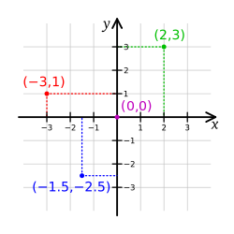
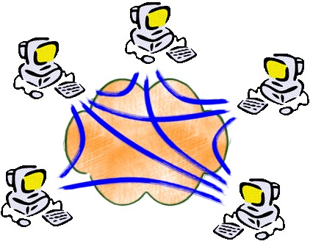
What is Network Coordinate System?
P2P, CDN, DHT, …
How to measure distance between a pair of nodes
Efficient estimation of latency
B
A
C
Notes:
At present, P2P, CDN, Distributed Hash Tables are popular. You may also have downloading experience in P2P.
One issue in p2p system is to get the file fast. How to find the closest node among the ones scattered in the Internet?
In the Cartesian coordinate system, you can measure the distance between a pair of nodes.
For example, the distance of A and B can be calculated using the Pythagoras formula.
Likewise, a P2P file system also requires a distance measuring system. This is the network coordinate system.
It assigns a virtual coordinates to each node in a network and allows efficient estimation of latency.
Without the coordinate system, it will take O(n^2) time in a network with n nodes.

Slide 3
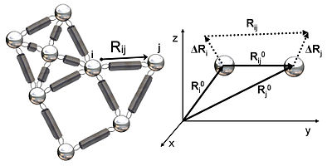
Embedding Error in Network Coordinates
Real value ≈ Estimated value?
What if the error is very big?
What a coordinate system should do?
Notes:
All network coordinate systems have embedding error. Embedding error is the difference between real value and estimated value in a coordinate system.
In the first graph, the left one is with real data and the right one is with estimated data. Can you find any problem in this picture?
You can find that the real value may not conform to the triangular inequality, meanwhile the embedded values should depend on the triangular inequality.
As the embedding error increases, a coordinate system becomes inaccurate and unstable.
Therefore, a coordinate system repeatedly updates a node position in a way to diminish any embedding error comparing the real RTT and estimated RTT.
It’s like a spring network in the right picture. This is the way how a coordinate system operates.

Slide 4
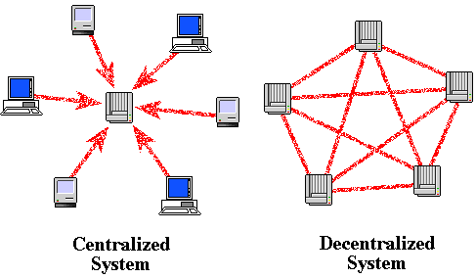
Existing Network Coordinate Systems
Vivaldi
Decentralized
Resilient to network dynamics
Pyxida
Implementation of Vivaldi
Open source designed to operate on P2P
[Dabek et al. ,2004]
[Pyxida 2009]
Notes:
Vivaldi is an algorithm of network coordinate system. It is decentralized, ‘decentralized’ means that there are not dedicated trusted nodes assigning virtual coordinate.
Vivalid provides resilience to a dynamic network conditions. For example, in P2P network, join and leave are very frequent.
Pyxida is an implementation of Vivaldi. It is was designed to operate on a P2P network.
Its main function is to estimate the latencies between hosts with stable and accurate network coordinates.

Slide 5
Coordinate Update
Relative Error
=|Estimated-Real|/Real
=|19.8-25|/25 = 20.8%
(1,20)
25ms
(14,5)
Alice update coordinate that reduces error
Notes:
In Pixida, each node updates its coordinate to reduce relative error.
Relative error is the difference between estimated RTT and real RTT divided by real value.
For example, in the example, the RTT is 25ms and estimated RTT is 19.8ms
Alice computes relative error to Bob and moves its coordinate to reduce error.

Slide 6
Vivaldi is not secure
A
Real RTT
T
V’
V
A’
Measured RTT
Notes:
To adjust dynamic network conditions, Vivaldi changes its coordinate using neighbors’ coordinates.
The weakness comes from the point that an attacker can lie about its reported coordinates and delay its response, but Vivaldi has no verification mechanism.
For example, attacker reports its coordinate A’, and Victim estimate real RTT. Then it can know that its coordinate is too close to A’ and moves to the direction of T
In this way, an attacker can move a victim to a target point.

Slide 7
Existing secure mechanism
A
V’
V
Mahalanobis distance, Kalman Filter, Veracity
Notes:
Of course, there are several counter measures
Mahalanobis outlier detection and Kalman Filter uses a statistical method to determine the acceptability of a reported coordinate.
If the displacement exceed the boundary, the system reject the update data.
Veracity is a distributed reputation system using two step methods.

Slide 8
Frog-Boiling Attack
A
V’
V
Displacements falls inside the threshold
Notes:
Intuitive attack to the existing scheme is frog-boiling attack you know.
If attacker A continually reports to Victim V its coordinates as a near point of V so that the movement does not exceed the detection boundary,
Then, the victim is gradually moved to the target point as the attacker wishes

Slide 9
Targeted Attack
Goal: make victim report spoiled coordinate to the rest of the network and flagged as outliers and isolated
Is frog-boiling attack simple to achieve?
A
A
V
A
Notes:
So, the goal of this attack is to make a victim report incorrect coordinate to the rest of the world moving to a target.
Then, the secure coordinate mechanisms flag the nodes as outliers, and their data are not accepted and the nodes become isolated.
However, the frog-boiling attack is not so simple because attackers are not the only neighbors of the victims and good friends can send back
the victims. Therefore, an elaborate scheme is necessary so that a portion of attackers are always in the victims’ neighbor list.

Slide 10
Three Variant Attacks
Basic-Targeted Attack: moves targeted nodes to some coordinate (a)
Network-Partition Attack: partitions a network into several subnetworks (b)
Closest-Node Attack: attacker becomes the closest node to the victim (c)
Honest nodes are shaded whereas malicious nodes are white
Notes:
Targeted attack has three variants
The basic targeted attack transfers victim nodes to some coordinate
Network-Partition attack applies the scheme to group of nodes in a network and partitions the network into several subnetworks.
Finally, the closest-node attack enables the attacker to be the closest node of the victims

Slide 11
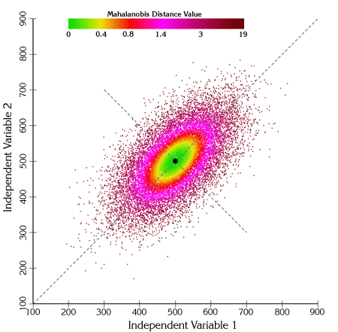

Mahalanobis Distance
Distance measure of a point from a group of values based on the correlation between variables.
Given
$x=(x_{1},$ $x_{2},$ $x_{3},$ …, $x_{N})^{T}$,
$μ=(μ_{1},$ $μ_{2},$ $μ_{3},$ …, $μ_{N})^{T}$,
covariance matrix $S,$
Then,
$$D_{M}\left(x\right)= \sqrt{{\left(x−μ\right)}^{T}S^{−1}(x−μ})$$
Notes:
Mahalanobis distance is a distance measure based on the correlation among variables, which measures a distance of a point from a group of values.
Given a point x and a group of values with mean $μ$ and its covariance S, the Mahalanobis distance is calculated like this.
Simply put, when the distribution is like an ellipsoid, the distance of the test point from the center of mass is divided by the width of the ellipsoid in the direction of the test point. So, it is scale-invariant

Slide 12
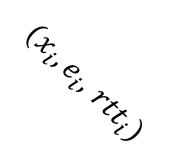
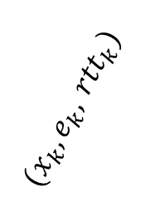
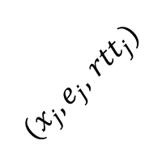
Mahalanobis Outlier Detection
$(x_{j},e_{j},$ ${rtt}_{j})$
$(x_{k},e_{k},$ ${rtt}_{k})$
$(x_{i},e_{i},$ ${rtt}_{i})$
Vivaldi
Spatial filter’s vector
[ Peer’s reported error,
change in the peer’s coordinate,
the latency ]
Mahalanobis Outlier Detection
Temporal filter’s vector
[ The remote error, local error, latency, change in the peer’s coordinate,
local coordinate change ]
Used to update
Coordinate
History for filters
Notes:
Mahalanobis outlier detection algorithm uses two filters for anomaly detection
When a peer reports its coordinate change, two filters check if the reported data falls inside an ellipsoid defined by previously seen vectors.
If the peer’s data fails to pass the filter the data is discarded, which means the data is not used for updating coordinate and history for filters.
The two filters use the displayed variables for each.

Slide 13
Convergence Time and Overhead
Long-Running Experiment
400 PlanetLab nodes for almost 2 days with no attackers
Stabilized after 2 hours with low median relative error, rrl, ralp
A network coordinate system does not impose high latency penalty
RRL(Relative Rank Loss): pairwise orderings of each neighbor
RLAP(Relative Application Latency Penalty: percentage of lost latency
Notes:
This is the initial test to find the convergence time and overhead of the coordinate system.
The system was setup with 400 Planetlab nodes and run for 2 days.
(a) Is median relative error, (b) is RRL, and (c) is RALP
You can find that after 2 hours the network start to stabilize and in the end all the metric values go below 0.1, which implies coordinate system is very accurate.
The low value of RALP indicates that the coordinate system does not impose a high latency penalty

Slide 14
Basic-Targeted Attack Evaluation
Coordinate oscillation attack as a baseline
At time 120m, attacker nodes(11%) start to random coordinate attack
Basic-Targeted Attack
Notes:
To establish a baseline to compare, the authors implemented the previously proposed “coordinate oscillation attack”
Without defense scheme, at time 120m when the system was stabilized, attacker nodes started random coordinate attack and the result is as shown,
Next, authors evaluated basic-targeted attack. With this attack attackers attempts to change the victim’s coordinate in small steps.
With 11% of attackers, the relative error increases twice at time 500m, which is comparable to the value 0.23 in random attack.
At time 1000m with only 5% attackers, the relative error is greater than 0.5, the rrl value is greater 40%, RALP is 0.45
implying that frog boiling attack successfully subverted the network coordinate system even with Mahalanobis outlier detection system.

Slide 15
Aggressive Frog-Boiling Attack Evaluation
Aggressive step size
Different step size δ is used: 2, 5, 10, 50, 100, 250 (ms)
Effectiveness
For the value of 5 or 10, the attack is very effective and fast
For higher values of 50 or 100, the attack is less effective
For the value of 250, the frog-boiling attack is not successful
Notes:
The authors tested the effect of a more aggressive attack with different step sizes.
With δ equal to 5 and 10, the relative error starts to increase at time 4 hours while with δ=2, it does after 6 hours.
Moreover, RRL and RALP start to increase as soon as the attackers join the network at 2 hours.
The attack is less effective with δ of 50 or 100, seeing that at 16 hours the median relative error is 0.5, which is smaller than 0.6 when δ =10.
The result is even worse with δ=250.

Slide 16
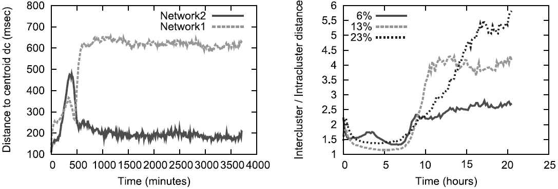
Network Partition Attack Evaluation
Both the victim nodes and the rest of the network are moved
Adversaries: 6%, Network1: 37%, Network2: 57%
Network1 is pushed to the location (1000,1000,1000,1000) with height 1000 while Network2 is pushed to the location (-1000, -1000,-1000,-1000) with height -1000
Notes:
Network partition is similar to the basic targeted attack. Both the victim nodes and the rest of the network are moved somewhere
6%, 37%, and 57% nodes were assigned to adversaries, network1, and network2.
At time 500 min, the two networks start to diverge, but intended coordinates is not reached because the two clusters continue to pull each other.
The right graph is the ratio of the intercluster distance to the intracluster distance.t
As time goes the two partitions continue to be away and the network partition is more effective with more number of attackers.

Slide 17
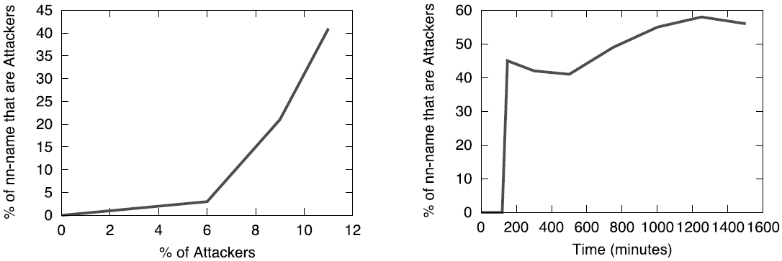
Closest-Node Attack Evaluation
Attacker nodes tries to become the closest node
Every victim node reports the closest neighbor at 10 minutes interval
The fraction of attackers was estimated
Snapshot of 500 minutes
Notes:
In this attack, an adversary tries to become the closest node to victim nodes.
To achieve it, the attackers reply to victims with coordinates $C_{v}+$δ
Every victim node reports the closest neighbor at 10 minute, and the fraction of attackers was estimated.
The result shows that with only 11% of attackers, an attacker is able to become the closest neighbor to a victim node 41% of the time.
After only one day 11% of attackers have almost a 60% chance of the time.

Slide 18
Kalman Filter anomaly detection
Comparison of predicted relative error
and measured error
with history and parameter
Expectation-Maximization + Parameter calculation
Parameter passing
For Kalman filter
Trusted nodes
Unrusted nodes
Notes:
Kalman filter is another scheme suggested to secure a coordinate network system.
Kalman filter has trusted nodes and it calculates parameters used in Kalman filter contacting only among them.
Untrusted nodes contact the trusted node to obtain the parameter value and calculate the difference between the predicted relative error and measured error
Based on their past relative errors and the parameters.
If the difference is bigger than the threshold, the update is rejected

Slide 19
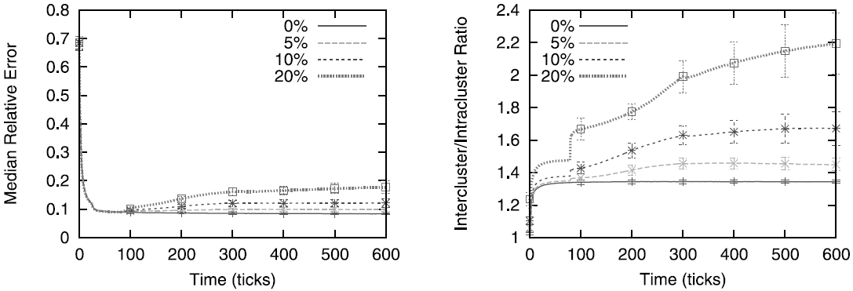
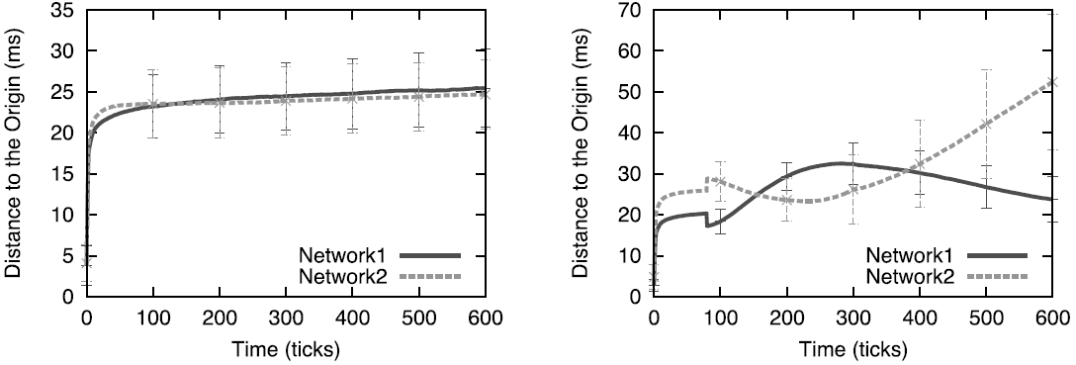
Kalman Filter Attack Evaluation
8% of nodes are set to trusted nodes with δ =10
Notes:
In the evaluation of the Kalman filter attack, only network partition attack was done since the other attacks are weak version of it.
8% of the nodes were set to be trusted with δ=10. Even though the median relative error remains unchanged,
the intercluster/intracluster ratio increases, implying the attack was successful.
Moreover, contrary to the case of the Mahalanobis distance, the attack starts having an immediate effect on the network.
By the end of the attack with 20% attackers, intercluster/intraclust ratio increases 2.2

Slide 20
Veracity Reputation System
Γ = 7
2. Coordinate verification test
V’s VSET (determined by V)
P
V
1. Coordinate report
Λ =7
3. RTT delay verification test
V’s RSET (randomly chosen by V)
Notes:
Veracity is another mitigation method against attacks on the coordinate system.
It uses two step methods. The first step verifies the correctness of peer’s self-reported network coordinate using ‘VSET’
The second step prevents a peer from delaying its reply so as to inflate the network latency using ‘RSET’, which compares V’s current and new average error ratio.
If an update fails to pass either of the two steps, the update information is rejected.

Slide 21
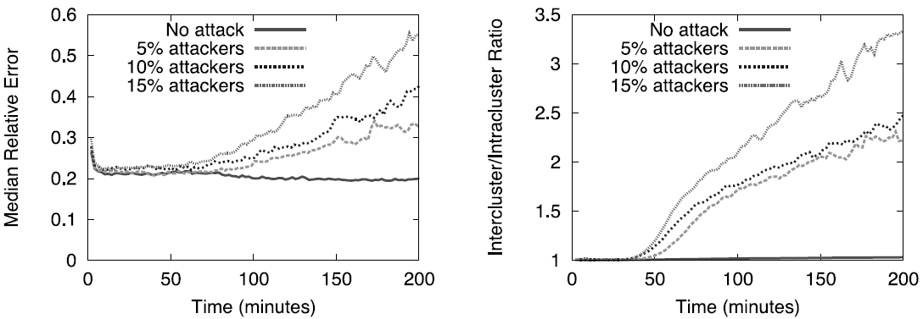
Veracity Attack Evaluation
δ = 0.4, Δ = 20%, Γ = 7, Λ =7
Each attack shifts its coordinate by +δ or - δ based on the victim’s unique global identifier GUID
Before replying with the forged coordinate to a victim node, the attacker sends out messages to the VSET members to compromise the first step of coordinate verification. Delaying RTT is not necessary.
Notes:
In the evaluation, only network-partition attack is experimented with the same reason as in the Kalman filter’s case.
Each attack shifts its coordinate based on the victim’s unique ID.
To bypass the first step, the attacker sends out message to the VSET members before replying with the forged coordinate to a victim node.
Delaying RTT is not necessary for this attack to succeed.
As seen in the right figure, the attacker started to attack at 33min, and the effect is seen almost immediately, as the two networks begin to drift apart.
The first figure shows that the more the number of the attackers increase, the more the effect becomes.

Slide 22
Summary
A decentralized network coordinate system with proposed secure mechanisms can be entirely disrupted by more clever attack of the frog-boiling attack.
Frog-boiling attack manipulates peers’ required property of coordinate update, and the adversary slowly expands the range of data accepted by the node by influencing the node’s recent history.
A secure network coordinate system will need to provide some mechanism to verify a node’s reported coordinates and/or RTTs, which is a challenging problem.
Notes:
This paper shows that a frog-boiling attack can disrupt a distributed coordinate network even if it is equipped with known security mechanisms.
The authors indicate that a secure network coordinate system should provide some mechanism to verify a node’s reported coordinates and/or RTT
which the known schemes failed. However, it is a very challenging problem.

Slide 23
Considerations
Limitary authentication mechanism dedicated for secure coordinate update can be considered
Mixing geographical information with a virtual coordinated can limit the range of victims that attackers can manipulate
Each node can be assigned a set of trusted nodes so that their coordinate information impacts majority of portion in a node’s coordinate change.
Periodically, each node can be made to verify its coordinate to a set of trusted nodes. If embedding error exceeds a boundary, its coordinate can be made reset by those trusted nodes and its neighbor list is reconstructed.

