Slide 1
Uncovering Social Network Sybils in the Wild
Zhi Yang | Christo Wilson | Xiao Wang
Peking University | UC Santa Barbara | Peking University
Tingting Gao | Ben Y. Zhao | Yafei Dai
Renren Inc. | UC Santa Barbara | Peking University
2011 ACM SIGCOMM conference
on Internet measurement conference (IMC 2011)
Presented by: MinHee Kwon

Slide 2
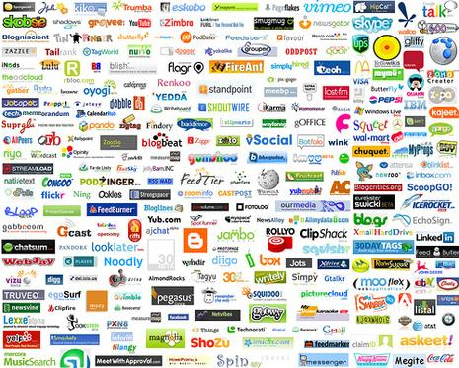
Online Network Service(OSN)

Slide 3
Sybil, fake account
Sybil, sɪbəl, Noun
: a book of which content is a case study of a woman
diagnosed with multiple personality disorder
“a fake account that attempts to create
many friendships with honest users”

Slide 4
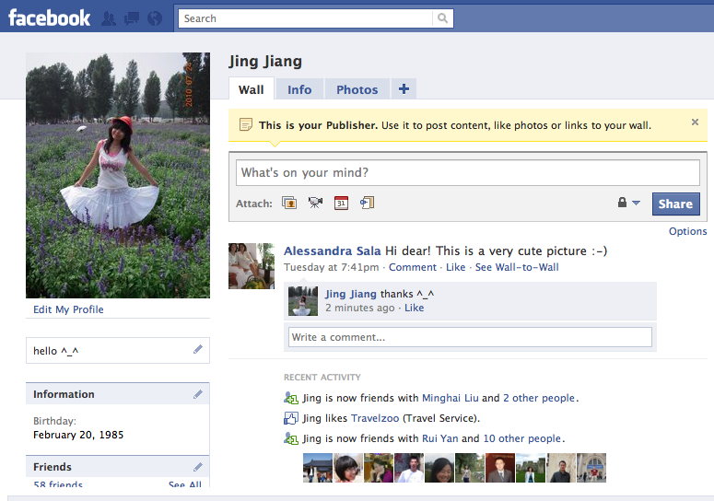
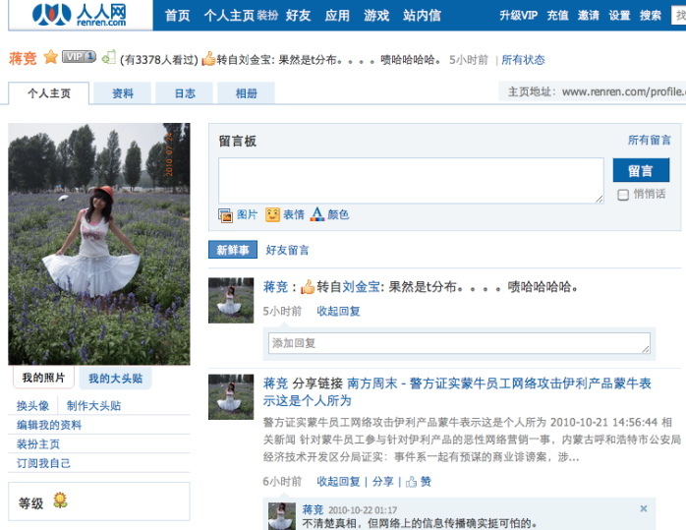
Renren Company
Renren is the oldest and largest OSN in China
Started in 2005, serviced for college students
To open public in 2009
Now,160M users
Facebook’s Chinese twin

Slide 5
Previous detector on Renren
Using orthogonal techniques to find sybil accounts
Spamming & Scanning content for suspect keywords and blacklisted URLS
Crowdsourced account flagging
Detect Results
560K Sybils banned as of August 2010
Limitations: ad-hoc based, requiring human effort, operating after posting spam content

Slide 6
Improved Detector
Developed improved Sybil detector for Renren
Analyzed ground-truth data on existing Sybils
find behavioral attributes to identify sybil accounts
examining a wide range of attributes
found four potential identifiers.

Slide 7
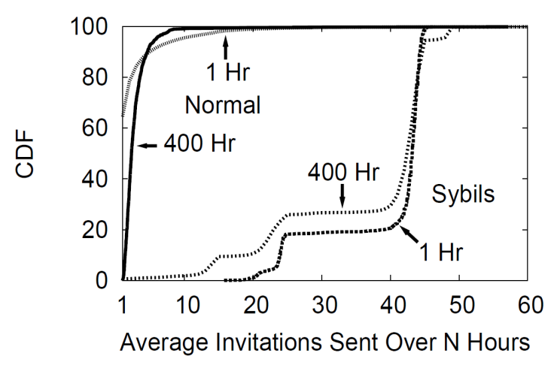
Four Reliable Sybil indicators
1. Friend Request Frequency (Invitation Frequency)
- The number of friend requests a user has sent within a fixed time period

Slide 8
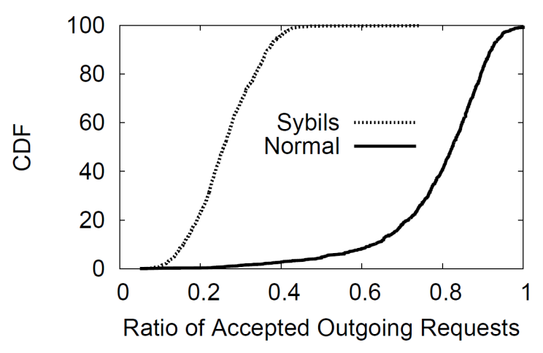
Four Reliable Sybil indicators
2. Outgoing Friend Requests Accepted
- Requests confirmed by the recipient
average

Slide 9
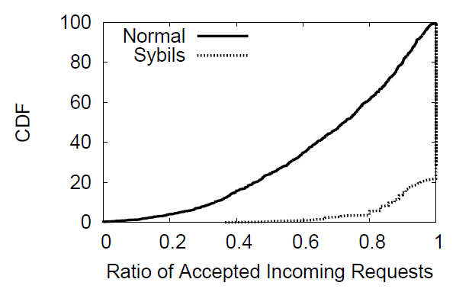
Four Reliable Sybil indicators
3. Incoming Friend Requests Accepted
- The fraction of incoming friend requests they accept
80%
20%

Slide 10
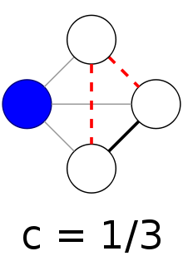
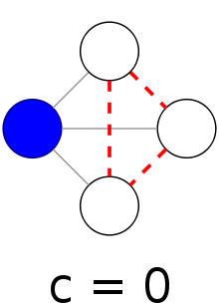
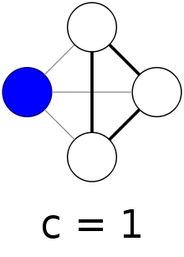
Four Reliable Sybil indicators
Clustering coefficient
# of real edges between neighbors of Node
total # of possible edges between neighbors of Node

Slide 11
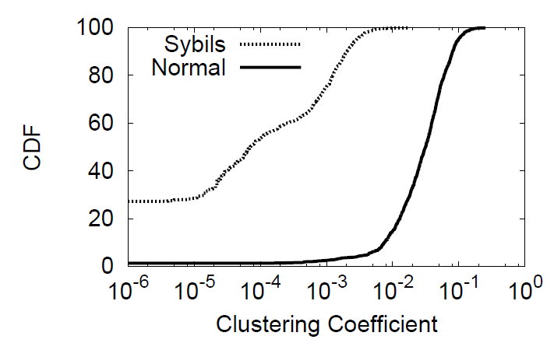
Clustering Coefficient
4. Clustering Coefficient
- a graph metric that measures the mutual connectivity of a user’s friends.
average

Slide 12
Verify Sybil Detector
Evaluated threshold and SVM detectors
Data set: 1000 normal user and 1000 sybils
Value of threshold:
outgoing requests accepted ratio < 0.5^ frequency > 20 ^ cc<0.01
Similar accuracy for both
Deployed threshold, less CPU intensive, real-time
Adaptive feedback scheme is used to dynamically tune threshold parameters
SVM |  | Threshold
Sybil | Non-Sybil | Sybil | Non-Sybil
98.99% | 99.34% | 98.68% | 99.5%

Slide 13
Detection Results
Caught 100K Sybils in the first six months (August 2010~February 2011)
Vast majority(67%) are spammers
Low false positive rate
Use customer complaint rate as signal
Complaints evaluated by humans
25 real complaints per 3000 bans (<1%)
]
Spammers attempted to recover banned Sybils by complaining to Renren customer support!

Slide 14
Community-based Sybil Detectors
Prior work on decentralized OSN Sybil detectors
Attack Edges
Edges Between Sybils
[Key Assumption]

Slide 15
Can Sybil Components be Detected?
Not amenable to community detection
Sybil components are internally sparse
Not amenable to community detection

Slide 16
Five Largest Sybil components
Sybils | Sybil Edges | Attack Edges | Audience
63,541 | 134,941 | 9,848,881 | 6,497,179
631 | 1153 | 104,074 | 21,104
68 | 67 | 7,761 | 7,702
51 | 50 | 15,349 | 15,179
37 | 40 | 14,431 | 13,886
Sybil components are internally sparse
Not amenable to community detection

Slide 17
Sybil Edge Formation
Are edges between Sybils formed intentionally?
Temporal analysis indicates random formation

Slide 18
Sybil Edge Formation
How are random edges between Sybils formed?
Surveyed Sybil management tools
Two factors:
Sending out numerous friend request
Target to popular users
Renren Marketing Assistant V1.0
Renren Super Node Collector V1.0
Renren Almighty Assistant V5.8

Slide 19
Conclusion
First look at Sybils in the wild
Ground-truth from inside a large OSN
Deployed detector is still active
Analysis of Sybil Topology
Limitation of Community-based detector
: Sybil edge no. < Attack edge no.
What’s next!
Results may not generalize beyond Renren
Evaluation on other large OSNs

Slide 20
Thanks you

Slide 21
Serf and Turf: Crowdturfing for Run and Profit
Gang Wang, Christo Wilson, Xiaohan Zhao, Yibo Zhu, Manish Mohanlal, Haitao Zheng and Ben Y. Zhao 21st International Conference on World Wide Web (WWW 2012)
SungJae Hwang
Graduate School of Information Security
Slide borrowed from : http://www.cs.ucsb.edu/~gangw/

Slide 22
Online Spam Today
Facebook profile
Complete information
Lots of friends
Even married
FAKE

Slide 23
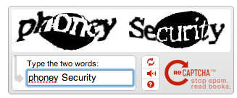
Defending Automated Spam
Variety of CAPTCHA tests
Read fuzzy text, solve logic questions
Rotate images to natural orientation
Rotate below images
But what if the enemy is a real human being?
CAPTCHA: Completely Automated Public Test to tell Computers and Humans Apart

Slide 24
What is Crowdturfing?
Crowdturfing = Crowdsourcing + Astroturfing
Crowdsourcing
Is a process that involves outsourcing tasks to a distributed group of people(wikipedia)
Astroturfing
Spreading Information

Slide 25
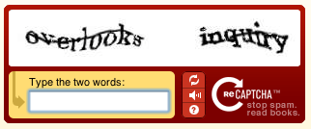
Luis von Ahn?

Slide 26
What is Crowd Sourcing?
Online crowdsourcing (Amazon Mechanical Turk)
Admins remove spammy jobs
NEW: Black market crowdsourcing sites
Malicious content generated/spread by real-users
Fake reviews, false ad., rumors, etc.

Slide 27
Crowdturfing Workflow
Customers
Initiate
campaigns
May be
legitimate
businesses
Campaign
Agents
Manage
campaigns
and workers
Verify
completed
tasks
Workers
Complete
tasks for
money
Control
Sybils on
other websites
Tasks
Reports
Company X
ZBJ/SDH
Worker Y

Slide 28
Outline of this paper
Motivation & Introduction
Crowdturfing in China
End-to-end Experiments
Future Work
Conclusion

Slide 29
Crowdturfing Sites
Focus on the two largest sites
Zhubajie (ZBJ)
Sandaha (SDH)
Crawling ZBJ and SDH
Details are completely open
Complete campaign history since going online
ZBJ 5-year history
SDH 2-year history

Slide 30
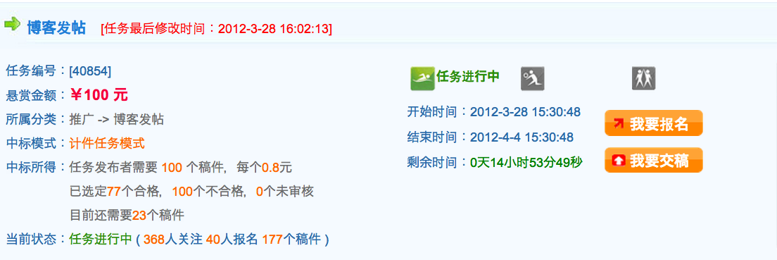
Campaign Information
Promote our product using your blog
Campaign ID
Input Money
Category
Blog Promtion
Get the Job
Rewards
Submit Report
100 tasks, each ￥0.8
77 submissions accepted
Still need 23 more
Status
Ongoing (177 reports submitted)
Check Details
Report generated by workers
Report ID
URL
Report Cheating
WorkerID
Experience
Accepted!
Reputation
Screenshot

Slide 31
High Level Statistics
Site | Active Since | Total Campaigns | Workers | Tasks | Reports | Accepted | $ Total | $ for Workers | $ for Site
ZBJ | Nov. 2006 | 76K | 169K | 17.4M | 6.3M | 3.5M | $3.0M | $2.4M | $595K
SDH | Mar.2010 | 3K | 11K | 1.1M | 1.4M | 751K | $161K | $129K | $32K
10,000
1,000,000
100,000
1,000
ZBJ
10,000
$
1,000
$
SDH
Campaigns
Campaigns
Jan. 08
Jan. 09
Jan. 10
Jan. 11

Slide 32
Are Workers Real People?
Late Night/Early Morning
Work Day/Evening
Lunch
Dinner
ZBJ
SDH

Slide 33
Campaign Types
Top 5 Campaign Types on ZBJ
Campaign Target | # of Campaigns | $ per Campaign | $ per Task | Monthly Growth
Account Registration | 29,413 | $71 | $0.35 | 16%
Forums | 17,753 | $16 | $0.27 | 19%
Instant Message Groups | 12,969 | $15 | $0.70 | 17%
Microblogs (e.g. Twitter/Weibo) | 4061 | $12 | $0.18 | 47%
Blogs | 3067 | $12 | $0.23 | 20%
Most campaigns are spam generation
Highest growth category is microblogging
Weibo: increased by 300% (200 million users) in a single year (2011)

Slide 34
Outline of this paper
Motivation & Introduction
Crowdturfing in China
End-to-end Experiments
Future Work
Conclusion

Slide 35
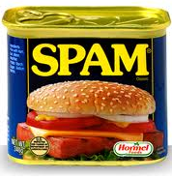
How Effective Is Crowdturfing?
What is missing?
Understanding end-to-end impact of Crowdturfing
Initiate campaigns as customer
4 benign ad campaigns
iPhone Store, Travel Agent, Raffle, Ocean Park
Ask workers to promote products
Clicks?

Slide 36
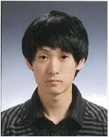
End-to-end Experiment
Campaign1: promote a Travel Agent
ZBJ (Crowdturfing Site)
Measurement
Server
Travel Agent
New Job Here!
Redirection
Check Details
Task Info
Trip Info
Great deal!
Trip to Maldives!
Workers
Create Spam
Weibo Users
Weibo (microblog)

Slide 37
Campaign Results
Campaign | About | Target | Input$ | Task/ Report | Clicks | Resp. Time
Trip | Advertise for a trip organized by travel agent | Weibo | $15 | 100/108 | 28 | 3hr
 |  | QQ | $15 | 100/118 | 187 | 4hr
 |  | Forum | $15 | 100/123 | 3 | 4hr
Settings:
One-week Campaigns
$45 per Campaign ($15 per target)
Benefit?
Generate 218 click-backs
Only cost $45 each
80% of reports are generated in the first few hours
Averaged 2 sales/month before campaign
11 sales in 24 hours after campaign
Each trip sells for $1500

Slide 38
Outline of this paper
Motivation & Introduction
Crowdturfing in China
End-to-end Experiments
Future Work
Conclusion

Slide 39
Crowdturfing in US
Sites | % Crowdturfing
MinuteWorkers | 70%
MyEasyTasks | 83%
Microworkers | 89%
ShortTasks | 95%
Growing problem in US
More black market sites popping up

Slide 40
Where Is Crowdturfing Going?
Growing awareness and pressure on crowdturfing
Government intervention in China
Researchers and media following our study
Paper does not talked about defensive techniques
It is future work….
Defending against Crowdturfing will be very challenging!!

Slide 41
Outline of this paper
Motivation & Introduction
Crowdturfing in China
End-to-end Experiments
Future Work
Conclusion

Slide 42
Conclusion
Identified a new threat: Crowdturfing
Growing exponentially in both size and revenue in China
Start to grow in US and other countries
Detailed measurements of Crowdturfing systems
End-to-end measurements from campaign to click-throughs
Gained knowledge of social spams from the inside
Ongoing research focused on defense

Slide 43
Thank you! Questions?

Slide 44
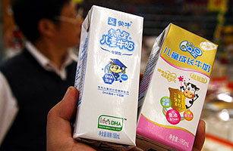
Real-world Crowdturfing
“Dairy giant Mengniu in smear scandal”
Biggest dairy company in China (Mengniu)
Defame its competitors
Hire Internet users to
spread false stories
Impact
Victim company (Shengyuan)
Stock fell by 35.44%
Revenue loss: $300 million
M
Warning: Company Y’s baby formula contains
dangerous hormones!

