Slide 1
On Attack Causality in Internet-Connected Cellular Networks
Presented by EunYoung Jeong

Slide 2
What’s new?
2G GSM
Only voice call, SMS service
2.5G GSM
GPRS: General Packet Radio Service
Introduce data service on GSM network.
Enables mobile devices to be connected to the Internet.
Divide CCH (Control Channel) of GSM network to provide data delivery.
Control signal, SMS, and data service over CCH

Slide 3
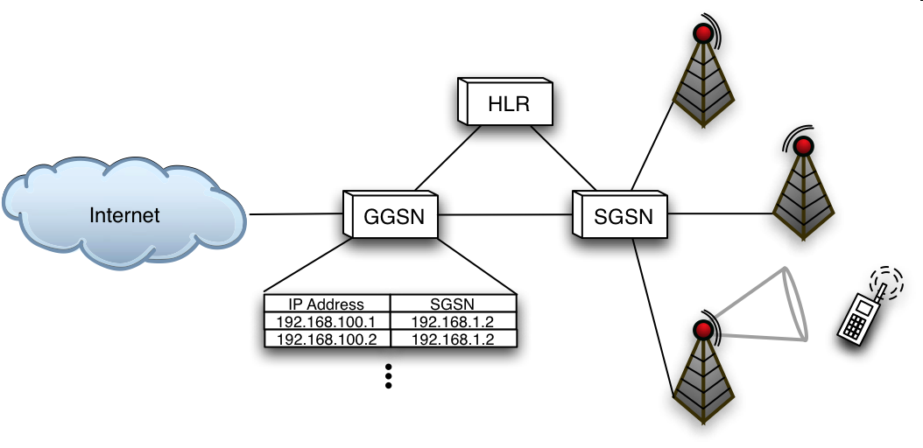
GPRS/EDGE Architecture

Slide 4
Authentication/Registration
After PDP context setup, mobile device can exchange packets.
Home Location Register:
User location, availability, services
GPRS attach
Packet Data Protocol (PDP) context:
IP address, billing, …

Slide 5
Packet Arrival

Slide 6
Receiving device status
To save power, mobile devices are not constantly listening for incoming packets.
States of devices
GPRS detach
Paging Request
IDLE
READY
STANDBY
GPRS attach
READY expire
STANDBY expire
Notes:
IDLE: The device is unregistered and unavailable.
STANDBY: The device is in power-saving state and periodically listening for “wake up” messages (pages).
READY: The device is listening for packets.

Slide 7
Packet Arrival
Notes:
SGSN creates paging messages to be sent from a number of base stations.

Slide 8
Packet Arrival
Paging request
Notes:
SGSN creates paging messages to be sent from a number of base stations.

Slide 9
Paging Procedure
Packet Paging Request
Packet Paging Channel (PPCH)
Packet Channel Response
Packet Random Access Channel (PRACH)
Packet Resource Assignment
Packet Access Grant Channel (PAGCH)
Packet Paging Response
Packet Associated Control Channel (PACCH)
Packet Data Transfer
Packet Data Traffic Channels (PDTCHs)
Notes:
Shared control channel among voice and data.
Base station transmits paging request to multiple sectors.
The paging process requires multiple iterations.
When target device becomes awake and hears it, it responds to PRACH (Packet Random Access Channel).
After PDTCH (Packet Data Traffic Channel) assigned, it can receive packet.

Slide 10
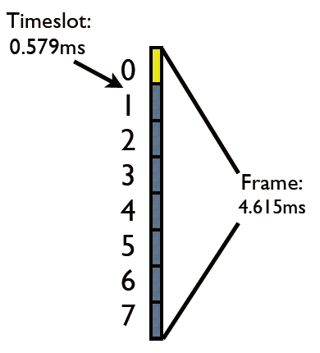
Packet Multiplexing
GPRS multiplex multiple traffic flows to serve large number of users on a single physical channel concurrently.
8 time slots -> a frame
52 frames -> multiframe
Notes:
Why do this?
There was only Traffic channel (TCH) and Control Channel (CCH) on GSM.
They have to share single physical channel between voice and data service.

Slide 11
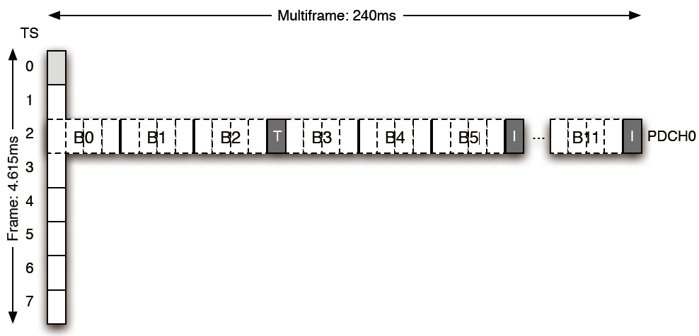
GPRS Channel Structure
PPCH
PDTCH
Notes:
Multiframe is subdivided into 12, four timeslot blocks.
Logical channels mapped onto each block.

Slide 12
Optimizations
As paging is expensive, paging for every packet is impossible.
Paging a device takes over 5 seconds.
End devices continue listening to PDTCH for a number of seconds before returning to STANDBY.
Typically 5 seconds (same as paging overhead)
For this, GPRS differentiates packets at the MAC layer by Temporary Block flows (TBFs) and they are identified by 5-bit Temporary Flow IDs (TFIs).

Slide 13
Exploiting Connection Teardown
TFIs are implemented as 5-bit fields.
There can be maximum 32 concurrent flows for each sector.
If an adversary send a message to a phone once every 5 seconds before returning to STANDBY, the targeted device maintains its TFI.
An adversary can block legitimate flows by sending 32 messages to each sector every 5 seconds.

Slide 14
Exploiting Connection Teardown (Cont.)
55 sectors on Manhattan
32 messages for each sector
41 bytes for each packet (TCP/IP header + 1 byte)
Every 5 second
An adversary can deny service with only 110 Kbps traffic.

Slide 15
Exploiting Connection Setup
PRACH (or RACH) channel is shared by all hosts attempting to establish connection.
Slotted-ALOHA protocol is used to minimize contention.
The maximum theoretical utilization is 0.368.
Potential system bottleneck.
Given a large number of paging requests,
RACH becomes very busy.
Many of connection requests may fail.
It blocks voice connection as well as data connection.

Slide 16
Teardown Attack Simulation
Target
Manhattan cellular data service
Exhaust TFIs of data service with malicious traffic
Legitimate traffic
Modeled as Poisson random process
Voice calls: 50,000 per hour (120 seconds duration)
Data calls: 20,000 per hour (10 seconds duration)
Attack flows
Modeled by Poisson random process
100 - 200 Kbps

Slide 17
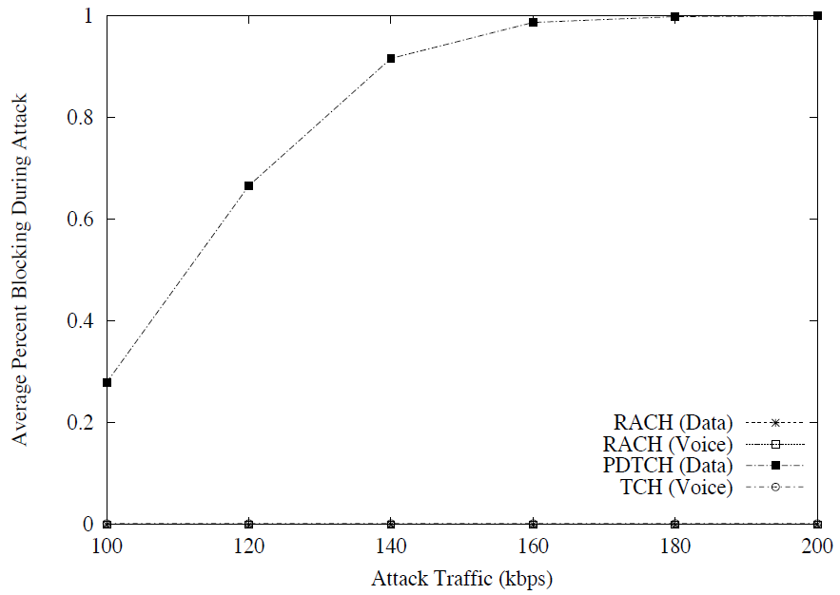
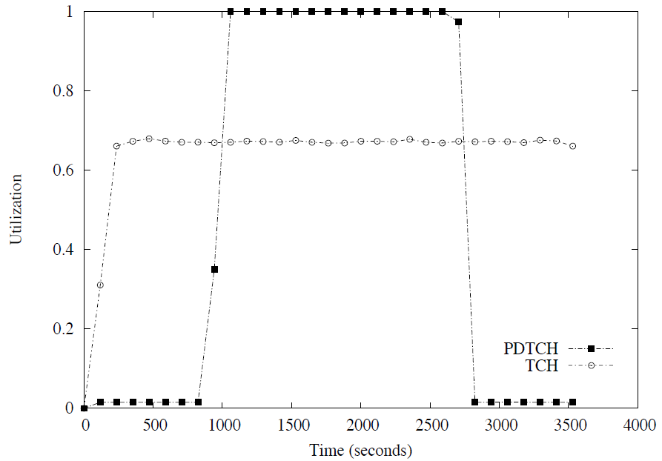
Teardown Attack
At rate > 160 Kbps, the cellular data service within Manhattan is virtually nonexistent.
Voice channel is not affected. (separate use of channel)
At 200 Kbps

Slide 18
Setup Attack Simulation
Target
Manhattan cellular voice and data service
Exhaust RACH channel that is shared by voice and data
Legitimate traffic
Modeled as Poisson random process
Voice calls: 50,000 per hour (120 seconds duration)
Data calls: 20,000 per hour (10 seconds duration)
Attack flows
Modeled by Poisson random process
2200 – 4950 Kbps

Slide 19
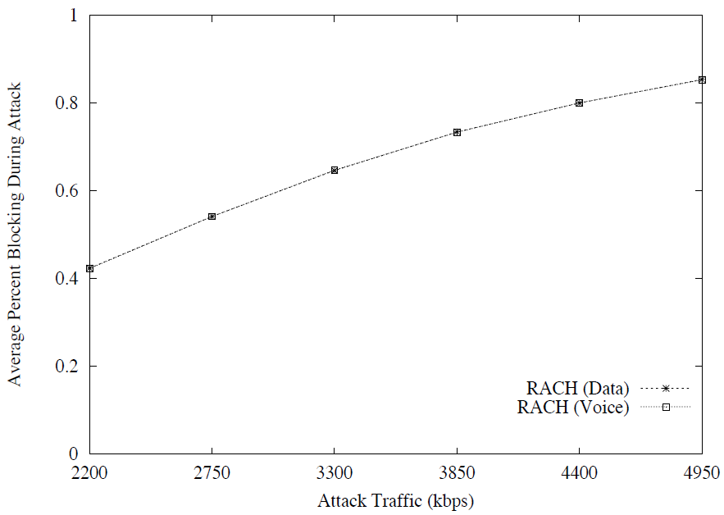
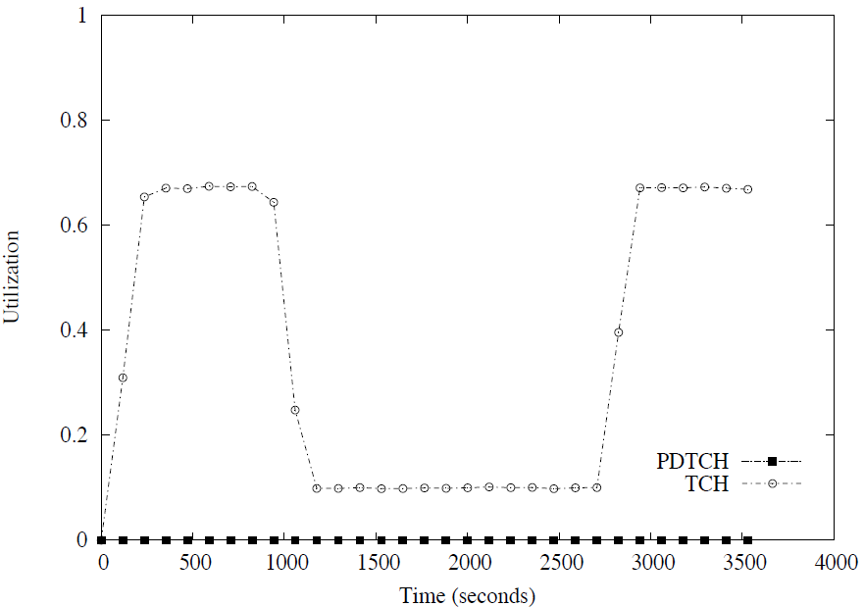
Teardown Attack
Both voice and data flows experience blocking on the RACH.
The dual use of control channel allows interference.
At 4950 Kbps

Slide 20
Possible Mitigation
Adding more range of TFI values
32 concurrent flow/sector is requisite concession.
Increasing it will degrade individual connectivity.
Adding more bandwidth
High cost of connection establishment is same.
Effect of adding bandwidth is limited.

Slide 21
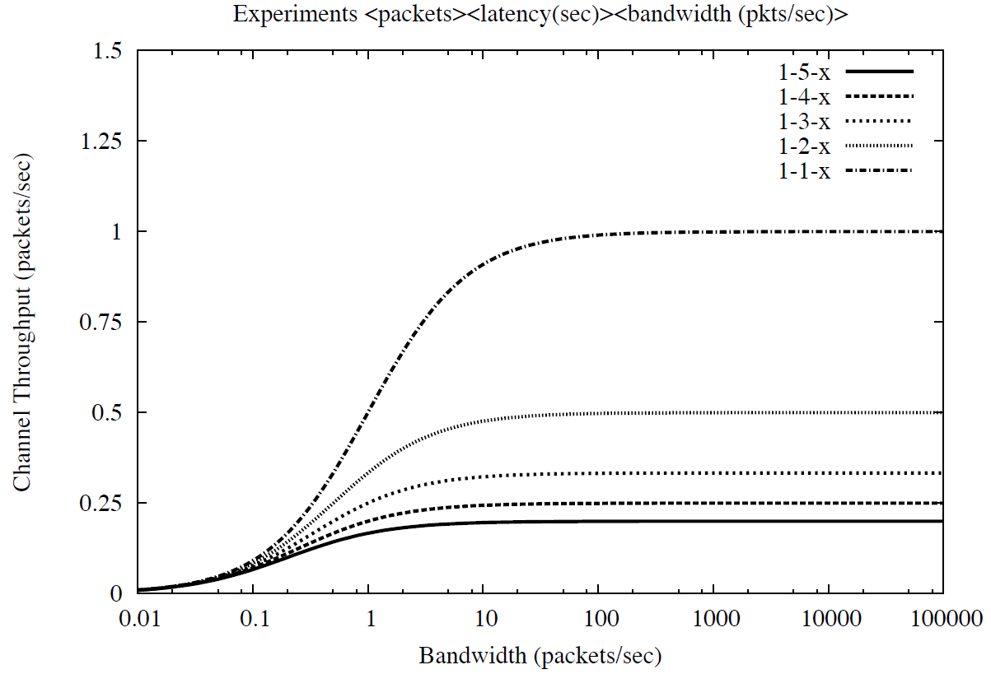
Failure of Bandwidth
Channel throughput is saturated!

Slide 22
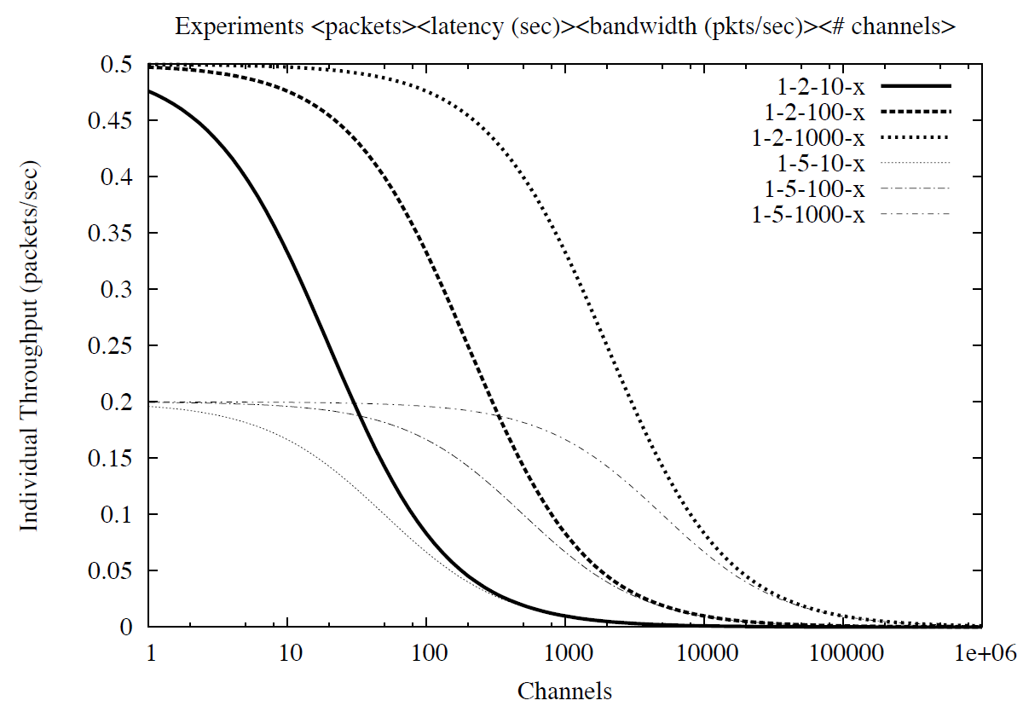
Possible Mitigation (Cont.)
Adding more channels
Decrease individual throughput.
Increase contention to RACH.

Slide 23
Connecting the Dots
The concept of connection
Data networks
Connection unaware
Simply forward packet for connection
Cellular networks
Lack of power and computation in end devices
Page, wake and negotiate for connection
Amplifying a single incoming packet to expensive connection mechanism is the source of the attacks.

Slide 24
Clash of Design Philosophies
Data network
Built on the end-to-end principle.
Applications do not expect nothing other than best effort delivery.
Cellular data network
Still fundamentally circuit-switched systems
Specialized to mobile devices and ensures a device is ready to receive.
Rigidity from specialized network
Unable to adapt to meet changing requirements and conditions
When conditions change, the rigidity causes break.
Notes:
Reliable delivery, content confidentiality and in-order arrival: all responsibility of higher layer

Slide 25
For Robust Cellular Data Network
The move to larger flow pool or shorter paging
Mitigation possible for this work
Eventual security?
As long as there is difference in delivering packet, exploitable mechanisms will exist.
Can we just forward packet?
Eliminating needs for paging
Smarter end devices
Location-awareness
Power problem
Shorter sleep cycle
More computation
Notes:
There are some researches to reduce paging overhead and the mobile network is actually evolving with larger flow pool and shorter paging.

Slide 26
Conclusion
They find two new vulnerabilities to demonstrate that low bandwidth DoS attacks can block legitimate cellular traffic.
These attacks are from not mismatch of bandwidth rather from different network topology “smart” and “dumb”.
Rigidity fails to adapt changing conditions.
Without fundamental change in cellular data network design, the low-bandwidth exploits are not easy to be solved.

Slide 27
Questions

Slide 28
Garbage

Slide 29
Introduction
The interconnection of cellular networks and the Internet
Significant expand of the services on telecommunications subscribers
New vulnerabilities from conflicting design philosophies
Cellular networks
Smart, controlled
The Internet
Dumb, best effort service
None have examined the inherent security issues caused by the connection of two systems built on opposing design tenets.

Slide 30
Vulnerabilities
To new vulnerabilities that can deny cellular data services and voice services.
Exploiting Connection Teardown
Exploiting Connection Setup
These attacks target connection teardown and setup procedures in networks implementing General Packet Radio Service (GPRS).

