Slide 1
A Study of Android Application Security
William Enck, Damien Octeau, Patrick McDaniel, Swarat Chaudhuri
System and Internet Infrastructure Security Laboratory
Department of Computer Science and Engineering
The Pennsylvania State University
USENIX Security Symposium 2011
Dongkwan Kim

Slide 2
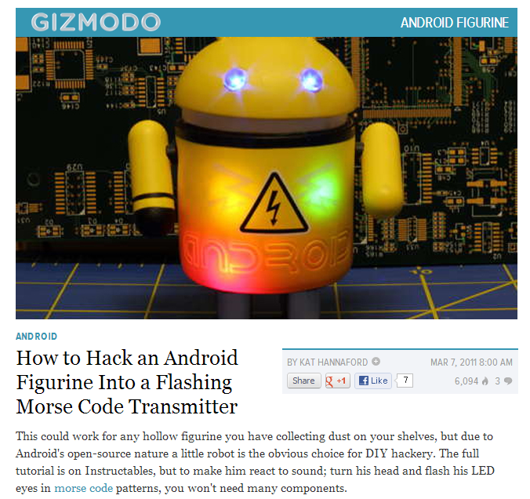
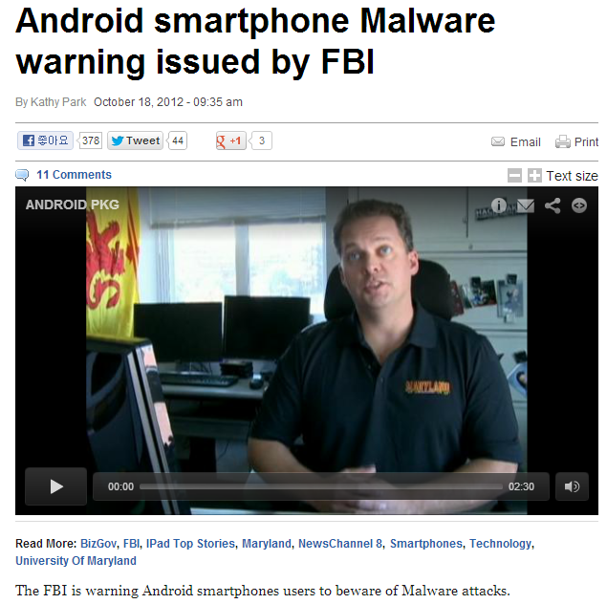
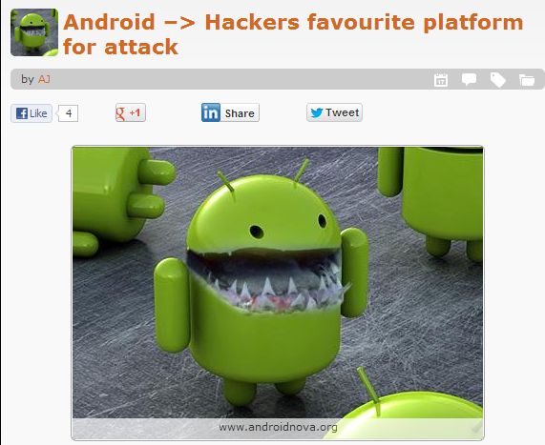
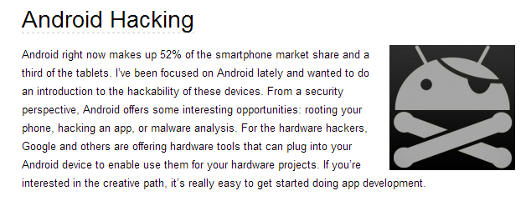
Boom!

Slide 3
What?
Markets are not in a position to provide security in
more than a superficial way
To broadly characterize the security of applications
in the Android Market
Contributions
ded: A Dalvik decompiler.
DVM-to-JVM bytecode retargeting.
Analyze 21 million LoC from the top 1100 free applications
Notes:
Lines of code

Slide 4
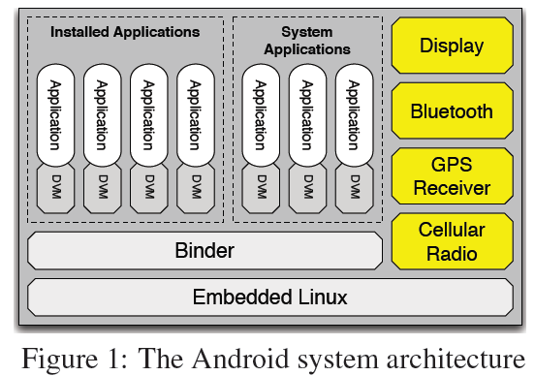
Background
Android

Slide 5
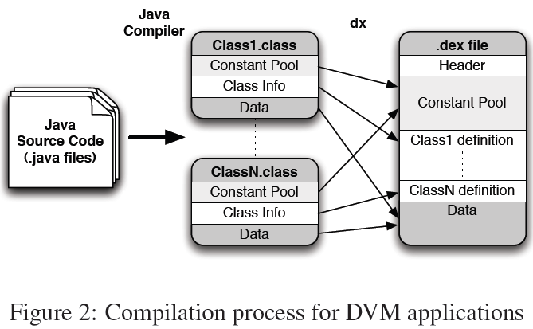
Background
Dalvik Virtual Machine
JVM => .class
DVM => .dex
Dalvik dx compiler
Constant Pool:
References to other classes
Method names
Numerical constants
Class Definition:
Access flags
Class names
Data:
Method code
Info related to methods
Variables
Notes:
Info related to methods: #(DVM register used), local variable table, operand stack sizes
Architecture, instruction set, pool structure

Slide 6
The ded decompiler
Decompiler from DEX to Java
Leverage existing tools for code analysis
Require access to source code to identify false-positives resulting from automated code analysis
Three stages
Retargeting
Optimization
Decompilation

Slide 7
The ded decompiler

Slide 8
The ded decompiler
Optimization and Decompilation
Soot as a post-retargeting optimizer
Java bytecode generated by ded is legal
Source code failure rate is almost entirely
due to Soot’s inability

Slide 9
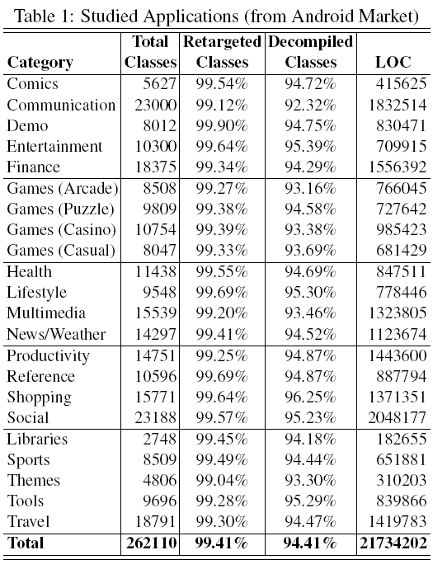
The ded decompiler
Source Code Recovery Validations
All 1,100 apps
decompilation time:
497.7 hours
99.97% of total time -> Soot

Slide 10
The ded decompiler
Retargeting Failures
0.59% of classes
Unresolved reference
Type violations by
Android dex compiler
ded produces
illegal bytecode (rare)
Decompilation Failures
5% of classes
Soot was able to
decompile 94.59%

Slide 11
Analysis Specification
Using Fortify SCA custom rules
Control flow analysis
Look at API options
Data flow analysis
Information leaks, injection attacks
Structural analysis
Grep on steroids
Semantic analysis
Look at possible variable values
Notes:
Grep a token, every instances has actual flow
variables vs method, Class of method, super class of method
Potential values, Hard coded sms

Slide 12
Analysis Overview
Notes:
when your wireless device is turned on, how your device is functioning, device signal strength, where it is located, what device you are using, what you have purchased with your device, how you are using it, and what sites you visit.

Slide 13
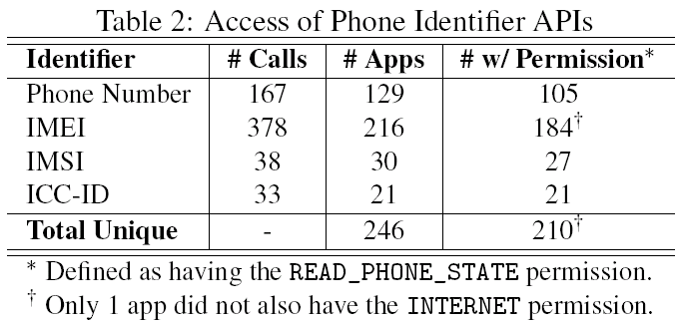
Phone Identifier
246 apps uses phone identifier
Only 210 has READ_PHONE_STATE permission
22.4%
19.6%

Slide 14
Phone Identifier (cont.)
Phone identifiers (ph.#, IMEI, IMSI, etc) sent to network servers, but how are they used?
Program analysis pin-pointed 33 apps leaking Phone IDs
Finding 2 - device fingerprints
Finding 3 – tracking actions
Finding 4 – along with registration and login
Notes:
1. Sdcard serial number
2. Everthing about device, os information…

Slide 15
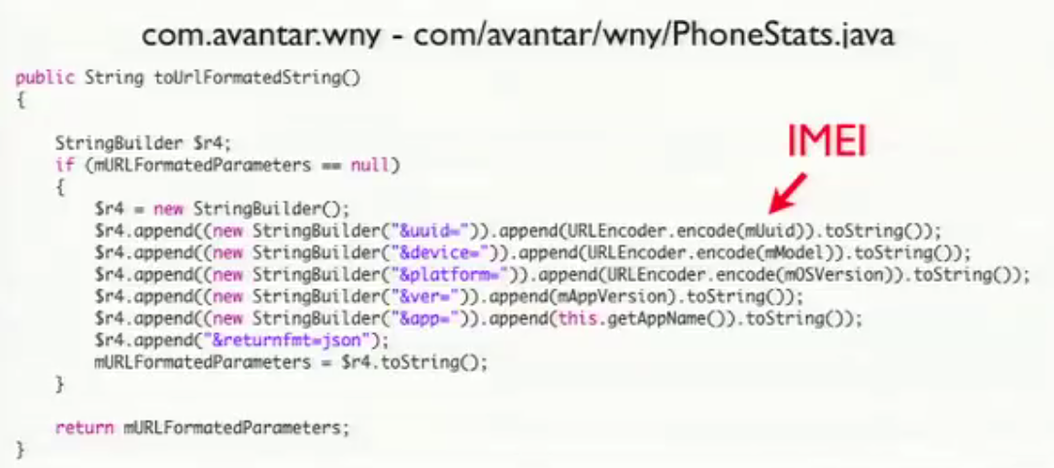
Device Fingerprints

Slide 16
Tracking

Slide 17
Registration and Login
Pros and cons…
Notes:
Users information to advertisement and analytics server

Slide 18
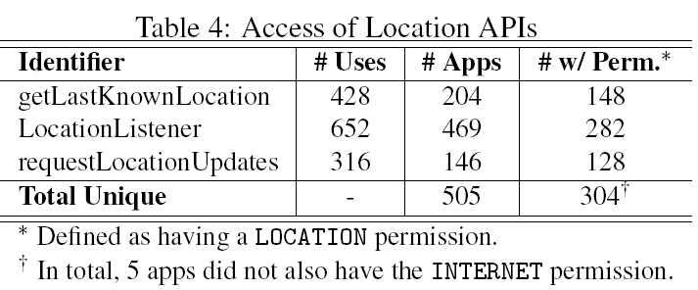
Location Information
27.6%
505 applications attempt to access location
304 have the permission.
45.9%

Slide 19
Location Information (cont.)
Found 13 apps with geographic location data flows to the network
Many were legitimate: weather, classifieds, points of interest, and social networking services
Several instances sent to
advertisers (same as TaintDroid).
Code recovery error in
AdMob library
Notes:
Taintdroid: realtime privacy monitoring tool
AdMob: banner , advertisement

Slide 20
Phone Misuse
No evidence of abuse in sample set
Hard-coded numbers for SMS/voice
premium-rate
Background audio/video recording
Socket API use (not HTTP wrappers)
Harvesting list of installed applications
Notes:
Trojans …
Telephony service

Slide 21
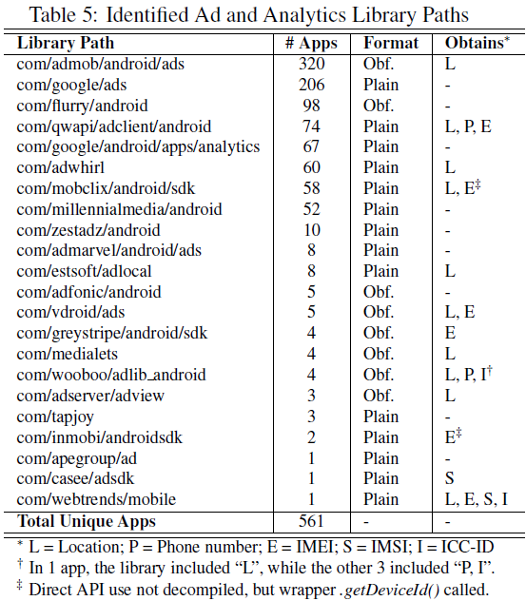
Ad/Analytics Libraries
51% of the apps included an ad or analytics library (many also included custom functionality)
29%
18.7%
51%

Slide 22
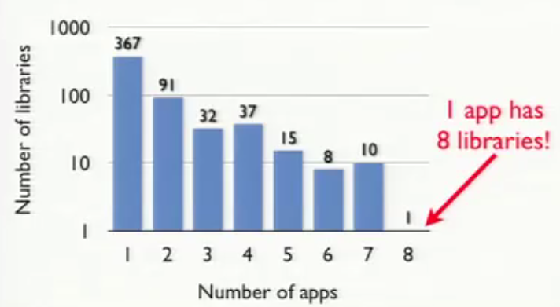
Ad/Analytics Libraries (cont.)
A few libraries were used most frequently
Use of phone id, and location sometimes configurable by developer

Slide 23
Probing for Permissions (1)

Slide 24
Probing for Permissions (2)

Slide 25
Developer Toolkits
Some developer toolkits replicate dangerous functionality
Probing for permissions
Ex) Android API, catch SecurityException
Well-known brands sometimes
commission developers that
include dangerous functionality.
“USA Today” and “FOX News”
developed Mercury Intermedia
(com/mercuryintermedia),
which grabs IMEI on startup
Notes:
Dead codes
Middle company

Slide 26
Custom Exceptions
Notes:
Grep your phone number and send to developer
!?

Slide 27
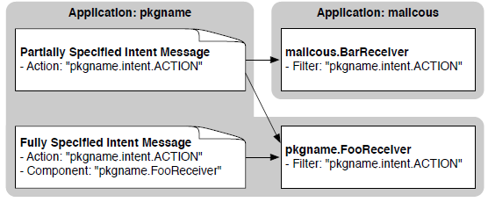
Intent Vulnerabilities
Leaking information to Logs
Leaking information via IPC
Unprotected bcast receivers
Intent injection attacks
16 apps had potential vulns
Delegating control
Pending intents are tricky to analyze – get permissions
(notification, alarm, and widget APIs) – no vuln found
Null checks on IPC input
3925 potential null dereferences in 591 apps (53.7%)
Sdcard/JNI Use
Notes:
Private information logging
Location, client’s status …
Intent address is derived from untrusted input – attack specifying victim name directly, controlling action string
Apps crash, unexpected behavior
Sdcard data
Java Native Interface inherent dangers
No memory check for extended code in other language

Slide 28
Study Limitations
The sample set
Code recovery failures
Android IPC data flows
Fortify SCA language
Obfuscation
Notes:
Program analysis tool cannot compute data and control flows for IPC between components
Missing data and control flows may lead to false negatives

Slide 29
Summary & Conclusion
ded decompiler
Wide misuse of privacy sensitive information
Ad and analytic network libraries (51% apps)
Failed to securely use Android APIs
Potential vulns
Found no evidence of telephony misuse
Future Directions
Code recovery – Fernflower
Automated certification
App markets need transparency
Q?
Notes:
Fernflower – 98.04% recovery rate

Slide 30
- Thank you -
`

