Slide 1
Location Leaks on GSM Air Interface
D. Foo Kune, J. Koelndorfer, N. Hopper, Y. Kim

Slide 2
Location Privacy
News
  Nov 2011: Carrier IQ
  Oct 2011: HTC Android phone location leakage
  April 2011: iPhone and Android location information
Default options
  HLR (Home Location Register)
  Apps allowing location tracking

Slide 3
Location Privacy Leaks on GSM
We have the victim’s mobile phone number
Can we detect if the victim is in/out of an area of interest?
  Granularity? 100 km²? 1km²? Next door?
No collaboration from service provider
  i.e. How much information leaks from the HLR over broadcast messages?
Attacks by passively listening
  Paging channel
  Random access channel
  Location leaks on the GSM air interface, D. F. Kune, J. Koelndorfer, N. Hopper, Y. Kim, NDSS 2012
  Media: Ars Technica, Slashdot, MPR, Fox Twin Cities, Physorg, TG Daily, Network World, e! Science News, Scientific Computing, gizmag, Crazy Engineers, PC Advisor, Mobile Magazine, The CyberJungle, Inquisitr

Slide 4
Cellular Network
HSS
GSM Air Interface
ATR
HLR
MS
BTS
VLR
PSTN
MSC
BSC
Notes:
• The Home Location Register (HLR), a database containing the subscription information and location information.
• The Visitor Location Reguster (VLR), in charge of one or multiple areas where mobile stations may roam in and out of. This entity handles the temporary IDs (TMSI) of the mobile stations.
• TheMobileServicesSwitchingCenter(MSC)handlestheregistrationandhandoverformobile stations roaming in and out of the area it is responsible for.
• The Base Station System (BSS) is a network of base station transceivers and controllers re- sponsible for communicating directly with the mobile station. Those equipments are typically what is at a cellular network tower.
• The Mobile Station (MS) is the mobile device carried by the user. It is composed of the actual device and a Subscriber Identity Module (SIM).

Slide 5
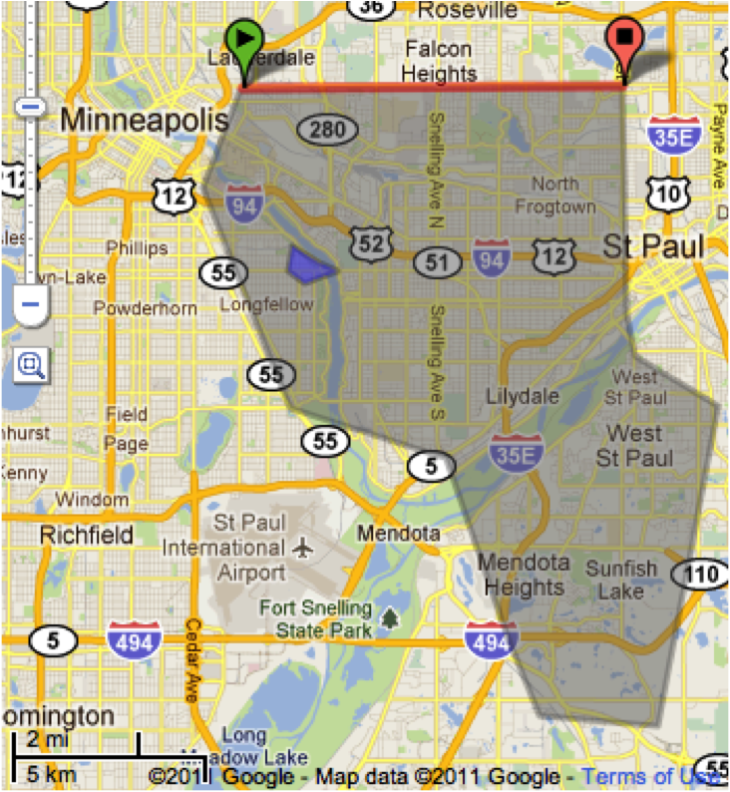
Location Leaks on Cellular Network
IMSI
  a unique # associated with all GSM
TMSI
  Randomly assigned by the VLR
  Updated in a new area
PCCH
  Broadcast paging channel
RACH
  Random Access Channel
SDCCH
  Standalone Dedicated Control Channel
LAC has multiple cell towers that uses different ARFCN
BTS
MS
Paging Request
PCCH
Channel Request
RACH
Immediate Assignment
PCCH
Paging Response
SDCCH
Setup and Data
Notes:
IMSI (International Mobile Subscriber Identity), TMSI (Temporary Mobile Subscriber Identity), LAC (Location Area Code), absolute radio-frequency channel number (ARFCN)
Call the victim to ensure they have their phone on (The network uses an ID unknown to us)
Watermark calls: 2 or 3 calls with known delays in between, Abort each call before completion, 5 seconds after dialing, Paging messages issued, but victim’s phone never rings
Attempt to recover the watermark on the paging channel, Find paging messages with IDs and delays similar to the ones we used
Result
Case 1: watermark on PCCH is heard, The victim is in the same LAC
Case 2: immediate assignment on AGCH is heard “regularly”, The victim is within the same cell tower
Case 3: the RACH traffic from the victim’s phone is heard, They are really close (20 m)

Slide 6
Attack
Call the victim to ensure they have their phone on
  The network uses an ID unknown to us
Watermark calls
  2 or 3 calls with known delays in between
  Abort each call before completion, 5 seconds after dialing
  Paging messages issued, but victim’s phone never rings
Attempt to recover the watermark on the paging channel
  Find paging messages with IDs and delays similar to the ones we used
Result
  Case 1: watermark on PCCH is heard
    The victim is in the same LAC
  Case 2: immediate assignment on AGCH is heard “regularly”
    The victim is within the same cell tower
  Case 3: the RACH traffic from the victim’s phone is heard
    They are really close (20 m)

Slide 7
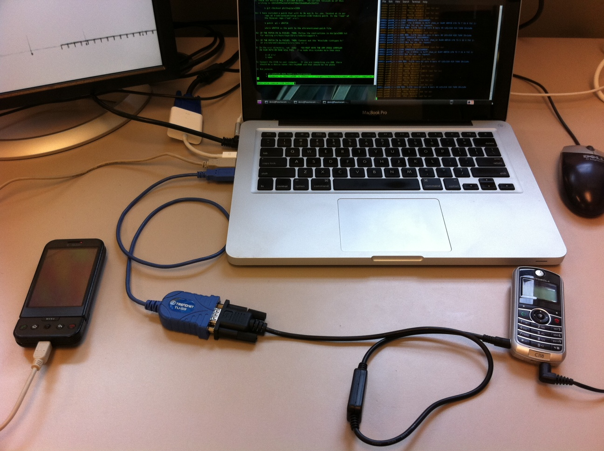
Platform
Serial cable and reprogrammer cable ($30)
VirtualBox running Ubuntu and OsmosomBB software (free)
HTC Dream with custom Android Kernel ($100)
Motorola C118 ($30)

Slide 8
Phone number-TMSI mapping
dt
PSTN
PCH
dt
Time

Slide 9
Silent Paging
Delay between the call initiation and the paging request: 3 sec
Median delay between call initiation and ring: 6 sec

Slide 10
Immediate Assignment
Is IA message sent to all towers in the same LAC?
How do we identify IA message?
  No identifiable information
Check the correlation between IA and Paging request
Notes:
The left box plot shows the time difference between the paging request for our target TMSI and the very next Immediate Assignment.
The middle boxplot shows the difference between the TMSI timestamp and the IA messages if we are listening on a different ARFCN.
Finally the last boxplot shows a control by picking a random time and the next IA message.

Slide 11
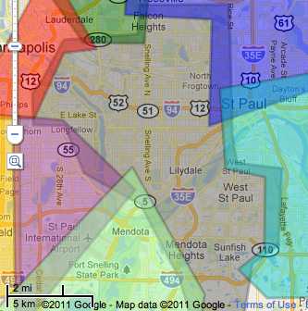
Location Area Code (LAC)
Notes:
Grey area is T-Mobile LAC 747d

Slide 12
Hill Climbing to discover towers

Slide 13
Mapping cell signal strength
Notes:
A cell phone will likely pick the tower that has the highest signal strength (RSSI). This map indicates where that phone might be if they are on a particular tower.

Slide 14
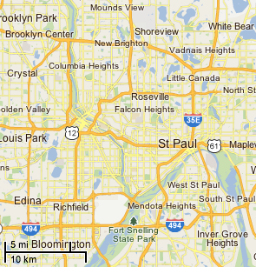
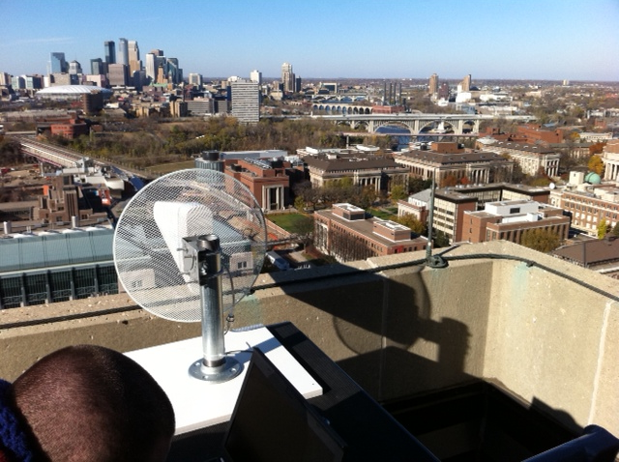
Coverage area with 1 antenna
Downtown Minneapolis
Observer
Yagi antenna
Towers in this area are observable with a rooftop 12 db gain antenna
John’s newly shaved head

Slide 15
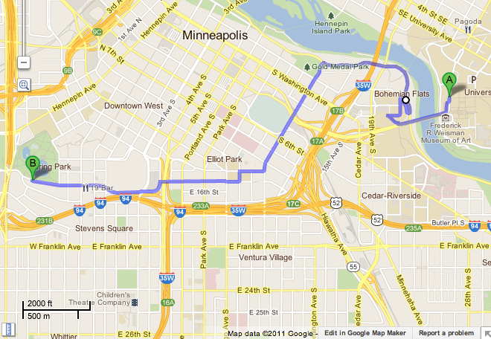
Following a walking person
Observer
End
Start
Approximate areas covered by towers to which the victim’s phone was attached to

