Slide 1
Exploiting Machine Learning to Subvert Your Spam Filter
Blaine Nelson / Marco Barreno / fuching Jack Chi / Anthony D. Joseph
Benjamin I. P. Rubinstein / Udam Saini / Charles Sutton / J.D. Tygar / Kai Xia
University of California, Berkeley
April, 2008
Presented by: GyuYoung Lee

Slide 2
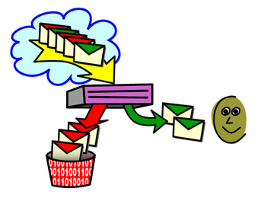
Introduction
Do you know ?
☞ Spam Filtering System
☞ Machine learning is applied to Spam Filtering
☞ Adversary can exploit machine learning ➔ Making Spam Filter to be useless ➔ User give up using Spam Filter

Slide 3
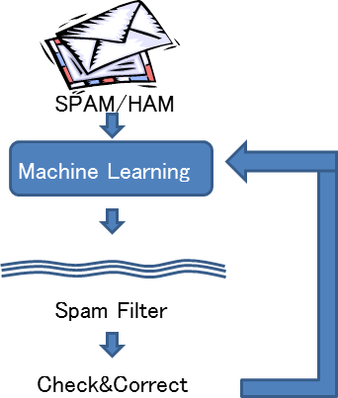
Spam Filtering System
Which part is most weak ?
☞ Machine Learning
How can we attack ?
☞ Poisoning Training Set

Slide 4
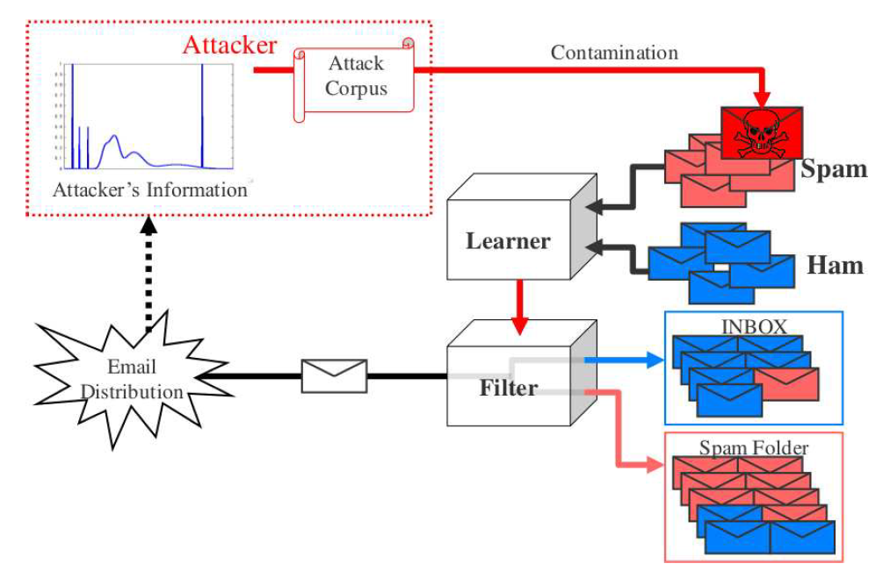
Poisoning Training Set
False
Negative
False
Positive

Slide 5
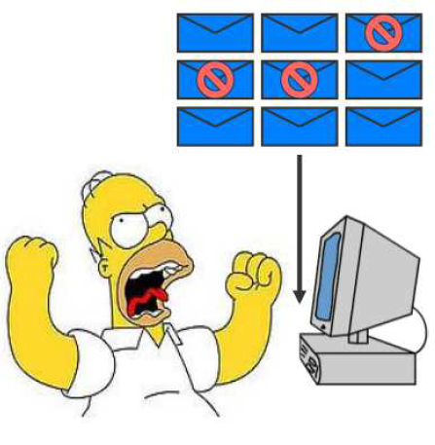
Poisoning Effect
If attacker wins at contaminating attack?
High false positives ☞ User loses so many legitimate e-mails
High false negatives ☞ User encounters so many spam e-mails
High unsure messages ☞ so many human decision required ➔ No time saving
▣ Finally, user gives up using spam filter

Slide 6
Bayesian Spam Filtering - Concept
Bayesian spam filter
Three classifications
Spam
Ham(non-spam)
Unsure
Score
Spam filter generate one score for ham and another for spam
Strength | ↓ false positives ↓ false negatives
Weakness | ↑ unsures (need human decision)
message | Spam score | Ham score
spam | high | low
ham | low | high
unsure | high | high
unsure | low | low

Slide 7
Bayesian Spam Filtering - Steps
Spamicity of words included in the e-mail
Measure them respectively
Combine them
Evaluate the possibility that the e-mail can be spam

Slide 8
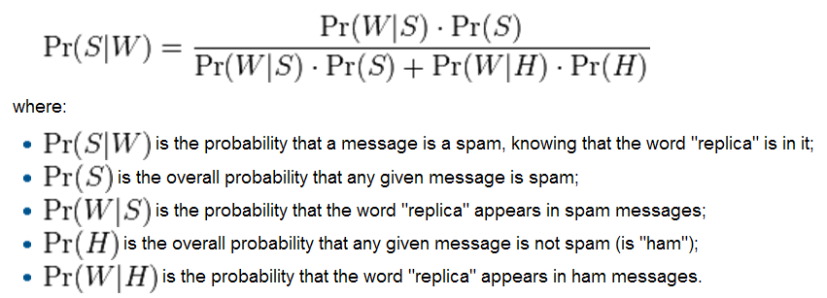
Bayesian Spam Filtering - Details
① Measure Spamicity of words respectively

Slide 9
Bayesian Spam Filtering - Steps
② Combine Spamicity of words

Slide 10
Bayesian Spam Filtering - Steps
③ Evaluate the possibility that the e-mail can be spam
☞ If (Pr > Threshold)
then regard the e-mail as Spam

Slide 11
Attack Strategies
Traditional attack : modify spam emails ➔ evade spam filter
Attack in this paper : subvert the spam filter ➔ drop legitimate emails

Slide 12
Attack Styles
Dictionary attack
Include entire dictionary ☞ spam score of all tokens
Legitimate email ☞ marked as spam
Focused attack
Include only tokens in a particular target e-mail
Target message ☞ marked as spam

Slide 13
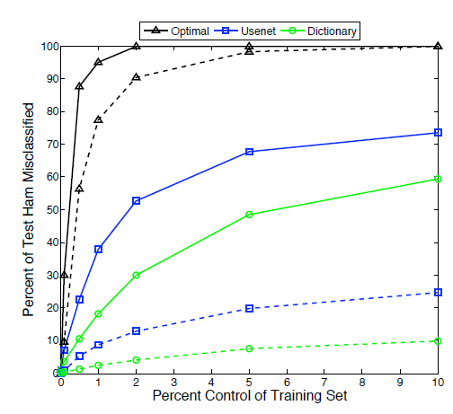
Experiments – dictionary attack
We can find
1% attack emails
Accuracy falls significantly
Filter unusable

Slide 14
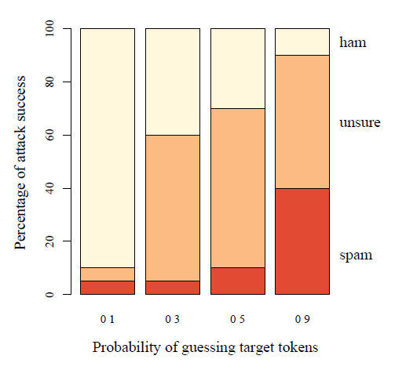
Experiments – focused attack #1
Probability of guessing
Guessing p increase ➔ Attack is more Effective
We can find
Success of target attack ➔ depends on prior knowledge

Slide 15
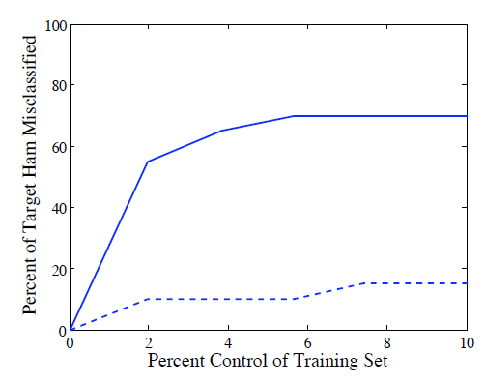
Experiments – focused attack #2
Condition
Fix Guessing p to 0.5
X-axis
N of msgs in the attack
Y-axis
% of msgs misclassified
We can find
Target e-mail is quickly blocked by the filter

Slide 16
Defenses – RONI
RONI (Reject on Negative Impact) defense
Idea ☞ Measuring each email’s impact ☞ Removing deleterious messages from training set
Method ☞ Measuring the effect of email ☞ Testing performance difference with and without that e-mail
Effect ☞ Perfectly identify all dictionary attacks ☞ Hard to identify focused attack emails

Slide 17
Defenses – dynamic threshold
Dynamic threshold defense
Method ☞ Dynamically adjusts two spots of threshold
Effect ☞ Compared to SpamBayes alone, ☞ Misclassification is significantly reduced

Slide 18
Conclusion
Adversary can disable SpamBayes filter
Dictionary attack
Only 1% control ➔ 36% misclassification
RONI can defense it effectively
Dynamic threshold can mitigate it effectively
Focused attackhard to defend by attack’s knowledge
These Techniques can be effective
Similar learning algorithms (ex) Bogo Filter
Other learning system (ex) worm or intrusion detection

