Slide 1
Reverse Engineering Android Applications
2014. 10. 8.
Shinjo Park
Thanks to Sungjae and Suwan

Slide 2
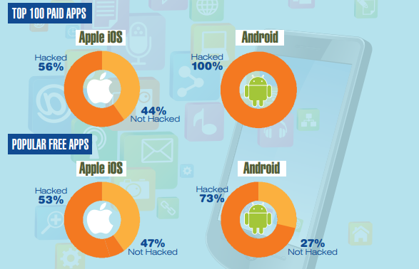
Mobile Apps under Attack
State of security in the app economy
  Mobile app hacking revealed
Notes:
Market을 제외한 3rd party sites에서 hacking 관련 review 등이 올라온 것을 기준으로 함

Slide 3
Agenda
Android application reverse engineering
  Decompiling APK file
  Structural problems in application
What to see and what to get
  Static, dynamic analysis
  Countermeasures
  Details about obfuscation
Real world examples
  Raon Secure application and more

Slide 4
Android Application Reverse Engineering

Slide 5
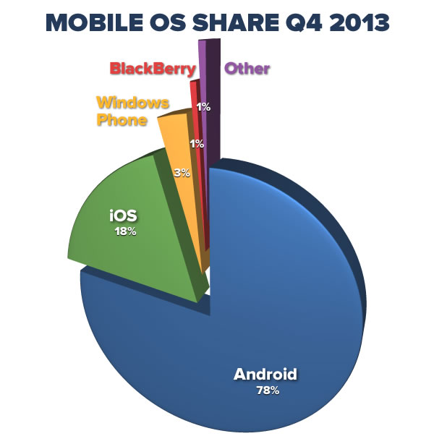

Android?
Mobile operating system by Google
Based on Linux kernel and Dalvik VM
#1 popular mobile OS

Slide 6
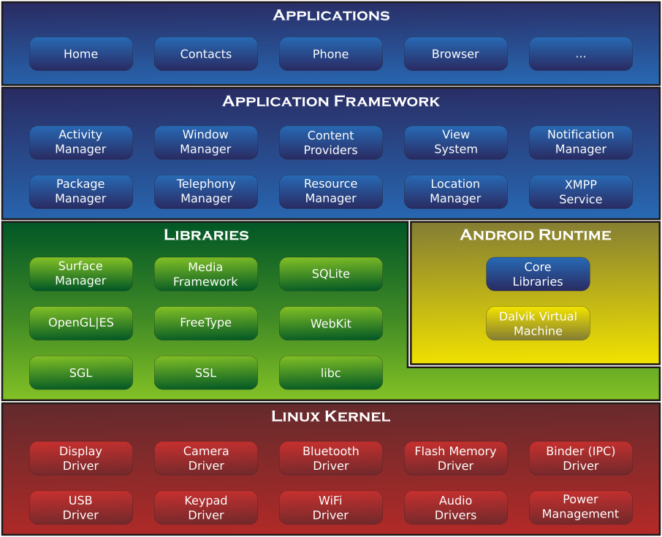
Android Components
Platform middleware, library, API in native code
Android framework and system/user applications
Notes:
We’re going to analyze the application layer.
Every application is based on apk file we said above.

Slide 7

Android Application
Distributed in Google Play or 3rd-party store as APK (Android application package) format
  Contains application binary and resources
Variant of JAR (Java ARchive)/ZIP
Self-signed by developer

Slide 8
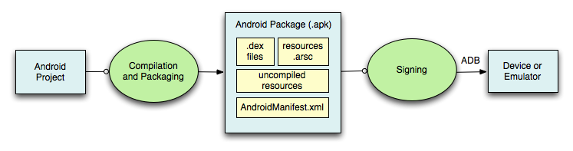
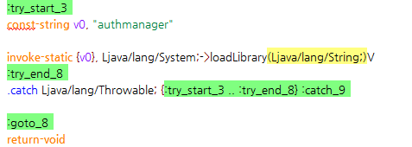
Android Application(2)
APK build process
.dex file
  Compiled Dalvik bytecode, smali analogous to “assembler”

Slide 9
Main Problem
Easy distribution of repackaged app
Self signing
  Any key will be accepted (in first install)
Source code exposure
  Decompiling DEX bytecode is easy
  Easy analysis of control flows inside app
  Easy manipulation of smali (disassembled Dalvik bytecode)

Slide 10
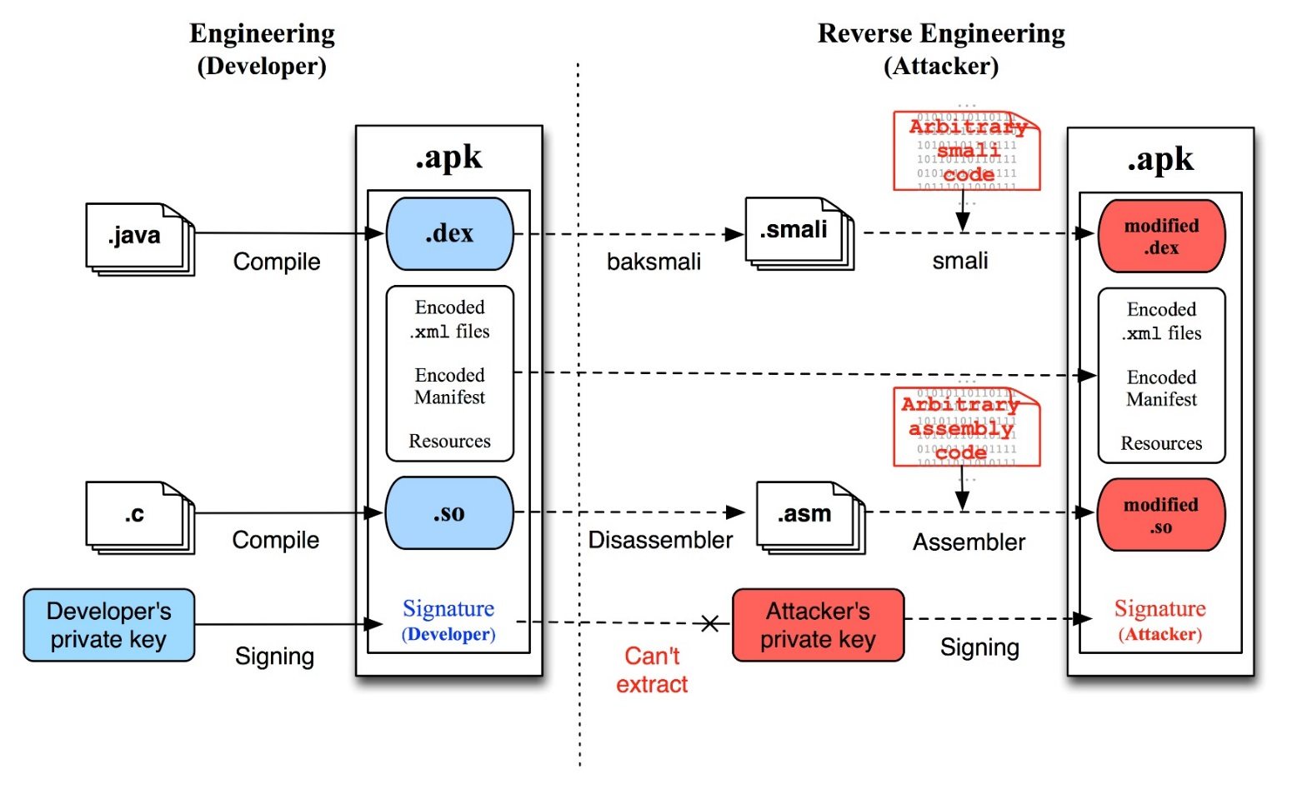
Android Application Repackaging
Tampering app made easy
  Decompile and modify DEX bytecode
  Recompile and distribute malicious APK

Slide 11
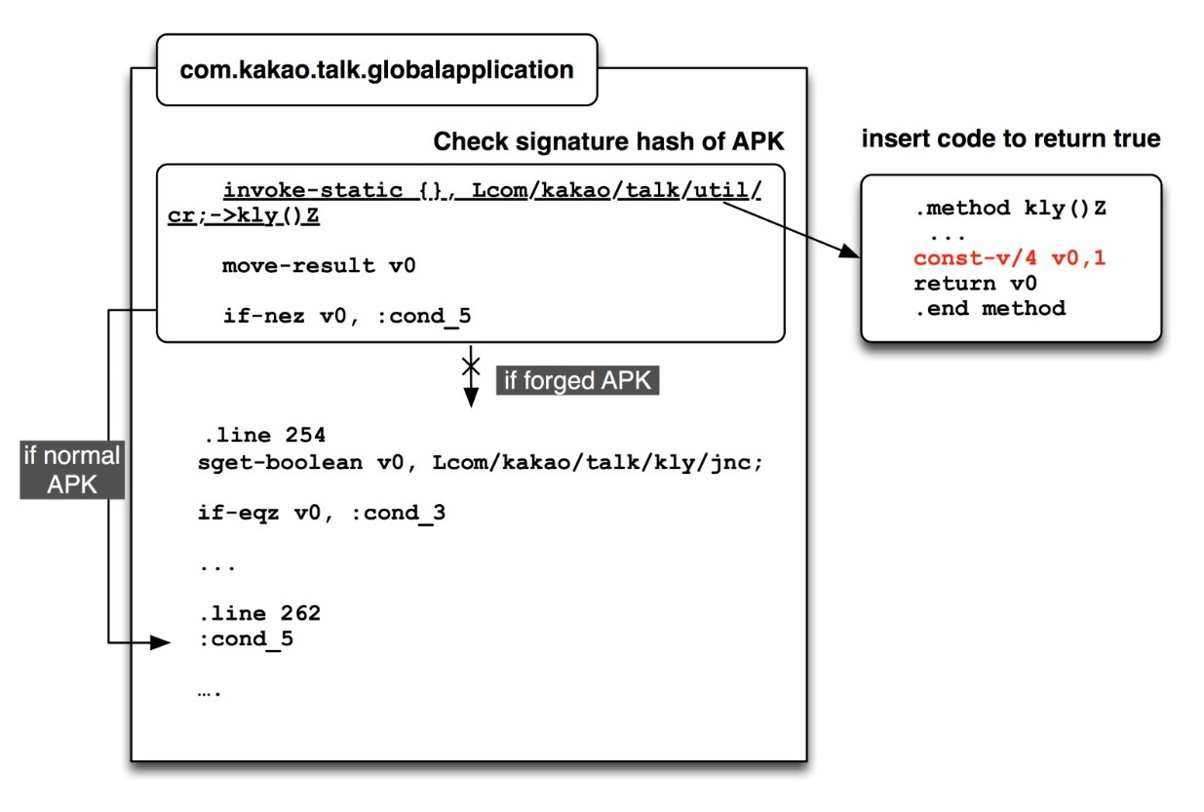
Example: Bypassing Integrity Check
Remove the routine to check integrity

Slide 12
Related Tools
Android DEX to Java
  dex2jar: apk -> jar
  JAR decompiling tools: jad / jd-gui
Android DEX to smali
  Smali in Android is analogous to assembly in PC
  apktool: apk -> smali
Frequently used by both crackers and hackers

Slide 13

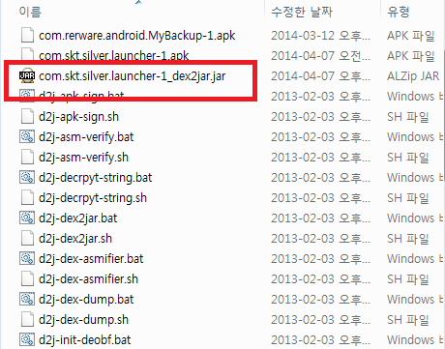
dex2jar
Convert Dalvik bytecode to Java bytecode

Slide 14
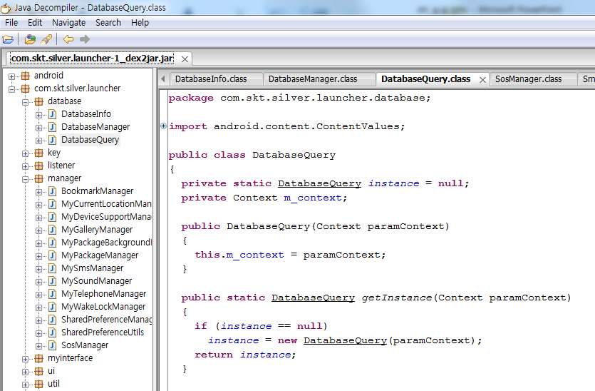
jad / jd-gui
Decompile Java bytecode to source code

Slide 15
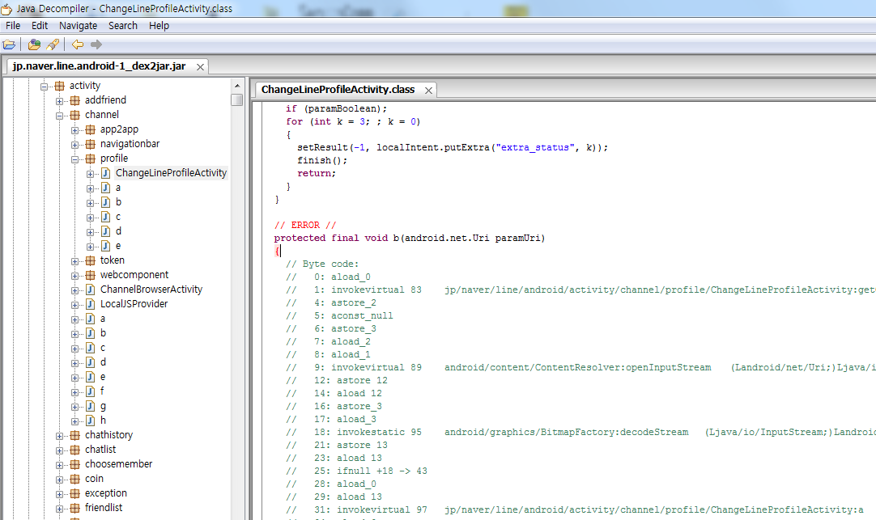
Problems of jad/ jd-gui
Dalvik is not Java, decompile can fail

Slide 16
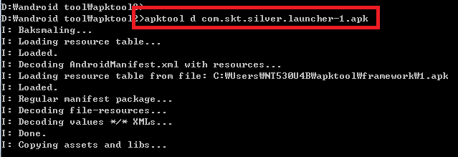
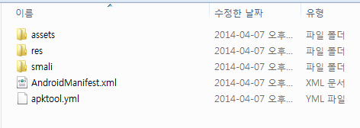
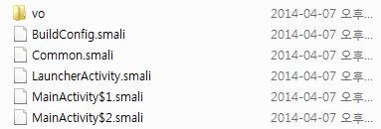
apktool
Extract smali and resources of APK file
smali: Dalvik (dis)assembler

Slide 17
Sample smali Code
new-instanve v0, Lcom/example/adbmobileversion/AdbConnection;
invoke-direct {v0}, Lcom/example/adbmobileversion/AdbConnection;-><init>()V
.line 93
.local v0, newConn:Lcom/example/adbmobileversion/AdbConnection;
iput-object p1, v0, Lcom/example/adbmobileversion/AdbConnection;->crypto:Lcom/example/adbmobileversion/AdbCrypto;
.line 95
iput-object p0, v0, Lcom/example/adbmobileversion/AdbConnection;->socket:Ljava/net/Socket;
.line 96
invoke-virtual {p0}, Ljava/net/Socket;->getInputStream()Ljava/io/InputStream;
move-result-object v1
iput-object v1, v0, Lcom/example/adbmobileversion/AdbConnection;inputStream:Ljava/io/InputStream;
.line 97
invoke-virtual {p0}, Ljava/net/Socket;->getOutputStream()Ljava/io/OutputStream;

Slide 18

smali Code Syntax
.class public Lcom/example/simmobileversion/simConnection; // Class name
.super Ljava/lang/Object; // Parent class name
.source "simConnection.java"
.field private connected:Z // Boolean variable declaration
.field private connectionThread:Ljava/lang/Thread; // Thread variable declaration
.field private lastLocalId:I // Integer variable declaration
.method public connect()V
.registers 3
[instruction] {args} [package-type]->[function-name](arg-type)ret-type
iget-object v0, p0, Lcom/example/simmobileversion/SimConnection;->outputStream:Ljava/io/OutputStream;
invoke-static {}, Lcom/example/simmobileversion/SimProtocol;->generateConnect() [B
move-result-object v1
invoke-virtual {v0, v1}, Ljava/io/OutputStream;->write([B)V
invoke-virtual {v0}, Ljava/io/OutputStream;->flush()V
.end method // End of method

Slide 19
smali Code Syntax
// Java code
if (intVar == 1) intVar = 2;
else intVar = 3;
// smali code
const/4 v1, 0x1
if-ne v0, v1, :cond_0 // v0 not equals v1
const/4 v2, 0x2
move v0, v2
goto :goto_0
:cond_0
const/4 v2, 0x3
move v0, v2
:goto_0
// Other considerations
if-eq v0, v1, :cond_0 // v0 equals v1
if-ge v0, v1, :cond_0 // v0 is greater or equal to v1

Slide 20
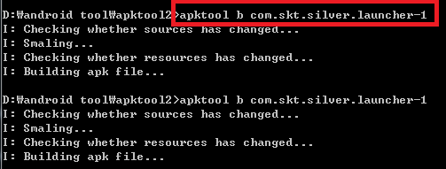
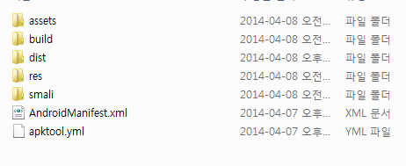

Recompile Application

Slide 21
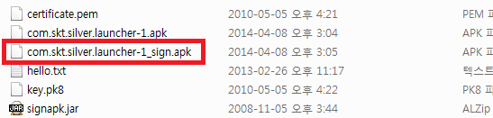
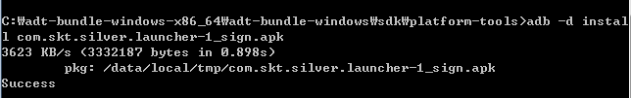
Sign APK File with SignAPK
App installed to device

Slide 22
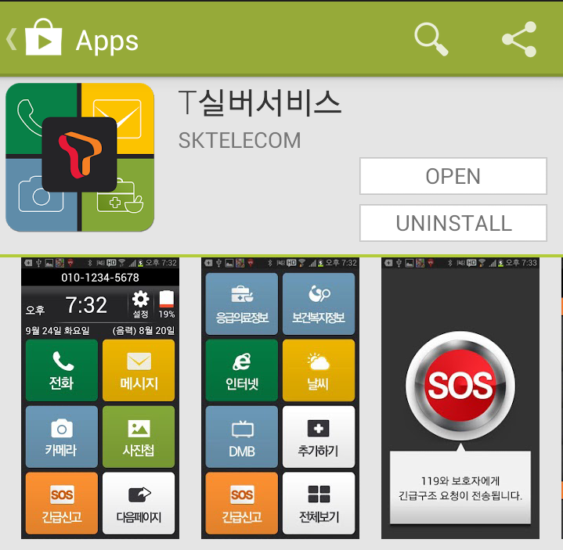
Repackaging Example
T Silver Service by SK Telecom
  Dial hacker’s number instead of 119
  Send SMS messages to hacker instead of 119
  Launch hacker’s website/apps in launcher

Slide 23
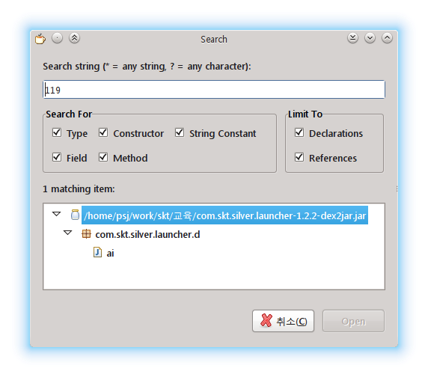
Finding Strings
String constants are not modified by simple obfuscation
Strong obfuscators modify strings
  Fixed replacement of bytes
  Dynamically decrypt string inside code

Slide 24
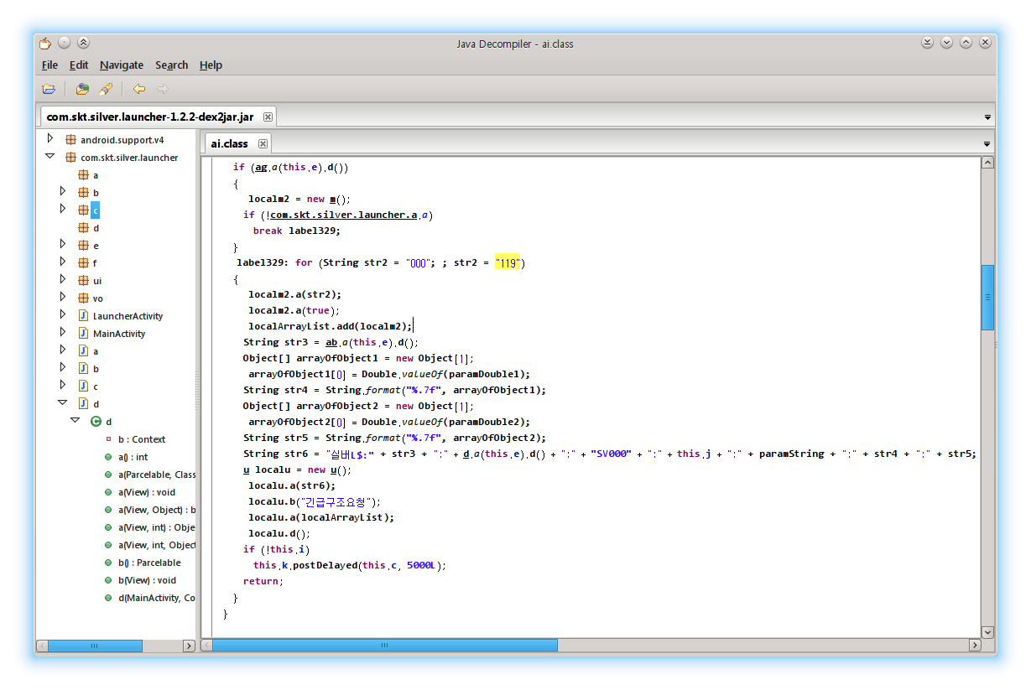
Found Target String

Slide 25
What to See and
What to Get

Slide 26
What to See on Apps
Java/smali code filtered by search string
Network packets
  Capture using Wireshark and rogue AP
  PC – Rogue AP – Android phone
  HTTPS connection: mitmproxy, Paros, Burp Suite
  Custom encryption: good luck!
Debug messages
  Android provides System.log API to collect logs
  Android <=4.0 allows any apps to read logs
  Android >=4.1 requires root/PC adb connection

Slide 27
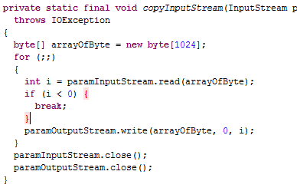
Code Analysis
Get control flow, string information
  Java Decompiler
  baksmali (used by apktool)

Slide 28
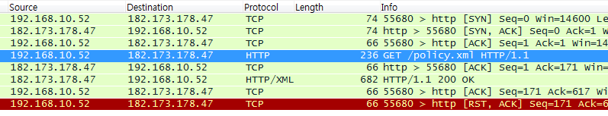
Packet Capture
Use capture tools on Android side
  Some tool like tcpdump required rooting
Build rogue AP and sniffing
  ARP spoofing, MITM attack
  Content-modifying proxy

Slide 29
SSL Man-in-the-Middle
Client Hello?
Client Hello
Client Hello
Server Hello
Server Hello
Client Key Exchange
Client Key Exchange
Server Key Exchange
Server Key Exchange

Slide 30
Requirements
Access point
  Connected via PC for black box analysis
  Firmware modification possible
SSLStrip
  Python, Linux
  http://www.thoughtcrime.org/software/sslstrip/
Paros
  Java runtime, tested on Windows and Linux
  http://sourceforge.net/projects/paros/
  Alternatives: Burp Suite, mitmproxy (http://www.portswigger.net/burp/, http://mitmproxy.org/)

Slide 31




SSLStrip: ARP Spoofing
192.168.0.1
00:00:be:ef:ca:fe
192.168.0.2
00:00:de:ad:be:ef
192.168.0.x
Default GW: 192.168.0.1

Slide 32
SSLStrip: ARP Spoofing
192.168.0.1 is
00:00:de:ad:be:ef

Slide 33
SSLStrip: ARP Spoofing
Can see every packets
www.google.com via 192.168.0.1

Slide 34
How SSLStrip Works
https://asdasdasd
https://sdfsdfsdf
http://asdasdasd
http://sdfsdfsdf
http://www.google.com

Slide 35


Paros
Web proxy with content manipulation
Free software

Slide 36
How Paros Works
https://iamlegal
https://secured
https://allyourbase
https://belongtous
http://www.naver.com
http://www.google.com

Slide 37
Paros Setup
Paros running on gateway
  Windows or Linux
Smartphone’s proxy set to Paros
  Manual setting on Android
  Traffic hijacking could be possible
App analysis
  All http is inspectable via Paros
  https without certificate check also inspectable

Slide 38
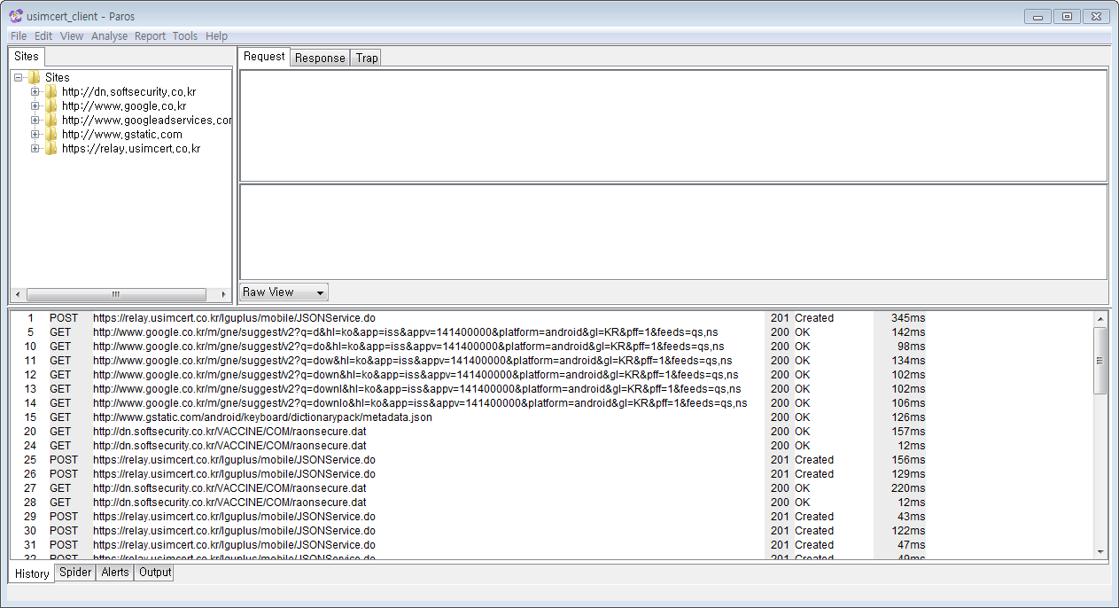
Paros Application

Slide 39
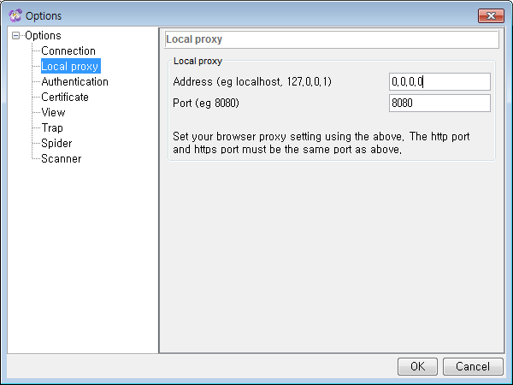
Use Paros as Global Proxy

Slide 40
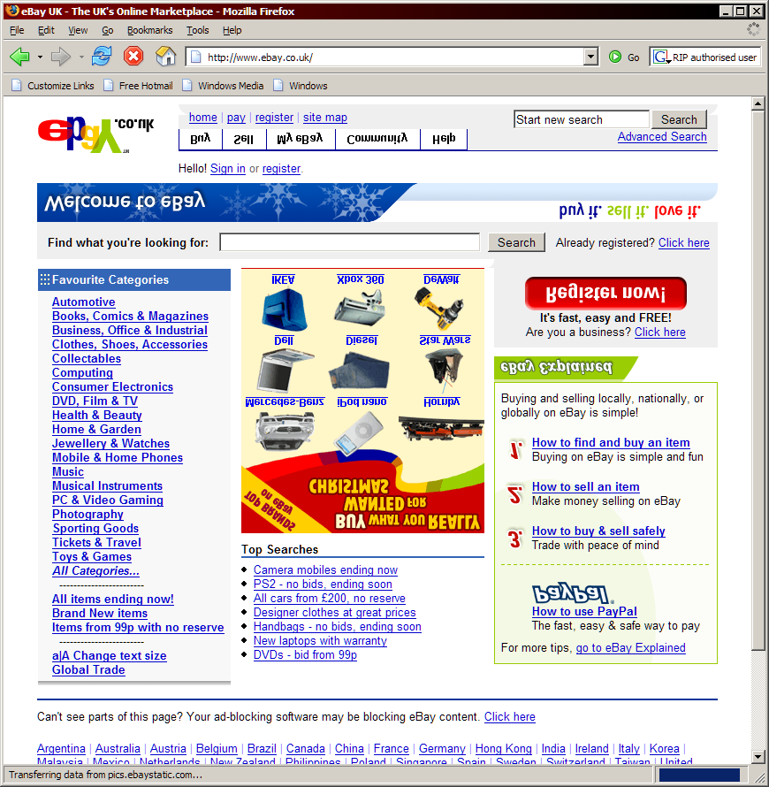
Fun: Upside-Down-Ternet
http://www.ex-parrot.com/pete/upside-down-ternet.html

Slide 41
Will This Work?
SSL without certificate validation
  App developer must turn off explicitly
  Attacker can harvest all private information
SSL with certificate validation
  Mitmproxy can generate certificate on-the-fly
  If root certificate is trusted (installed on the device), SSL could be hijacked
Certificate pinning
  Must modify application to modify pinning
  Most secure method to protect connection

Slide 42
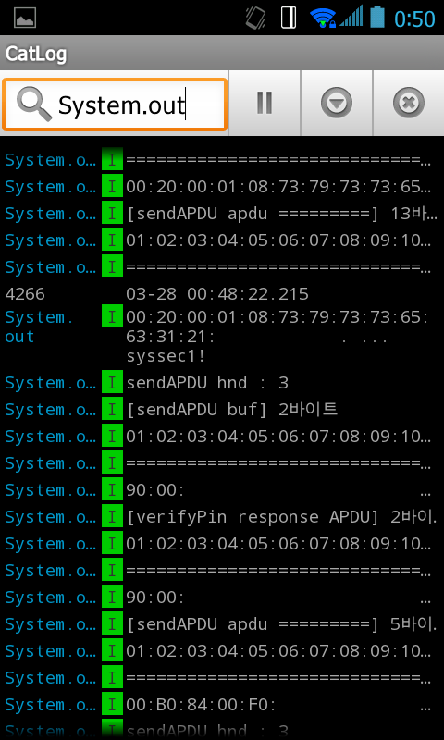
Logcat on Device
Android <=4.0 allows arbitrary log access

Slide 43
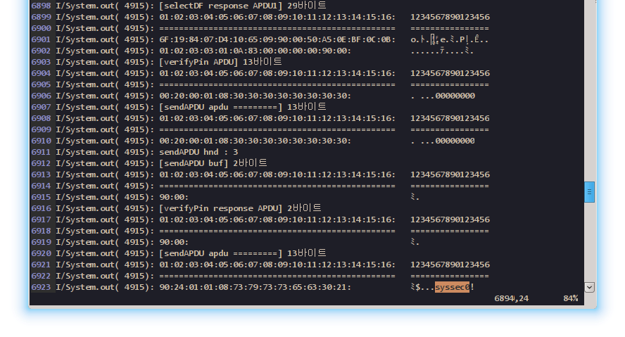
Private Information on Debug Log
Probably developers are too lazy
Google recommends screening of all logging API on Android before release
Example of PIN code on debug log
PIN: syssec0!
Notes:
APDU 노출 사례 소개

Slide 44
Injecting Debug Code
Insert debug code around interested instructions on application
  Print private key, private information, etc.
Problems
  No automatic variable management: we must track free Dalvik registers
  String literal is also counted as variables
  Recommendation: compile Android code, compile and convert to smali, inject the resulting code
Native code is still a problem

Slide 45
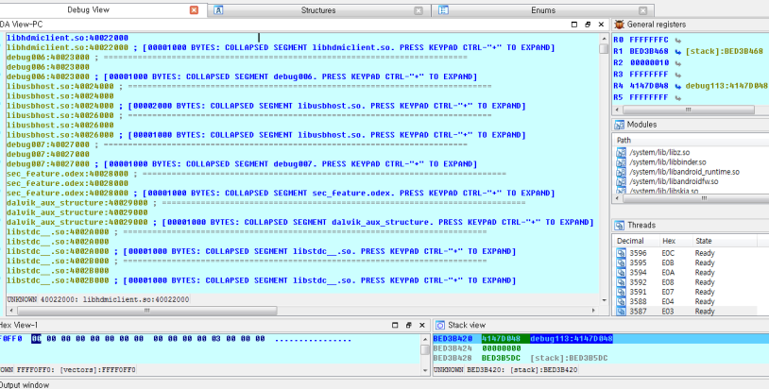
Native Code Debugging
Android app may use native code
Dynamic analysis of native code
  No Dalvik VM is involved, native debugger like GDB, IDA could be used

Slide 46
Developer’s Countermeasures
Integrity check: Bytecode/Native code, Resources
Use secured network connection and do not deliberately degrade security
Remove any log outputs before releasing
Obfuscate code, resource to prevent script kiddies from analyzing

Slide 47
What Obfuscator Does
Variable, Class renaming
  AnInterestingClass -> a, MySecretVariable -> b
String encryption
  GoToClass(“EE515”) -> a(sd(“RR494”))
Entire class encryption
  Encrypt important class (license checking, In App Billing, …)
API hiding
  Hide sensitive API using reflection

Slide 48
What Obfuscator Does
Tamper detection
  Check whether app is modified or not
  Usually done by comparing hash with developer’s one
Resource encryption
  Encrypt resources like image, audio, text
Native library obfuscation

Slide 49
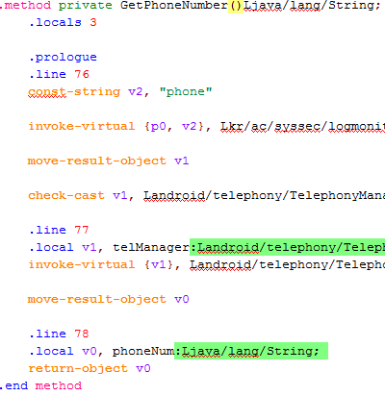
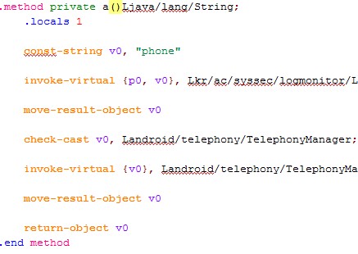
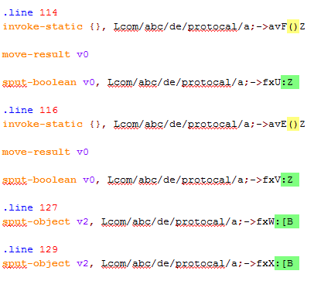
Android Obfuscator: Proguard
Provided by default on Android SDK
Renaming, optimization

Slide 50
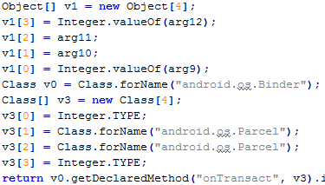
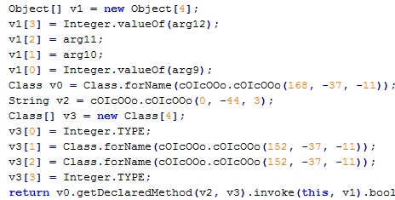
Android Obfuscator: DexGuard
Commercially available
Custom methods, string encryption, API hiding

Slide 51
Real World Examples

Slide 52
Android App Vulnerability Examples
Naver Line
  Update server problem: attacker can hijack update request and install malicious APK (fixed)
Xiaomi MiTalk
  Can steal friend list by SQL injection on content provider
USIM-based mobile PKI
  Can steal private information via logcat (partially fixed)
  SSL proxy possible in some cases

Slide 53

Naver Line

Slide 54



Line Update Vulnerabilities
Request service.xml
Response service.xml
Request update files
Response update files
appdown.naver.com

Slide 55
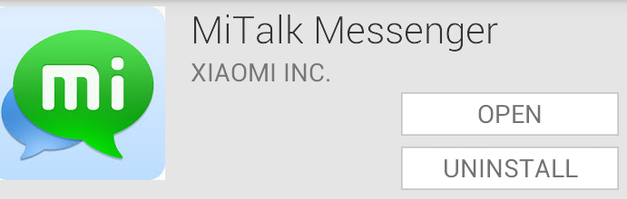
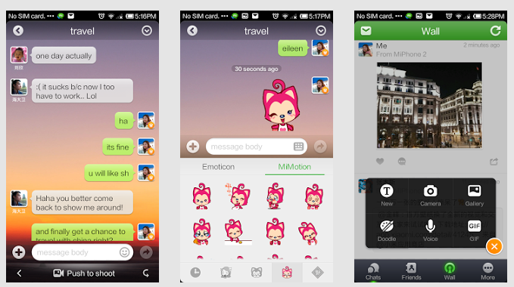
Xiaomi Mitalk

Slide 56



Xiaomi Mitalk SQL Injection
Mitalk
Card #
Can’t access
Friend List
Messages
Can access
Content Provider
Chat Buddy
SQL Injection

Slide 57
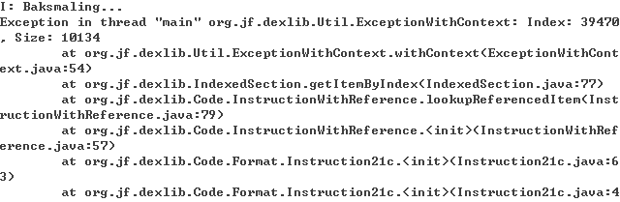
USIM-based Mobile PKI
Consists of USIM applet and Android app
  Further reading: Analyzing Security of Korean USIM-based PKI Certificate Service, WISA 2014
baksmali gives error on extraction

Slide 58
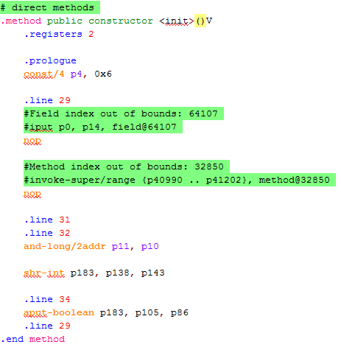
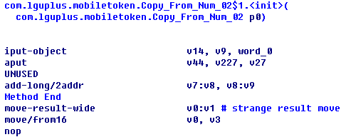
What?!
Decompile results by baksmali/IDA
Unusual decompile results
Notes:
다른 난독화 기술이 적용되어 있음을 확인

Slide 59

Key Inside Crypt
Custom obfuscation method based on native library
  Android loads unencrypted bootstrap, whose memory region is read-only
  Bootstrap calls native function to grant read-write access to application bytecode
  Let’s start from this function

Slide 60
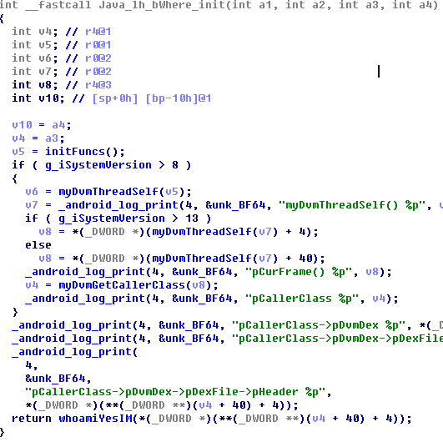
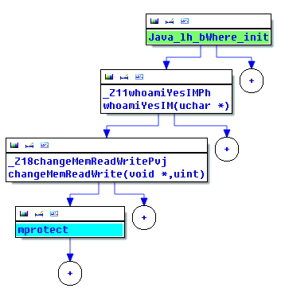
Opening the Real Crypt
Native function to decrypt application: “Java_lh_bWhere_init”
Follow control flow, assisted by decompiler (Hex-Rays)

Slide 61
Decryption Overview
Dexcrypto, custom obfuscation method
com.example.mobiletoken.apk
classes.dex
Initialize
Encrypted Area
Decrypted Area
Load library and
call decryption routine
Decrypt
Libraries
libhi.so
…

Slide 62
How to Crack?
Dump memory area after decryption
Remove call to decryption
com.example.mobiletoken.apk
classes.dex
Initialize
Encrypted Area
Decrypted Area
Load library and
call decryption routine
Decrypt
Libraries
libhi.so
…

Slide 63
Cracking Method Summary
Install and execute the application
Get memory dump using IDA
  Custom script to gather scattered bytecode
Convert to regular DEX file
  Optimization applied by Dalvik VM: reference to system framework, JIT compilation, etc.
Disassemble DEX to smali
Modify application and repackage

Slide 64
Lecture Summary
Android applications are easy to reverse engineer due to usage of bytecode
Reverse engineering starts from collecting every traces of the application
Application could be protected by integrity check, obfuscation, etc.
  These could be easily circumvented!

Slide 65
Questions?

