Slide 1
Cellular Networks II
KAIST
Yongdae Kim

Slide 2
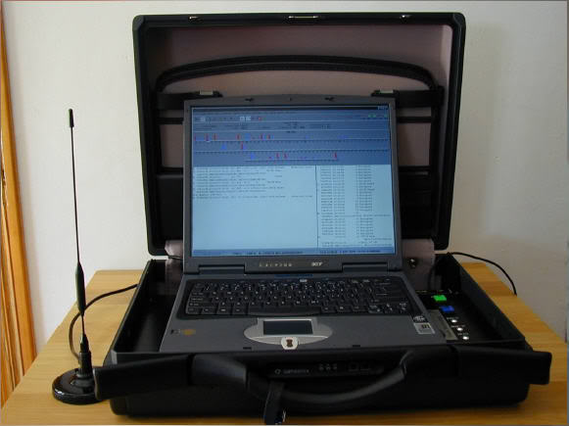
IMSI Catcher
Man-in-the-middle between the MS and BST
  Eavesdropping device used for interception
  Tracking of cellular phones
  Undetectable for the users of mobile phones
GSM uses one-way authentication
  UMTS uses mutual authentication, but backward compatible to GSM
Manufacturers
  Meganet, NeoSoft, Shoghi, Proximus
  Chris Paget built a custom one for
  $1,500.
Detection of IMSI catcher?
  2011. Karsten Nohl. catcher catcher!

Slide 3
Decrypting Phone Calls
Dec. 2010. Karsten Nohl at CCC
$15 phone and open-source software
OsmocomBB
  Free/Open Source GSM Baseband software implementation.
  Replace the need for a proprietary GSM baseband software
    drivers for the GSM analog and digital baseband peripherals
    the GSM phone-side protocol stack, from layer 1 up to layer 3
2009: GSM A5/1 encryption can be decryptable
How about 3G and LTE?
  Debugger for the Qualcomm baseband chip MSM6280
  CDMA longcode?

Slide 4
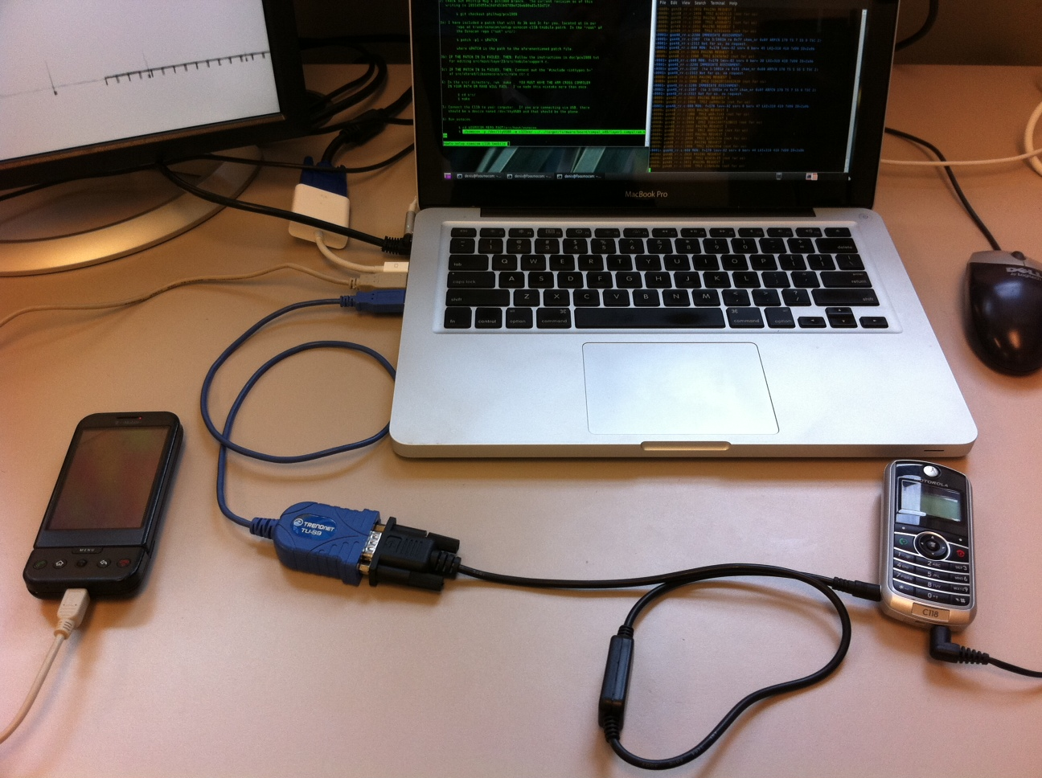
Platform
Serial cable and reprogrammer cable ($30)
VirtualBox running Ubuntu and OsmosomBB software (free)
HTC Dream with custom Android Kernel ($100)
Motorola C118 ($30)

Slide 5
Satellite Phone System
Location Privacy
  Marie Colvin: Syria regime accused of murder (Aug. 2012)
    Syrian forces had “locked on” to their satellite phone signals
  Appelbaum
    “These phone protocols are intentionally insecure”
    “Tracking people is sometimes considered a feature”
Confidentiality
  Driessen and Hund have showed that both GMR-1 and GMR-2 are broken. (Feb. 2012)
  Completely reverse-engineered the encryption algorithm
  Took less than 30 min due to insecure design of the algorithm

Slide 6
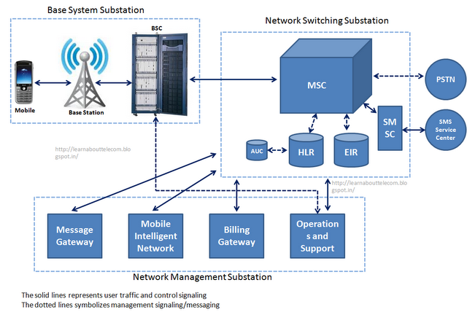
Cellular Networks and SMS
Targeting 2.5G GSM networks
Exploiting Open Functionality in SMS-Capable Cellular Networks, McDaniel et. al., ACM CCS 2005 (Mobicom, Usenix Security, …)

Slide 7
Weaknesses of SMS: Bottlenecks
All systems have bottlenecks; finding them reveals a weak point
SMSCs have per-user queues; once reached, texts are dropped
  Sprint: 30 messages; Verizon: 100: ATT: 400+
Delivery rate from SMSC to MH measured at 7-8 seconds
  Can send messages via Internet in 0.71 seconds

Slide 8
Possible attack: local DOS
Phone network can be DOSed with enough text
  Same channels used to initiate voice calls and deliver text
How many text messages does it take?
  Estimate Washington, D.C. can handle 240 msg/sec
Internet-based attacker needs only 2.8 Mbps
Some networks allow sending to 10 people at once
  Reduces needed bandwidth to 280 kbps

Slide 9
Location Privacy Leaks on GSM
We have the victim’s mobile phone number
Can we detect if the victim is in/out of an area of interest?
  Granularity? 100 km²? 1km²? Next door?
No collaboration from service provider
  i.e. How much information leaks from the HLR over broadcast messages?
Attacks by passively listening
  Paging channel
  Random access channel
Location leaks on the GSM air interface, D. F. Kune, J. Koelndorfer, N. Hopper, Y. Kim, NDSS 2012
Media: Ars Technica, Slashdot, MPR, Fox Twin Cities, Physorg, TG Daily, Network World, e! Science News, Scientific Computing, gizmag, Crazy Engineers, PC Advisor, Mobile Magazine, The CyberJungle, Inquisitr

Slide 10
Cellular Network
HSS
GSM Air Interface
ATR
HLR
MS
BTS
VLR
PSTN
MSC
BSC
Notes:
• The Home Location Register (HLR), a database containing the subscription information and location information.
• The Visitor Location Reguster (VLR), in charge of one or multiple areas where mobile stations may roam in and out of. This entity handles the temporary IDs (TMSI) of the mobile stations.
• TheMobileServicesSwitchingCenter(MSC)handlestheregistrationandhandoverformobile stations roaming in and out of the area it is responsible for.
• The Base Station System (BSS) is a network of base station transceivers and controllers re- sponsible for communicating directly with the mobile station. Those equipments are typically what is at a cellular network tower.
• The Mobile Station (MS) is the mobile device carried by the user. It is composed of the actual device and a Subscriber Identity Module (SIM).

Slide 11
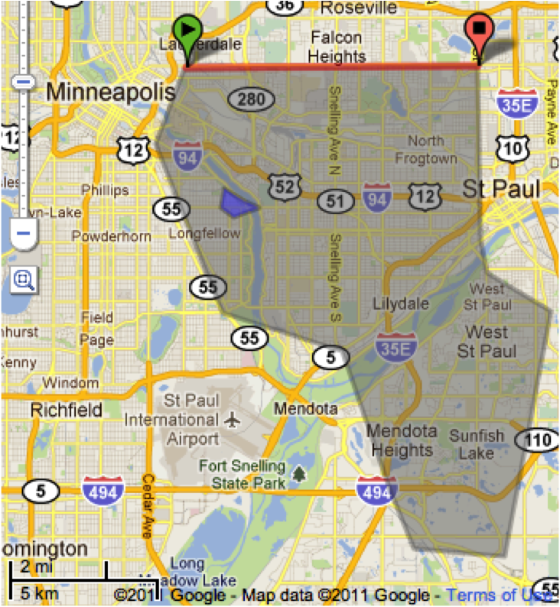
Location Leaks on Cellular Network
IMSI
  a unique # associated with all GSM
TMSI
  Randomly assigned by the VLR
  Updated in a new area
PCCH
  Broadcast paging channel
RACH
  Random Access Channel
SDCCH
  Standalone Dedicated Control Channel
LAC has multiple cell towers that uses different ARFCN
BTS
MS
Paging Request
PCCH
Channel Request
RACH
Immediate Assignment
PCCH
Paging Response
SDCCH
Setup and Data
Notes:
IMSI (International Mobile Subscriber Identity), TMSI (Temporary Mobile Subscriber Identity), LAC (Location Area Code), absolute radio-frequency channel number (ARFCN)
Call the victim to ensure they have their phone on (The network uses an ID unknown to us)
Watermark calls: 2 or 3 calls with known delays in between, Abort each call before completion, 5 seconds after dialing, Paging messages issued, but victim’s phone never rings
Attempt to recover the watermark on the paging channel, Find paging messages with IDs and delays similar to the ones we used
Result
Case 1: watermark on PCCH is heard, The victim is in the same LAC
Case 2: immediate assignment on AGCH is heard “regularly”, The victim is within the same cell tower
Case 3: the RACH traffic from the victim’s phone is heard, They are really close (20 m)

Slide 12
Platform
Serial cable and reprogrammer cable ($30)
VirtualBox running Ubuntu and OsmosomBB software (free)
HTC Dream with custom Android Kernel ($100)
Motorola C118 ($30)

Slide 13
Phone number-TMSI mapping
dt
PSTN
PCH
dt
Time

Slide 14
Silent Paging
Delay between the call initiation and the paging request: 3 sec
Median delay between call initiation and ring: 6 sec

Slide 15
Immediate Assignment
Is IA message sent to all towers in the same LAC?
How do we identify IA message?
  No identifiable information
Check the correlation between IA and Paging request
Notes:
The left box plot shows the time difference between the paging request for our target TMSI and the very next Immediate Assignment.
The middle boxplot shows the difference between the TMSI timestamp and the IA messages if we are listening on a different ARFCN.
Finally the last boxplot shows a control by picking a random time and the next IA message.

Slide 16
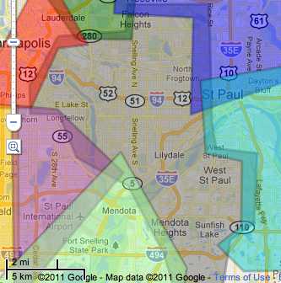
Location Area Code (LAC)
Notes:
Grey area is T-Mobile LAC 747d

Slide 17
Hill Climbing to discover towers

Slide 18
Mapping cell signal strength
Notes:
A cell phone will likely pick the tower that has the highest signal strength (RSSI). This map indicates where that phone might be if they are on a particular tower.

Slide 19
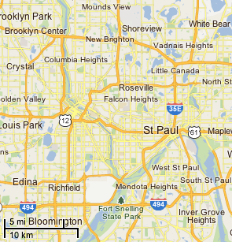
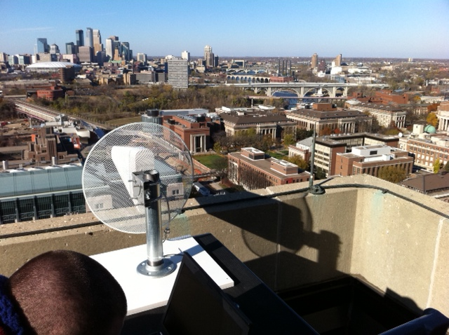
Coverage area with 1 antenna
Downtown Minneapolis
Observer
Yagi antenna
Towers in this area are observable with a rooftop 12 db gain antenna
John’s newly shaved head

Slide 20
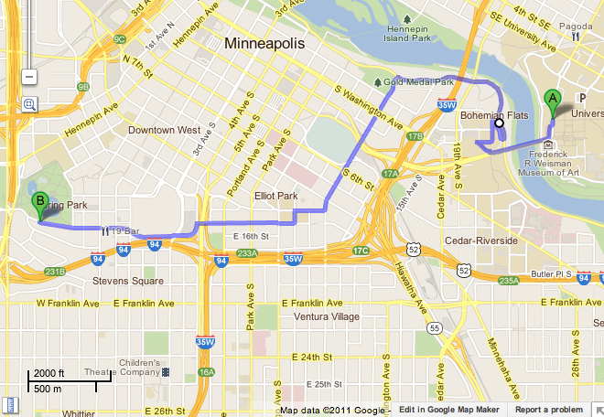
Following a walking person
Observer
End
Start
Approximate areas covered by towers to which the victim’s phone was attached to

Slide 21
Femtocell and 3G
Solutions to offload traffic to other networks
Small/cheap cells in residential environments
~ Q2 2011, 31 operators in 20 countries adopted femtocell
100,000 Femtocells are deployed in S. Korea
Rooting is assumed, which is available in
  Borgaonkar, Redon, Seifert. "Security Analysis of a Femtocell device"
Femtocells: A Poisonous Needle in the Operator’s Hay Stack, Borgaonkar, Golde, Redon, Blackhat’11

Slide 22
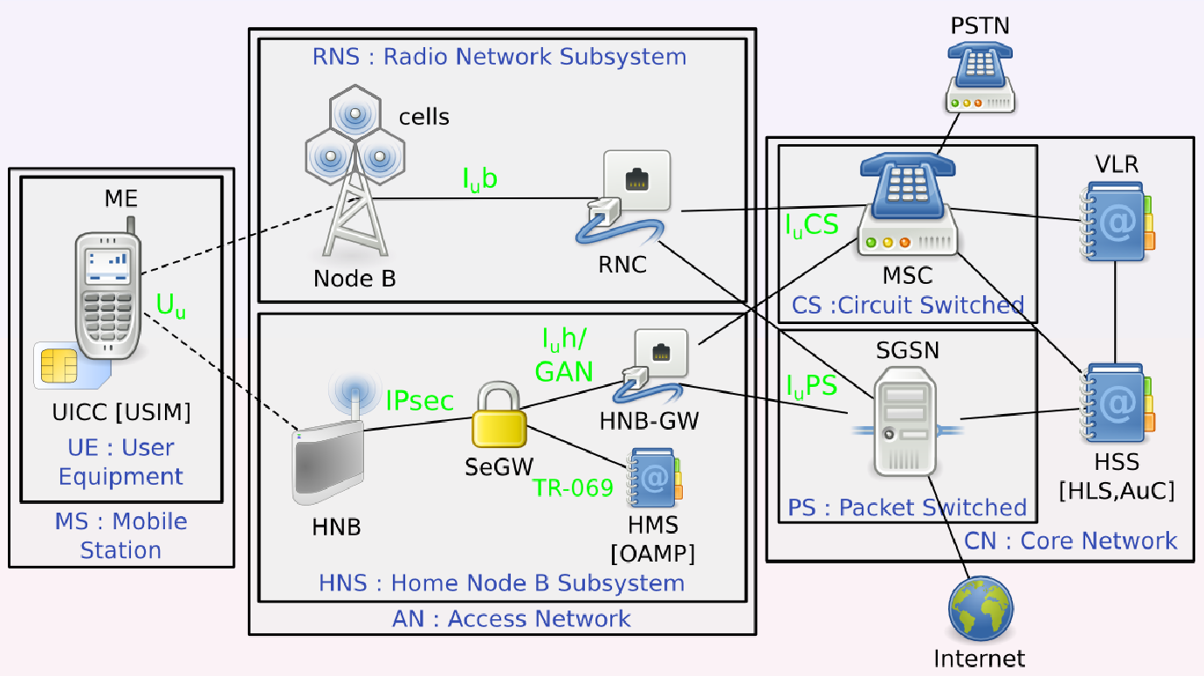
Femtocell Architecture

Slide 23
Threats
End Users
  IMSI Catching
  Voice/data recording
  MitM (Impersonation or injection)
  Detach subscriber
Infrastructure
  Data mining subscriber information
  Signalling DDoS

Slide 24
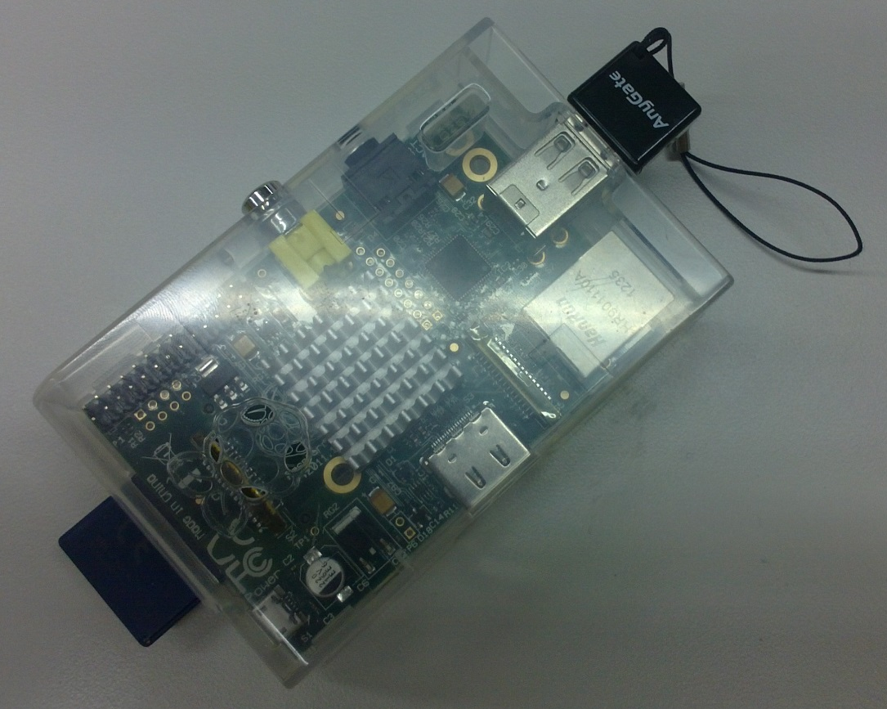
Mobile Tapping
Wi-Fi provides Internet link: WiBro, other 3G/LTE network
tcpdump runs on Raspberry Pi
Power supply from battery or car cigar jack
Femtocell, power source, mobile internet connection not included in price
Raspberry Pi + Case: 50,000 Won
USB Wi-Fi: \15000
2GB SD Card: \2000
Ethernet connection to Femtocell
Power required for RPi, Femtocell, Backhaul link

Slide 25
Known Attacks
2012 SFR (Nico Golde, NDSS 2012)
2012 Vodafone (The Hacker’s Choice, 2011)
2013 Verizon (iSecPartners, Blackhat 2013)
Notes:
There were some researches on attacking femtocells already.
SFR – french
Vodafone – UK
Verizon – American their femtocells already hacked.
As shown in those previous works, femtocell were hacked in many other countries.
So we begin to pay attention on the security of femtocells in Korea.

Slide 26



Femtocell Detection Apps
All released apps are based on cell ID/LAC
MyCell
Femto Widget
Femto Catcher
Uses predefined range of network ID.
Only works on Verizon CDMA. Presented on Black Hat 2013
Preselect nearest cell and notifies when cell ID changed
Determine femtocell by predefined range of LAC code

