Slide 1
Korean Cellular Security
KAIST
Yongdae Kim

Slide 2
Historical List of Botnet
Creation | Name | # of Bots | Spam | Control
2004 | Bagle | 230K | 5.7 B/day | Centralized
2007 | Storm | > 1,000K | 3 B/day | P2P
2008 | Mariposa | 12,000K | ? | Centralized
2008 | Waledac | 80K | ? | Centralized
2008 | Conficker | >10,000K | 10 B/day | Ctrlzd/P2P
2009? | Mega-D | 4,500K | 10 B/day | Centralized
2009? | Zeus | >3,600K | ?
2009 | BredoLab | 30,000K | 3.6 B/day | Centralized
2010 | TDL4 | 4,500K | ? | P2P

Slide 3
3ooGbps DDoS
300 Gbps DDoS against Spamhous from Stophous
Mitigation by CloudFlare using anycast
Stophous turn targets to IX (Internet Exchange)
Korea – World IX Bandwidth
  KT: 560 Gbps, SKB: 235 Gbps, LGU+: 145 Gbps, SKT: 100 Gbps
  Total: 1 Tbps

Slide 4
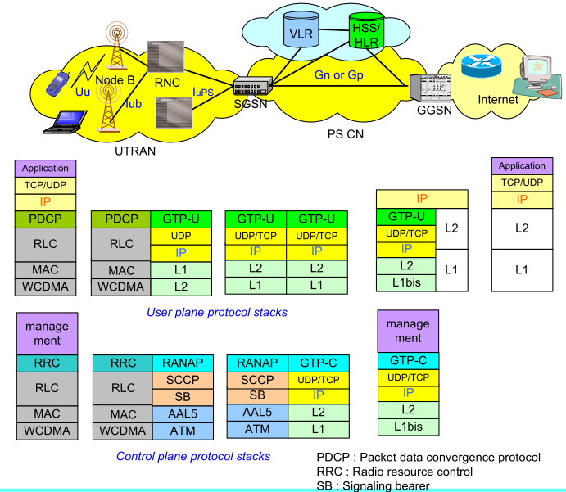
CellNet Fundamental Problem?
Capacity between Internet and 3G/4G
NAT box in GGSN useless

Slide 5
Femtocell and 3G
Solutions to offload traffic to other networks
Small/cheap cells in residential environments
~ Q2 2011, 31 operators in 20 countries adopted femtocell
Rooting is assumed, which is available in
  Borgaonkar, Redon, Seifert. "Security Analysis of a Femtocell device"
Femtocells: A Poisonous Needle in the Operator’s Hay Stack, Borgaonkar, Golde, Redon, Blackhat’11

Slide 6
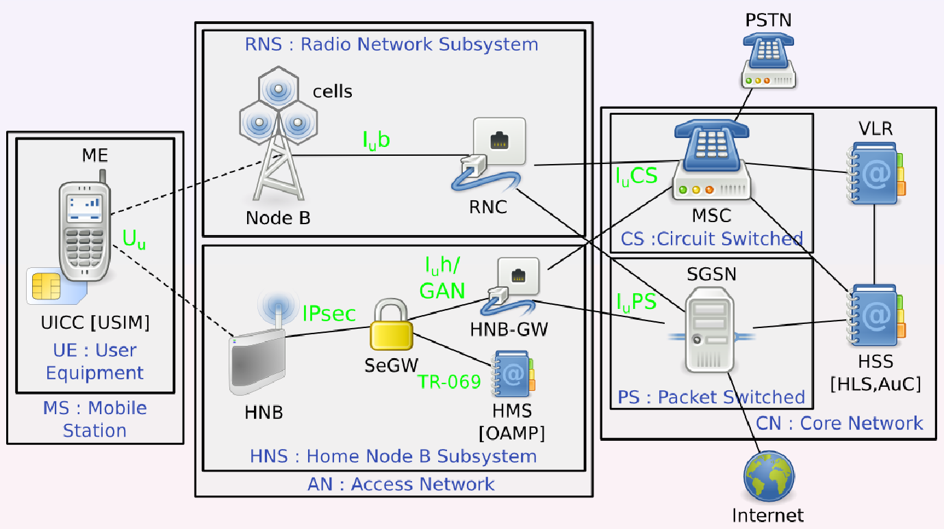
Femtocell Architecture

Slide 7
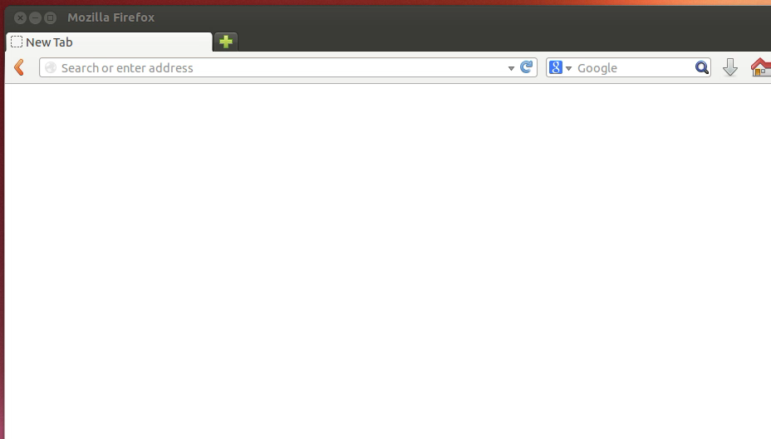
Attack 3G FemtoCell
Notes:
Attacker의 화면, Assumption: Attacker knows IP of a femtocell
웹페이지 파일 목록 (system dump from Flash memory and reversing)
Firmware upgrade page 접근, 인증 없음 확인
Local에 Webshell 및 공격 코드 작성 (html, php), 직접 접근할 수 있는 웹페이지를 만듬, Webshell upload, 가능, 손상되었으나 OK, root 밑에 깔림, add cmd
Tcpdump가 깔려 있음
http, sms request는 암호화, response는 sms, http 평문도 보임
키를 구하면 양쪽 다 가능.

Slide 8
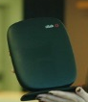
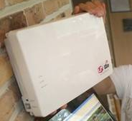
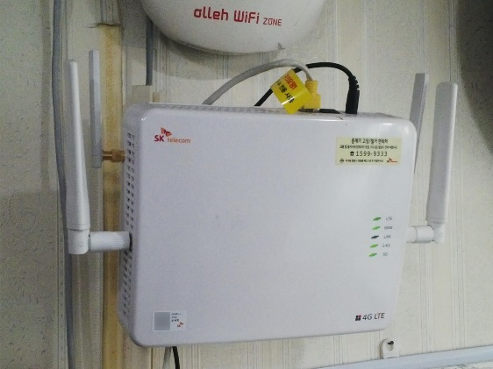
4G Femtocell in Korea
All MNO provides femtocell
Approval required for installation
  Must use same landline ISP by policy
SKT
KT
LG U+
http://smartblog.olleh.com/3412
http://blog.uplus.co.kr/m/post/view/id/1555

Slide 9
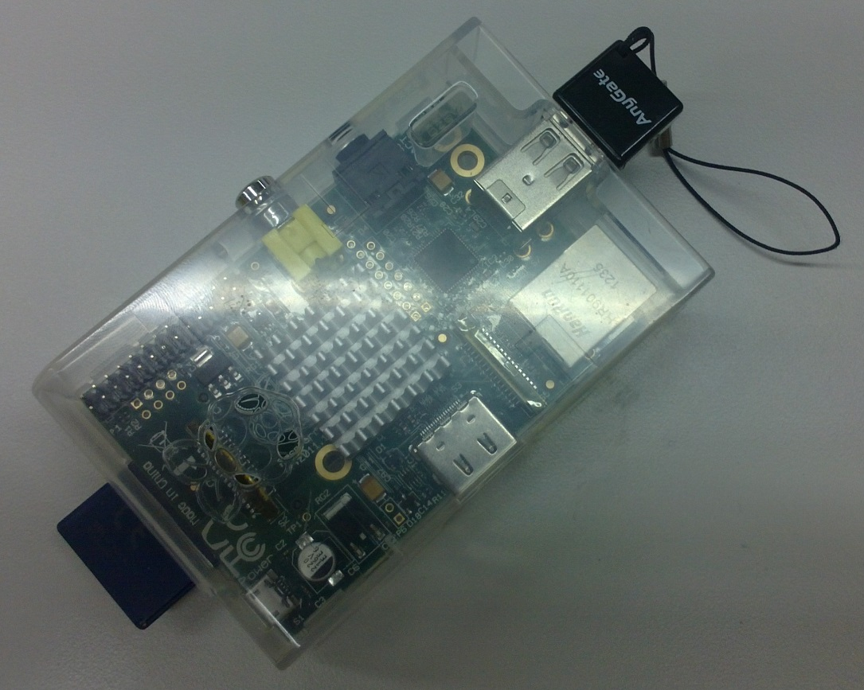
Mobile Tapping
Wi-Fi provides Internet link: WiBro, other 3G/LTE network
tcpdump runs on Raspberry Pi
Power supply from battery or car cigar jack
Femtocell, power source, mobile internet connection not included in price
Raspberry Pi + Case: 50,000 Won
USB Wi-Fi: \15000
2GB SD Card: \2000
Ethernet connection to Femtocell
Power required for RPi, Femtocell, Backhaul link

Slide 10
Known Attacks
2012 SFR (Nico Golde, NDSS 2012)
2012 Vodafone (The Hacker’s Choice, 2011)
2013 Verizon (iSecPartners, Blackhat 2013)
Notes:
There were some researches on attacking femtocells already.
SFR – french
Vodafone – UK
Verizon – American their femtocells already hacked.
As shown in those previous works, femtocell were hacked in many other countries.
So we begin to pay attention on the security of femtocells in Korea.

Slide 11
Targets
Femtocells from 3 Korean cellular providers.
Collecting Basic information of Femtocells
  Serial Ports are mainly used for debugging
  Other network ports for management
Cellular Provider | A | B | C
Type | 3G Femtocell | LTE Femtocell | LTE Femtocell
Architecture | ARM+MIPS (32bit) | MIPS 64bit | MIPS 64bit
Serial Port | UART | Mini USB-B | USB-B
Opened Ports | Web, telnet | telnet, unknown ports | telnet, unknown ports
Notes:
We got three femtocells from three major cellular providers in Korea.
First, we collected basic information of them. The table shows the information. Most embedded devices have serial port for debugging.
We also port scanned femtocells to find opened network ports.
Those network ports are main target of attack because we can connect remotely on the ports.
From now, I will talk about problems each femtocell.

Slide 12
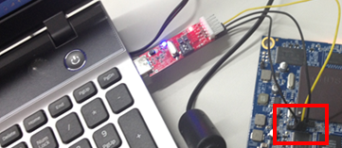
A 3G Femtocell
Firmware Extraction using UART
  Connect UART Port in PCB of the femtocell
  Extract firmware by sending Uboot command
Firmware analysis
  Many trials to detect format of firmware
  Found web interface in file system
Notes:
First, three G femtocell from A provider.
When we removed the cover of femtocell, we could find UART serial port.

Slide 13
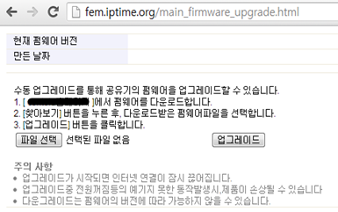
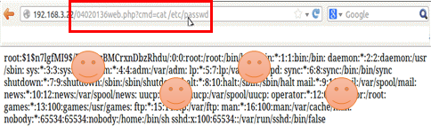
A 3G Femtocell Vulnerability
Web Interface security analysis
  Arbitrary File upload vulnerability in firmware update page
  Webshell can be uploaded
  Permission of web server was “root”
Remotely exploitable via internet

Slide 14
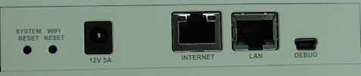

B,C LTE Femtocell
Firmware Extraction using USB debug port
  Extract firmware by sending Uboot command
Firmware analysis
  Many trials to detect format of firmware
  Reverse engineered programs in file system

Slide 15
Challenges
MIPS64, Cavium Networks Octeon CPU
  Weird String reference and Function call
  Unanalyzed Instruction in disassembler
  Difficulty in reverse engineering
Static analysis Only
  No environment for debugging
  Even QEMU doesn’t support the CPU
Notes:
There were some challenges when analyzing LTE femtocells from B and C
The CPU is specially designed for network devices. The system has weird structure on string reference or function calls.
Also some instructions are not analyzed in disassemblers.

Slide 16
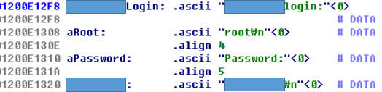
B LTE Femtocell Vulnerability
System control program “X”
  Requires “root” permissioned terminal to execute
System management program “Y”
  Uses “X” in management
  Makes telnet connection to localhost with “root” id
Reverse-engineering “Y”
Can login using the credentials from remote

Slide 17
C LTE Femtocell Vulnerability
Remote management program
  Receives commands in specific format
  Remotely accessible via internet
  No authentication
RCE Vulnerability in the program
  system function is used while handling some commands
  Any shell commands can be injected
  “root” permission

Slide 18



Femtocell Detection Apps
All released apps are based on cell ID/LAC
MyCell
Femto Widget
Femto Catcher
Uses predefined range of network ID.
Only works on Verizon CDMA. Presented on Black Hat 2013
Preselect nearest cell and notifies when cell ID changed
Determine femtocell by predefined range of LAC code

Slide 19
4G Egg Authentication Bypass
Assumptions
  Attacker and victim shares same LTE Router
  Attacker knows WEP key of LTE Router
    Using tools like Aircrack can reveal WEP key
Main problems
  Most of “restricted” functionality works without login ☹
  Preventing mouse right button click is no-no ☺

Slide 20
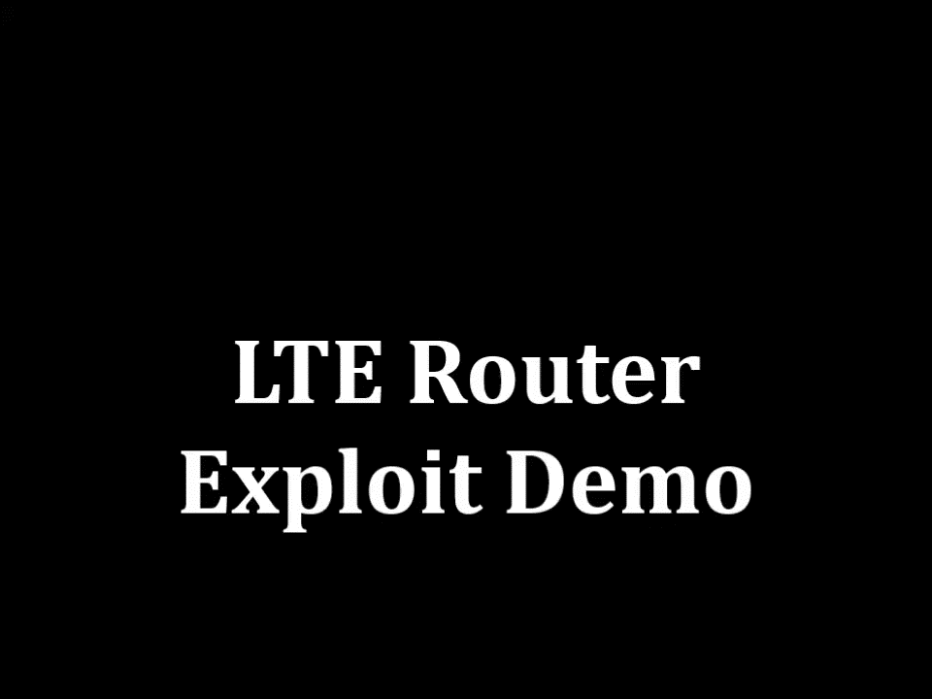
4G Egg Password Reveal Exploit

Slide 21

GTP Attack
Notes:
GTP는 GPRS망 내 SGSN과 GGSN 간 패킷 데이터와 시그널링 정보 흐름을 처리한다
GGSN fingerprint: “GTP Create PDP Context Request sent” to all IP in SKT, If response, the IP address is from the GGSN
SGSN fingerprint: “GTP Echo request” to all IP in SKT. If echo response, it must be either GGSN or SGSN. Subtract GGSN.
Nmap to discover information about GGSN and SGSN.

Slide 22

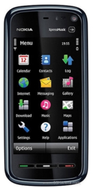



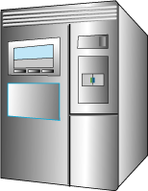

GTP Attack
USB테더링
공격자
PS(PacketSwitch)
Internet
RNC
Node-B
SGSN
GGSN
스마트폰
Router
GGSN
SGSN
GGSN
CN(CoreNetWork)

Slide 23
IP addresses of GGSN/SGSN
GGSN
SGSN
192.168.143.204
192.168.149.28
…
192.168.149.10
192.168.52.130
…

Slide 24


IP Spoofing
NAT/Firewall
Victim
143.248.0.10:3000
10.0.0.100:1000
SYN+ACK Packet
20.0.0.100
Internet
TCP SYN Packet
20.0.0.100
TCP SYN Packet
10.0.0.100:1000
Attacker
10.0.0.200:1000
Attacker
20.0.0.100

Slide 25

Overbilling Scenario
NAT/Firewall
Charged ₩ Bomb
143.248.0.10:3000
10.0.0.100:1000
UDP Packet
10.0.0.100:1000
Internet
UDP Packet
20.0.0.100
UDP Packet
10.0.0.100:1000
10.0.0.200:1000

Slide 26
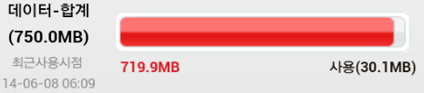
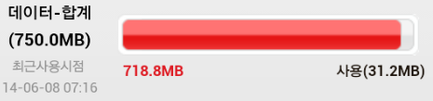


Overbilling Attack evaluation
Sends 1,000 1024 Byte UDP Packet
A 통신사(+1MB)
B 통신사(+1MB)

Slide 27
Sysmocom SIMtrace
MitM device for USIM card
Sits between mobile phone and USIM card
Environment
  3.3V, 115.2Kbps card only (Answer to Reset contains card characteristics)
  Most of Korean USIM cards are supported
  PC program available only for Linux

Slide 28
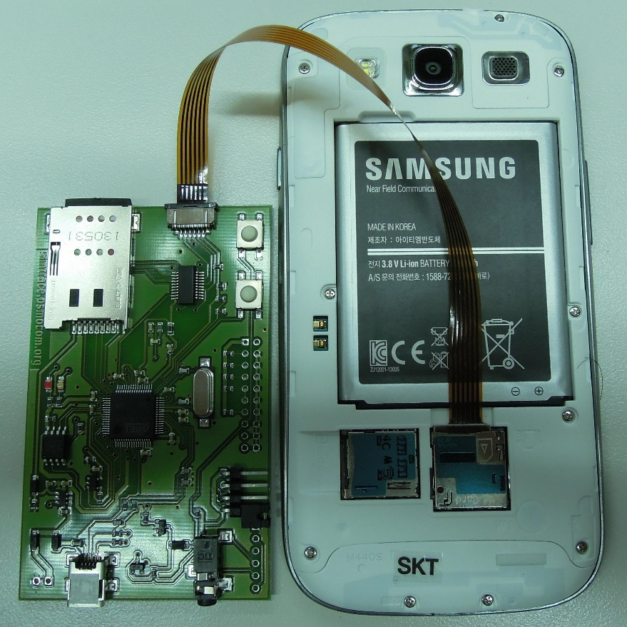
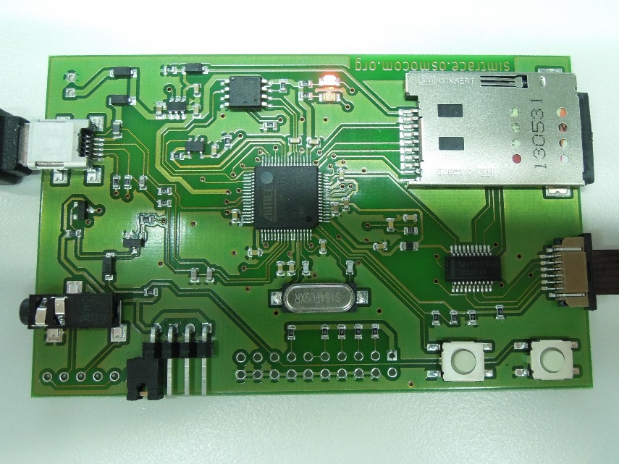
Sysmocom SIMtrace

Slide 29
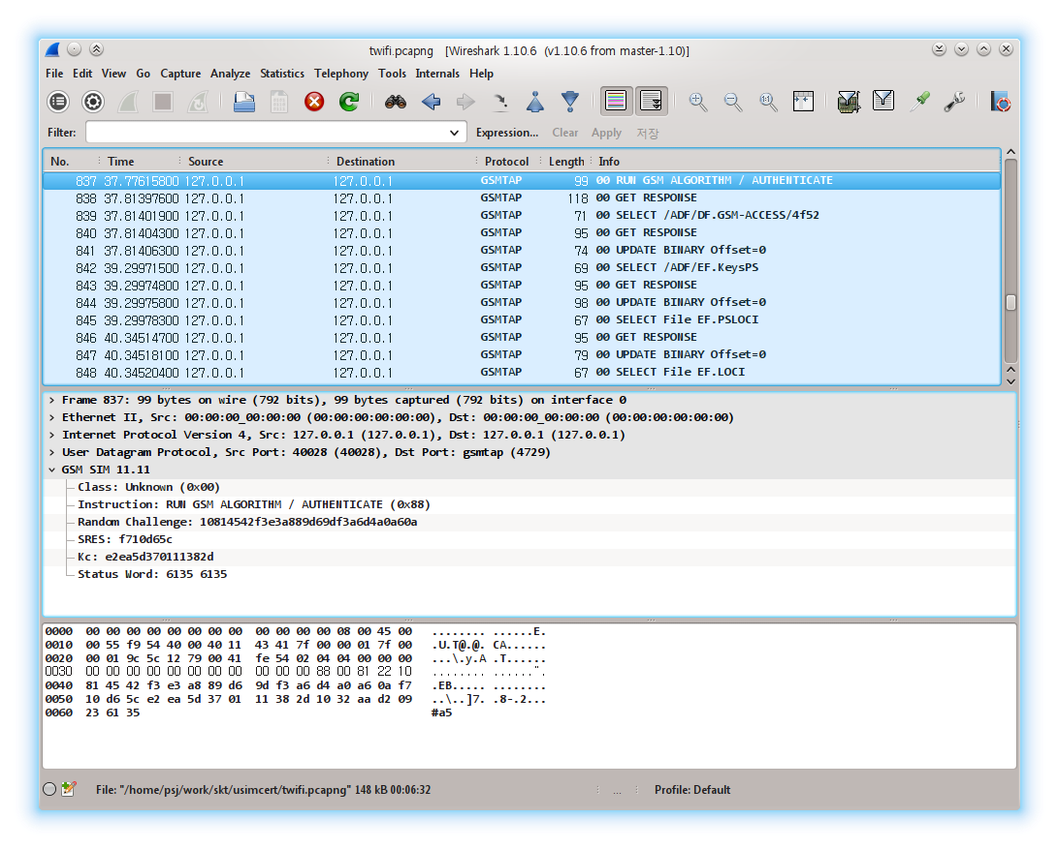
Wireshark Integration

Slide 30
Korean USIM Certificate
Raonsecure: SKT, LG U+
Dreamsecurity: SKT, KT
Components
  PC handler application (보안토큰, 스마트인증)
  Android application to control USIM
  USIM applet

Slide 31
Problems
Certificate installation
  Logcat sniffing on Android: mining P, Q, PIN
Certificate usage
  Logcat sniffing: mining PIN
SSL certificate validation problem
Notes:
USIM 직전에 풀리는 사례 소개

Slide 32
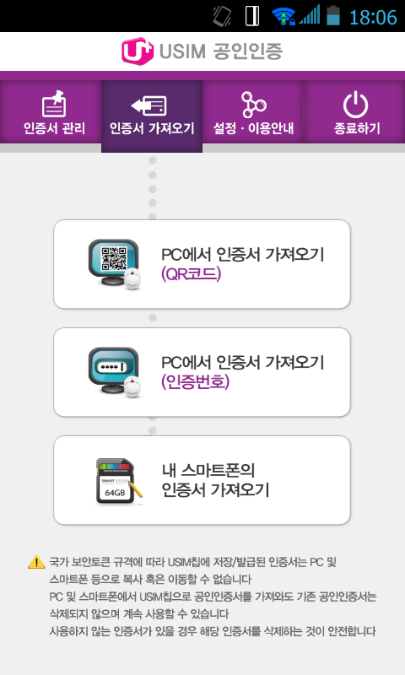
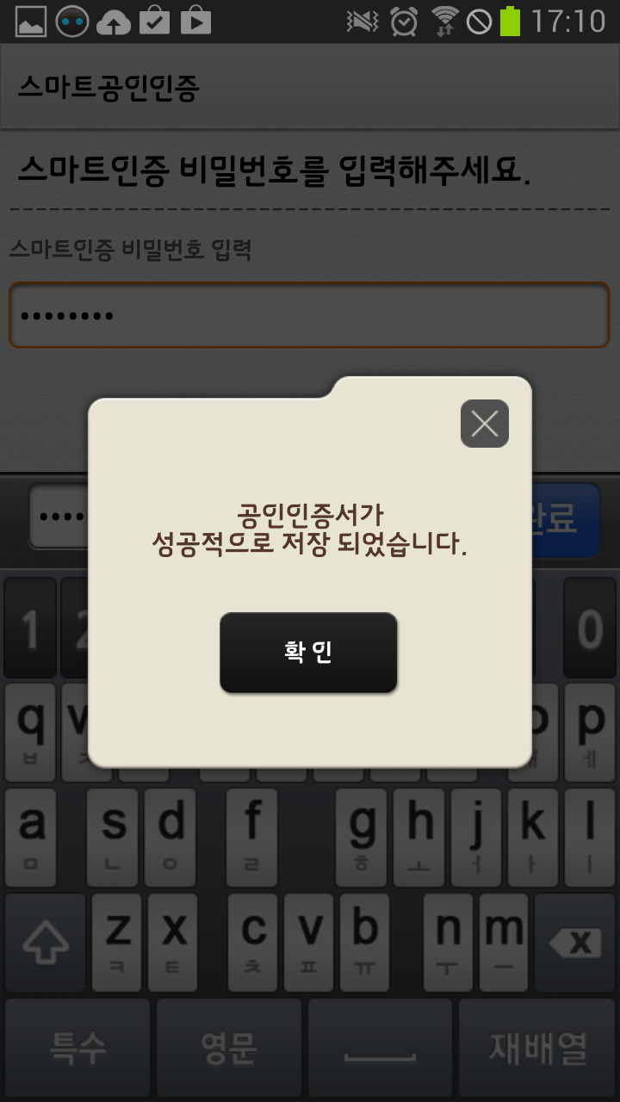
Certificate Installation
PC
  One-time password or QR code
Phone
  Preinstalled certificate from NPKI folder

Slide 33
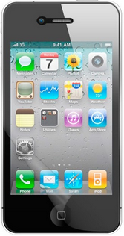
Certificate Installation
Dream/Raon Relay Server
Select Certificate
SIM
PC
Phone
Notes:
파란색: 사용자 비밀 키

Slide 34
Certificate Installation
Dream/Raon Relay Server
Enter Certificate Password
SIM
PC
Phone

Slide 35
Certificate Installation
Dream/Raon Relay Server
SSL
Encrypt Once More
SIM
PC
Phone
Notes:
빨간색: PC에서 생성한 임의의 nonce

Slide 36
Certificate Installation
Dreamsecurity Relay Server
4-digit one time verification code
User enters last 2 digits
****
SIM
PC
Phone

Slide 37
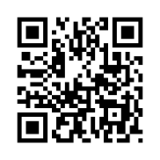
Certificate Installation
Raonsecure Relay Server
QR Code with Server and Key
Read Using Camera
SIM
PC
Phone

Slide 38
Certificate Installation
Dream/Raon Relay Server
SSL
Connect to Server and download/decrypt certificate
SIM
PC
Phone

Slide 39
Certificate Installation
Dream/Raon Relay Server
Store certificate into USIM
Authenticated by service PIN
Log Sniffing
SIM
PC
Phone
Notes:
녹색: 사용자가 선택한 PIN 번호

Slide 40
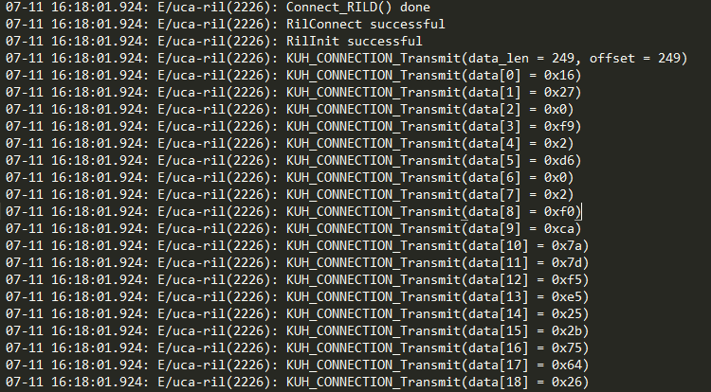
Log Sniffing
Logcat shows debug messages and APDU
  PIN number to access secure storage
  RSA prime p, q during certificate install
  Plaintext to be signed
  Structural analysis of application
Mallory can watch log output and reconstruct private key
RSA Values, PIN
Notes:
APDU 노출 사례 소개

Slide 41
Test Results (KT)
Phone | OS Version | Result
LG G Pro (LG-F240K) | 4.1 | Full APDU/Vulnerable
LG G Pro (LG-F240K) | 4.4 | Partial APDU/Okay
Samsung Galaxy S3 (SHV-E210K) | 4.1 | Full APDU/Vulnerable
Samsung Galaxy S4 Mini (SHV-E370K) | 4.2 | Full APDU/Vulnerable
Samsung Galaxy S5 (SM-G900K) | 4.4 | Full APDU/Vulnerable
* SKT and LG U+ are not affected

Slide 42
SSL Validation Results
Dreamsecurity
  SSL MitM possible for notification and SKP server
  Not possible for Dreamsecurity relay server
Raonsecure
  SSL MitM possible for all servers
  Improper encryption of PIN using 보안토큰

Slide 43
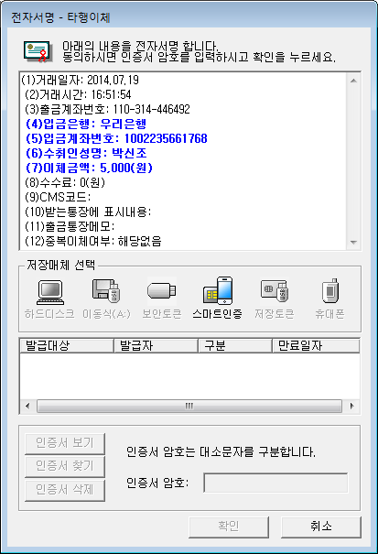
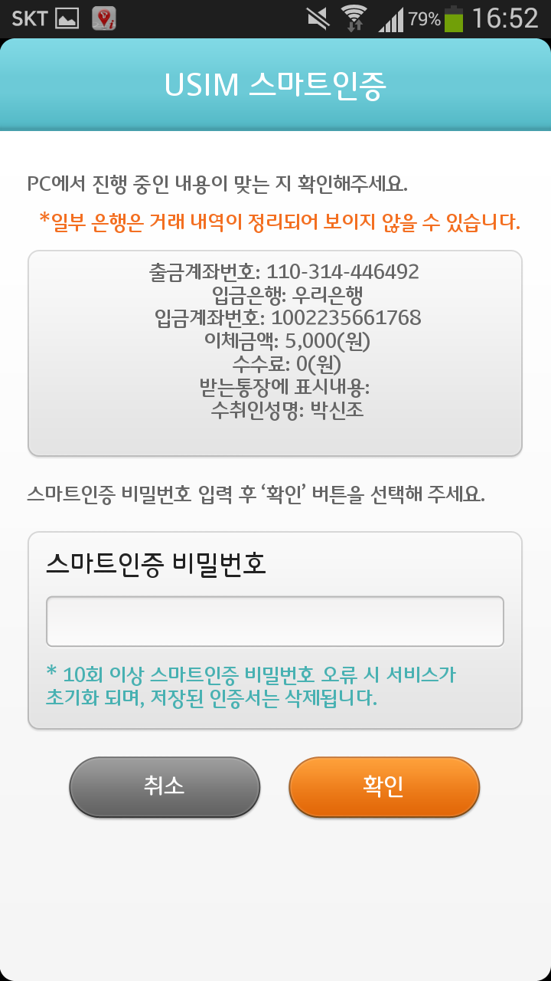
스마트인증

Slide 44
Possible Attack Scenario
SSL hijacking
  Dreamsecurity: Not possible
  Raonsecure: Message properly encrypted
Application repackaging
  Modify application to show hacker’s predefined messages
Trusted user interface required

Slide 45
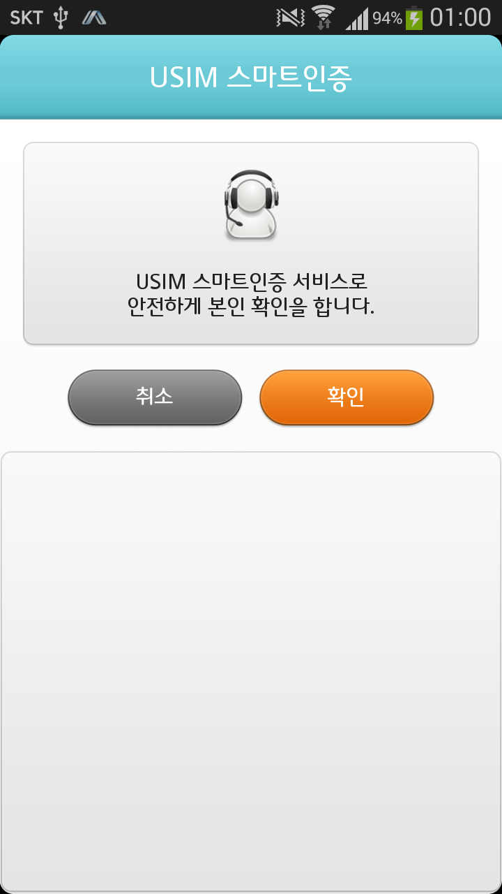
User Interface Problem

Slide 46
Summary
Bank
Relay
Push
SSL
SSL
Improper logcat messages
SIM APDU with plaintext
SIM
PC
Phone
Notes:
Installation/transaction 둘 다 설명할 것

Slide 47
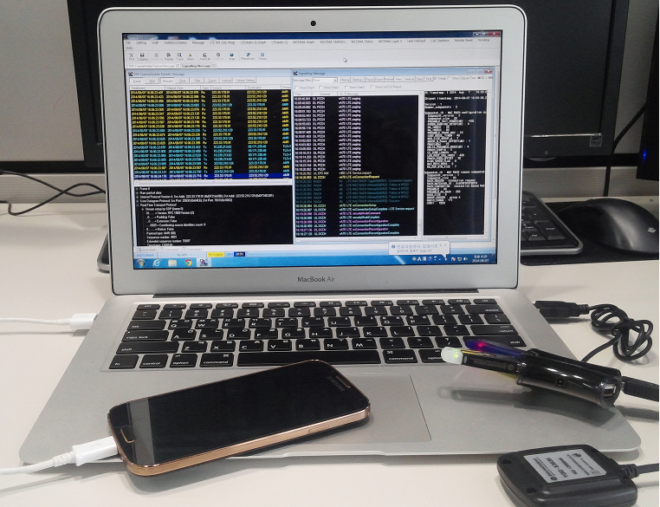
Diagnostic Monitor (DM)
What’s the DM?
  A real-time data collection and diagnostic logging tool for measuring mobile-based RF performance
DM key
UE
GPS

Slide 48





NAT box hole filling attack
SKT Public IP
203.226.207.17: ?
Push service IP and Port
173.194.72.188:5228
UE
Send RST packets
Src : 173.194.72.188:5228
Dst : 203.226.207.17:(1024-65535)
NAT Box
Attacker

Slide 49
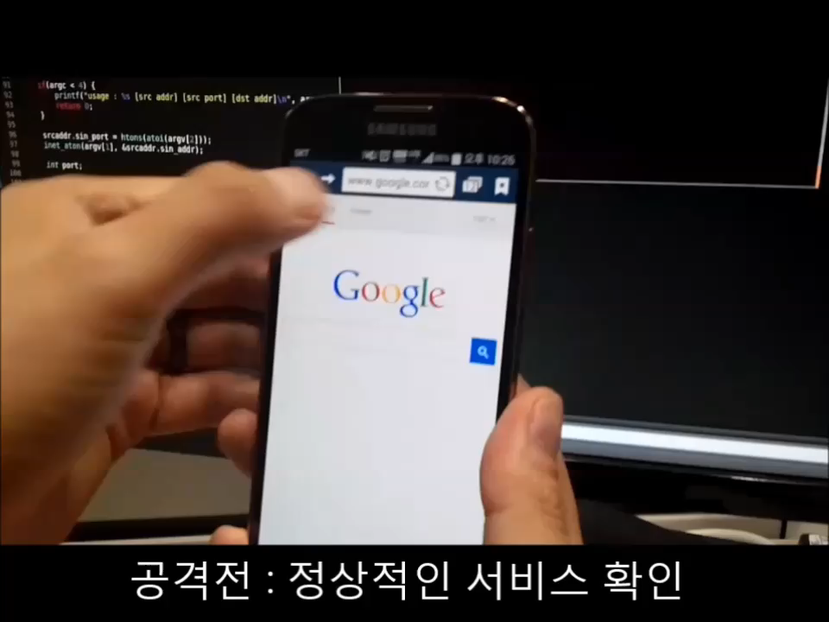
DEMO

Slide 50
SIP INVITE
UE A
CSCF
UE B
INVITE
180 Ringing
200 OK
ACK
Media session
BYE
ACK

Slide 51
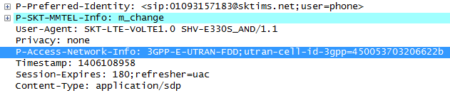
INVITE message header
Fig. INVITE message from UE A to P-CSCF
Utran-cell-id-3gpp = 450 05 3703 206622b
MNC + MCC + TAC + Cell ID
Notes:
SCTP 패킷은 Common Header와 Chunk로 구분된다. Common heade에는 Association이 설정된 Endpoint들을 유일하게 식별할 수 있는 32bit nonce 값이 있고, Adler-32 알고리즘을 이용한 SCTP 패킷 체크섬이 있다.
Chunk들은 SCTP의 연결 설정, 해제, 에러 전송등을 위한 Control Chunk와 데이터 전송을 위한 Data Chunk 응답을 위한 Sack Chunk 등이 있다.
Data: User data, Stream Identifier + Stream sequence number (이것 덕분에 멀티스트리밍가능)
SACK: 수신된 DATA Chunk의 결과와 손실된 데이터의 갭을 통보하는 역할
INIT: 엔드포인트 사이에 associatio을 하기 위해 사용 – 스트림의 수, 윈도우 사이즈, 사용 가능한 IP 등이 파라미터에 포함되어 전송
Heartbeat: 멀티호밍에 의해 생성된 다른 path가 데이터 전송이 가능한지를 판별하기 위해 보내지는 chunk
null echo: association의 초기화 동안 사

Slide 52
SIP Private Headers
P-Associated-URI header
P-Called-Party-ID header
P-Visited-Network-ID header
P-Access-Network-Info header
P-Charging-Function-Addresses header
P-Charging-Vector header
Notes:
1. 등록된 주소등을 return, 2. INVITE request를 보낸 URI 정보, 퍼스널한것과 비지니스용이 있는 등. 3. 홈네트워크의 visited network, subscriber정보 4. radio cell identity etc. 5. 6. 차징 함수 정보

Slide 53



SIP Private Headers
Private Header to the SIP for the 3GPP – RFC3455
IP multimedia call control protocol SIP and SDP – 3GPP TS 24.229
Notes:
1. 등록된 주소등을 return, 2. INVITE request를 보낸 URI 정보 3. 홈네트워크의 visited network, subscriber정보 4. radio cell identity etc. 5. 6. 차징 함수 정보

Slide 54
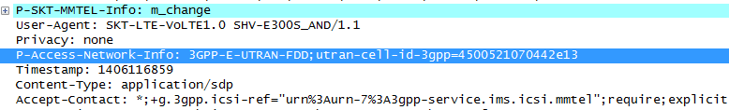
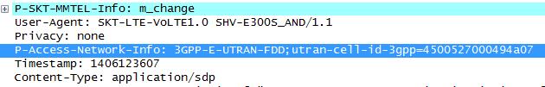
Privacy Leakage
발신자: 서울 관악구 대학동
발신자: 수원 권선구 금곡동
발신자: 대전 유성구 구성동
Notes:
1. 등록된 주소등을 return, 2. INVITE request를 보낸 URI 정보 3. 홈네트워크의 visited network, subscriber정보 4. radio cell identity etc. 5. 6. 차징 함수 정보

Slide 55
Questions?
Yongdae Kim
  Google “Yongdae Kim”
  http://syssec.kaist.ac.kr/~yongdaek
  yongdaek@kaist.ac.kr
  Facebook: https://www.facebook.com/y0ngdaek
  Twitter: https://twitter.com/yongdaek

