Slide 1
Botnet
Yongdae Kim
KAIST

Slide 2
Towards Systematic Evaluation of the evadability of bot/botnet detection methods
Elizabeth Stinson, John C. Mitchell

Slide 3
Purpose
Contribution
  Systematic framework for evaluating the evadability of botnet detection methods
    Quantifying the evasion cost
Approaches
  Examine existing Automated Botnet Detection Methods
  Evasive Techniques & its Cost
  Problems on detection methods
  Future research approaches

Slide 4
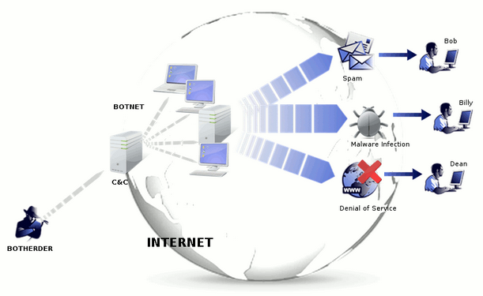
Bot/Botnet
Definition of a bot
  Receive commands through C&C
  Carry out attacks by commands
  No limit on attack time & format
  ※ More general than usual
Attack type
  DDoS, Identity Theft, Malware Distribution, Phishing, Piracy, Proxying, Scanning, Server hosting(SMTP,HTTP), Spamming

Slide 5
Automated Detection Methods
Relying Characteristics
Characteristic | Description
Basis | Type of method as in host- or network-based
Hub | Relies on network topology where single server has multiple clients
IRC | Relies on specific IRC port number or model of communications patterns
Flow-Chars | uses flow characteristics to correlate C&C communications and/or attacks
Time | Correlates events or network traffic that occur within a time window
Net-Det | Relies on automated, network-based detection of botnet attacks such as scanning
Syntax | Relies on bots' use of a particular nickname, command, or protocol syntax
Taint | Requires that bots' execution of commands demonstrates explicit information flow

Slide 6
#1. Strayer : Detection
Eliminate flows unlikely to be botnet
Keep only IRC flows
by machine learin alg.
Cluster related flows by 5D space & topol. anal
5 Distinct Filters
Non-TCP Traffic
Port Scans
High bit-rate flows
(* Bandwidth > 8kb/s)
Flows w/ packet > 300Kb/s
Short lived connection
(* > 60’)
Flow characteristics
Duration
Role
Bytes per packet (bpp)
Bytes per second (bps)
Packets persecond (pps)
Keep flows : time period
Use 5d space
· Find a cluster of flows
their distance is small
- Topological analysis
· Identify RP
Manual analysis
· Identify bot master IP
Notes:
Three stages for identifying tight C&C in IRC network
Evasion: Injecting packet- and flow-level noise to defeat "High bit-rate flow" filter

Slide 7
#2. Rishi : Detection
Identifies bot-infected hosts by passively monitoring network traffic (IRC packets)
Analyzing IRC packets with nicknames that match pre-specified templates
Heavily Rely on IRC client nickname(Syntax)
Notes:
Encrypt communications traffic
Change C&C protocol or the syntax of nickname

Slide 8
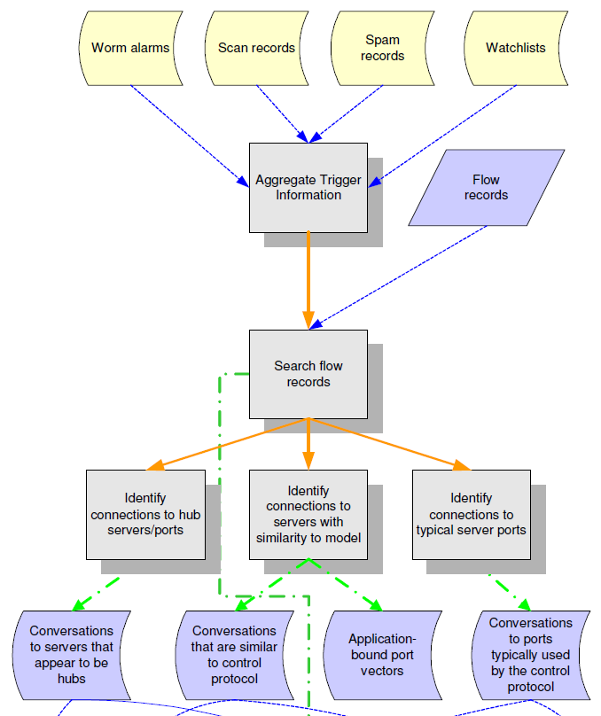
#3. Karasaridis : Detection
Focusing on detecting IRC botnet C&C using 4 steps
Identify hosts w/ bad behaviors : scan, spam..
Isolate flows to/from those hosts
Identify C&C u/ 3 criteria
- stad. IRC ports
- remote hub having multiple
access from suspicious hosts
- flows whose characteristics
within a flow model for IRC

Slide 9
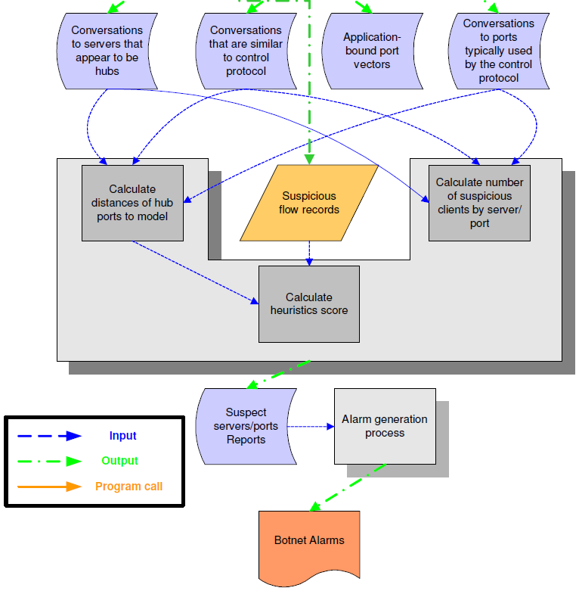
#3. Karasaridis : Detection
Focusing on detecting IRC botnet C&C using 4 steps
Analysis of C&C records : 3 stages
  # of unique suspected bots for a given hub
  Avrg. fpa, ppf, bpp from most popular hub
  Distance b/w traffic to hub and model traffic
  heuristic score (e.g., #of idle clients)
Assign confidence score to suspected control servers
Alarm when c.score > threshold
Notes:
By injecting packet- and flow-level noise, we can perturb bpp and ppf
- To break similarities between C&C traffic and the
model for IRC.
Connect-disconnect-reconnect defeat fpa. (flows per address)
Other approaches
- Limiting the botnet’s attack types,
- Inducing IP churn,
- Using OOB coordination,
- Using C&C protocols other than IRC,
- Thwarting identification of hub servers.

Slide 10
#4. Botswat : Detection
Focusing on system call invocation
  remotely-initiated vs locally initiated
Characterize each behaviors
  Identify data initiated from local user inputs
  Track tainted data initiated remotely
Compare
  Behavioral separation b/w two
Notes:
Launder tainted data
- Since it relies on explicit information flow
Other approaches
- Communication encryption, attack process monitor

Slide 11
BotHunter
Bot Infection Dialog Model
  E1 : External to Internal Inbound scan
  E2 : External to Internal Inbound exploit
  E3 : Internal-to-external binary download
  E4 : Internal-to-external C&C communications
  E5 : Outbound port scan
Three detection engine
  Port scan detection engine
  Payload-anomaly detection engine
  Snort signatures
Correlation Engine declares host infection (static C&C IP) when
  E2 with E3, E4 or E5
  Any 2 of {E3, E4, E5}
Notes:
1) Spacing events out in time
- necessary combinations do not occur closely together
2) Encrypting C&C communication packets : evasion of E4
- since Snort rule-sets rely on content-based matching
3) Restricting scanning target : evasion of E1 or E5
- by scanning hosts on the same internal network,
- since the detector is at the network boundary
4) Induce IP churn
- since correlation engine analyze one specific IP

Slide 12
BotMiner
Clustering similar communication traffic
  cluster hosts whose flows are similar bpp, bps, ppf, fph
Clustering similar attack traffic
  clustering hosts scanning same ports, spamming, or downloading similar files
Performing cross cluster correlation to identify the bots
Notes:
Optimal approach
- Injecting packet- and flow-level noise to target
communications-plane clustering
Other approaches
- Defeating scan detection, restricting communications
and attack targets

Slide 13
Conclusion
Limitations on detection methods
  Two common assumptions are less true
    Bots simultaneous attack participation
      => Only a few needs that : DDoS, phishing
    Coordination through C&C network
      => This can be achieved outside of the C&C
Alternative approaches
  Focus on botnet utility
  Ways to negatively affect this utility

Slide 14
Sherlock Holmes and the Case of the Advanced Persistent Threat
Ari Juels, Ting-Fang Yen

Slide 15
What is APT?
Advanced
  “Operate[s] in the full spectrum of computer intrusion.” [Bejtlich’10]
Persistent
  Maintains presence – Targeted
Threat
  Well-resourced, organized, motivated

Slide 16
Is This New?
 | Traditional Attackers | APT
Means of exploitation | Software vulnerabilities, Social engineering
Objectives | Spam, DoS attack, Identity theft | Espionage, IP theft
Motive | Fame, Financial gain | Military, Political, Technical
Target | Machines with certain configurations | Users
Scope | Promiscuous | Specific
Timing | Fast | Slow
Control | Automotive malware | Manual Intervention

Slide 17















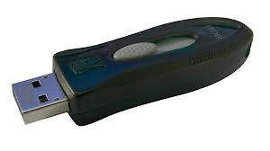



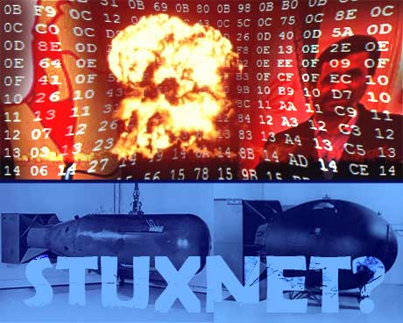
Commonalities between Reported APTs
Night
Dragon

Slide 18








Typical APT
Command and Control
Targeting
Data Exfiltration
Lateral movement

Slide 19
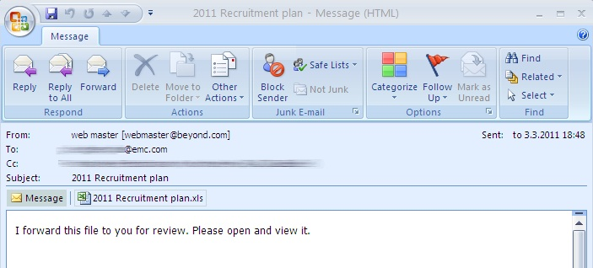
Targeting : Spear Phishing
Socially Engineered Mail
Zeroday Vulnerability in Attachment
Notes:
RSA breach에서 사용되었던 email. 첨부파일에는 Adobe Flash zeroday 취약점이 존재.

Slide 20
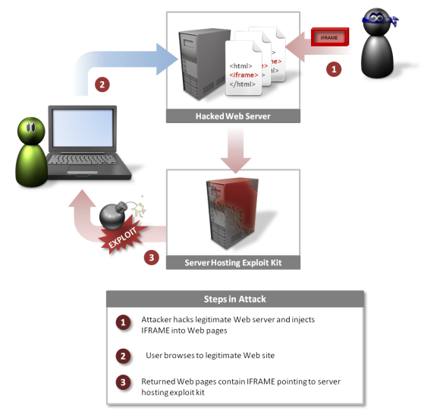
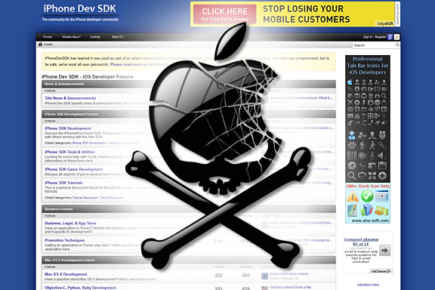
Targeting : Watering Hole
iOS Developer Site at Core of Facebook, Apple

Slide 21
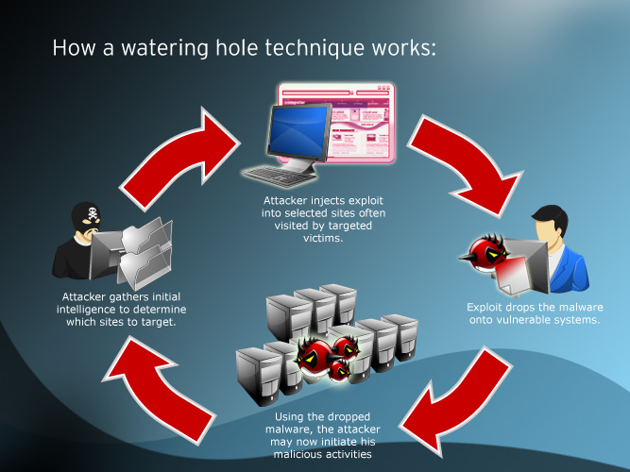
Targeting : Watering Hole
http://securityledger.com/many-watering-holes-targets-in-hacks-that-netted-facebook-twitter-and-apple/

Slide 22



Targeting: Exploit Trusted Relationship
SecureID two-factor authentication product
Attacker
ALZip Update Server

Slide 23
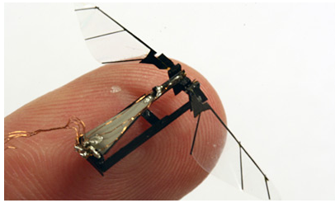
Other Techniques: Tools
Infected digital photo frames
Infected mobile phones
Bluetooth vulnerabilities
Compromised device drivers

Slide 24
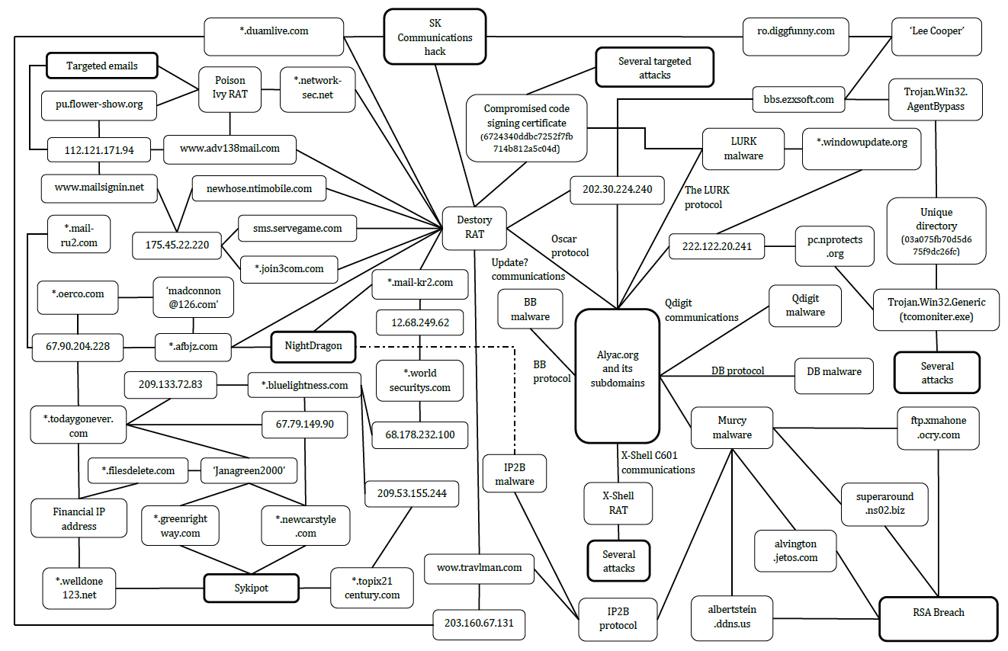
Command and Control
Illustration of links among SK communications, RSA, and Night Dragon
Notes:
총 8 개 종류의 C&C 통신이 이루어졌으며 해당 통신은 ‘LURK’, ‘X-Shell C601’, ‘Update?’, ‘Murcy’, ‘Oscar’, ‘BB’, ‘DB’, ‘Qdigit’으로 명명되었다. 각 통신들은 모두 같은 악성코드에서 발생한 통신 내역이며 ‘alyac.org’의 서브 도메인에서 관찰되었다.

Slide 25
Command and Control : Insights
Uses Specific DNS servers
The TTL of domains
Communicate with C&C at frequent intervals
Inspection of TCP port 443 traffic
Notes:
■ 공격자에 의해 침해된 컴퓨터가 C&C 통신을 할 때 사용되는 DNS 서버는 침해된 컴퓨터의 기본 DNS 서버를 사용하지 않고 공격자가 따로 지정한 DNS 서버를 사용함으로써 C&C 채널의 통신을 기본 DNS 서버에서 탐지가 어렵도록 하고 있다. 따라서 기관이나 조직에서는 기본 DNS 서버가 아닌 다른 DNS 서버를 사용하는 것을 허용하지 않도록 하며 이러한 통신이 발생할 시 분석하여 대응할 수 있도록 하여야 한다.
■ 몇몇의 악성코드는 일정한 간격으로 주기적으로 C&C 서버와 통신을 시도한다. 일정한 간격으로 주기적으로 통신이 일어나는 경우 악성코드에 의한 C&C 서버와의 통신을 의심해 볼 수 있다.
■ TCP에서 사용하는 443 포트는 SSL 암호화에 의해 네트워크 트래픽을 조사하기 어렵기 때문에 대다수의 네트워크 관리자가 443 포트에서 발생하는 통신을 모니터링 하지 않는다. 이러한 점을 이용하여 공격자들은 443 포트를 C&C 통신에 활용하기도 한다.

Slide 26




Data Exfiltration
High value asset
HTTP, FTP
Attacker’s
Notes:
- data encryption, compression with file transfer protocol(FTP, HTTP)
- steganography
- covert channels in TCP/IP packet header
- piggybacking upon existing communications
- fast-flux
- Google Translate

Slide 27

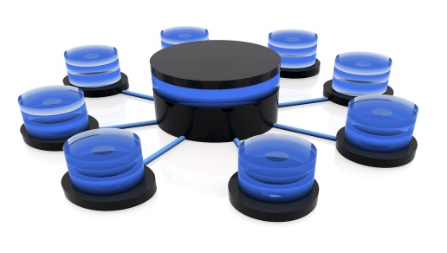






Case Study : SK Comm. Hack
1010010110101000011100010000..
Database
Tool
Downloading
WayPoint
10100101101010..
Tool box Server
Malicious Update
Targeted Computers
C&C
Communication
Gain Access
Legitimate
Update
Attacker
ALZip Update Server
Non-targeted Computers
C&C Server

Slide 28
Reconnaissance & Preparation (1/2)
C&C Server
  Registering the domain ‘alyac.org’
  At attack time, a Korean IP was used
  Time-To-Live(TTL) = 30 minutes
Tool box server
  A large Taiwanese publishing company website
  Webserver was used to download malwares

Slide 29
Reconnaissance & Preparation (2/2)
Gained access
Uploaded instructions
Attacker from
a Chinese IP
ALZip Update Server
SK Comm. Info. was gained
to distinguish target
Targeted Computers
Non-targeted Computers

Slide 30
Targeting
Request malicious update file
Over 60 Computers were infected
Malicious Update
Targeted Computers
Tool
Downloading
x.exe: network monitor
nateon.exe: access the user databases
rar.exe: modified WinRAR
ALZip Update Server
Tool box Server
Notes:
Downloaded malware
x.exe - Monitoring network, obtain credentials such as usernames and passwords
nateon.exe - access the user databases, compiled over 6 months before attack
rar.exe – modified(remove the program properties to display) version of winrar command line program

Slide 31
Data Exfiltration
Personal details of 35 million SK Comm. users
User identifier, password was encrypted but others not
Database
101001010010111000100000..
101001010010111000101..
Targeted Computers
Attacker
WayPoint
Collecting Information
Korean IP
A Company in Nonhyeon
Chinese IP

Slide 32
The Red-Headed-League Attack
Encompass a victim in a general event that conceals a targeted attack.
Red-headed Botnet

Slide 33
Other Red-headed Attacks
Open source software
Social Network
  Friend finding
Free USB Sticks

Slide 34
The Blue-Carbuncle Attack
Conceal unauthorized communications within commonplace objects or activities.
High value asset
HTTP, FTP
Attacker’s

Slide 35
The Bohemian-Scandal Attack
Create disturbances to the victim to obtain intelligence about a target resource
Recommended responses to a breach can reveal...
  Location of valuables
  Critical services
  What you know about the
  attack

Slide 36
The Speckled-Band Attack
Breach a security perimeter through unconventional means
Examples
  Infected digital photo frames
  Infected mobile phones
  Bluetooth vulnerabilities
  Compromised device drivers

Slide 37
Conclusion
APT is a campaign
  No formula or playbook of tactics
How about detection?
  Behavior profiling
  Defensive deception
  Information sharing

