Slide 1
Mining Your Ps and Qs:
Detection of Widespread Weak Keys in Network Devices
N. Heninger, Z. Durumeric, E. Wustrow, and J. Halderman
USENIX Sec’ 2012

Slide 2
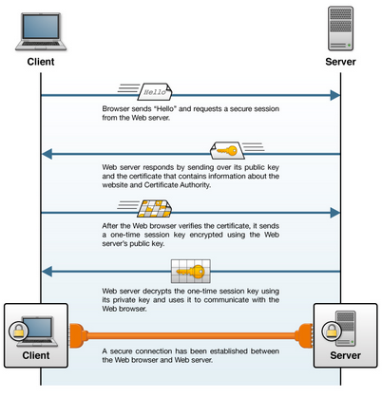
Background: TLS

Slide 3
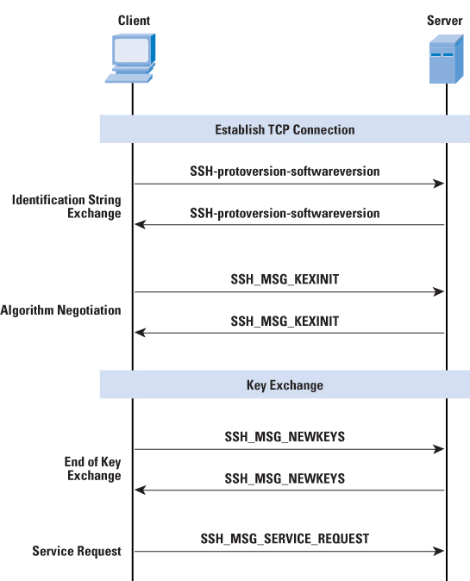
Background: SSH

Slide 4
PKE with insecure channel
Passive
Adversary
e Insecure channel
Key source
d
Encryption
E_{e}(m) = c
c
Insecure channel
Decryption
D_{d}(c) = m
m
m
Plaintext source
destination
Alice
Bob

Slide 5
Question
How random is the random number generator used in embedded devices?
How secure are they?
Quickly break PKC just by finding public keys?
…

Slide 6
Random Number Generator: Vulnerabilities
1996. Goldberg and Wagner, Netscape RNG insecurity
2007. Windows RNG
2008. Karsten Nohl, MIFARE: a poor random source
2008. Debian OpenSSL, Poor RNG (SSH, VPN, …)
2010. Playstation, private key recovery since it uses the same random number
2012. Poor RNG in imbedded devices (this and *)
2013. Snowden. Dual_EC_DBRG has NSA backdoor
2013. Java Nonce collision affects Bitcoin and Android
Lenstra, Hughes, Augier, Bos, Joppe, Kleinjung, Wachter, (2012). "Ron was wrong, Whit is right". Crypto’12

Slide 7
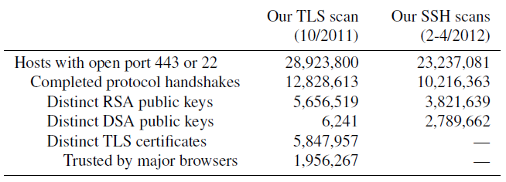
Collect Public Keys for SSL and SSH

Slide 8
Repeated Keys
 | TLS Scan | SSH Scan
Number of live hosts | 12,828,613 | 10,216,363
Using repeated keys | 7,770,232 | 6,642,222
using non-vulnerable repeated keys | 7,055,989 | 5,661,056
using vulnerable repeated keys | 714,243 | 981,166

Slide 9
Shared Keys?
Non-vulnerable reasons for shared keys
  Corporations share keys across certificates
  Shared hosting providers
Vulnerable reasons for shared keys
  Default certificates and keys
  Entropy problems during key generation

Slide 10



RSA Encryption
Key Generation
  Two random primes p and q, each roughly the same size
  n = pq, f(n) = (p-1)(q-1)
  e, 1< e < f(n), such that gcd(f(n), e) = 1
  ed ≡1 mod f(n)
  A’s public key is (n, e); A’s private key is d
Encryption: compute c = m^{e} mod n
Decryption: m = c^{d} mod n
Why?
  c^{d} mod n = m ^{ed} mod n = m ^{1 mod f(n)} mod n
  = m ^{1 + k f(n)} mod n = m
  if n is a product of distinct primes and if r=s mod f(n), then a^{r}=a^{s} (mod n) for all a  Z_{n}*
Notes:
Factoring N reveals private keys
Gcd (N_1, N_2) = ?

Slide 11
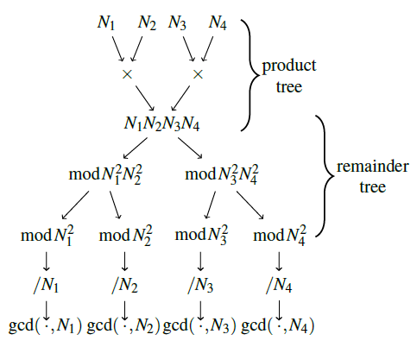
Finding GCD in N integers

Slide 12
Results
Found 2,134 prime factors!
Can compute private keys for
  64,081 TLS hosts and
  2,459 SSH hosts

Slide 13
DSA (US Standard)
DSA Algorithm : key generation
  select a prime q of 160 bits
  1024 bit p with q|p-1
  Select g’ in Z_{p}*, and g = g^{k}=g’^{(p-1)/q} mod p, g≠1
  Select 1 ≤ x ≤q-1, compute y= g^{x} mod p
  public key (p, q, g, y), private key x
Signature Generation
  Select a random integer k, 0 < k < q
  Compute r=(g^{k} mod p) mod q
  compute k⁻¹ mod q
  Compute s = k⁻¹ (h(m) + xr) mod q
  signature = (r, s)
Notes:
Two primes p and q. We are dealing with two groups, one Z*p and a subgroup of that of order q. Here alpha is a generator of that subgroup. Notice that the security of our key is based on the discrete logarithm problem.

Slide 14
DSA Vulnerabilities
Two different signatures with same ephemeral and long-term keys
  Can easily compute randomness
  Can easily compute private key
Break
  Collect DSA signatures during SSH key exchange
  4,365 signatures used shared ephemeral keys
  Compute private long-term keys for 105,728 (1.03%) of SSH hosts

Slide 15
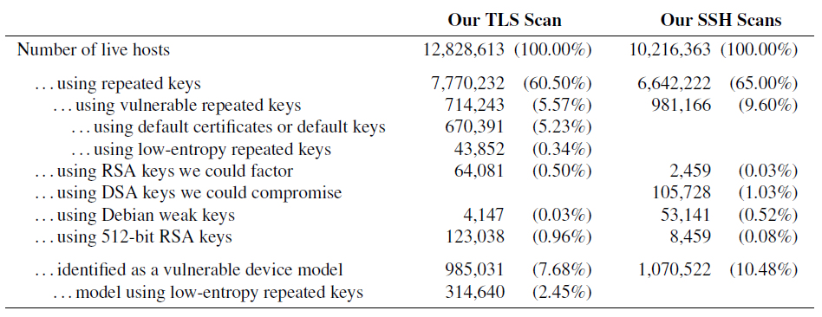
Summary

Slide 16
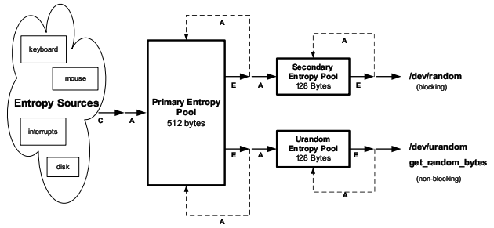
Why?
Linux /dev/(u)random
  Random number generator in Linux kernel
  Nearly everything uses it
Random number generating mechanism
  Collect entropy
  Extract entropy and mix it into the (non)blocking pool
  Extract bytes from the (non)blocking pool

Slide 17
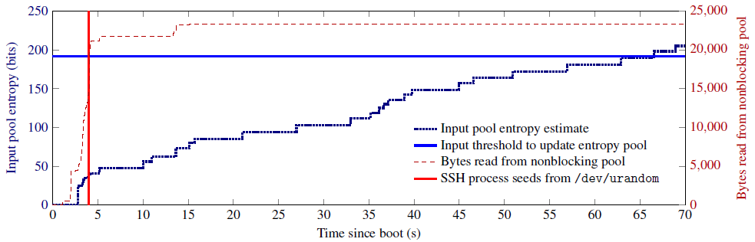
Linux RNG Bug
Linux /urandom boot-time entropy hole
  Return before it has been seeded with any entropy

