Slide 1
EE515/IS523
Think Like an Adversary
Lecture 1 Introduction
Yongdae Kim
한국과학기술원

Slide 2
Offense vs. Defense
“Know your enemy.” – Sun Tzu
"the only real defense is active defense” - Mao Zedong
“security involves thinking like an attacker, an adversary or a criminal. If you don’t see the world that way, you’ll never notice most security problems.” - Bruce Schneier

Slide 3
Instructor, TA, Office Hours
Instructor
  Yongdae Kim
    5th time teaching EE515/IS523
    23rd time teaching a security class
  Email: yongdaek (at) kaist. ac. Kr
  yongdaek (at) gmail. com
    Please include ee515 or is523 in the subject of your mail
  Office: N26 201
  Office Hours: TBD
TA
  EE TA: Yunmok SOn yunmok00 (at) kaist.ac.kr
  GSIS TA: Eunsoo Kim hahah (at) kaist.ac.kr
  Office hours: by appointment only

Slide 4
Crypto Crypto+Security Network/Distributed System Security System Security
1993
1998
2002
2008
2012
ETRI
USC
UMN
KAIST
20 year career in security research
  Applied Cryptography, Group key agreement, Storage, P2P, Mobile/Sensor/Ad-hoc/Cellular Networks, Social networks, Internet, Anonymity, Censorship
Published about 70 papers (+4,300 Google scholar citations)
10 PhD, 9 MS, 15 BS advised at UMN
9 PhD, 10 MS, ** BS (being) advised at KAIST
Notes:
Don’t forget to talk about the Korean connection

Slide 5
Class web page, e-mail
http://security101.kr
  Read the page carefully and regularly!
  Read the Syllabus carefully.
  Check calendar.
E-mail policy
  Include [ee515] or [is523] in the subject of your e-mail

Slide 6
Textbook
Required: Papers!
Optional
  Handbook of Applied Cryptography by Alfred J. Menezes, Paul C. Van Oorschot, Scott A. Vanstone (Editor), CRC Press, ISBN 0849385237, (October 16, 1996) Available on-line at http://www.cacr.math.uwaterloo.ca/hac/
  Security Engineering by Ross Anderson, Available at http://www.cl.cam.ac.uk/~rja14/book.html.

Slide 7
Overview
To discover new attacks
The main objective of this course is to learn how to think like an adversary.
Review various ingenuous attacks and discuss why and how such attacks were possible.
Students who take this course will be able to analyze security of the practical systems and

Slide 8
Course Content
Overview
  Introduction
  Attack Model, Security Economics, Legal Issues, Ethics
  Cryptography and Key Management
Frequent mistakes
  User Interface and Psychological Failures
  Software Engineering Failures and Malpractices
Case Studies
  Embedded Device Security
  Automobiles and IoT Security
  Internet Protocols
  RF Security
  Low Level Attacks
  Cellular Network Security
  Cryptographic Failures
  Sensing Security
  Critical Systems
  Medical Device Security
  De-anonymization
  Air-gapped Networks
  Machine Learning Security

Slide 9
Evaluation (IMPORTANT!)
Lecture (20%)
Reading Report (18 x 2.5% = 45%)
Project (35%)

Slide 10
Group Projects
Each project should have some "research" aspect.
Group size
  Min 1 Max 5
Important dates
  Pre-proposal: Sep 22, 9:00 AM.
  Full Proposal: OCt 6, 9:00 AM.
  Midterm report: Nov 3, 9:00 AM
  Final report: Dec 1, 9:00 AM. (NO EXTENSION!!).
Project examples
  Attack, attack, attack!
  Analysis
  Measurement

Slide 11
Grading
Absolute (i.e. not on a curve)
  But flexible ;-)
Grading will be as follows
  93.0% or above yields an A, 90.0% an A-
  85% = B+, 80% = B, 75% = B-
  70% = C+, 65% = C, 60% = C-
  55% = D+, 50% = D, and less than 50% yields an F.

Slide 12
And…
Incompletes (or make up exams) will in general not be given.
  Exception: a provably serious family or personal emergency arises with proof and the student has already completed all but a small portion of the work.
Scholastic conduct must be acceptable. Specifically, you must do your assignments, quizzes and examinations yourself, on your own.

Slide 13
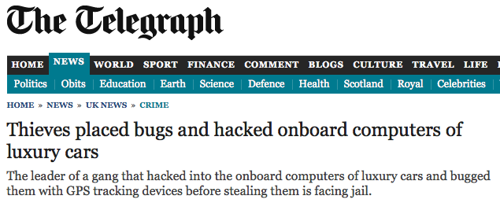
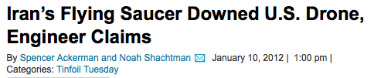

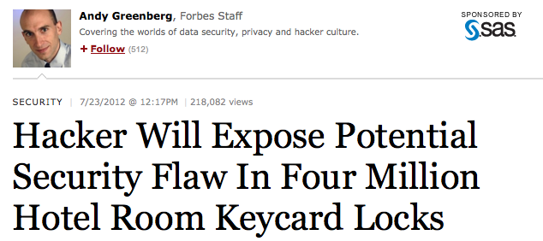
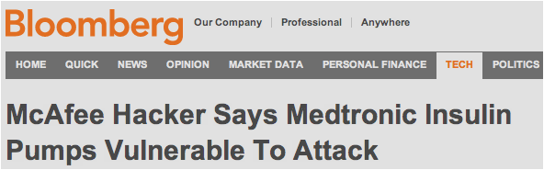
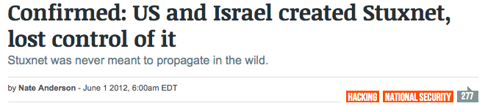

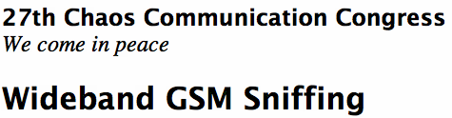
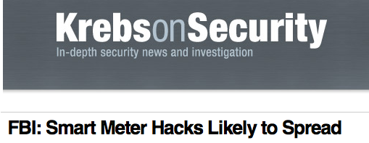
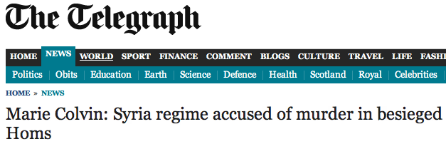

Slide 14
Security Engineering
Building a systems to remain dependable in the face of malice, error or mischance
System | Service | Attack Deny Service, Degrade QoS, Misuse | Security Prevent Attacks
Communication | Send message | Eavesdrop | Encryption
Web server | Serving web page | DoS | CDN?
Computer | ;-) | Botnet | Destroy
SMS | Send SMS | Shutdown Cellular Network | Rate Control, Channel separation
Pacemaker | Heartbeat Control | Remote programming and eavesdropping | Distance bounding?
Nike+iPod | Music + Pedometer | Tracking | Don’t use it?
Recommendation system | Collaborative filtering | Control rating using Ballot stuffing | ?

Slide 15
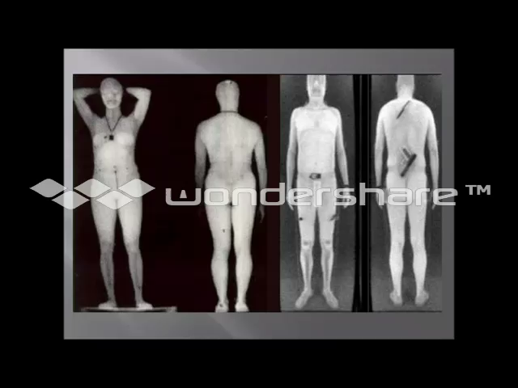
TSA Body Scanner

Slide 16
Design Hierarchy
What are we trying to do?
How?
With what?
Considerations
  Top-down vs. Bottom-up
  Iterative
  Convergence
  environment change
Policy
Protocols
Hardware, crypto, ...

Slide 17
Goals: Confidentiality
Confidentiality of information means that it is accessible only by authorized entities
  Contents, Existence, Availability, Origin, Destination, Ownership, Timing, etc… of:
  Memory, processing, files, packets, devices, fields, programs, instructions, strings...

Slide 18
Goals: Integrity
Integrity means that information can only be modified by authorized entities
  e.g. Contents, Existence, Availability, Origin, Destination, Ownership, Timing, etc… of:
  Memory, processing, files, packets, devices, fields, programs, instructions, strings...

Slide 19
Goals: Availability
Availability means that authorized entities can access a system or service.
A failure of availability is often called Denial of Service:
  Packet dropping
  Account freezing
  Jamming
  Queue filling

Slide 20
Goals: Accountability
Every action can be traced to “the responsible party.”
Example attacks:
  Microsoft cert
  Guest account
  Stepping stones

Slide 21
Goals: Dependability
A system can be relied on to correctly deliver service
Dependability failures:
  Therac-25: a radiation therapy machine
    whose patients were given massive overdoses (100 times) of radiation
    bad software design and development practices: impossible to test it in a clean automated way
  Ariane 5: expendable launch system
    the rocket self-destructing 37 seconds after launch because of a malfunction in the control software
    A data conversion from 64-bit floating point value to 16-bit signed integer value

Slide 22
Interacting Goals
Failures of one kind can lead to failures of another, e.g.:
  Integrity failure can cause Confidentiality failure
  Availability failure can cause integrity, confidentiality failure
  Etc…

Slide 23
Threat Model
What property do we want to ensure against what adversary?
Who is the adversary?
What is his goal?
What are his resources?
  e.g. Computational, Physical, Monetary…
What is his motive?
What attacks are out of scope?

Slide 24
Terminologies
Attack (Exploit): attempt to breach system security (DDoS)
Threat: a scenario that can harm a system (System unavailable)
Vulnerability: the “hole” that allows an attack to succeed (TCP)
Security goal: “claimed” objective; failure implies insecurity

Slide 25
Security Engineering
Building a systems to remain dependable in the face of malice, error or mischance
System | Service | Attack Deny Service, Degrade QoS, Misuse | Security Prevent Attacks
Communication | Send message | Eavesdrop | Encryption
Web server | Serving web page | DoS | CDN?
Computer | ;-) | Botnet | Destroy
SMS | Send SMS | Shutdown Cellular Network | Rate Control, Channel separation
Pacemaker | Heartbeat Control | Remote programming and eavesdropping | Distance bounding?
Nike+iPod | Music + Pedometer | Tracking | Don’t use it?
Recommendation system | Collaborative filtering | Control rating using Ballot stuffing | ?

Slide 26
Reading Report (Precise and Concise)
Target System
Target Service
Vulnerability
Exploitation (Attacks)
Evaluation
Defense
Future Work: 이 논문을 읽고 나서 다음 논문으로 쓸만한 주제
  이 논문이 제대로 평가를 못한 점
  다른 비슷한 시스템
  고려 안된 다른 취약점

Slide 27



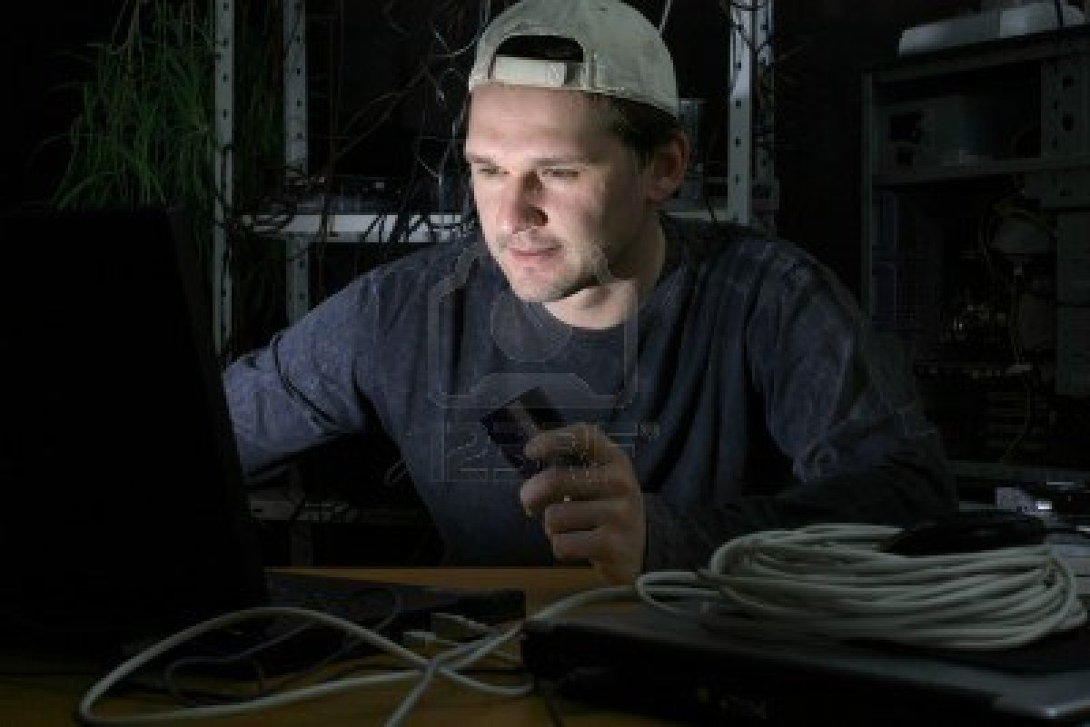



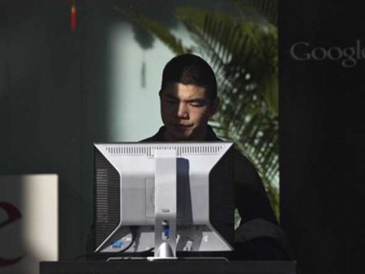
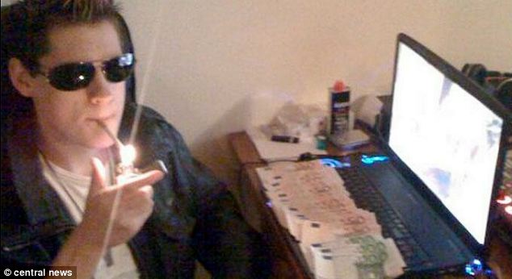
Who are the attackers?
No more script-kiddies
State-sponsored attackers
  Attacker = a nation!
Hacktivists
  Use of computers and computer networks as a means of protest to promote political ends
Hacker + Organized Criminal Group
  Money!
Researchers

Slide 28
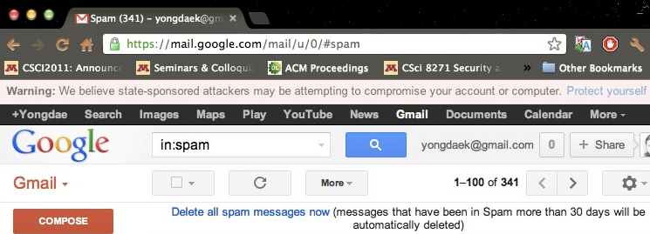
State-Sponsored Attackers
2012. 6: Google starts warning users who may be targets of government-sponsored hackers
2010 ~: Stuxnet, Duqu, Flame, Gauss, …
  Mikko (2011. 6): A Pandora’s Box We Will Regret Opening
2010 ~: Cyber Espionage from China
  Exxon, Shell, BP, Marathon Oil, ConocoPhillips, Baker Hughes
  Canada/France Commerce Department, EU parliament
  RSA Security Inc. SecurID
  Lockheed Martin, Northrop Grumman, Mitsubushi

Slide 29


Hacktivists
promoting expressive politics, free speech, human rights, and information ethics
Anonymous
  To protest against SOPA, DDoS against MPAA, RIAA, FBI, DoJ, Universal music
  Attack Church of Scientology
  Support Occupy Wall Street
LulzSec
  Hacking Sony Pictures (PSP jailbreaking)
  Hacking Pornography web sites
  DDoSing CIA web site (3 hour shutdown)

Slide 30
Security Researchers
They tried to save the world by introducing new attacks on systems
Examples
  Diebold AccuVote-TS Voting Machine
  APCO Project 25 Two-Way Radio System
  Kad Network
  GSM network
  Pacemakers and Implantable Cardiac Defibrillators
  Automobiles, …

Slide 31
Rules of Thumb
Be conservative: evaluate security under the best conditions for the adversary
A system is as secure as the weakest link.
It is best to plan for unknown attacks.

Slide 32
Security & Risk
The risk due to a set of attacks is the expected (or average) cost per unit of time.
One measure of risk is Annualized Loss
Expectancy, or ALE:
ALE of attack A
Σ
( p_{A}
×
L_{A} )
attack A
Annualized attack
incidence
Cost per attack

Slide 33
Risk Reduction
A defense mechanism may reduce the risk of a set of attacks by reducing L_{A} or p_{A}. This is the gross risk reduction (GRR):
The mechanism also has a cost. The net risk reduction (NRR) is GRR – cost.
Σ
(p_{A}
×
L_{A} – p’_{A}×L’_{A})
attack A

Slide 34
Bug Bounty Program
Evans (Google): “Seeing a fairly sustained drop-off for the Chromium”
McGeehan (Facebook): The bounty program has actually outperformed the consultants they hire.
Google: Patching serious or critical bugs within 60 days
Google, Facebook, Microsoft, Mozilla, Samsung, …

Slide 35
Nations as a Bug Buyer
ReVuln, Vupen, Netragard: Earning money by selling bugs
“All over the world, from South Africa to South Korea, business is booming in what hackers call zero days”
“No more free bugs.”
‘In order to best protect my country, I need to find vulnerabilities in other countries’
Examples
  Critical MS Windows bug: $150,000
  a zero-day in iOS system sold for $500,000
  Vupen charges $100,000/year for catalog and bug is sold separately
  Brokers get 15%.

Slide 36
Sony vs. Hackers
2000.8
Sony Exec
2005.10
Russinovich
2007.1
FTC
2011.1
Hotz
2011.4
Sony, Hotz
2011.4
PSN
do whatever to protect revenue
Sony
rootkit
Reimburse
<$150
PS3 Hack
settled
Hacked
2011. 3 $36.27 per share
2011. 6 $24.97 per share
2011.4
Sony
2011.4
Sony
2011.4
Sony
2011.4
Sony
2011.4
anon
2011.5
Sony Exec
½ day to
recover
Don’t know if PI leaked
Credit card encrypted
Share down by 4.5%
2.2M Credit Card on-line
Apologized
2011.5
SOE
2011.5
Sony
2011.6
Sony
2012.3
Anon
Hacked
Outage cost
$171M
Fired security staff
Posted Unreleased Michael Jackson video
Notes:
I did not support hackers’ actions.

Slide 37
Patco Construction vs. Ocean Bank
Hacker stole ~$600K from Patco through Zeus
The transfer alarmed the bank, but ignored
“commercially unreasonable”
  Out-of-Band Authentication
  User-Selected Picture
  Tokens
  Monitoring of Risk-Scoring Reports

Slide 38
Auction vs. Customers
Auction의 잘못
  개인정보 미암호화
  해킹이 2일에 걸쳐 일어났으나 몰랐던점
  패스워드
    이노믹스 서버 관리자 ‘auction62’, 데이터베이스 서버 ‘auctionuser’, ‘auction’
  서버에서 악성코드와 트로이목마 발견
무죄
  해커의 기술이 신기술이었다, 상당히 조직적이었다.
  옥션은 서버가 많아서 일일이 즉각 대응하기는 어려웠다,
  당시 백신 프로그램이 없었거나, 오작동 우려가 있었다.
  소기업이 아닌 옥션으로서는 사용하기 어려운 방법이었다.
  과도한 트래픽이 발생한다.

Slide 39
법이 강해서 오히려 정보보안이 약화되는 딜레마
강력한
형법
제한적
보안 투자
취약점
양산
보안사고
보안 산업의 약화

Slide 40
Basic Cryptography

Slide 41

The Main Players
Eve
Yves?
Bob
Alice

Slide 42
Attacks
Normal Flow
Source
Destination
Interruption: Availability
Interception: Confidentiality
Source
Destination
Source
Destination
Modification: Integrity
Fabrication: Authenticity
Source
Destination
Source
Destination

Slide 43
Taxonomy of Attacks
Passive attacks
  Eavesdropping
  Traffic analysis
Active attacks
  Masquerade
  Replay
  Modification of message content
  Denial of service

Slide 44
Encryption
Adversary
Encryption
E_{e}(m) = c
c
insecure channel
Decryption
D_{d}(c) = m
m
m
Plaintext source
destination
Alice
Bob
Why do we use key?
  Or why not use just a shared encryption function?

Slide 45
SKE with Secure channel
Adversary
Key source
d Secure channel
e
Encryption
E_{e}(m) = c
c
Insecure channel
Decryption
D_{d}(c) = m
m
m
Plaintext source
destination
Alice
Bob

Slide 46
PKE with Insecure Channel
Passive
Adversary
e Insecure channel
Key source
d
Encryption
E_{e}(m) = c
c
Insecure channel
Decryption
D_{d}(c) = m
m
m
Plaintext source
destination
Alice
Bob

Slide 47
Public Key should be authentic!
e’
e
E_{e}(m)
E_{e’}(m)
e
E_{e}(m)

Slide 48
Hash Function
A hash function is a function h satisfying
  h:{0, 1}* ➔ {0, 1}^{k} (Compression)
A cryptographic hash function is a hash function satisfying
  It is easy to compute y=h(x) (ease of computation)
  For a given y, it is hard to find x’ such that h(x’)=y. (onewayness)
  It is hard to find x and x’ such that h(x)=h(x’) (collision resistance)
Examples: SHA-1, MD-5

Slide 49
Questions?
Yongdae Kim
  email: yongdaek@kaist.ac.kr
  Home: http://syssec.kaist.ac.kr/~yongdaek
  Facebook: https://www.facebook.com/y0ngdaek
  Twitter: https://twitter.com/yongdaek
  Google “Yongdae Kim”

