Slide 1
The Limitations of Deep Learning in Adversarial Settings
Nicolas Papernot, Patrick McDaniel, Somesh Jha, Matt Fredrikson, Z. Berkay Celik, Ananthram Swami
Accepted to the 1st IEEE European Symposium on Security & Privacy, IEEE 2016. Saarbrucken, Germany.
Presented by YOUNGMIN CHOI, EE515 2019 Fall

Slide 2
Introduction
Notes:
딥 뉴럴 네트워크가 발달하면서 딥러닝은 수많은 데이터셋의 학습을 통해 기존의 classification의 정확도를

Slide 3

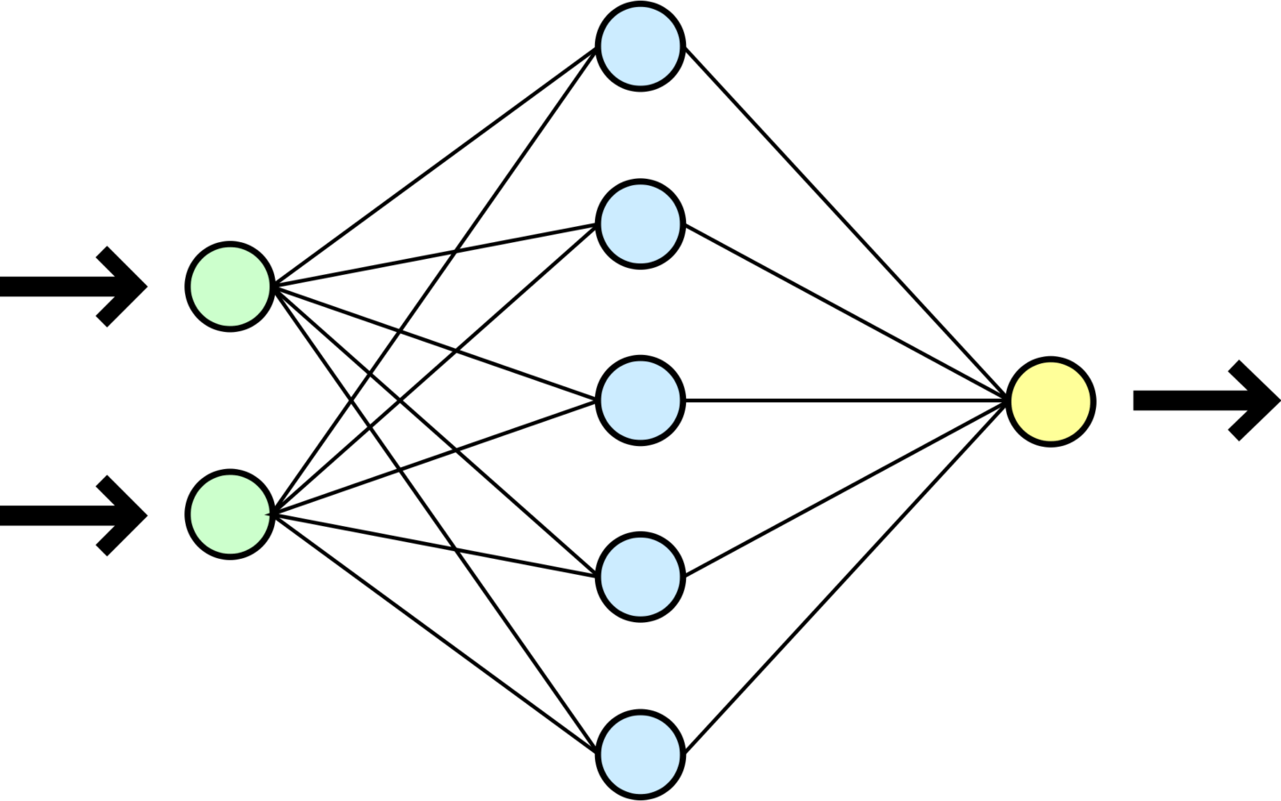
Introduction
DNNs achieved high accuracy on image classification tasks
  ResNet achieved 96.43% accuracy on ImageNet test set.
New threats appear in DL area
  Ex) DL to identify traffic signs
Misclassify!!
‘Go’ Sign

Slide 4
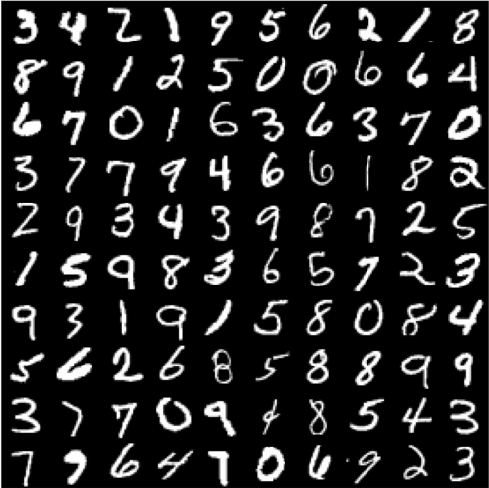
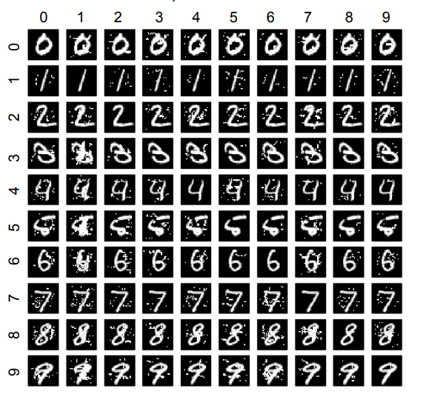
Introduction
An adversarial sample is an input crafted to cause DNNs to misclassify.
This paper proposed a new algorithm to craft an adversarial sample against DNNs
Misclassification
perturb
Original MNIST dataset
Adversarial Sample

Slide 5
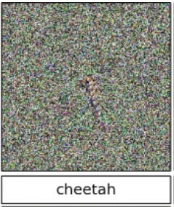
Previous Works
“Deep neural networks are easily fooled: High confidence predictions for unrecognizable images”, Nguyen et al., CVPR’15
  Compute gradients to update input, not weight
“Explaining and harnessing adversarial examples”, Ian J. Goodfellow et al., ICLR’ 15
  Explain the reason why adversarial attacks work

Slide 6
Background

Slide 7
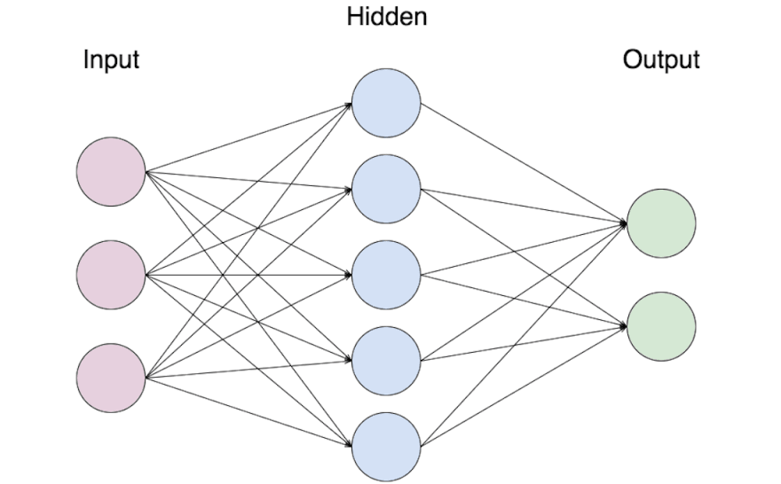
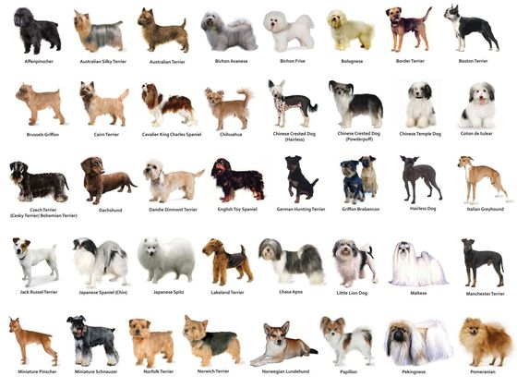
What is Deep Learning?
Training the networks
Training dataset
Notes:
딥러닝은

Slide 8
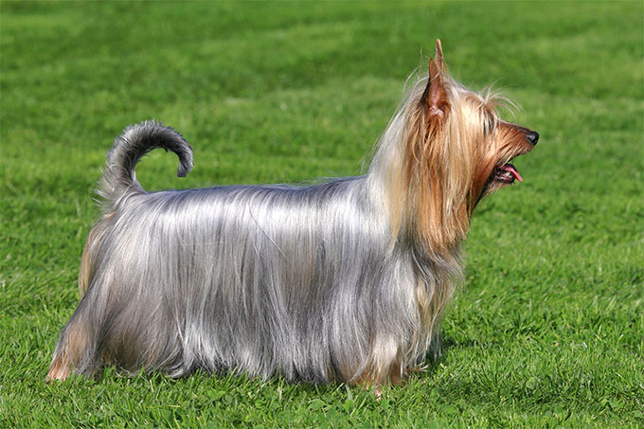
What is Deep Learning?
Inference process
Test dataset
“ Silky Terrier ”
Notes:
딥러닝은

Slide 9
Training vs Inference
Training
  Training data, labels
  Feedforward and backpropagation
  Updating parameters
Inference
Test data
Feedforward
No updates of parameters
This paper Attacks on inference time

Slide 10
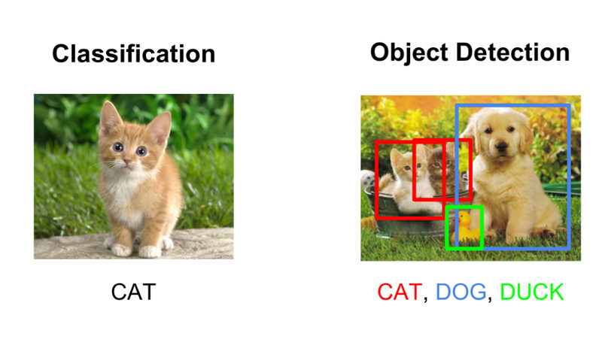
Computer Vision
Notes:
딥러닝은 컴퓨터 비전

Slide 11
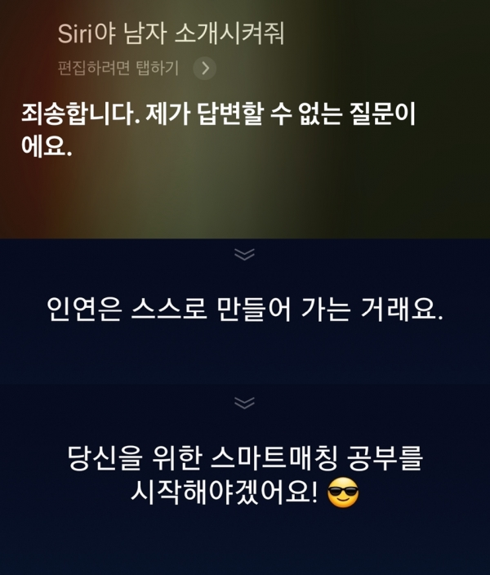
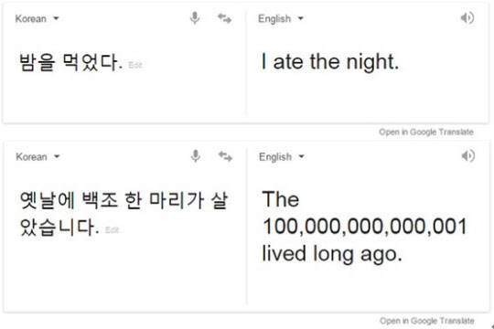
Natural Language Processing
< Speech Recognition >
< Machine Translation >

Slide 12
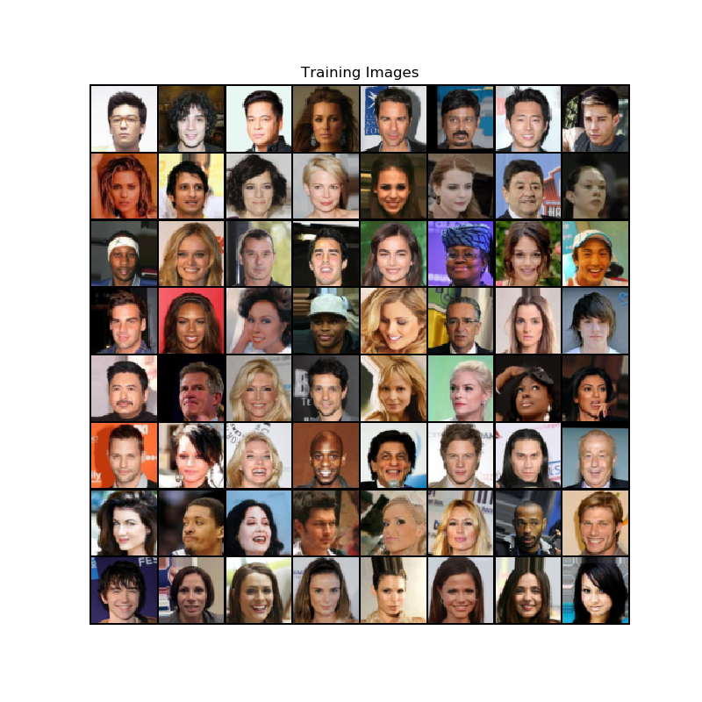
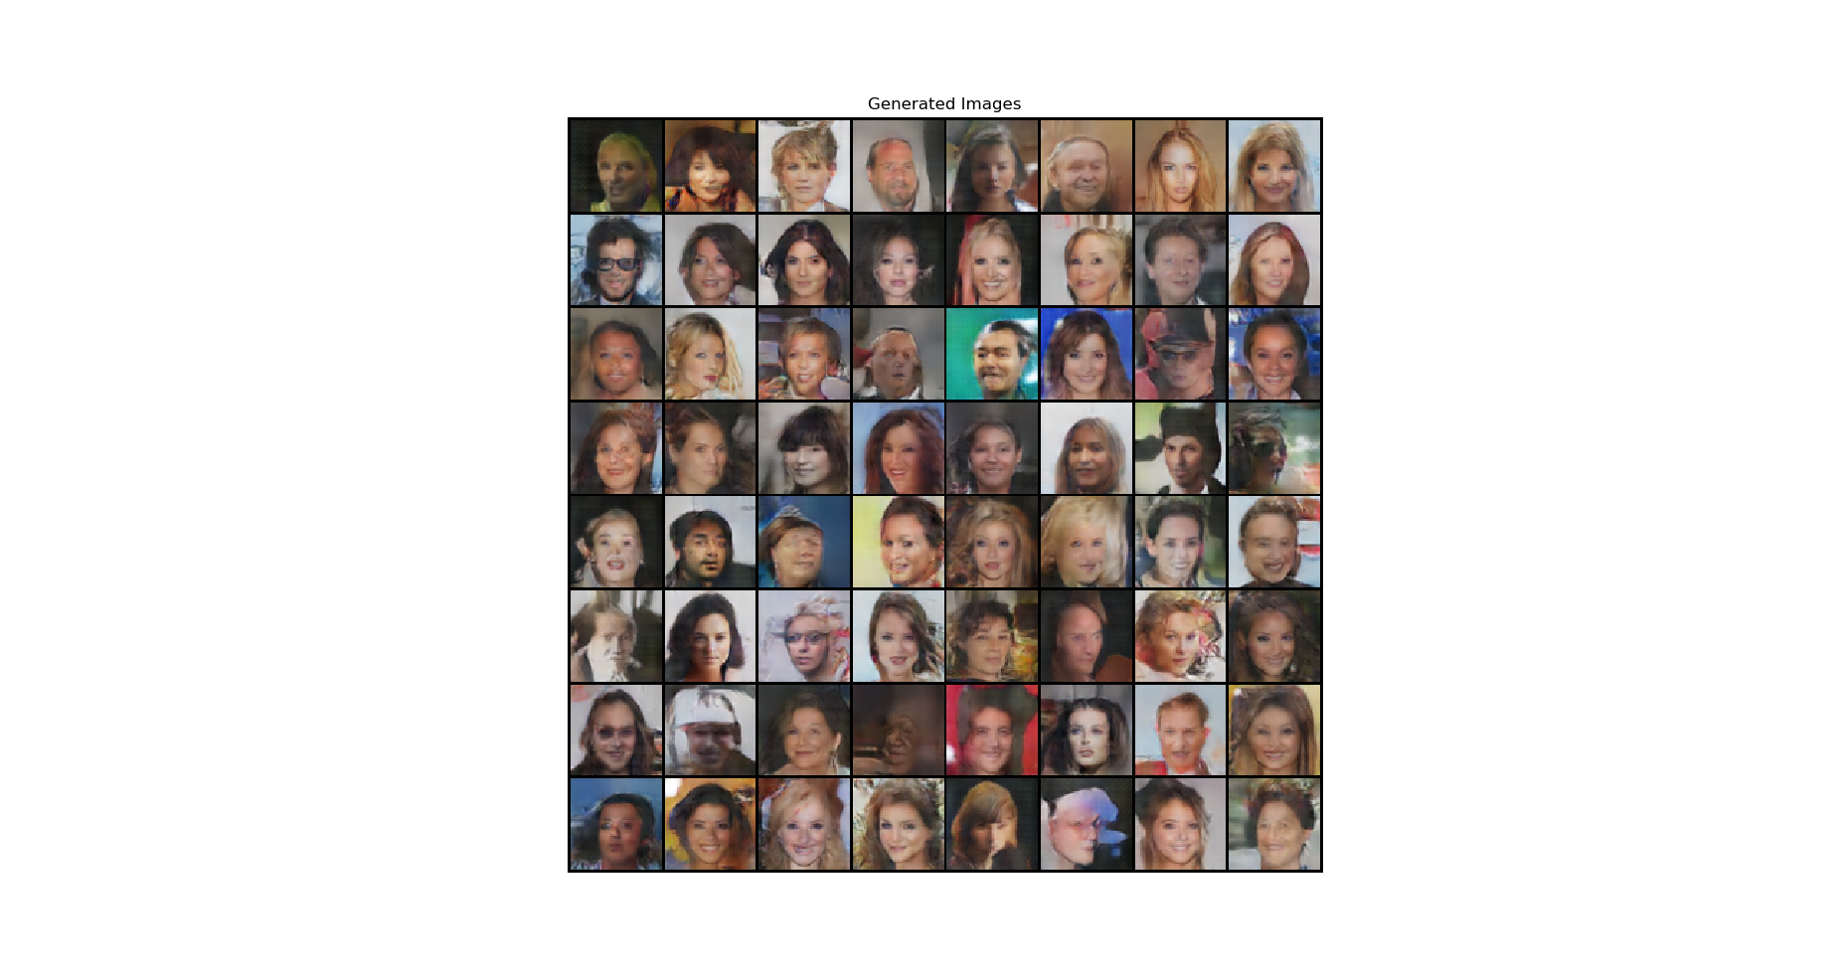
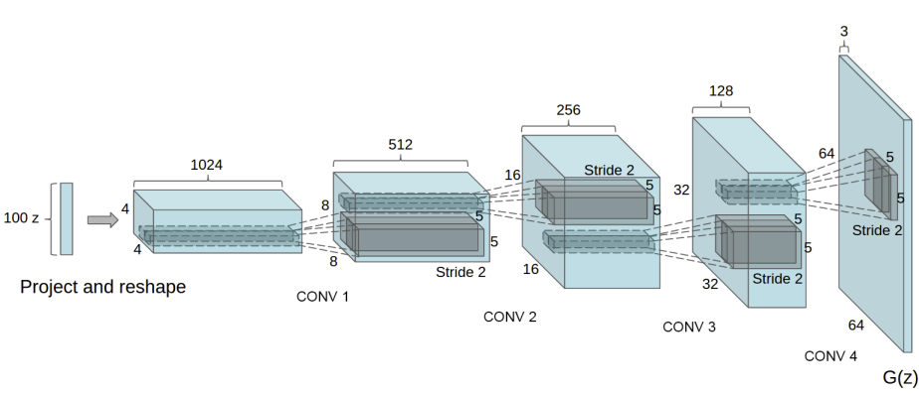
GAN (Unsupervised Learning)
Training Images
Generated Images

Slide 13
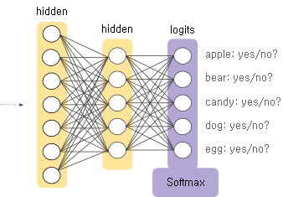
Soft-max Function
One of activation functions
Fully connected last layer
Sum of outputs = 1
It can be interpreted as probability

Slide 14
Threat Model

Slide 15
Adversarial Goals
1) Confidence reduction
2) Misclassification
3) Targeted misclassification
4) Source/target misclassification

Slide 16
Adversarial Capabilities
Adversary has knowledge of network architecture and its parameter values.
  The layers and activation functions
  Weights and biases after training phase
It is possible to simulate the network with this information

Slide 17
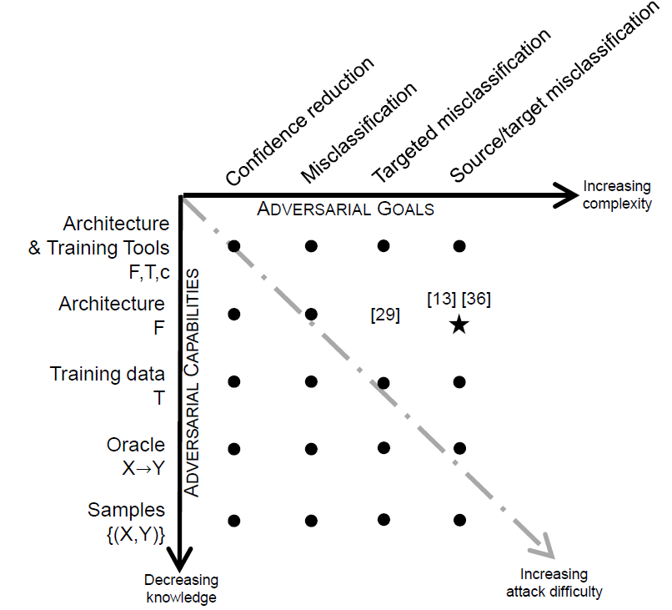
Threat Model Taxonomy
Only know the network architecture (layers, activations, trained weights, biases, etc)
Source class → target class Ex) 2 → 8

Slide 18
Approach

Slide 19

Approach
Main idea: find small perturbations of the input that change the output.
$F\left(X\right)=Y$
$X^{∗}=x+δx$
$F{(X}^{∗})=Y^{∗}$
Original input
Original output
Add perturbation
Adversarial input
target output

Slide 20
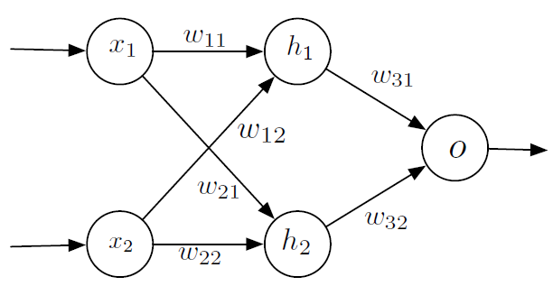
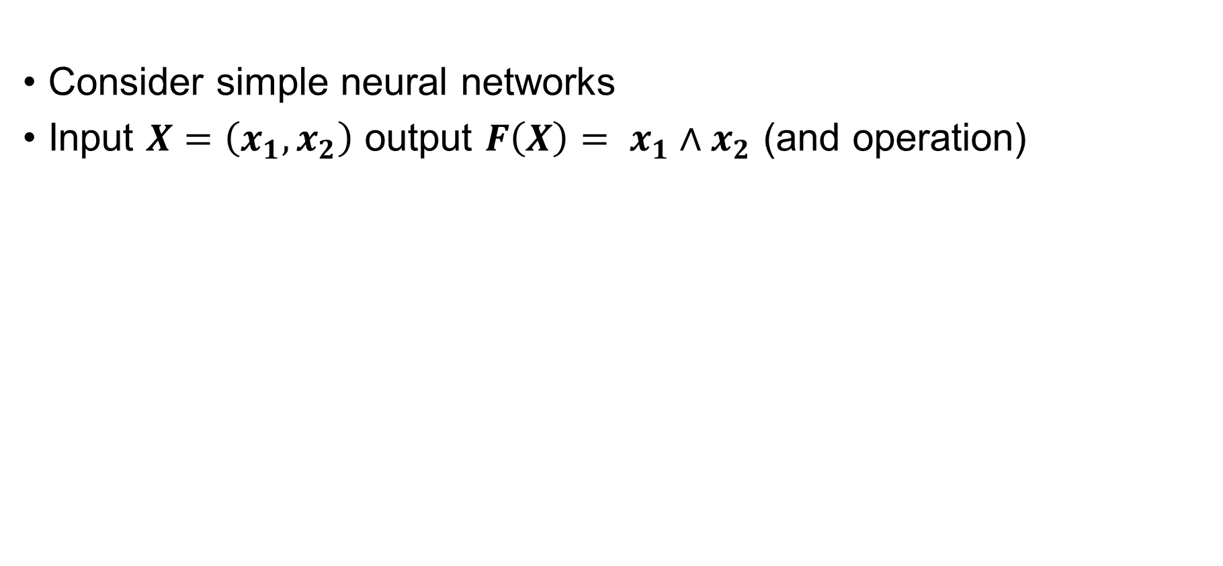
How to craft adversarial samples?
Consider simple neural networks
Input $X=\left(x_{1},x_{2}\right)$ output $F\left(X\right)= x_{1}∧x_{2}$ (and operation)

Slide 21
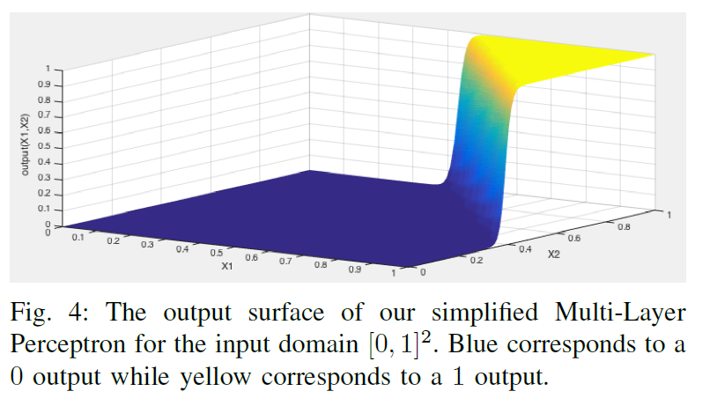
How to craft adversarial samples?
After training 100 epochs

Slide 22
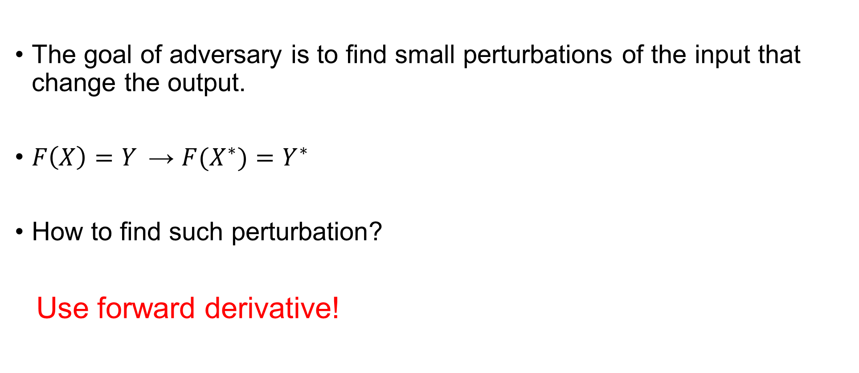
How to craft adversarial samples?
The goal of adversary is to find small perturbations of the input that change the output.
$F\left(X\right)=Y$ → $F{(X}^{∗})=Y^{∗}$
How to find such perturbation?
Use forward derivative!

Slide 23
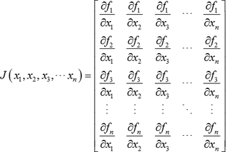
How to craft adversarial samples?
“Forward derivative” is defined as the Jacobian matrix of function.

Slide 24

How to craft adversarial samples?
In this example
$∇F\left(X\right)=[\frac{∂F\left(X\right)}{∂x_{1}},\frac{∂F(X)}{∂x_{2}}]$

Slide 25
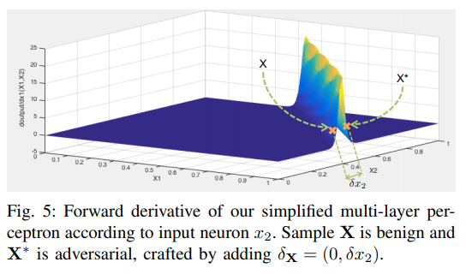

How to craft adversarial samples?
$X=\left(1, 0.37\right)$
$X^{∗}=\left(1, 0.43\right)$
$F\left(X\right)=0.11$
${F(X}^{∗})=0.95$

Slide 26
How to craft adversarial samples?
Small input variations can lead to extreme variations of the output.
Not all regions of input domain are conducive to find adversarial samples.
The forward derivative reduces the adversarial-sample search space.

Slide 27

Steps for crafting adversarial samples
1) Compute the forward derivative $∇F{(X}^{∗})$
2) Construct a saliency map S based on the derivative
3) Modify an input feature

Slide 28

How to compute forward derivative?
We can compute derivatives using gradients as doing in back-propagation.
Take the derivative of the network, rather than on cost function.
Propagate gradients forward to find input that changes outputs a lot.

Slide 29

Adversarial Saliency Maps
Saliency maps indicate which input features should the adversary perturb.
Increase the probability of target class decrease the probability of other classes
Notes:
Saliency map은 input feature 중에서 어떤 것을 변화시켜야 네트워크의 아웃풋을 원하는 대로 변화시킬 수 있는 지를 나타낸다. Forward derivative를 이용해서 adversary는 target class의 확률 (F)를 높이고 다른 클래스들의 확률(F)를 낮춰야 한다. 따라서, saliency map은 target class의 derivative가 0보다 작거나 , 다른 클래스들의 derivative의 합이 0보다 크면 그 input feature를 reject해야 한다는 것을 나타낸다.

Slide 30
Steps for crafting adversarial samples
1) Compute the forward derivative $∇F{(X}^{∗})$
2) Construct a saliency map S based on the derivative
3) Modify an input feature
Notes:
즉, forward derivative를 계산하고
계산한 forward derivative를 통해 saliency map을 계산해서 어떤 input feature가 target class의 확률을 높일 수 있는지 알아내서 해당하는 input feature의 값을 변화시켜서 adversarial sample을 만들 수 있다.

Slide 31
Evaluation
Notes:
Paper에서는 제안한 알고리즘을 통해 실제로 adversarial sample을 만들어서 여러 가지 실험을 진행했습니다.

Slide 32
Goals of Experiment
(1) Can we exploit any sample?
(2) How can we identify samples more vulnerable than others?
(3) How do humans perceive adversarial samples compared to DNNs?
Notes:
실험을 통해서 알고자 했던 것들은 다음과 같습니다.

Slide 33
Crafting Adversarial Samples
30,000 samples from MNIST dataset
9 adversarial samples were generated for each sample.
Total 270,000 adversarial samples

Slide 34
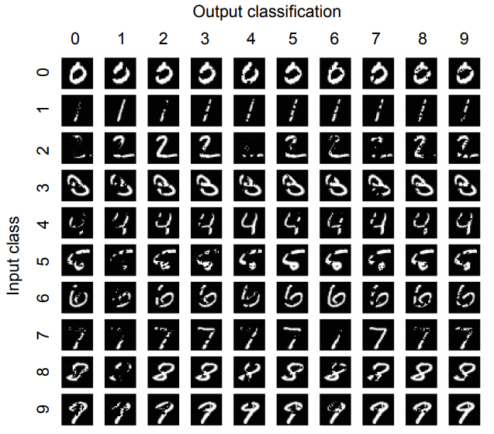
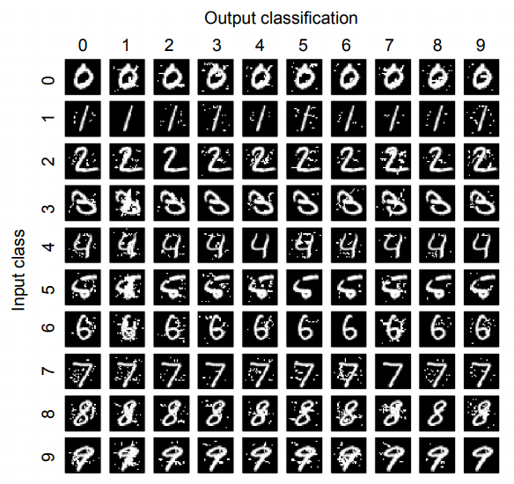
Crafting Adversarial Samples
Decreasing pixel intensity
Increasing pixel intensity

Slide 35
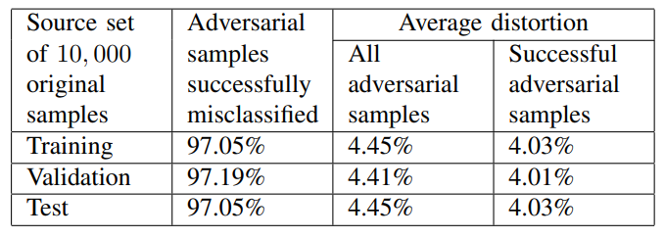
Results on Larger Datasets
Average success rate = 97.10%
Average distortion of successful samples = 4.44%

Slide 36
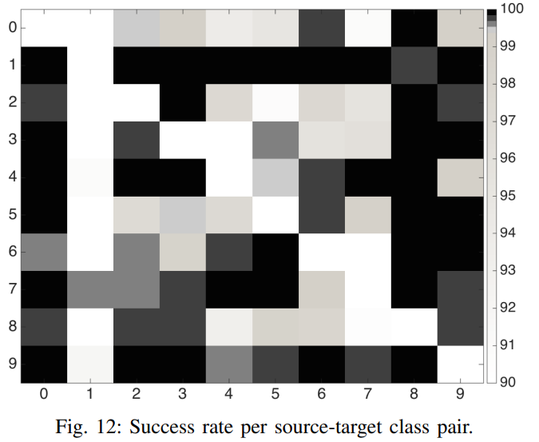
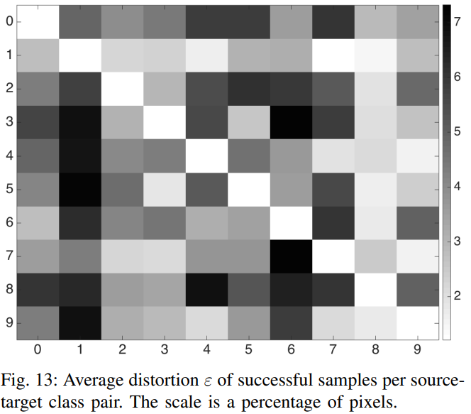
Class Pair Study
0, 8 : Easy to succeed
0, 8 : small distortion

Slide 37
Class Pair Study
1 : Hard to succeed
1 : huge distortion

Slide 38
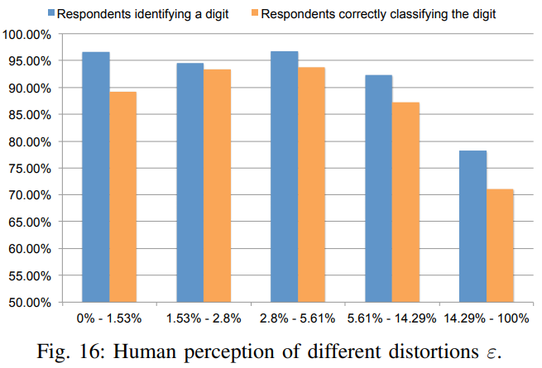
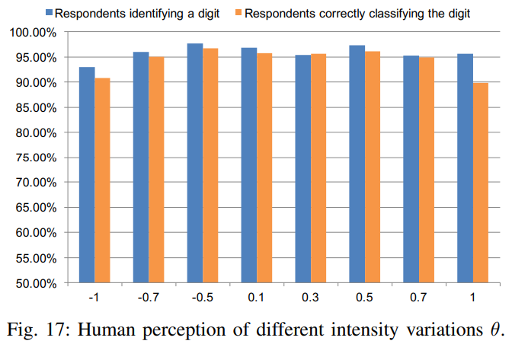
Human Perception Study
Ask ‘is that sample a numeric digit’?, ‘What digit is it?’

Slide 39
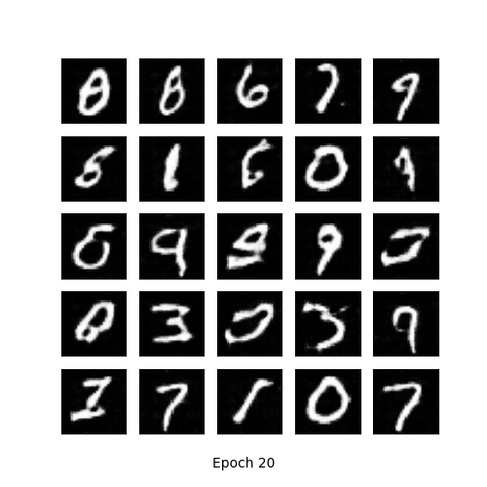
Defenses
1) Adversarial sample detection
  The sum of squared difference between each pair of neighboring pixels is always higher for adversarial samples.
2) Improvements of DNN robustness
  Generate adversarial samples using GAN
  Train models with adversarial samples
Adversarial samples generated using DCGAN

Slide 40
Related Works
NIPS 2017 Defense against adversarial attack
“Practical Black-Box Attacks against Machine Learning” Nicolas paper not et al., 2017
  Shows the black-box attacks resulting from ‘transferability’ between architectures

Slide 41
Conclusion
This paper introduces a new algorithm to craft adversarial samples based on forward derivatives.
This algorithm can generate adversarial samples correctly classified by human but misclassified in specific targets by a DNN with a 97% success rate while modifying only 4.02% of input features.

Slide 42
Thank you

