Slide 1
On the Feasibility of Side-Channel Attacks with Brain-Computer Interfaces
Ivan Martinovic, Doug Davies, Mario Frank, Daniele Perito, Tomas Ros, Dawn Song
Presenter: Hwijoon Lim

Slide 2
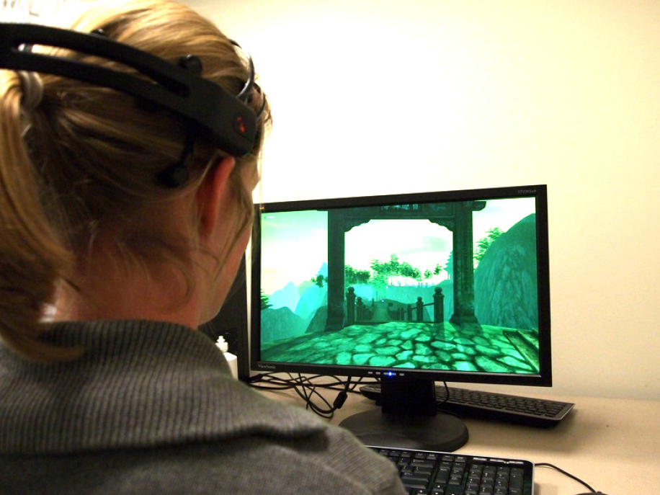
Brain-Computer Interfaces (BCIs)
BCIs enable a non-muscular communication between a user and an external device

Slide 3
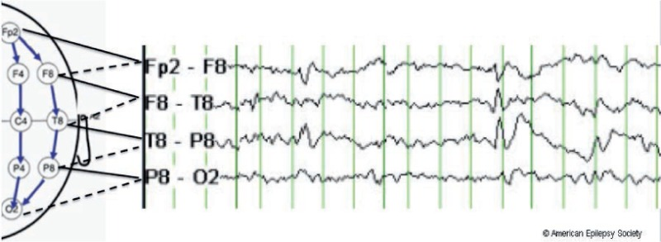
Electroencephalography (EEG)
Non-invasive method
The EEG signal is recorded from scalp electrodes and continuously sampled (typically 128Hz – 512Hz)

Slide 4
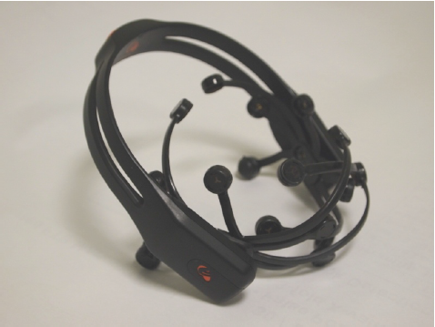
BCI devices
Consumer-grade BCI devices
Low-cost EEG-based gaming devices are offered by Emotiv Systems and NeuroSky
An EPOC device (Emotiv Systems)
A MindSet device (NeuroSky)

Slide 5
BCI devices
Consumer-grade BCI devices
Software development kits to support the expansion of tools and games
Such as a mind-controlled keyboard and mouse and hands-free arcade games
How third-party EEG applications could infer private information about the user?

Slide 6
Event-Related Potential (ERP)
An ERP is detected as a pattern of voltage change after a certain auditory or visual stimulus is presented
Every ERP is time-locked to the stimulus
The most prominent ERP component is the P300

Slide 7
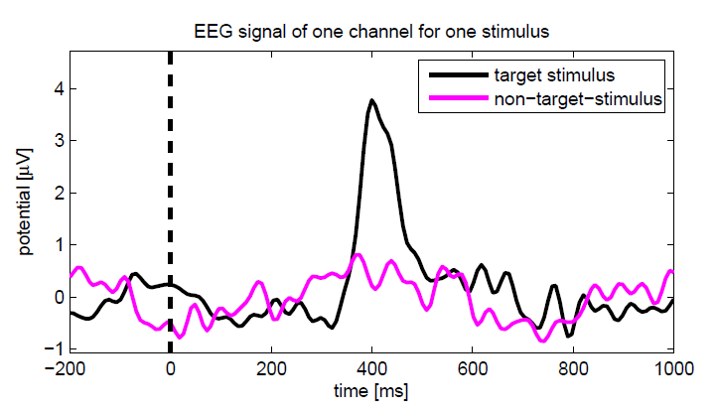
P300
P300 can be detected as an amplitude peak in the EEG signal at about 300ms after the stimulus

Slide 8
Related Works
EEG-based identification (Poulos et al., 1999)
It achieved a high true positive rate and a high true negative rate
EEG-based authentication (Marcel et al, 2007)
Instead of typing a password, it requires the user to think of password
Key generation technique resistant against coercion attacks (Gupta et al, 2010)
Incorporate the user’s emotional status through skin conductance measurements
Assisting a user in efficient search (Van Vliet et al, 2010)
An ERP called N400
Guilty-Knowledge Test (Abootalebi et al, 2009)
Use P300 in lie detection

Slide 9
BCI Application
BCI devices have “App Stores” like an application stores for smart phones
The applications are developed by third parties
Provide unrestricted access to the raw EEG signal
Applications can control the contents for users

Slide 10
Threat Model
The attacker is a malicious third-party developer
His goal is to learn as much information as possible about the user without any malware
The attacker can read the EEG signal from the device and can display text, videos and images on the screen

Slide 11
Experiment
Each experiment consisted of three main steps:
(optional) Brief verbal explanation of the task by the operator
(optional) Message on screen for 2 seconds
Images being flashed in random order for the duration of the experiment
Total 5 Experiments

Slide 12
Experiment 1
Pin Code
Choose and memorize random PIN!
Enter the first digit of PIN at the end of the experiment

Slide 13
Experiment 2
Bank Information
Just show the logo of different banks

Slide 14
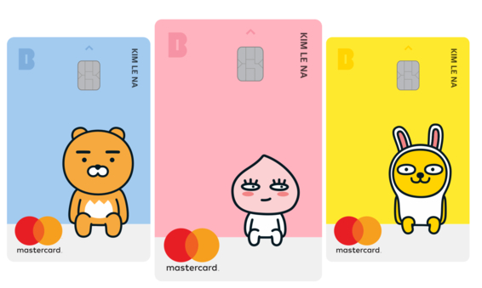
Experiment 2
Bank Information
Show the images of the debit card

Slide 15
Experiment 3
Month of Birth
On-screen message: Which month were you born?
Flashing the name of the months randomly
Feburary
December
March
April
November
June
May

Slide 16
Experiment 4
Face Recognition
On-screen message: Do you know any of these people?

Slide 17
Experiment 5
Geographic Location
Show highlighted maps with different highlighted zone

Slide 18
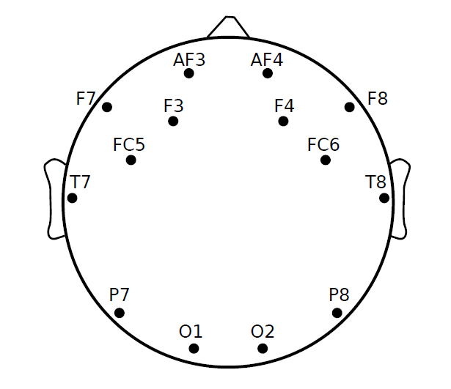
Data Collection
The amplitudes of the EEG signal are recoded with 14 different electrodes
The gaming device is not made for detecting P300
The P300 is mostly detected at the parietal lobe
But, they have more electrodes on the frontal part of the scalp

Slide 19
Data Collection
Each channel is recorded at a sampling rate of 128Hz
After showing stimuli to the user, output the time stamp and the indicator of each stimulus
Obtain the tuple of (EEG signal, the stimuli)

Slide 20
Data Collection – Challenges
The attack vector exploits the occurrence of P300 peaks
The attack vector must …
detect P300 peaks reliably
discriminate peaks from all other EEG signals measured on non-target stimuli
The user do not intend to provide a discriminative signal for the target stimuli
→ Train classifier to detect P300 peaks and corresponding stimuli!

Slide 21
Classification of Target Stimuli
Input : EEG data (called epochs) associated with a stimulus
Each EEG data starts a few milliseconds prior to the stimulus
Each EEG data ends 800ms - 1500ms after the stimulus
The classification task = Training phase + Classification phase
( , )
( , )

Slide 22
Training Phase
Train how to tell if input epoch is generated is target stimulus
Input
A set of epochs ${x∈X}^{train}$
A vector of label $y∈Y$
Output
A function $g$ that maps epochs to target stimuli labels:
$g\left(x\right)=y$

Slide 23
Classification Phase
Use model from training phase to obtain stimulus from given epoch
Input
A set of new epochs $x^{test}∈X^{test}$
Output
A set of estimation $\{\hat{y}=g\left(x^{test}\right)\}$

Slide 24
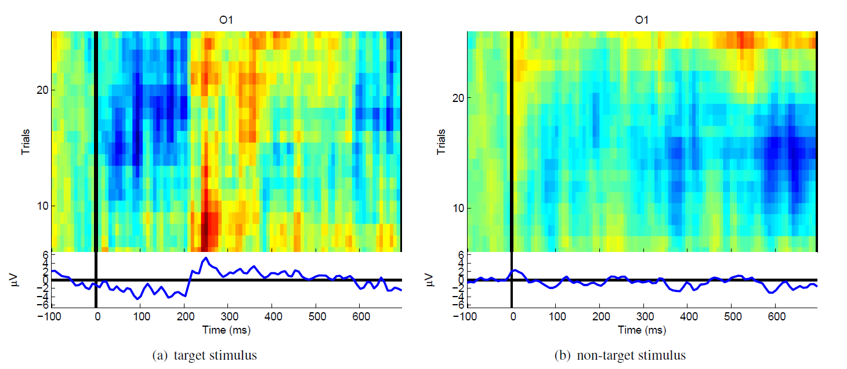
Classification phase
For stimulus $k$, $N_{k}^{(+)}$ is the sum of $y$’s that are associated with stimulus $k$

Slide 25
The Classifier Function
Boosted logistic regression (bLogReg)
The model is trained on the training data by minimizing the negative Bernoulli log-likelihood of the model
Stepwise Linear Discriminant Analysis (SWLDA)
Extension of Fisher’s linear discriminant analysis (LDA)
More robust to noise

Slide 26
Two Training Situation
User-supported calibration
Actively support the training phase
Do not support the detection with new stimuli
On-the fly calibration
Do not support the training phase
Do not support the detection with new stimuli

Slide 27
Result

Slide 28
Result

Slide 29
Defense
Users of the BCI devices could actively try to hinder probing
Concentrate on non-target stimuli
Not realistic
Do not expose the raw data from EEG devices to third-party applications
The EEG vendor would create a restricted API
Add noise to the EEG raw data
It could decrease accuracy of legitimate applications

Slide 30
Future works
“Hacking the brain: brain–computer interfacing technology and the ethics of neurosecurity” (Marcello et al, 2016)
Research on “Brain-hacking”
“Side-Channel Attacks Against the Human Brain: the PIN Code Case Study” (Lange et al, 2017)
Extract concrete PIN codes from EEG signals
“Detection of Subconscious Face Recognition Using Consumer-Grade Brain-Computer Interfaces” (Martin et al, 2016)
Study subconscious face recognition

