Slide 1
Lest We Remember: Cold-Boot
Attacks on Encryption Keys
By J. Alex Halderman, Seth D. Schoen, Nadia Heninger, William Clarkson, William Paul,
Joseph A. Calandrino, Ariel J. Feldman, Jacob Appelbaum, and Edward W. Felten
(USENIX Security 2008, Awarded Best Student Paper)
Presented By Hyunjin Choo
Notes:
Good afternoon.
My name is Hyunjin Choo and I am going to talk about the paper “Lest We Remember: Cold-Boot Attacks on Encryption Keys” by Halderman and 8 other people.
This paper was published in USENIX security 2008, ten-years-ago from now, and awarded best student paper then.
Before I get started, I have one question. Have you heard about “Cold-Boot Attack”?
“Cold-Boot Attack” is quite an old and simple, but most computers including ours are still vulnerable to this attack.

Slide 2
Contents
1 | Introduction
2 | Vulnerability
3 | Tools and Attacks
4 | Key Reconstruction & Identification
5 | Attacking Encrypted Disks
6 | Countermeasures
7 | Related Works & Conclusion
Notes:
Here are the contents of my presentation.
First, I will introduce briefly this paper.
Next, I will explain vulnerability and attacks.
Finally, I will talk about countermeasures, related works, and conclusion.

Slide 3
Contents
1 | Introduction
2 | Vulnerability
3 | Tools and Attacks
4 | Key Reconstruction & Identification
5 | Attacking Encrypted Disks
6 | Countermeasures
7 | Related Works & Conclusion
Notes:
Let’s start with introduction.

Slide 4
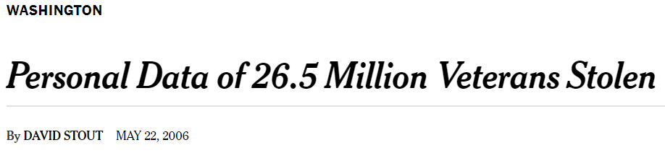
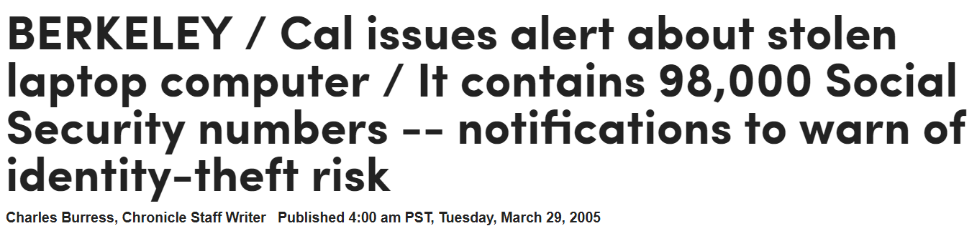
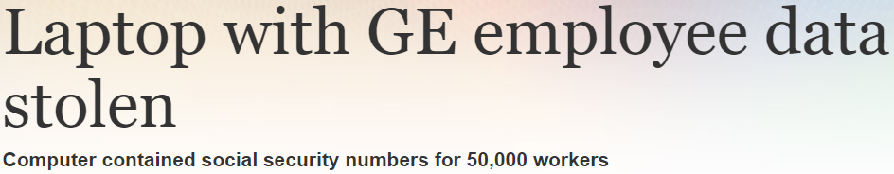
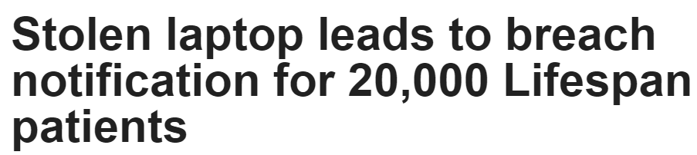

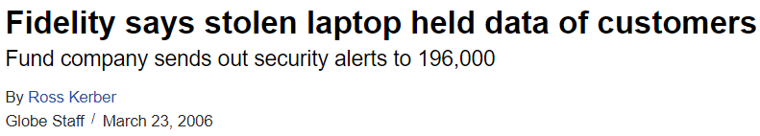
Stolen Laptops
Notes:
Here are some headlines about stolen laptops.
As you can see, these laptops contained very important information such as Social Security numbers and bank account.

Slide 5



How Safe is a Stolen Laptop?
Screen
HDD
Protection
Unlocked
Unencrypted
No protection
Locked
Unencrypted
Minimal protection
Locked
Encrypted
Thought to be safe
Notes:
So, can you imagine how safe is your laptop if someone steals it?
If unlocked, there is no hope of protection.
If the screen is locked, it’s not enough because the hard disk is removable.
If both screen is locked and hard disk is encrypted, it can be thought to be safe.
[next] However, is disk encryption really enough to protect them?
[next] This paper suggests not.

Slide 6
Disk Encryption
Protects access to data
Allows read/write access while protecting via encryption
Scrambles the contents, unreadable without an encryption key
Encryption key needs to be kept available
  Stored in RAM until the disk is unmounted
BitLocker (Windows) / FileVault (Mac OS) / LoopAES (Linux)
dm-crypt (Linux) / TrueCrypt (Win/Mac OS/Linux)
Notes:
Disk encryption is used to protect against data theft.
It allows transparent read/write access to the hard drive while protecting the information via encryption.
Disk encryption scrambles the contents of the hard drive and makes them unreadable without an encryption key, which is typically protected with a user password.
The key needs to be kept available so that programs can access the disk; most key is stored in RAM until the disk is unmounted.
Windows, Mac OS, and Linux all provide disk encryption features.

Slide 7


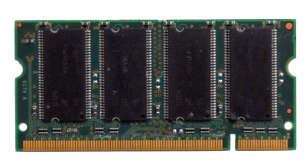
Disk Encryption (cont’d)
Password:
********
File System
Disk Encryption
Memory is not erased without power
Exploit this to recover keys in memory
Defeat popular disk encryption systems
Disk Drivers
Notes:
I will explain disk encryption progress with some pictures.
Disk Encryption [next]
operates between file system and disk. It encrypts data as written, decrypts as read. Accessing the disk requires a key [next]
Usually derived from a user password. Key needs to be kept in RAM [next] for as long as disk is mounted
So, let’s assume that the attacker steals a screen-locked laptop with an encrypted disk.
Then he cannot access the disk through the OS because of the screen lock. [next]
If he reboots to bypass screen lock, memory and the key inside will be erased because DRAM is known to be volatile, so he cannot access the disk. [next]
However, this paper shows that memory is not always erased immediately without power.
So the attacker can exploit this effect to recover keys in memory and defeat disk encryption systems.

Slide 8
Contents
1 | Introduction
2 | Vulnerability
3 | Tools and Attacks
4 | Key Reconstruction & Identification
5 | Attacking Encrypted Disks
6 | Countermeasures
7 | Related Works & Conclusion
Notes:
Let’s move on to the vulnerability part.

Slide 9

DRAM Remanence
DRAM Cell
(Capacitor)
0
1
1
0
Write “1”
If it loses power?
Refresh (Read and rewrite)
Refresh Interval ≈ few ms
Data fades almost instantaneously
Any residual data is difficult to recover
Notes:
Now, DRAM is used as the main memory of most modern computers
DRAM is a type of random access memory that stores each bit of data in a capacitor. [next]
The capacitor can either be charged or discharged; The two values of a bit, 1 and 0, represent these two states. [next]
Over time, the electric charge on the capacitors slowly leaks off, so the data would soon be lost, or, more precisely, it will decay to its ground state. [next]
To prevent this decay, DRAM requires a refresh within a few milliseconds, meaning that the capacitor must be recharged to hold its value. [next]
Then what will be happened if it loses power? [next]
DRAM is known to be erased immediately, or difficult to restore data [next]
However, DRAM loses its contents gradually over an enough time for an attack.
This phenomenon is called “remanence” and let’s see the video clip for better understanding.

Slide 10
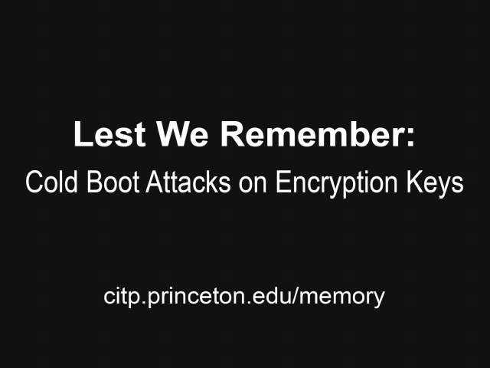
DRAM Remanence (cont’d)
Notes:
The authors loaded a bitmap image of “Mona Lisa” into memory and read it back after cutting power for varying periods of time.
The chips remained close to the room temperature.
As you can see in the video, data on memory doesn’t get wiped out immediately and it loses its contents gradually over a period of seconds.
An attacker can exploit this remanence to launch a “Cold-Boot Attack”.

Slide 11
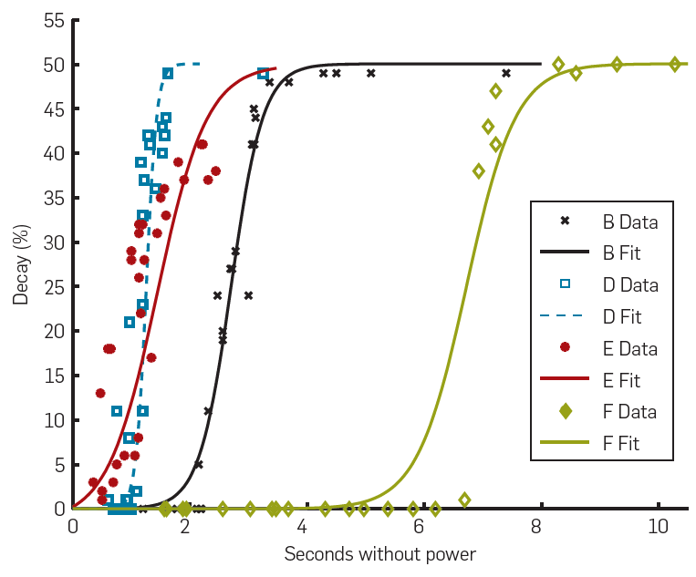
Measuring Decay
 | Density | Type | System | Year
A | 128MB | SDRAM | Dell Dimension 4100 | 1999
B | 512MB | DDR | Toshiba Portégé R100 | 2001
C | 256MB | DDR | Dell Inspiron 5100 | 2003
D | 512MB | DDR2 | IBM Thinkpad T43p | 2006
E | 512MB | DDR2 | IBM Thinkpad x60 | 2007
F | 512MB | DDR2 | Lenovo 3000 N100 | 2007
Notes:
They performed experiments with six systems to characterize memory decay after various intervals without power under normal operating temperature.
They measured the error rate, where fully decayed memory have an error rate of 50%, since half the bits would match by chance.
Note that curves for machines A and C are off the scale to the right.
As you can see, the decay curves had similar shapes and various demensions between machines, but even the shortest times were long enough for an attack.

Slide 12




Visualizing Decay
5 secs
30 secs
60 secs
300 secs
Notes:
[next] After 5 seconds, the image is nearly indistinguishable from the original [next] [next]
Decay occurs gradually as time goes on [next]
Even after 5 minutes, the traces of the original remain.
The most prominent pattern is a gradual decay to the ground state as charge leaks out.
Blocks of cells alternate between a ground state of zero and one, resulting in the horizontal bars.
The fainter vertical bands are due to manufacturing variations.

Slide 13
Decay at Reduced Temperature
Colder temperatures slow decay
 | Seconds without Power | Average Bit Errors
 |  | No Cooling (%) | -50 °C (%)
128MB SDRAM | 60 | 41 | No errors
 | 300 | 50 | 0.000095
512MB DDR | 360 | 50 | No errors
 | 600 | 50 | 0.000036
256MB DDR | 120 | 41 | 0.00105
 | 360 | 42 | 0.00144
512MB DDR2 | 40 | 50 | 0.025
 | 80 | 50 | 0.18
Notes:
They also measured memory errors for 4 machines after intervals without power at normal operating temperatures (no cooling) and reduced temperatures of −50°C.
You can see the slower rates of decay under reduced temperatures, which are enough for recovering most of bits in just 1 minute.
The result shows that the data might be recoverable for hours or days with sufficient cooling.

Slide 14
Contents
1 | Introduction
2 | Vulnerability
3 | Tools and Attacks
4 | Key Reconstruction & Identification
5 | Attacking Encrypted Disks
6 | Countermeasures
7 | Related Works & Conclusion
Notes:
The next part is about the attack exploiting previous findings.

Slide 15

Attack Demo Video
Notes:
Let's see the demo video first.
As you saw in the demo video, this attack can defeat disk encryption in a few minutes with no special equipment.
Rather than trying to break encryption, attack uses DRAM remanence and looks for the key in memory after a forced reboot.
If computer is stolen or left unattended for short time, an attacker can access the protected data.
I will continue to explain the detail of the attack.

Slide 16
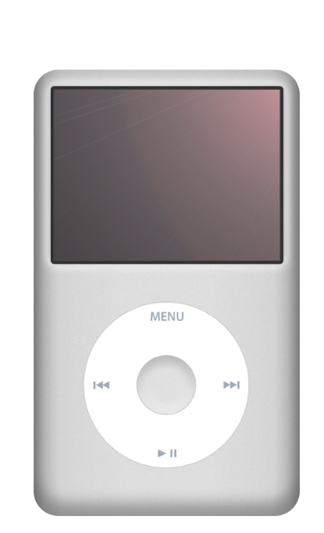
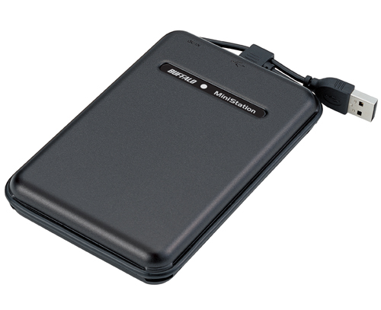
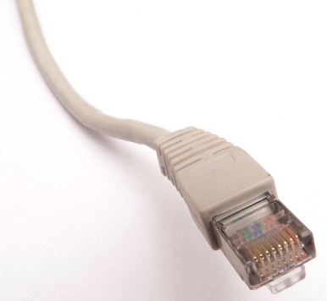
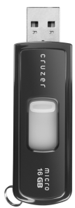
Imaging Tools
Requires no special equipment
Challenge: Booting will overwrite memory
  Solution: Use program to dump contents to external medium
Network boot
  PXE (Intel’s Preboot Execution Environment)
  EFI (Extensible Firmware Interface)
USB drives
iPods
Notes:
Extracting memory requires no special equipment.
When the system is powered on, the memory starts refreshing, so programs can read any residual data.
However, booting the system will overwrite memory. While the BIOS overwrites only a small fraction, loading a full OS would be destructive.
Solution is to use special-purpose programs to copy the memory contents to some external medium with minimal disruption to the original state.
They implemented tiny applications, with only few KBs, that can be booted via these tools (PXE, EFI, USB drives, and iPods) and capture memory dumps.

Slide 17
Imaging Attacks
Simple Reboot Attack
  Warm-boot
    Restarting machine while it is powered on (Ctrl + Alt + Del on Windows, kexec on Linux)
    No memory decay, but software chance to wipe data
  Cold-boot
    Restarting machine from a power-less state (Disconnect and reconnect power)
    Little to no memory decay, and no software chance to wipe data
Advanced Cold-Boot Attack
  Transfer the memory to attacker’s computer, if the BIOS clears RAM or prevents memory dumping
  Cooling the memory slows decay to be transferred with minimal decay
Notes:
A way of attack depends on level of access to the system and the countermeasures employed.
The simplest attack is to reboot the machine and configure the BIOS to boot the memory extraction tool.
A warm boot, with the OS’s restart procedure, will normally ensure that the memory has no decay, though software will have an opportunity to wipe sensitive data.
A cold boot, initiated from reset switch or by removing power, may result in a small decay, but denies software any chance to scrub memory before shutting down.
Even if the BIOS clears RAM or prevents memory dumping, an attacker can transfer the memory to his computer and extract it.
Cooling the memory slows the decay to be transferred with minimal data loss.

Slide 18

Simple Cold-Boot Attack
Dumping
RAM…
Screen-locked machine
(if hibernating/sleeping,
just wake it up!)
Notes:
Let me show you some pictures describing simple cold-boot attack on screen locked laptop with an encrypted disk.
First, if laptop is asleep or hibernating, simply wake it up [next]
Next, reboot the machine by disconnect and reconnect the power and use the memory extraction tool [next]
Then, the attacker can extract the key in memory and decrypt the disk

Slide 19

What if the BIOS clears RAM?
!!!
BIOS:
Clearing
RAM…
Notes:
[next] what if the BIOS clears RAM or prevents memory dumping?
Then the attacker cannot extract the key in memory.
But he can still perform an advanced version of the attack.

Slide 20
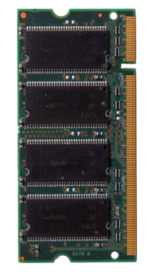
Advanced Cold-Boot Attack
Dumping
RAM…
Victim’s Computer
Attacker’s Computer
Notes:
The attacker can transfer the memory to his computer without cutting power and extract their contents.
He might use the fact that cooling memory slows decay while transferring.
Let’s see the demo video clip for this attack.

Slide 21

Advanced Cold-Boot Attack (cont’d)

Slide 22
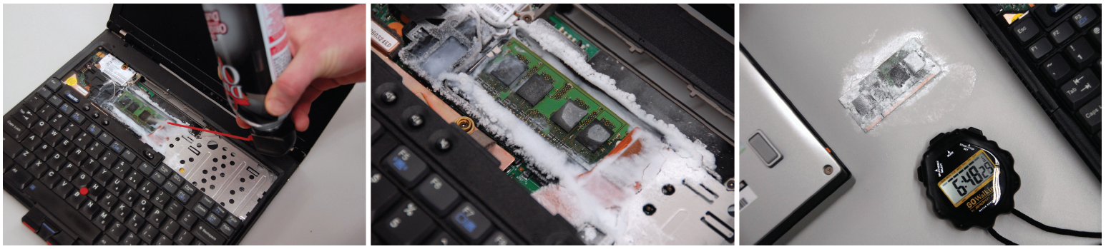
Advanced Cold-Boot Attack (cont’d)
Most powerful attack
Reduces the temperature of the memory to −50°C while running
  Data persists for several minutes even if the memory modules are removed
Moves them to another machine and read them
Cheap and practical way to move the RAM without losing data
Notes:
This is the most powerful attack.
The attacker reduces the temperature of the memory to −50°C by spraying with “canned air” holding cold liquid while the computer is still running.
At this temperature, the data will persist for several minutes after power loss with minimal error, even if the memory modules are removed from the computer.
Then he moves them to another machine configured to read them without overwriting any data.
This is a cheap, practical way to move the RAM from one computer to another without losing much data

Slide 23
Contents
1 | Introduction
2 | Vulnerability
3 | Tools and Attacks
4 | Key Reconstruction & Identification
5 | Attacking Encrypted Disks
6 | Countermeasures
7 | Related Works & Conclusion
Notes:
The attacker could dump the memory so far, so how can he exploit the key in memory?
The next part is about how the key for an attack.

Slide 24
Key Reconstruction
Even a small error complicates extracting key
Developed algorithms for reconstructing keys
  Work when only 27% of the bits are known
Trade-off between efficiency and security
  Stores precomputed data from the encryption keys to speed up computation
  This precomputed data contains much more structure than the key itself
Most decay is unidirectional
  Bits decay to a predictable ground state
  Decay probability is known to the attacker
Notes:
When the memory is partially decayed, there may be errors in the keys, and this makes extracting key complicated.
The authors developed algorithms for reconstructing keys which are working when only 27% of the bits are known and of course better than brute force.
The algorithms use two properties; a trade-off between efficiency and security and unidirectional decay.
Most encryption programs stores precomputed data from the key such as a key schedule to speed up computation.
This data contains much more structure than the key itself, so the algorithms use this structure to perform error correction.
Also, in their experiments, almost all bits decayed to a predictable ground state with only a tiny fraction flipping in the opposite direction.
They assume that the ground state decay probability is known to the attacker because it can be approximated by comparing the fractions of zeros and ones in the extracted key data.

Slide 25
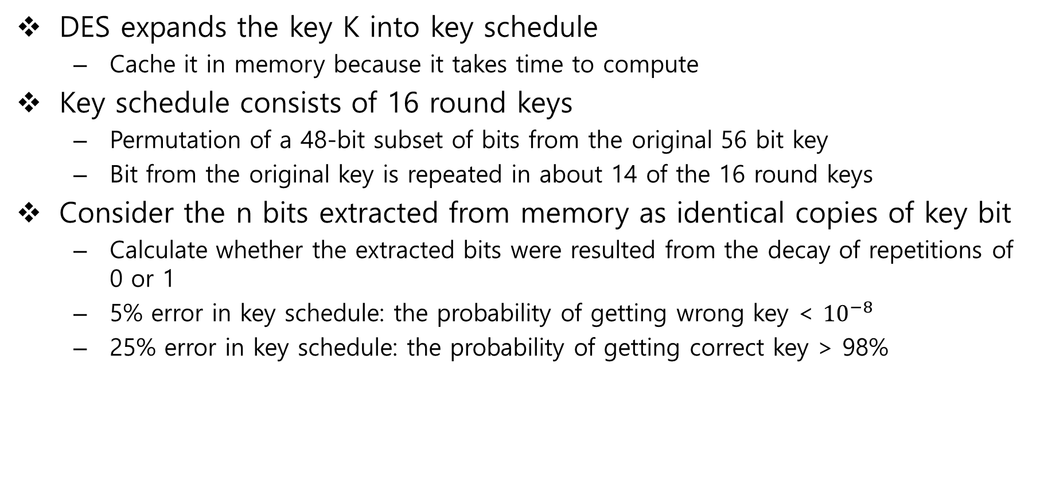
DES Key Reconstruction
DES expands the key K into key schedule
  Cache it in memory because it takes time to compute
Key schedule consists of 16 round keys
  Permutation of a 48-bit subset of bits from the original 56 bit key
  Bit from the original key is repeated in about 14 of the 16 round keys
Consider the n bits extracted from memory as identical copies of key bit
  Calculate whether the extracted bits were resulted from the decay of repetitions of 0 or 1
  5% error in key schedule: the probability of getting wrong key < ${10}^{−8}$
  25% error in key schedule: the probability of getting correct key > 98%
Notes:
First, let’s look at DES key reconstruction.
DES must expand the secret key K into key schedule before using it.
Programs typically cache it in memory as long as K is in use because it takes time to compute.
The key schedule consists of 16 round keys, each a permutation of a 48-bit subset of bits from the original 56-bit key.
Every bit from the key is repeated in about 14 of the 16 round keys.
For each bit of the key, consider the n bits extracted from the memory as all identical copies of that key bit.
Since we know the probability that each bit decayed 0 → 1 or 1 → 0, we can calculate whether the extracted bits were more likely to have resulted from the decay of repetitions of 0 or 1.
If 5% of the bits have decayed, the probability of getting wrong key is less than ${10}^{−8}$.
Even if 25% of the bits are in error, the probability of reconstructing the correct key is more than 98%.

Slide 26
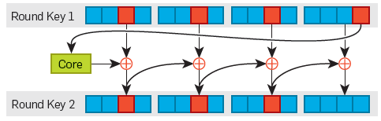
AES Key Reconstruction
AES uses a key schedule with a more complex structure
  For 128-bit keys, the key schedule consists of 11 round keys, each made up of four 32-bit words.
  Each subsequent word is generated either by XORing two earlier words, or
  Performing a core operation on an earlier word and XORing the result with another earlier word
Slice up the keys and use linearity in the key scheduling
  Pick 7 bytes from the first 2 round-keys as shown in picture
Generate the relevant 3 bytes of the next round key from first 4 bytes
  Guess the candidate key by calculating possibilities that these 7 bytes might have decayed
  Calculate the key schedule for each candidate key
  Unique guess under unidirectional decay
To reconstruct key with 7% bit error: 1 second / half of keys with 15% bit error: 30 seconds
Notes:
Next is key reconstruction of AES, which is a more modern cipher than DES.
AES uses a key schedule with a more complex structure.
For 128-bit keys, the AES key schedule consists of 11 round keys, each made up of four 32-bit words.
Each subsequent word is generated either by XORing two earlier words, or by performing a core operation on an earlier word and XORing the result with another earlier word.
The algorithm will slice up the keys and use linearity in the key scheduling.
Pick 7 bytes from the first 2 round-keys as shown in picture.
Then, generate the relevant 3 bytes of the next round key from first 4 bytes and guess the candidate key by calculating possibilities that these 7 bytes might have decayed to the corresponding bytes extracted from memory.
For each candidate key, calculate the key schedule.
The guess will be almost certainly a unique when the decay is unidirectional because a single flipped bit results in a cascade of bit flips, half of bits are “wrong”.
They succeed to reconstruct keys with 7% of bit error in a second and half of keys with 15% of bit error within 30 seconds.

Slide 27
RSA Key Reconstruction
RSA public key consists
  Modulus N
  Public key exponent e
RSA private key consists
  Private exponent d
Optional values
  Prime factor p and q of N
  d mod(p-1)
  d mod(q-1)
  q⁻¹ mod p
Given N and e, any of the private values is sufficient to generate the others
  Stored to speed computation
Key structure is the mathematical relationship between the public and private key
  Enumerate potential RSA private keys and prune those that do not satisfy these relationships
  Recover a RSA key in 1 second when only 27% of the bits are known
Notes:
An RSA public key consists of the modulus N and the public exponent e,
while the private key consists of the private exponent d,
and several optional values: prime factors p and q of N, d mod (p − 1), d mod (q − 1), and q−1 mod p.
Given N and e, any of the private values is sufficient to efficiently generate the others.
In practice, some or all of these values is stored to speed computation.
In this case, the key structure information is the mathematical relationship between the fields of the public and private key.
It is possible to iteratively enumerate potential RSA private keys and prune those that do not satisfy these relationships.
Heninger and Shacham showed on the paper “Improved RSA private key reconstruction for cold boot attacks” that it’s possible to recover a RSA key with all optional fields in 1 second when only 27% of the bits are known.

Slide 28
Key Identification
Automatic techniques for locating encryption keys in memory
  Target the key schedule instead of the key itself
AES key identification algorithm:
  Iterate through each byte of memory. Treat that address as the start of an AES key schedule.
  Calculate the Hamming distance between each word in the potential key schedule and the value that would have been generated from the surrounding words in a real, undecayed key schedule.
  If the sum of the Hamming distances is sufficiently low, the region is close to a correct key schedule; output the key.
keyfind application for 128- and 256-bit AES
  Receive extracted memory and output a list of likely keys
  Recovered keys from disk encryption programs successfully
RSA key identification
  Search for known key data or for characteristics of the standard data structure used for storing RSA private keys
  Located the SSL private keys in memory successfully
Notes:
The authors have developed fully automatic techniques for locating encryption keys in memory, even in the presence of errors.
They targeted the key schedule instead of the key itself, searching for blocks of memory that satisfy the properties of a valid key schedule.
They developed an algorithm for locating AES keys in extracted memory:
Iterate through each byte of memory. Treat that address as the start of an AES key schedule.
Calculate the Hamming distance between each word in the potential key schedule and the value that would have been generated from the surrounding words in a real, undecayed key schedule.
If the sum of the Hamming distances is sufficiently low, the region is close to a correct key schedule; output the key.
They implemented this algorithm for 128- and 256-bit AES keys in an application called “keyfind”.
The program receives extracted memory and outputs a list of likely keys.
They successfully used keyfind to recover keys from disk encryption programs
This approach can be applied to many other ciphers, including DES
To locate RSA keys, search for known key data or for characteristics of the standard data structure used for storing RSA private keys.
They successfully located the SSL private keys in memory.

Slide 29
Contents
1 | Introduction
2 | Vulnerability
3 | Tools and Attacks
4 | Key Reconstruction & Identification
5 | Attacking Encrypted Disks
6 | Countermeasures
7 | Related Works & Conclusion
Notes:
Attacker can now find and reconstruct the keys in memory.
The final part of the attack is decrypting the encrypted hard disks.

Slide 30
Successful Attacks Against
Attacks work on all operating systems (Windows, Mac OS, and Linux)
BitLocker in basic mode
  Even fully “at rest” with computer powered off
FileVault, dm-crypt, TrueCrypt, and Loop-AES
  where computer was running, sleeping, or hibernating
Disk encryption is not a sufficient defense against physical data theft
Notes:
Attacks work on all operating systems
The authors succeed to break BitLocker in basic mode even with computer powered off and FileVault, dm-crypt, TrueCrypt, and Loop-AES
So the result is that the disk encryption is not necessarily a sufficient defense against physical data theft.

Slide 31
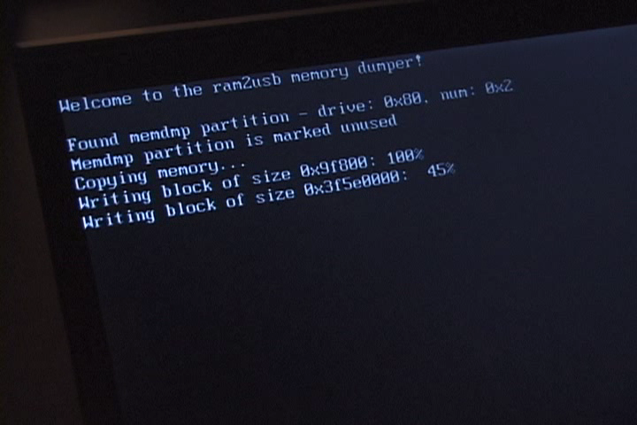
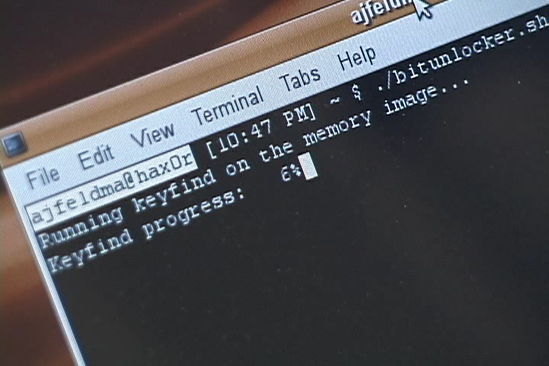
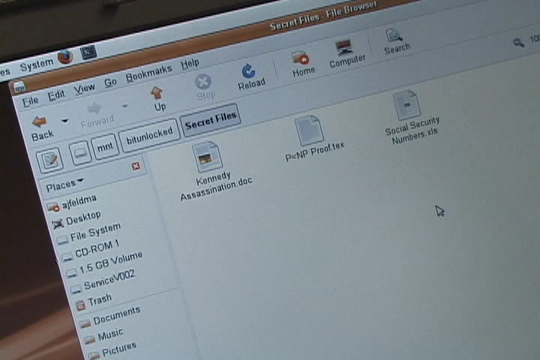
BitLocker
Disk encryption for Windows
BitUnlocker (fully automated demonstration attack tool)
  External USB hard disk containing a Linux, a custom SYSLINUX based bootloader, and a custom driver that allows BitLocker volumes to be mounted under Linux
  Reset, connect USB disk, and boot from this USB disk
  Automatically dumps the memory, runs keyfind to locate and reconstruct candidate keys, and mounts the BitLocker encrypted volume, which can be browsed like any other volume
Laptop with 2GB RAM as a target
Took 25 min to recover keys and decrypt entire disk
Notes:
BitLocker is a disk encryption included with Windows.
The authors created a fully automated demonstration attack tool called “BitUnlocker”.
It consists of an external USB hard disk containing a Linux, a custom SYSLINUX based bootloader, and a custom driver that allows BitLocker volumes to be mounted under Linux.
To use it, cut power to reset the machine, then connects the USB disk and boots from this USB disk .
[next] BitUnlocker automatically dumps the memory image to the external disk, [next] runs keyfind to locate and reconstruct candidate keys, [next] and mounts the BitLocker encrypted volume.
Once the encrypted volume has been mounted, one can browse it just like any other volume.
They tested this attack on a laptop with 2GB of RAM.
BitUnlocker successfully recovered the keys with no errors and decrypted the disk.
The entire process took around 25 min, and optimizations could even reduce it.

Slide 32
FileVault
Disk encryption for Mac OS
User password for both an AES key and IVs (initialization vectors)
EFI memory extraction program with a FileVault volume mounted
keyfind automatically identified the FileVault AES encryption key
IV key is present in RAM and an attacker can identify it
Encrypts each disk block in CBC mode
  The attacker can decrypt most disk block except the first cipher block using only the AES key
AES and IV keys together allow full decryption using programs like vilefault
Notes:
FileVault is a disk encryption for Mac OS.
A user password decrypts a header that contains both an AES key used to encrypt stored data and a second key used to compute IVs (initialization vectors).
The authors used EFI memory extraction program with a FileVault volume mounted.
keyfind program automatically identified the FileVault AES encryption key.
IV key is present in RAM and an attacker can identify it by attempting decryption using all substrings of memory.
FileVault encrypts each disk block in CBC mode, so even if the attacker cannot recover the IV key, he can decrypt most of disk block except the first cipher block using only the AES key.
The AES and IV keys together allow full decryption of the volume using programs like vilefault.

Slide 33
TrueCrypt, dm-crypt, and Loop-AES
TrueCrypt is disk encryption for the Windows, Mac OS, and Linux
dm-crypt and LoopAES are disk encryption for the Linux
All vulnerable to attacks
  Once a memory image extracted, to use keyfind to locate the keys and use the keys to decrypt and mount the disks were possible
Notes:
TrueCrypt is disk encryption for the Windows, Mac OS, and Linux and dm-crypt and LoopAES are disk encryption for the Linux.
The authors found that these disk encryption products are too vulnerable to attacks like BitLocker and FileVault.
In all three cases, once they had extracted a memory image, they were able to use keyfind to locate the encryption keys and used it to decrypt and mount the disks.

Slide 34
Contents
1 | Introduction
2 | Vulnerability
3 | Tools and Attacks
4 | Key Reconstruction & Identification
5 | Attacking Encrypted Disks
6 | Countermeasures
7 | Related Works & Conclusion
Notes:
This attacks are difficult to prevent because cryptographic keys must be stored somewhere.
Actually, there is no perfect solution, and all countermeasure has a drawback.
Anyway, the authors suggested 6 countermeasures.

Slide 35
Countermeasures
Suspending a system safely
  Power off the machine not in use to wipe the memory
  Encrypt the memory under a key derived from the user password
Storing keys differently
  Avoiding precomputation will improve resistance but worse performance
Physical Defenses
  Physically defend or detect memory from being removed
Architectural changes
  DRAM could be designed to lose their state quickly
  Store a keys securely while erasing them on power-up, reset, and shutdown
  Encrypt the memory routinely
Encrypting in the disk controller
  Store the key in the disk controller’s memory
Trusted computing
  Prevent a key from being loaded into memory, but cannot prevent from being captured
Notes:
1. With most disk encryption systems, users can power off the machine not in use to wipe the memory.
This is effective, but inconvenient because of lengthy booting time.
Another way is to encrypt the memory under a key derived from the user password.
2. Avoiding precomputation will improve resistance to attacks but worse performance.
3. Physically defend or detect memory from being removed.
Small amount of memory soldered to a motherboard would provide moderate defense at relatively low cost.
4. DRAM could be designed to lose their state quickly but this might be difficult.
Key-store hardware could be added to store a keys securely while erasing them on power-up, reset, and shutdown.
To encrypt the memory routinely is also proposed.
5. To encrypt the disk controller and store the key in the disk controller’s memory instead of the DRAM.
6. Trusted Computing devices can prevent a key from being loaded into memory for use, but they cannot prevent it from being captured once it is in memory

Slide 36
Contents
1 | Introduction
2 | Vulnerability
3 | Tools and Attacks
4 | Key Reconstruction & Identification
5 | Attacking Encrypted Disks
6 | Countermeasures
7 | Related Works & Conclusion
Notes:
I will introduce some related works and conclusion.

Slide 37
Previous Work
Pettersson, T., Cryptographic key recovery from Linux memory dumps [Presentation at Chaos Communication Camp’07]
  DRAM contents can survive cold boot and remanence could be used to acquire memory images and cryptographic keys
Chow, J., Shredding your garbage: Reducing data lifetime through secure deallocation [USENIX Sec‘05]
  Discovered the remanence during an unrelated experiment, and remarked security implications
MacIver, D., Penetration testing Windows Vista BitLocker drive encryption [Presentation at Hack In The Box’06]
  Microsoft knew that memory remanence and BitLocker is vulnerable to a cold-boot attack
Link, W., May, H., Eigenschaften von MOS-Ein-Transistorspeicherzellen bei tiefen Temperaturen [Archiv für Elektronik und Ubertragungstechnik‘79]
  Since the 1970s, DRAM remanence has been known
Gutmann, P., Secure deletion of data from magnetic and solid-state memory / Data remanence in semiconductor devices [USENIX Sec’96 / USENIX Sec’01]
  Attributes burn-in to physical changes, and suggests that keys be relocated periodically as a defense
Notes:
Pettersson suggested that DRAM contents can survive cold boot and remanence could be used to acquire memory images and cryptographic keys
Chow discovered the remanence during an unrelated experiment, and they remarked on its security implications
MacIver stated that Microsoft considered memory remanence in designing its BitLocker disk encryption system, because they knew that BitLocker is vulnerable to a cold-boot attack.
Researchers have known since the 1970s DRAM remanence
Gutmann attributes burn-in to physical changes when data is stored in RAM for a long time, and he suggests that keys be relocated periodically as a defense.

Slide 38
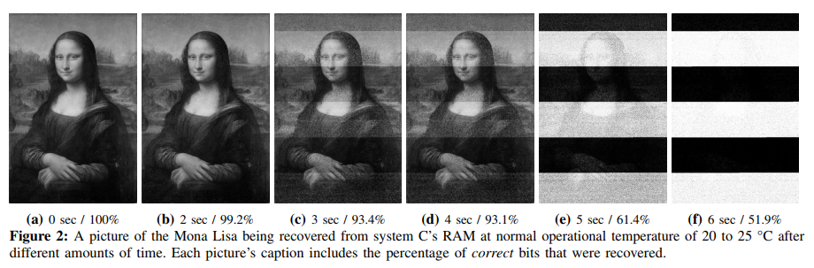
Memory Scramblers
From DDR3, memory scramblers are introduced as basic protection from the cold boot attack
Memory scramblers XOR the pseudo random numbers with data to be written
  DDR3: Number generated from pseudo random number generated from boot time and address to be written
Gruhn, M., On the Practicability of Cold Boot Attacks [International Conference on Availability, Reliability and Security'13]
  Could not reproduce cold boot attacks against DDR3
Notes:
The cold-boot attack on this paper was performed on DDR1 and DDR2 RAM.
However, now DDR3 and DDR4 RAM were released and used.
So, what has changed?
In recent years, it has become challenging to perform cold-boot attacks due to the DRAM memory scramblers.
It scrambles data by XORing it with a pseudorandom number before writing it to DRAM.
On the paper “On the Practicability of Cold Boot Attacks”, Gruhn could not reproduce cold boot attacks against DDR3

Slide 39
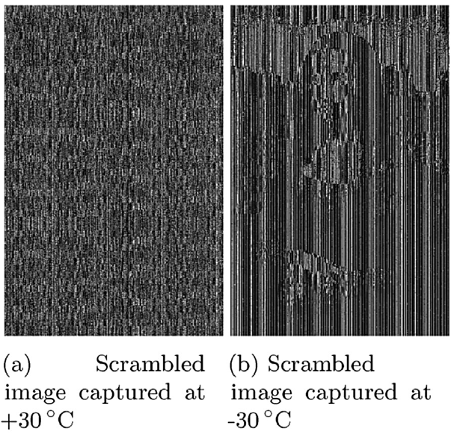
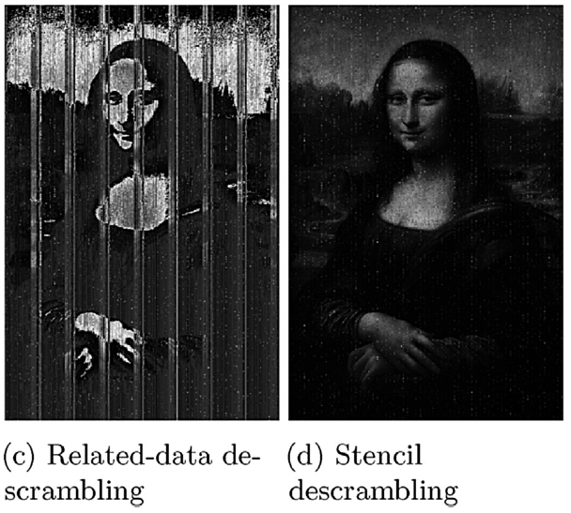
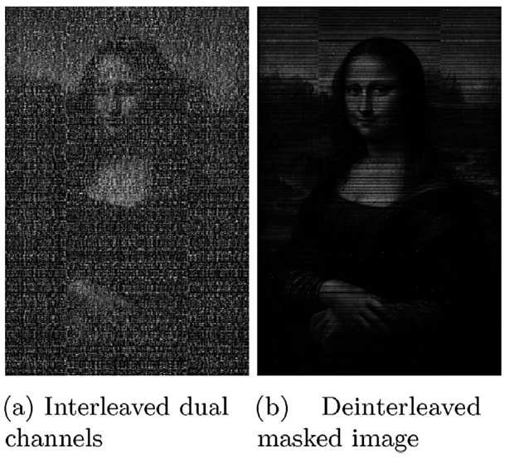
DDR3 was Broken
Bauer, J., Lest we forget: Cold-boot attacks on scrambled DDR3 memory [Digital Investigation'16]
  Demonstrated a cold boot attack that bypasses DDR3 scrambler son 2nd generation Intel Core (SandyBridge) CPUs
  Requires only 64 bytes of known plaintext per memory channel and only 50 bytes if the mathematical approach is chosen to descramble the image
Notes:
However, in 2016, two years ago, Bauer demonstrated a cold boot attack that bypasses DDR3 scrambler on the paper “Lest we forget: Cold-boot attacks on scrambled DDR3 memory”
The attack requires only 64 bytes of known plaintext per memory channel and only 50 bytes if the mathematical approach is chosen in order to yield complete descrambling of the image.

Slide 40
DDR4 was also Broken
DDR4 memory scramblers have been redesigned
Yitbarek, SF., Cold Boot Attacks are Still Hot: Security Analysis of Memory Scramblers in Modern Processors [IEEE International Symposium on High Performance Computer Architecture‘17]
  Effective attack on DDR4
  Scramblers do not provide confidentiality guarantees
  Replacing memory scramblers with strong cipher engines can provide better protection
Notes:
DDR4 memory scramblers have been redesigned in Intel’s 6th generation Intel Core(Skylake) CPUs to provide enhanced data confusion over previous generation DDR3-based scramblers
Last year, Yitbarek released the paper “Cold Boot Attacks are Still Hot: Security Analysis of Memory Scramblers in Modern Processors” to introduce an effective attack on DDR4.
Yitbarek said "scramblers do not provide sufficient confidentiality guarantees”
He also said “replacing memory scramblers with strong cipher engines can provide better protection against cold boot attacks, since any cold boot attack would require bruteforce decryption of the strong cipher”

Slide 41
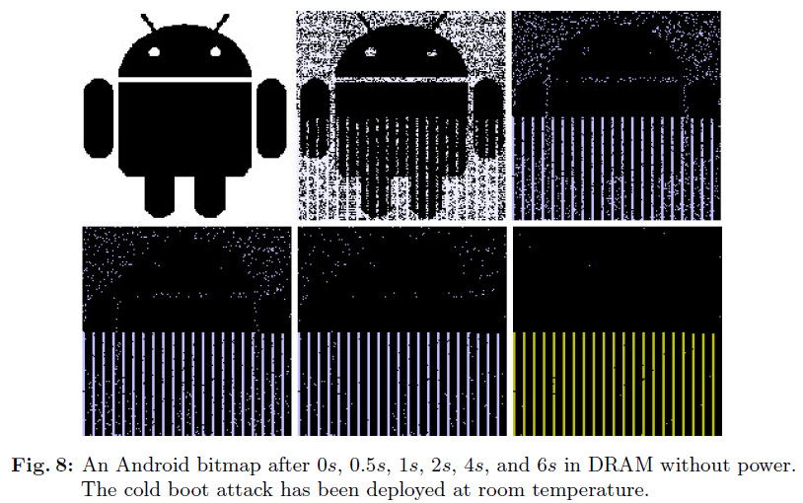
Android Smartphone
Müller, T., Frost; Forensic Recovery of Scrambled Telephones [International Conference on Applied Cryptography and Network Security'13]
  Broke Android smartphone with full disk encryption performing Cold-Boot Attacks
  Recovered sensitive information from RAM
Notes:
Müller broke Android smartphone with full disk encryption performing Cold-Boot Attacks on the paper “Frost”.
He recovered the sensitive information such as personal photos, messages, and contacts

Slide 42
Storing Keys Outside RAM
Register-based key storage
  Loop-Amnesia: 2011
  TRESOR: 2011
  TreVisor: 2012
  ARMORED: 2013
Cache-based key storage
  Copker: 2011
  Sentry: 2015
  CaSE: 2016
GPU-based key storage
  PixelVault: 2014
Notes:
Many defenses are still progressing and I will introduce some of them.
First is using register as a key storage
These four Implementations store encryption keys in registers
Second is using cache for storing a key
These three Implementations store encryption keys in registers
The last is using GPU as a key storage

Slide 43
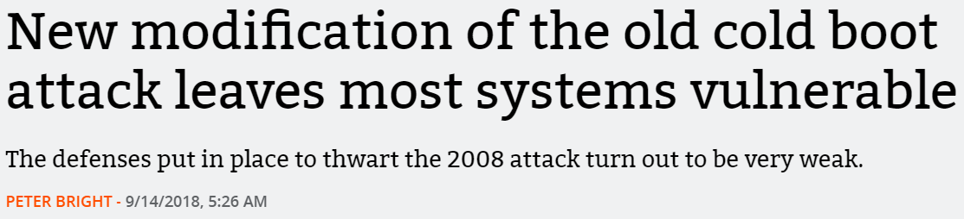
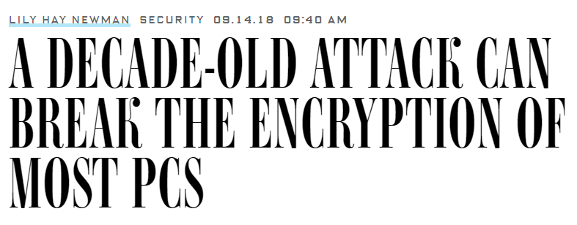

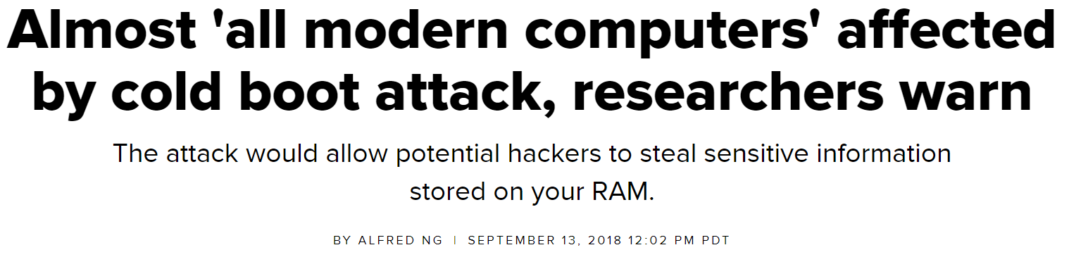

A Decade Later…
Notes:
A decade later from this paper, cold-boot attacks are resurfacing as a newer version, which work against modern computers.
Two researchers of F-Secure wrote about this on their blog and presented their findings at the SEC-T conference and Microsoft’s bluehat v18 2 month ago.

Slide 44

New Cold-Boot Attack
Notes:
This is the demo video for the new Cold-Boot Attack
Can you notice any difference from the old version?

Slide 45
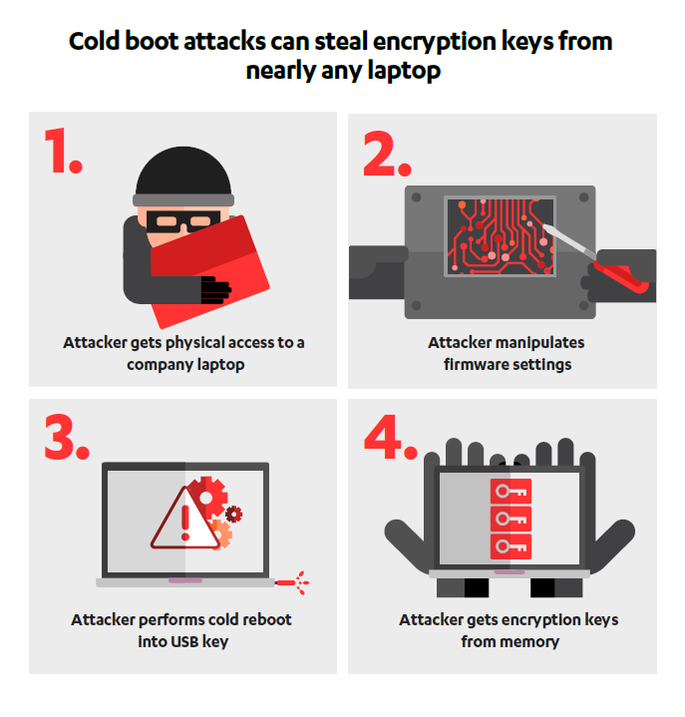
New Cold-Boot Attack (cont'd)
One safeguard overwrites the contents of the RAM when the power was restored
Figured out a way to disable this overwrite feature and enable booting from external devices by physically manipulating the hardware
Shared their research with Microsoft, Intel, and Apple and these companies are now exploring possible mitigations.
Notes:
The difference is number two of the picture. [next]
One safeguard overwrites the contents of the RAM when the power was restored.
They figured out a way to disable this overwrite feature and enable booting from external devices by physically manipulating the computer’s hardware.
So, cold-boot attacks can then be carried out.
They shared their research with Microsoft, Intel, and Apple and these companies are now exploring possible mitigations.

Slide 46
Conclusion
DRAMs hold their values for long intervals without power or refresh
Enables attackers to extract cryptographic keys and other sensitive information from memory
The attacks are practical
No perfect countermeasure so far
Recent computers and smartphones are still vulnerable
Notes:
Conclusion is the final part of my presentation
DRAMs hold their values for long intervals without power or refresh.
This fact enables attackers to extract cryptographic keys and other sensitive information from memory.
The attacks are practical—for example, we have used them to defeat several popular disk encryption systems.
There is no perfect countermeasure so far.
Recent computers and smartphones are still vulnerable

Slide 47
Thank you
Notes:
Thank you for listening.

