Slide 1
Ghost Talk: Mitigating EMI Signal Injection Attacks against Analog Sensors
Denis Foo Kune, John Backes, Shane S. Clark, Daniel Kramer, Matthew Reynolds, Kevin Fu, Yongdae Kim, and Wenyuan Xu
IEEE Symposium on Security and Privacy 2013

Slide 2
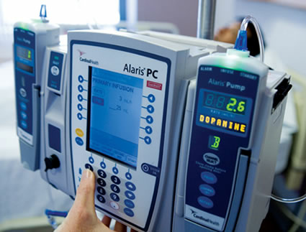
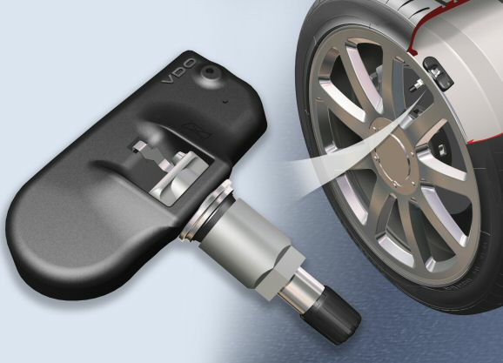
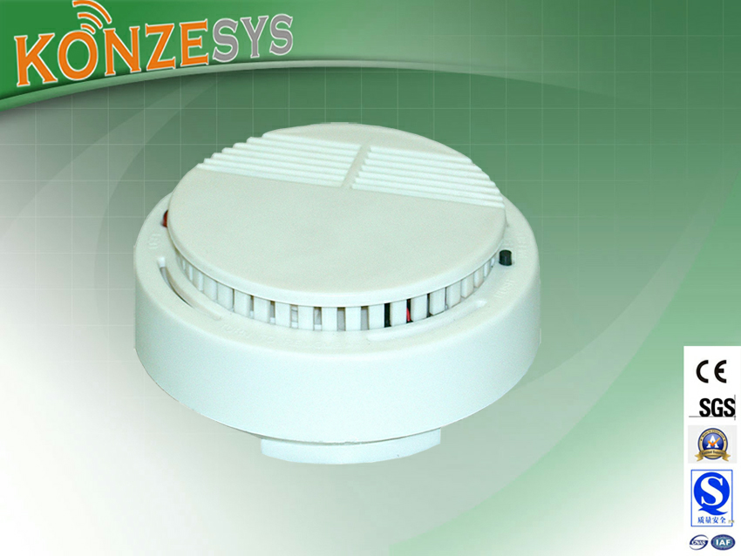
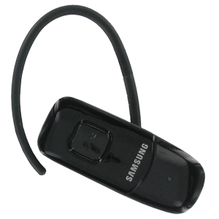
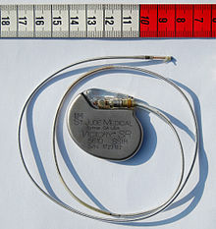
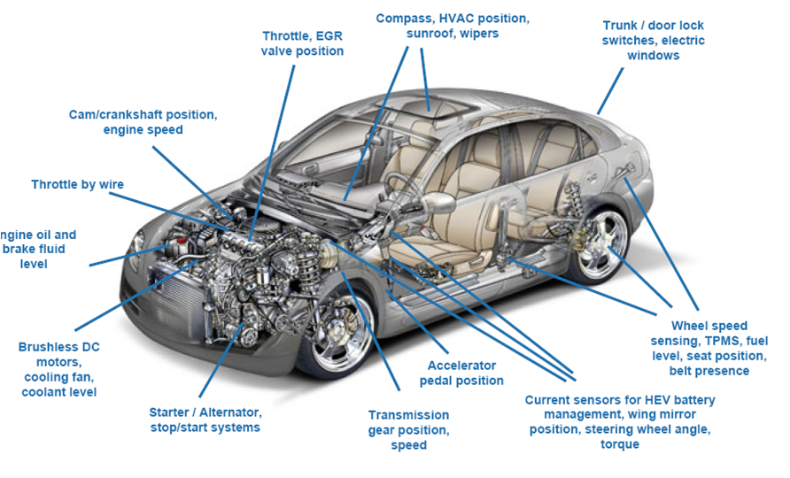
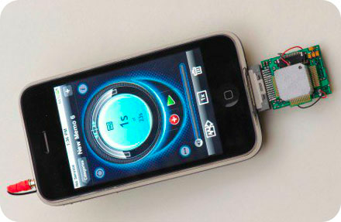
Sensing-and-Actuation System
Events
Sensor
ADC
Actuator
Amp

Slide 3

Notes:
What happens if a malicious adversary can cause this failure intentionally?
The rest of this talk will discuss how an adversary can fail sensors intentionally, which may cause fatal accidents like this.

Slide 4



Sensor & Security
Many prevention and detection mechanisms
  For malicious network traffics
  For software vulnerabilities
  Sensor = A new attack vector
Network packets
IoT
Device
Software vulnerabilities
Sensor input (or output)
Notes:
On the other hand, IoT devices blindly trust sensing inputs, and therefore, if we can manipulate sensing inputs, we can cause serious incidents as well.
So far, not many have been worried about sensor hackings and there is no good defense against it.

Slide 5
Attack Vectors of Sensors
Three interfaces
  Sensitive to legitimate physical quantities
  Insensitive to other physical quantities
  Need to send sensor data to the system
Spoofing
attack
Embedded
System
Sensor
Physical
quantities
Side-channel
attack
Legitimate channel
Non-legitimate channel
Side-channel
attack
Notes:
The first attack is the spoofing attack on a legitimate channel. In the following video, you will see a heart beat sensor counting the number of heart beats for one minute. I’ll show that using a green laser pointer, you can spoof the number of heart beats.

Slide 6
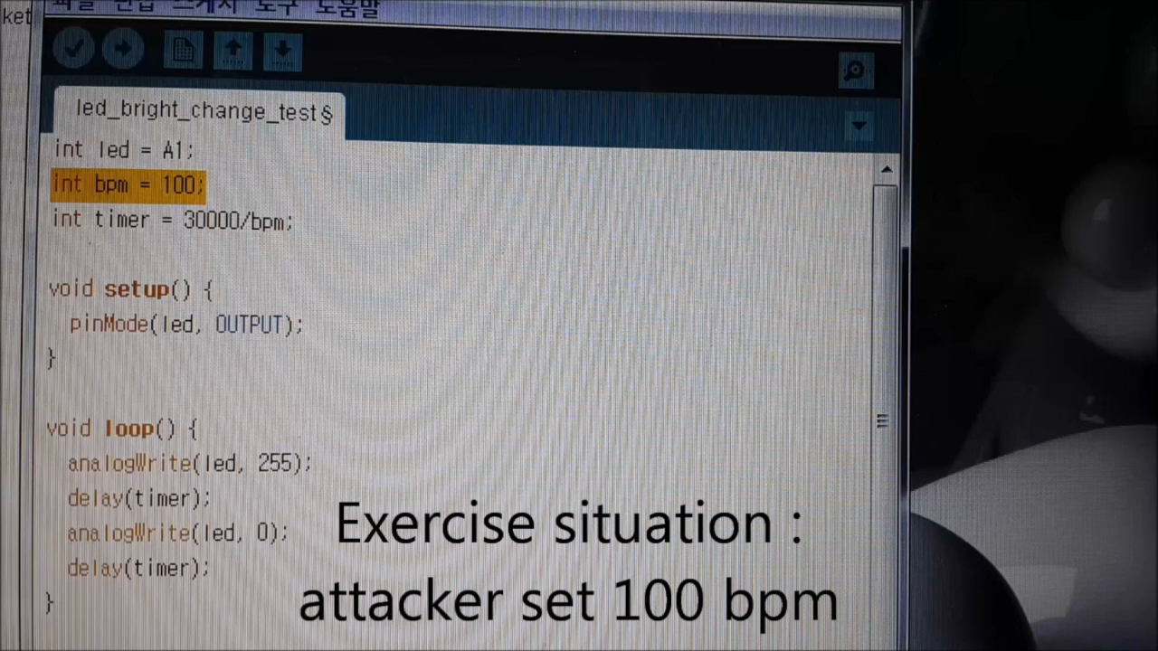
Heart Rate Sensor Spoofing
Notes:
The heart beat sensor is designed to detect movement on your wrist using the green laser. We simply turn the green laser pointer on and off 100 times per minute. We made it to miscalculate the number of heart beats.
Like this, if an attacker understands the mechanism behind the design of a sensor, she may spoof it easily. If this does not look serious, let’s look at the next example.

Slide 7

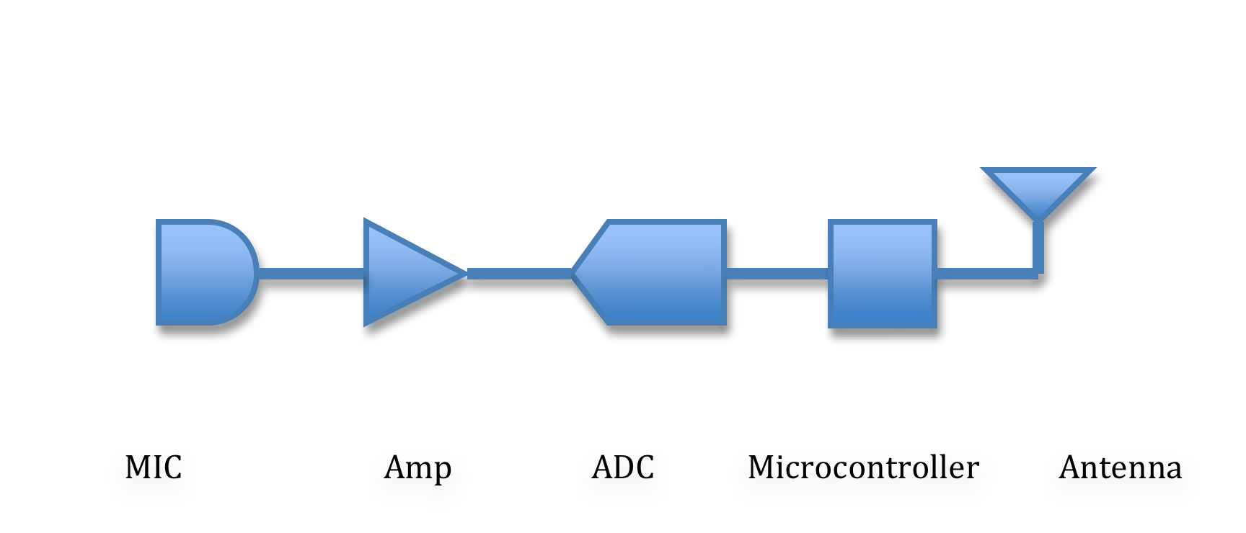
EMI on analog inputs
Analog
Digital

Slide 8
Classification on EMI
 | Intensional | Unintentional
Low Power | Yet to be explored | Circuit design issue
High Power | Can disable circuits | A lot of work

Slide 9
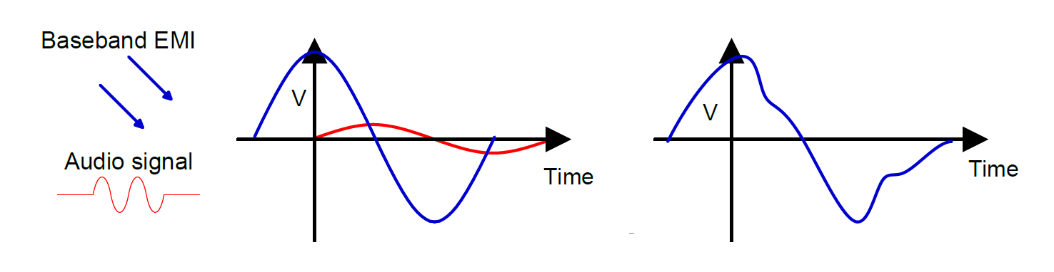
Voltage Induction

Slide 10
Between Sensor and Amp?
Sensor
Input
Analog Sensor
AS
Micro-
processor
AMP
ADC
Analog
Digital
On the order of few mV
On the order of few V

Slide 11
MICROPHONE

Slide 12
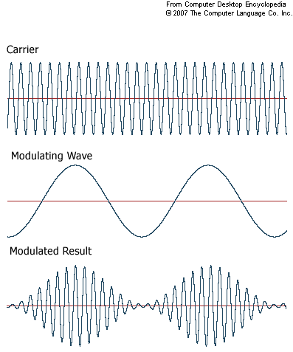
Modulated EMI Attack
Signals in high frequency range can be injected well compared to low frequency signals
Demodulation due to
  Nonlinear components
  Analog-Digital Convertor (ADC)
  Capacitor & Diode

Slide 13
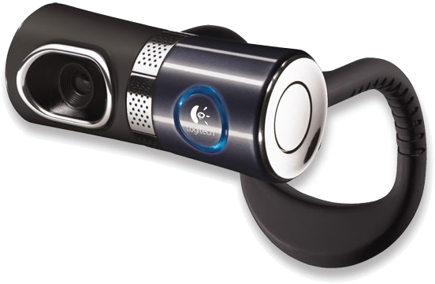
Attack technique 1: Black Box
Logitech Quickcam Ultravision
The attacker knows nothing about the target system
Cannot guess the length of a wire
Reverse tune all the frequency suspected

Slide 14

Attack Technique 2: Gray Box
Plantronics Voyager 510
Partial information
  microphone-amplifier wire length
Can roughly guess the resonant frequency of the wire
Antenna length ≒ λ/4
  6cm wire -> 1.25GHz

Slide 15
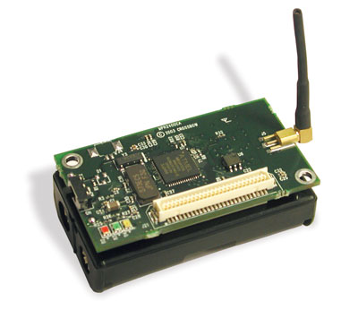
Attack Technique 3: White Box
MicaZ mote fitted with an sensor board
The whole schematic of the device is available
Multiple capacitors between the microphone and the amplifier
Conventional AM technique used

Slide 16
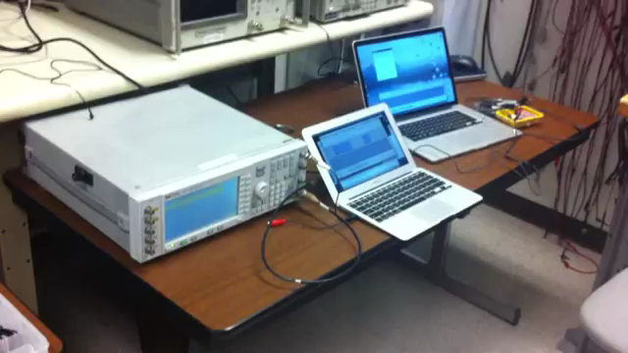
Use case

Slide 17
CARDIAC MEDICAL SYSTEM

Slide 18
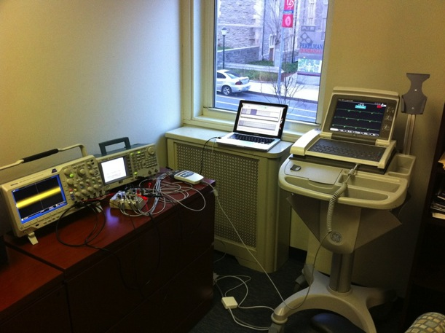
Inducing waveforms on EKG
Modulation waveform source
Signal generator
EKG
Oscilloscope
Patient simulator

Slide 19
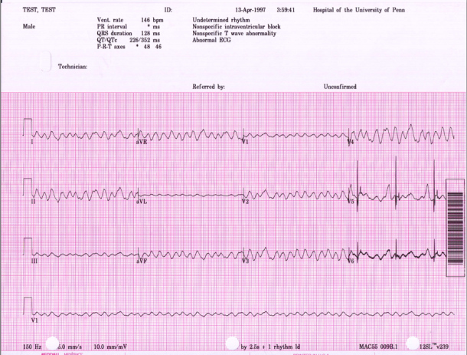
EKG – V-fib patient
Ventricular fibrillation
Induced 66 bpm signal

Slide 20
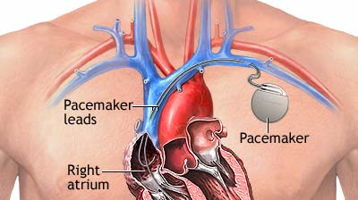
Cardiac Implantable Devices

Slide 21
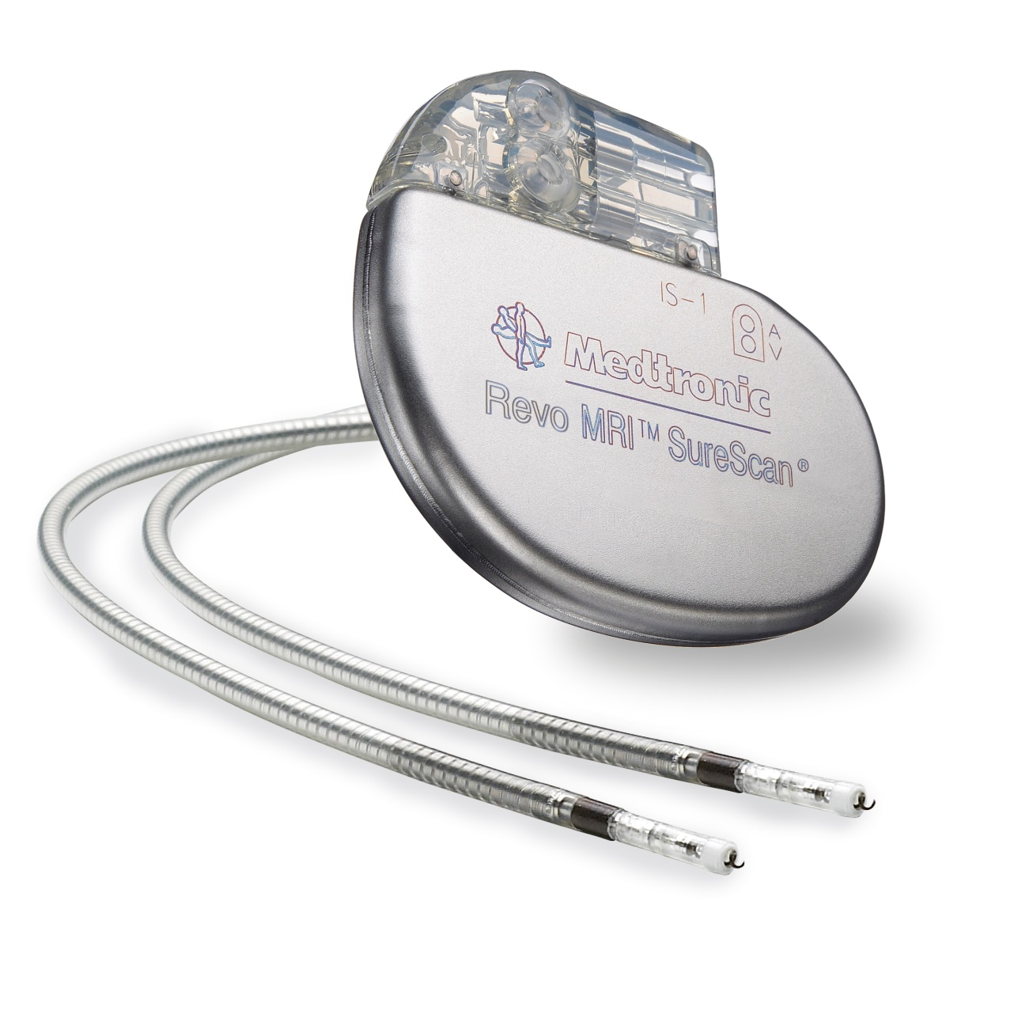
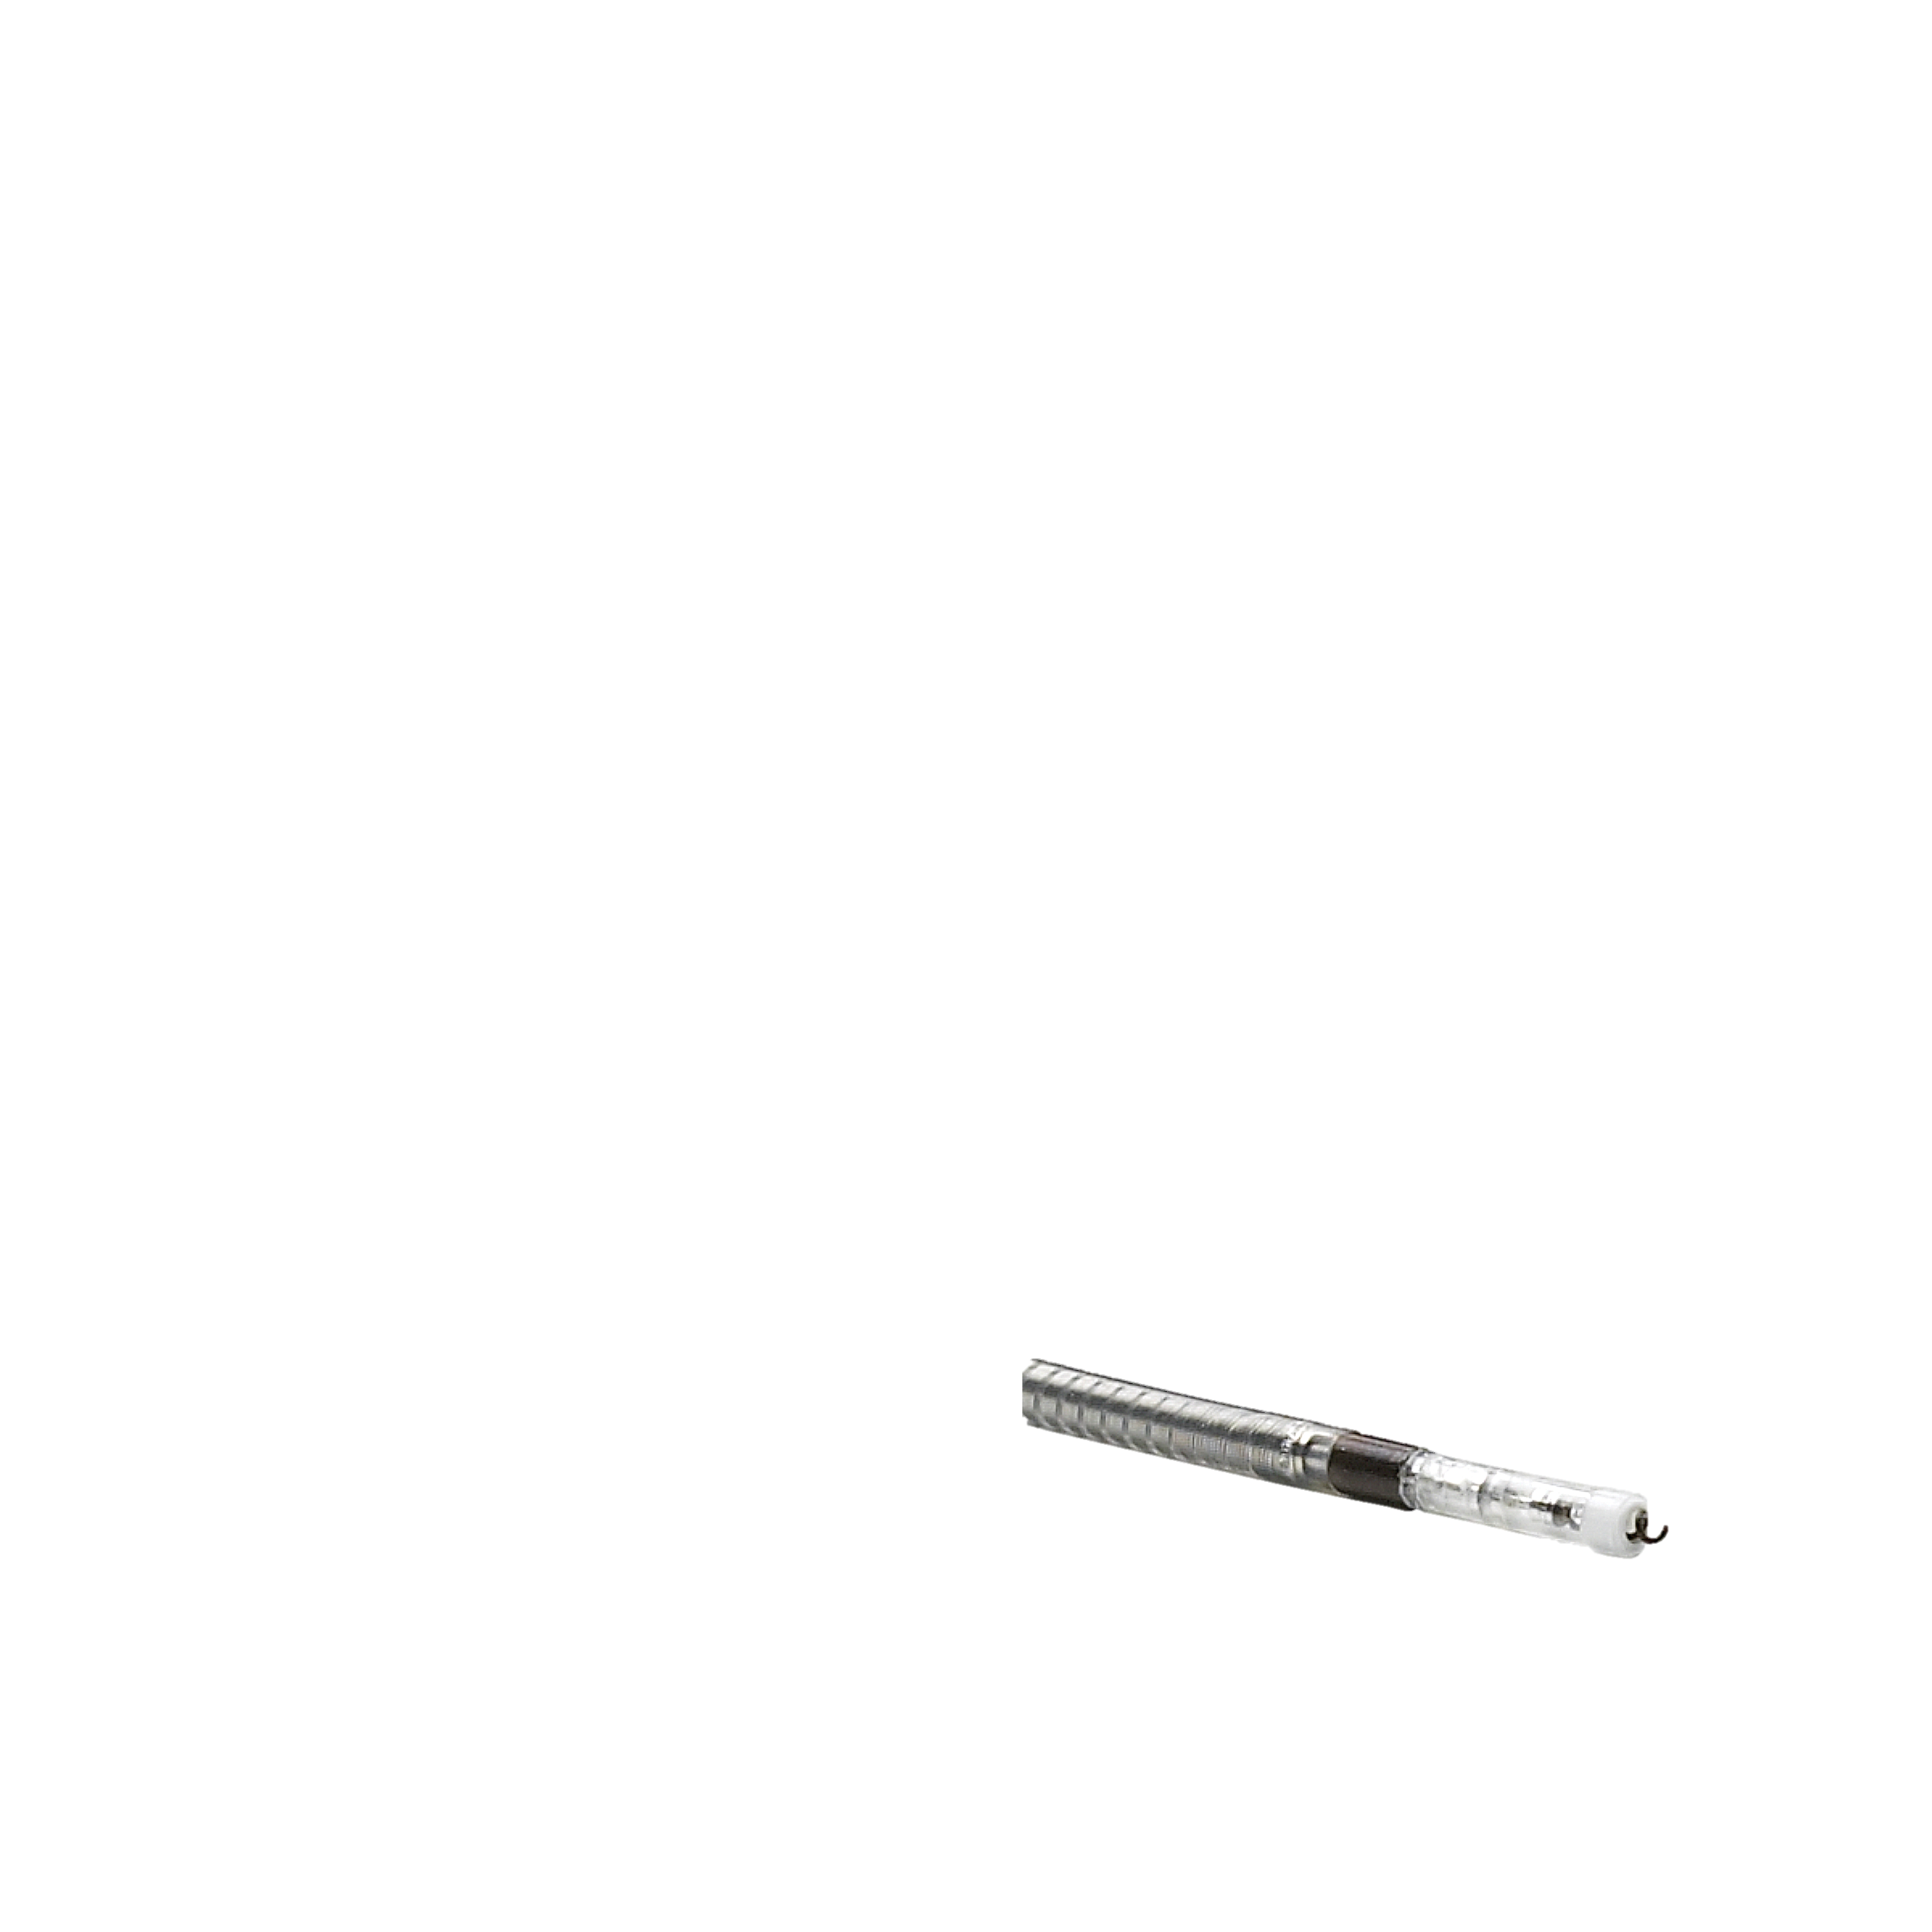
Standard Lead Design
Anode
Cathode

Slide 22
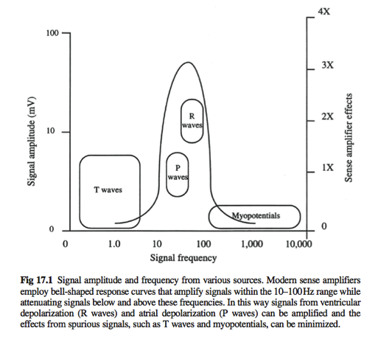
Application to medical devices
Modern devices amplify this region
Induced signals here could be dangerous
Notes:
Malicious signal waveform can look just like the real thing.
Alternate diagram: Hayes [2008, fig 12.1]

Slide 23
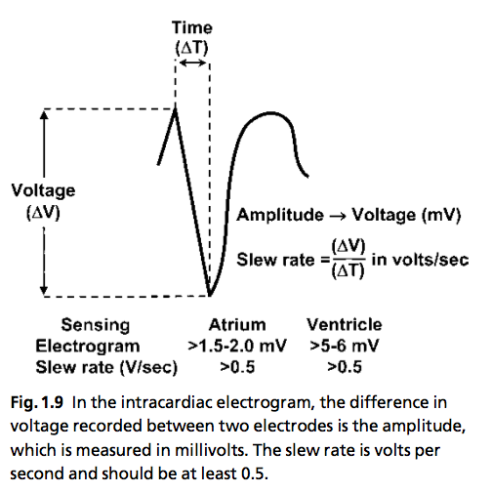
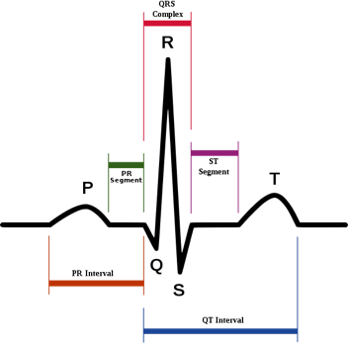
Sensing algorithm
Assuming bipolar configuration
QRS complex and detection

Slide 24
Results
Device | Open air | Saline | SynDaver
Medtronic Adapta | 1.36m | 0.03m | Unknown
Medtronic Insync Sentry | 1.57m | 0.05m | 0.08m
Boston Scientific ICD | No response | Unknown | Unknown
St. Jude ICD | 0.76m | Unknown | Unknown

Slide 25
Defenses

Slide 26
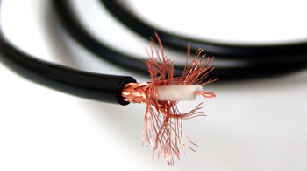
Shielding

Slide 27
Noise Cancellation with Adaptive Filter
x[n] + w₁[n] + m[n]
+
Original Signal
-m’[n]
m[n]
Antenna
Adaptive FIR Filter
Adaptive Algorithm

Slide 28
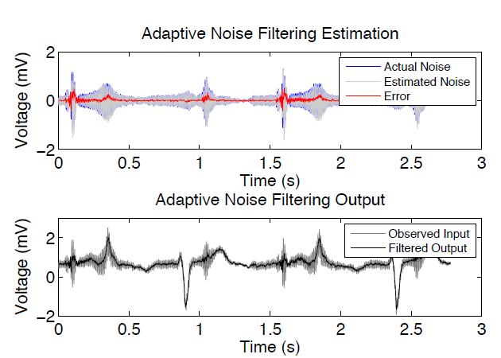
Results

Slide 29
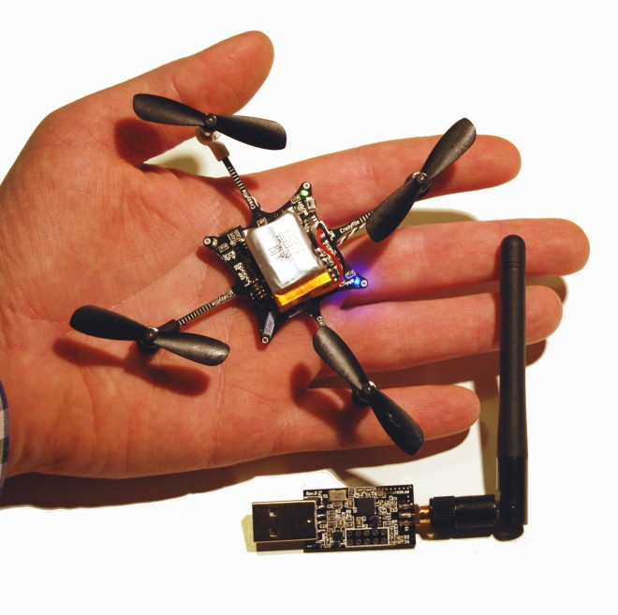

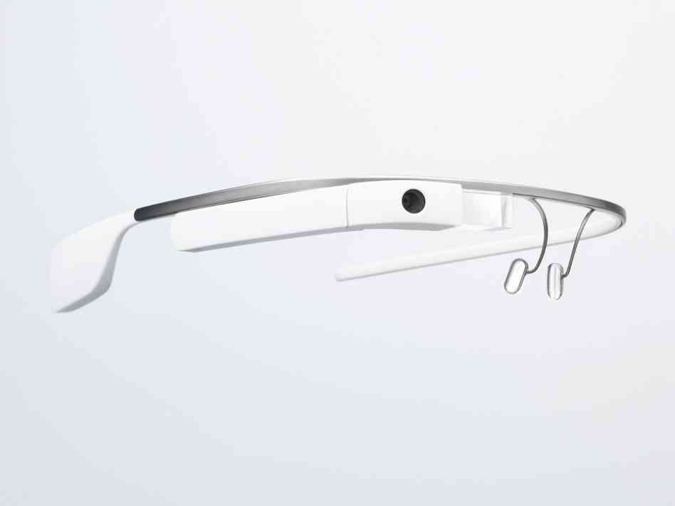
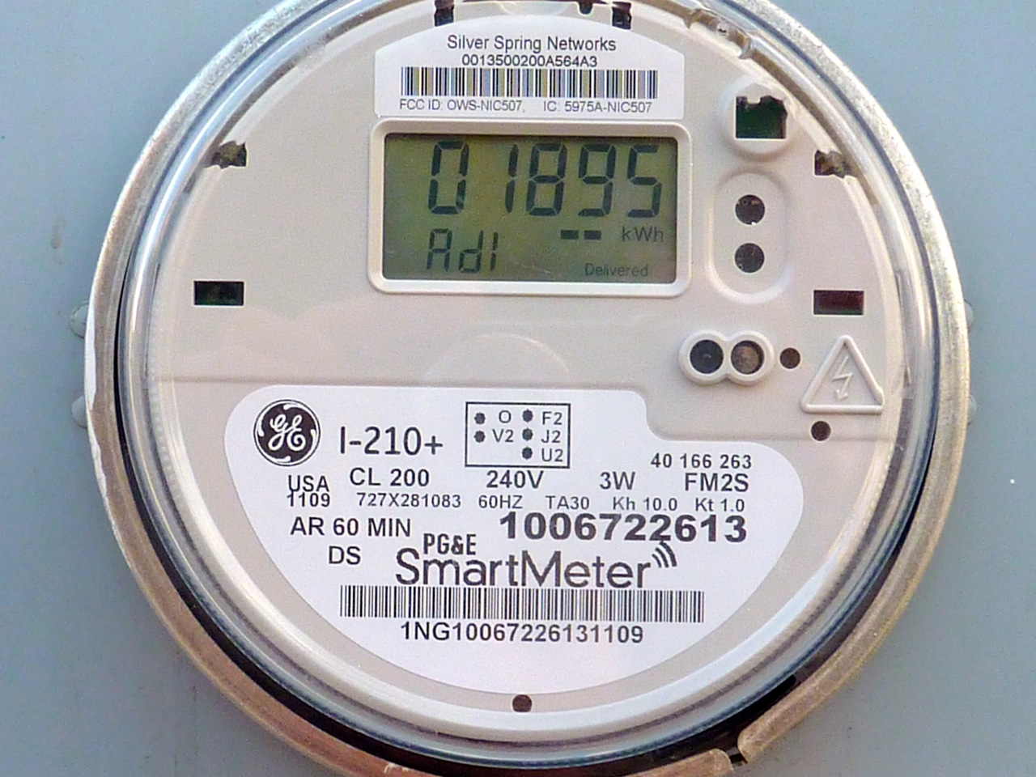
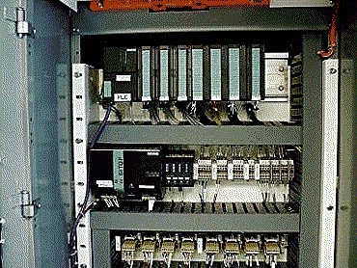

Sensing-and-Actuation System
Sensor
Amp
ADC
Situation Aware Logic
PLC
Actuator
Event
Sensor
Amp
ADC

Slide 30
Questions?
Yongdae Kim
  yongdaek@kaist.ac.kr
  http://syssec.kaist.ac.kr/~yongdaek
  Facebook: https://www.facebook.com/y0ngdaek
  Twitter: https://twitter.com/yongdaek

