Slide 1
Pacemakers and Implantable Cardiac Defibrillators:
Software Radio Attacks and Zero-Power Defenses
Daniel Halperin, Thomas S. Heydt-Benjamin, Benjamin Ransford,
Shane S. Clark, Benessa Defend, Will Morgan
Kevin Fu, Tadayoshi Kohno, William H. Maisel
Sangwon Lee
2019. 12. 05
Notes:
심박동기 삽입형 제세동기

Slide 2
Contents
Introduction
Vulnerabilities
Intercepting ICD communications
Defenses
Conclusions

Slide 3
Introduction
Security and privacy vulnerabilities in implantable medical devices (IMD).
What are IMDs?
Medical devices to replace, support, or enhance an biological structure.
Between 1990-2002: 2.6 million IMDs implanted in US patients
Notes:
Deep brain neurostimulators - 일정 주기마다 뇌에 전기 신호 보냄. 파키슨 병의 치료에 사용
cochlear implant - 인공 달팽이관
Gastric Stimulators - helps control the chronic nausea and vomiting
Foot drop - 신경성 족하수(걸음걸이 이상) 치료
Insulin pump

Slide 4
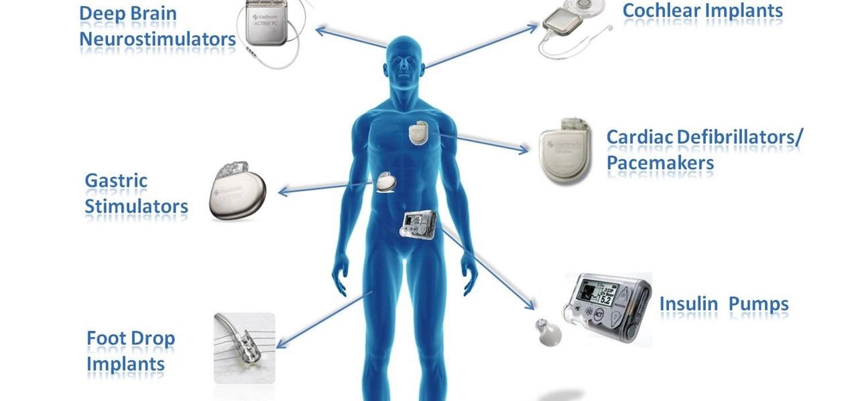
Notes:
Deep brain neurostimulators - 일정 주기마다 뇌에 전기 신호 보냄. 파키슨 병의 치료에 사용
cochlear implant - 인공 달팽이관
Gastric Stimulators - helps control the chronic nausea and vomiting
Foot drop - 신경성 족하수(걸음걸이 이상) 치료
Insulin pump

Slide 5
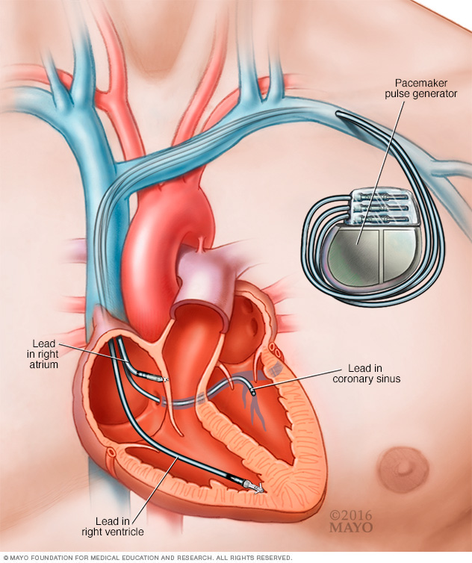
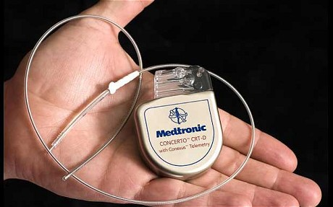
Implantable Cardioverter Defibrillators (ICDs)
Implanted inside the patient’s body.
Monitors and responds to heart activity
Pacing - steady small shocks
Defibrillation - Single larger shock
Power and connectivity
No physical external connections
Non-rechargeable internal batteries
Designed to last for many years

Slide 6
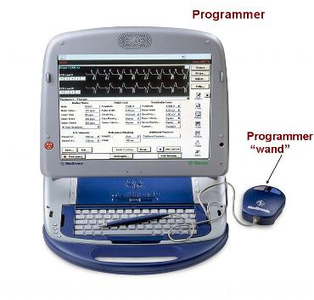
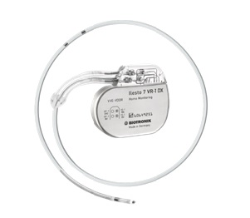
Implantable Cardioverter Defibrillators (ICDs)
Reprogrammable by the commercial device programmer
Perform diagnostics
Read / write patients’ private data
Adjust therapy settings.
Vulnerabilities exist
Wireless

Slide 7
Vulnerabilities

Slide 8
Vulnerabilities
Commercial ICD programmers can be used without authentication.
Wireless communication between the ICD programmer and the ICD is not encrypted. - can be eavesdropped.
ICDs can be re-programmed by an unauthenticated device.

Slide 9
Insider Attack - Commercial ICD programmer
Programmers can read all ICD information, change all settings.
No technological controls to ensure authorized use.

Slide 10
Intercepting ICD communications

Slide 11
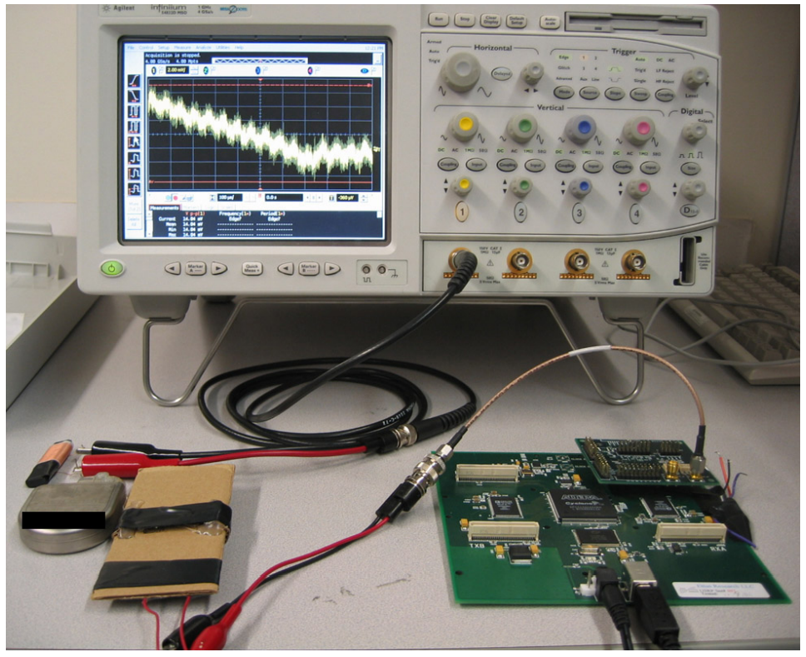
Used Equipment for Reverse Engineering
Oscilloscope
Measures voltage of signal and displays as a waveform
Universal Software Radio Peripheral
Device that interacts with open source GNU Radio libraries.
Software: GNU Radio, Perl, Matlab
Antennas
Oscilloscope
ICD
USRP
Antennas

Slide 12
Reverse Engineering Transmissions
Captured RF transmissions using the oscilloscope and USRP at 175 kHz.
Processed captured signals using the softwares to analyze the ICD’s protocols.
ICD
Programmer
RF signal capture
OSC
USRP
PC
Analyze signals

Slide 13
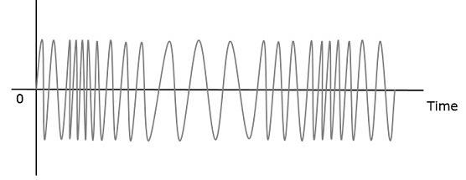
Reverse Engineering Transmissions
Transmissions from the Programmer
Capture raw bits between the programmer and the programming head.
Compare the raw bits with the encoded and modulated RF signals.
Head
Compare
0
1
1
0
...
1
Programmer

Slide 14
Reverse Engineering Transmissions
Transmissions from ICD
Made dummy patient name.
Analyzed RF signal to determine the modulation and encoding scheme.
Transmit information
containing the name
Programmer
ICD
Patient’s name
AAA
Analyze repeated patterned signals

Slide 15
Eavesdropping
Using GNU Radio library + USRP
Builds a GNU Radio program to gather data
Removed 87 lines of C++ code, added 44 lines of code.
Establishing a transaction timeline

Slide 16
Eavesdropping
Intercepting Patient Data
Not cryptographically protected
Cleartext representations of patient data
Easily extractable
Personal data
Patient’s name, date of birth, medical ID number, and patient history.
Name and phone number of the treating physician
Intercepting Telemetry
Activated with a magnet within 5cm of the ICD
Broadcast patient’s electrocardiogram in cleartext
Notes:
electrocardiogram - 심전도

Slide 17
Active Attacks
All active attacks are replay attacks
Transmit-only
Replay attacks with GNU radio
Disclosing patient data
Disclosing cardiac data
Changing patient name
Setting the ICD’s clock
Changing therapies
Inducing fibrillation

Slide 18
Changing therapies
Therapies
ICD’s responses to cardiac events
Replay attack can turns off therapies
After 24 replay attempts, more than one succeeded at disabling all therapies

Slide 19
Inducing fibrillation
The ICD can induce ventricular fibrillation
Sends command shock to the patient’s heart, averaging 137.7 V

Slide 20
Power denial of service attack
Continuous engagement in wireless communication
Decreases battery life faster

Slide 21
Defenses

Slide 22
Defense Goals
Security events should be detectable by patients
Prevent attacks from insiders and outsiders
Draw no power from primary battery

Slide 23
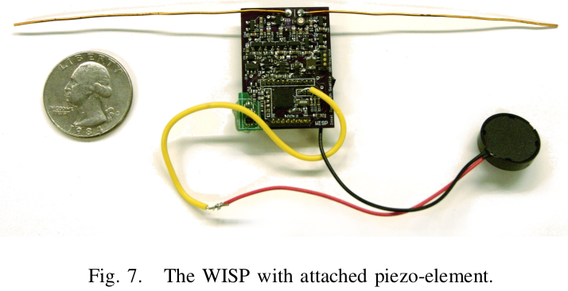
Zero Power Defense
WISPer - Wireless Identification and Sensing Platform
Embedded system : RFID circuit + microcontroller
WISPer harvests RF energy from a RFID reader
Three applications:
Notification
Authentication
Sensible key exchange

Slide 24
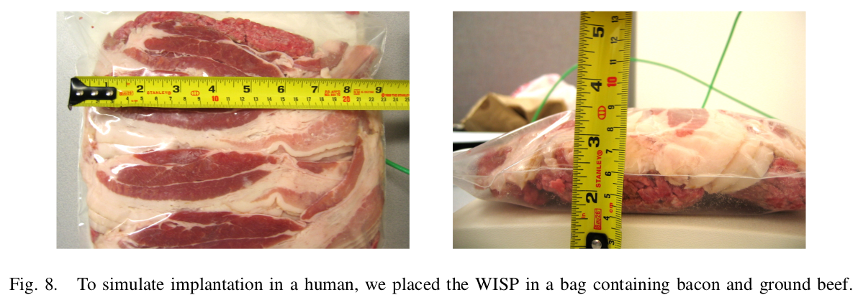
Defense 1 - Notification for Patients
When WISPer is activated, beep via piezoelectric speaker
After beep, notify ICD it can start using radio
Patient aware when ICD is being programmed
Tested with bacon
Measured 84 dB of sound at the surface of the tissue
Normal conversation: about 60 dB

Slide 25
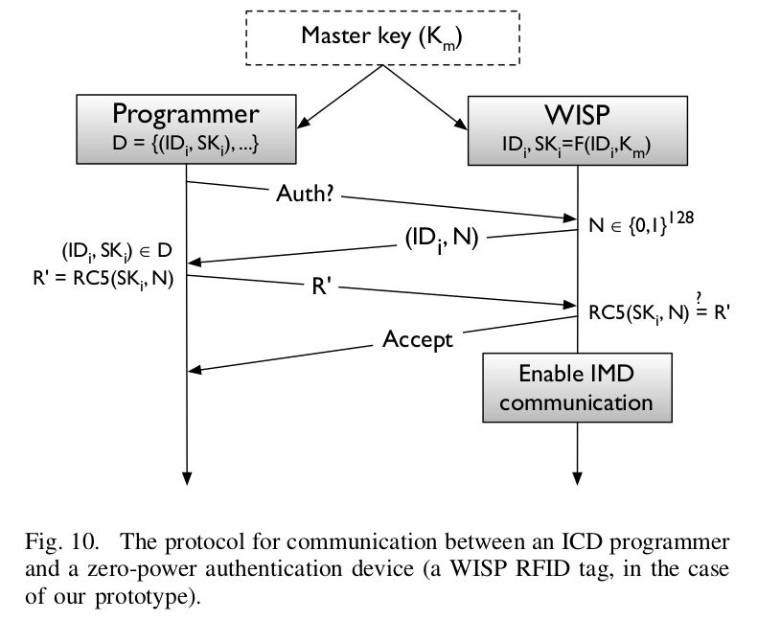
Defense 2 - Authentication
RC5-32/12/16-based Authentication
Only if authentication is successful will ICD be activated
No power is used until authentication succeeds.

Slide 26
Defense 3 - Sensible Key Exchange
Use audio as a channel for crypto key exchange.
Modulate sound wave using same scheme as radio.
Audible to patient, hard to hear at a distance.
Also uses no power.

Slide 27
Conclusion
ICD is susceptible to malicious attacks
From privacy information to intended malfunctioning
Balance between security, privacy, safety, and effectiveness should be achieved
More security should be considered for next-generation ICDs

Slide 28
Related works
Halperin, Daniel, et al. @ 2008
Security and privacy for implantable medical devices.
→ Earlier work surveys a wide range of IMD security issues, including the need
to balance IMD security and privacy goals with safety and effectiveness goals

Slide 29
Related works
A. Perrig et Al. @ 2002
SPINS: Security protocols for sensor networks
C. Karlof et Al. @ 2004 TinySec: A link layer security architecture for wireless sensor networks Studied wireless security in low-power environments, especially in the areas of sensor networks
S. Warren Et Al. @ 2005 Interoperability and security in wireless body area network infrastructures Wireless body area networks
→ Proposed zero-power security approaches to eliminate the stored-energy overhead of cryptography

Slide 30
Related works
D. Spill et Al. @ 2007 BlueSniff: Eve meets Alice and Bluetooth
T. S. Heydt-Benjamin et Al. @ 2007 Vulnerabilities in first-generation RFID-enabled credit cards
→ Demonstrated the utility of software radios by using them to help reverse-engineer and then participate in unknown radio protocols.

Slide 31
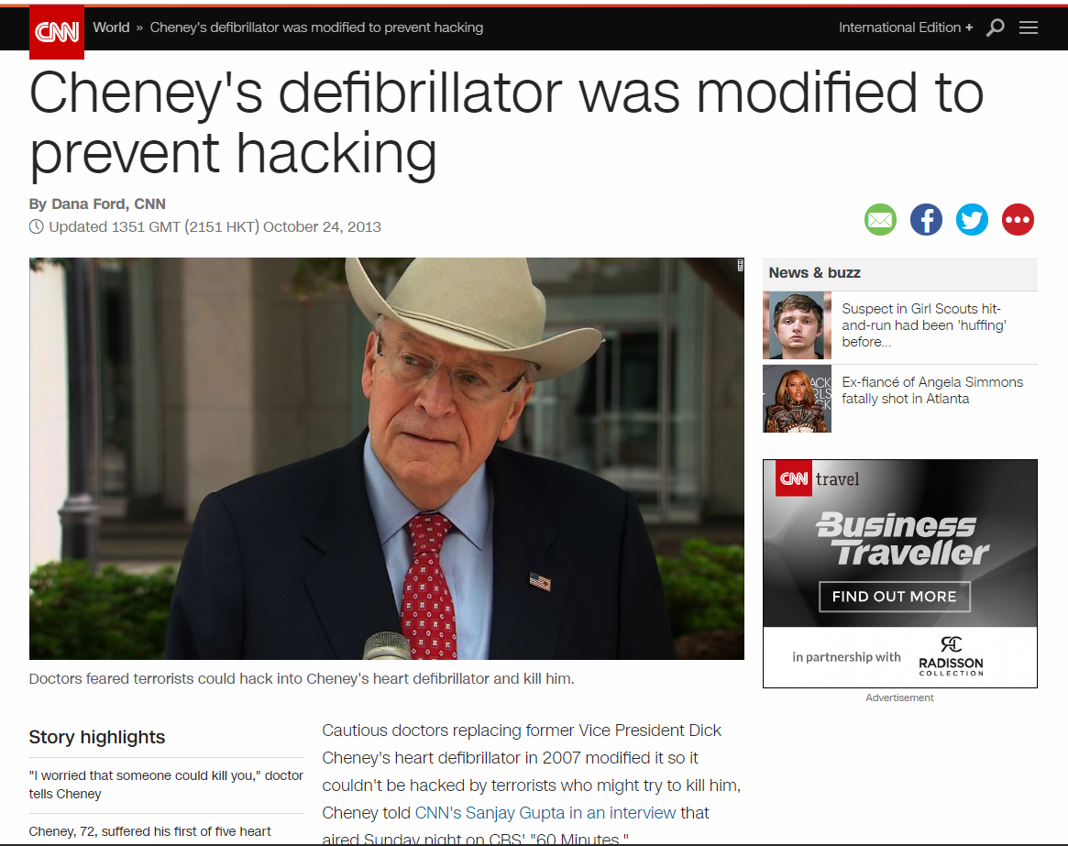
After the paper release

Slide 32
After the paper release

Slide 33
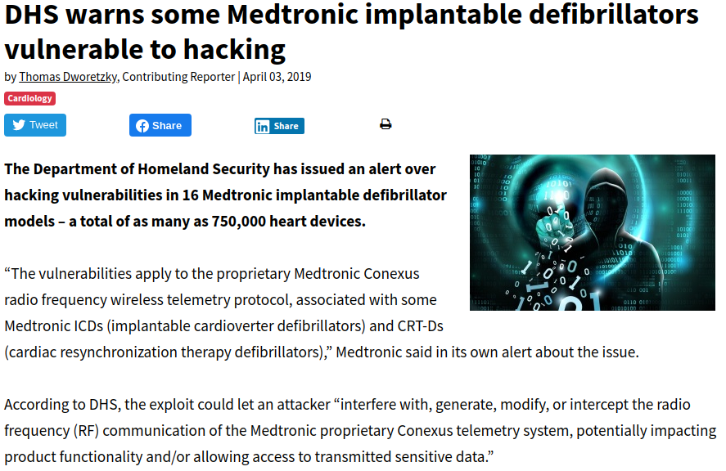
After the paper release

Slide 34
Thank you

