Slide 1
Is Stellar As Secure As You Think?
Minjeong Kim, Yujin Kwon, Yongdae Kim
KAIST
SysSec
Notes:
Hello, everyone. My name is Minjung Kim and I am the graduate student in KAIST. It is a great honor to be able to do the presentation in here. From now on, I am going to talk about the paper named “Is Stellar As Secure As You Think?”.

Slide 2
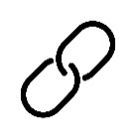
Blockchain
Distributed public ledger where anyone can record transparently, anyone can read, and no one can arbitrarily change the existing records.
new block
Notes:
The blockchain is a distributed public ledger where anyone can record transparently and anyone can read and no one can arbitrarily change any existing records. Each one block consists of some transactions, and the newly generated block is added to the blockchain in chronological order in every round.
And Stellar is one of the blockchain platforms especially for the cross-border payment.

Slide 3
Federated Byzantine Agreement (FBA)
Alternatives to BA
Open membership → Decentralization
Quorum slice
Notes:
And this list of trusted validator is called its quorum slice.

Slide 4
Federated Byzantine Agreement (FBA)
Alternatives to BA
Open membership → Decentralization
Quorum slice
Alice
Notes:
For example, let’s assume that Alice is the validator. And she trusts A,B and C.

Slide 5
Federated Byzantine Agreement (FBA)
Alternatives to BA
Open membership → Decentralization
Quorum slice
Alice’s quorum slice
A
B
C
Alice
Notes:
Then she will make her quorum slice as the green circle.

Slide 6
Federated Byzantine Agreement (FBA)
Alternatives to BA
Open membership → Decentralization
Quorum slice
Alice’s quorum slice
A
B
C
Alice
Statement a
Notes:
Therefore, when she decides whether she will agree on the statement a,

Slide 7
Federated Byzantine Agreement (FBA)
Alternatives to BA
Open membership → Decentralization
Quorum slice
Agree!
Agree!
A
Agree!
B
C
Alice
Statement a
Notes:
If she receives enough “agree” messages from the validators in her quorum slice,

Slide 8
Federated Byzantine Agreement (FBA)
Alternatives to BA
Open membership → Decentralization
Quorum slice
Agree!
Agree!
A
Agree!
Agree!
B
C
Alice
Statement a
Notes:
Then she will also agree on it.

Slide 9
Federated Byzantine Agreement (FBA)
Alternatives to BA
Open membership → Decentralization
Quorum slice
??
??
A
Agree!
B
C
Alice
Statement a
Notes:
On the other hand, if she couldn’t receive enough message,

Slide 10
Federated Byzantine Agreement (FBA)
Alternatives to BA
Open membership → Decentralization
Quorum slice
??
??
A
Agree!
??
B
C
Alice
Statement a
Notes:
Then she will not make any decision on the statement a.

Slide 11
Federated Byzantine Agreement (FBA)
Alternatives to BA
Open membership → Decentralization
Quorum slice
Alice’s quorum slice
A
B
C
D
Bob’s quorum slice
Alice
Bob
Notes:
In addition, if there is another validator named Bob, and he trusts C and D, then Bob’s quorum slice would be like the orange circle.
And Bob will make a decision based on messages from node C and D in his quorum slice.

Slide 12
Federated Byzantine Agreement (FBA)
Alternatives to BA
Open membership → Decentralization
Quorum slice
Alice’s quorum slice
A
Carol’s quorum slice
C
D
E
….
B
….
Bob’s quorum slice
Alice
Bob
Carol
Notes:
Carol also makes his quorum slice and so forth.
So in here, we can see some characteristics of quorum slices.
First, those quorum slices would be overlapped for the system-wide consensus on a new block.
Second, Alice, Bob, Carol or even you if you are running full node and ready to be a validator, you can participate in the consensus if you are included in someone’s quorum slice.
And at last, some validators who are popular might be included in someone’s quorum slice many times but some validators might not be included at all.

Slide 13
What if there is a byzantine node?
What if the node C does not send any messages to others ?
→ Liveness
Alice’s quorum slice
A
B
C
D
??
??
Bob’s quorum slice
Alice
Bob
Notes:
Now let’s think about the situation when there is a byzantine node in the quorum slice.
Note that the byzantine node acts arbitrarily such as sending incorrect messages to others or sending no message at all.
So, let’s assume that C does not send any message to others. If then, Alice and Bob might not be able to make any decision because they did not receive enough messages from validators of each quorum slice.
At this time, since there is no local decision among validators, the consensus process might not be proceeded, this situation is related with the liveness

Slide 14
What if there is a byzantine node?
What if the node C sends different messages to others?
→ Safety
Alice’s quorum slice
A
Agree?
Disagree?
B
C
D
Bob’s quorum slice
Alice
Bob
Notes:
Now, Let’s assume that C sends different messages to others.
For example, if C send “agree” message to Alice’s quorum slice, but “disagree” message to Bob’s quorum slice, then it is possible for Alice and Bob to make different decisions about the statement.
And this may be related with safety issue, because two different values might be confirmed at the same time.

Slide 15
What if there is a byzantine node?
Security : Safety & Liveness
Alice’s quorum slice
A
B
C
D
Bob’s quorum slice
Alice
Bob
Notes:
So, in here, we would regard the security of Stellar is a combination of safety and liveness.

Slide 16
Security depends on the structure of quorum slices?
Notes:
In fact, there can be various structures of quorum slices based on the individual quorum slices. So in the paper, we first investigate the fact that the security in FBA depends on the structure of quorum slices.

Slide 17
Security Depends on the Structure of Quorum Slice?
Relatively Centralized
Alice’s qs
Bob’s qs
Carol’s qs
Peter’s qs
!
!
!
!
Alice
Bob
Carol
Peter
* qs = quorum slice
Notes:
To intuitively understand the meaning of it, let’s think about it with a simple example.
Let’s assume that the current structure of quorum slice looks like the figure above.
This is relatively centralized because all the quorum slices trust the same node.
As a result, if that node fails, all the quorum slices can be affected, making it impossible for all to make any decision because every one cannot receive any message from that node.

Slide 18
Security Depends on the Structure of Quorum Slice?
Relatively Decentralized
Alice’s qs
Bob’s qs
Carol’s qs
Peter’s qs
!
Alice
Bob
Carol
Peter
Notes:
This time, let’s assume the relatively decentralized structure of quorum slices.
As the figure shows, each quorum slice has different and less overlapped validators.
At this time, even though one node fails, most of the quorum slices would not be affected.
Therefore, as can be seen in the explanations, if the structure is too centralized, then small number of byzantine nodes would impact a lot than the decentralized structure.

Slide 19
$(f, x)$-FT (Fault Tolerant) System
If less than $f$ nodes are byzantine, where account for $x \%$ of the total active validators, all nodes eventually can agree on the same value.
Notes:
And to show this fact numerically, we define the new definition, (f,x)-FT system. This means that if less than f nodes are byzantine where account for x% of the total active validators, all nodes eventually can agree on the same value.
For example, when we think about the PBFT, although the f value can be different based on the system, but x would be about 33%.

Slide 20
$(f, x)$-FT (Fault Tolerant) System
If less than $f$ nodes are byzantine, where account for $x \%$ of the total active validators, all nodes eventually can agree on the same value.
FBA is less than or equal to PBFT ($x=\frac{100}{3}$) in terms of $x$ value.
Notes:
And through it, we proved that FBA is less than or equal to PBFT in terms of x value meaning FBA is not superior to PBFT.

Slide 21
$(f, x)$-FT (Fault Tolerant) System
If less than $f$ nodes are byzantine, where account for $x \%$ of the total active validators, all nodes eventually can agree on the same value.
FBA is less than or equal to PBFT ($x=\frac{100}{3}$) in terms of $x$ value
$f$ and $x$ value in FBA can be changed depending on the structure of
the quorum slices
$$x$$
0
$$\frac{100}{3}$$
Notes:
And we also think that unlike PBFT that has the fixed number of x value, the f and x value in FBA can be changed depending on the structure of quorum slices.

Slide 22
What is the current $x$ value in the Stellar system?
Notes:
Therefore, to know the f and x value in Stellar, we had to know about the structure first. So we collected data by running full validators in the main network and by using many external information such as stellarbeat.io explorer to know the structure.

Slide 23
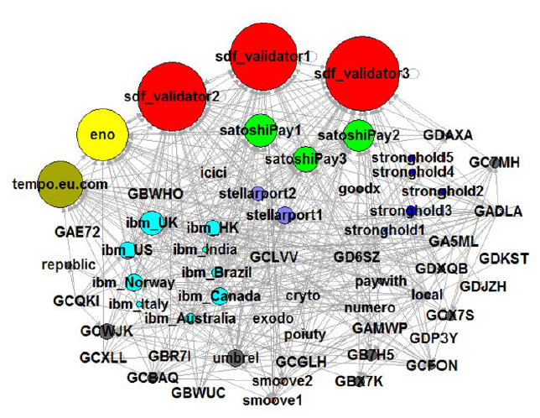
Visualization of Quorum Slices (Jan 22, 2019)
Notes:
With the collected data, we firstly visualized the current structure of quorum slices as the directed graph.
Each circle represents each validator.
And the names of the validator nodes are written on the circle.
And there is an edge. For example, if node A trusts node C then there will be edge from A to C.
Therefore, the more times the validator is trusted, the larger the size of the circle.
Lastly, some validators that are controlled by the same entity are colored the same.

Slide 24
Visualization of Quorum Slices (Jan 22, 2019)
Small number of validators : 62
The power distribution is biased (sdf_validator 1,2,3)
They are controlled by one organization (Stellar foundation)
Notes:
Through this figure, we could firstly find that there were small number of validators in the network, only 62.
Next, the power distribution was highly biased on the sdf_validator 1,2 and 3 with the red color and they are all controlled by the Stellar foundation.
In here, the power means how many nodes trust it. In other words, how many times the validator is included in other’s quorum slices or how many nodes are affected by the message from the validator.
So in here, we visually check that the current structure of quorum slices are highly centralized because Stellar foundation’s nodes are having almost all of the power in the network.

Slide 25
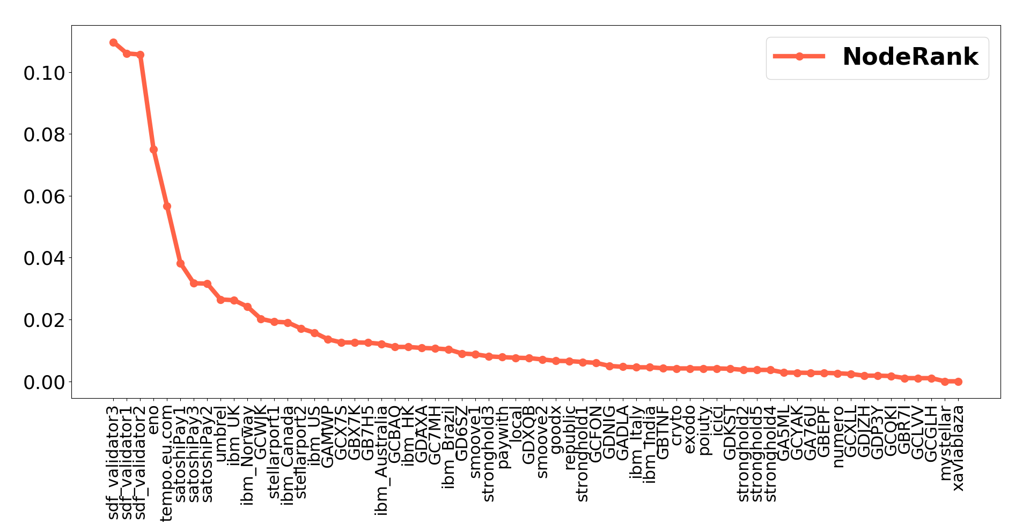
Evaluation of Node Influence (Jan 22, 2019)
NodeRank (NR)
Notes:
Then, to quantitatively compare each node’s degree of influence or power, we propose a new metric which is called as NodeRank.
Noderank is the upgrade version of Pagerank considering additional three typical characteristics of the quorum slices.
The below is the equation of the Noderank.
And this is the result.
The x-axis represents each validator and y-axis represents the NR value.

Slide 26
Evaluation of Node Influence (Jan 22, 2019)
NodeRank (NR)
sdf_validator 1,2,3 are having almost all the power
Centralized!
Notes:
As you can see, the NR values of sdf_Valdiator 1,2, and 3 are the highest.
And the gap between the NR values of sdf_Validators and the others is significant.
Therefore, from this, we can also numerically check that the current structure of quorum slices is centralized.
Then, with the centralized structure, what would be the x value in (f,x)-FT system?
How the centralized structure can have a negative impact on the Stellar system?

Slide 27
What is the effect of the centralized structure?
Notes:
To know that, we study cascading failure as one of the negative impacts of the centralized structure by deleting only a few nodes in Stellar.

Slide 28
Cascading Failure
Assume that the validator needs to receive more than 2 messages to make a decision.
Bob’s qs
Bob
Carol
Alice’s qs
Carol’s qs
Alice
Alice
Bob
Carol

Slide 29
Cascading Failure
Bob’s qs
Bob
Carol
Alice’s qs
Carol’s qs
Alice
Alice
Bob
Carol

Slide 30
Cascading Failure
Bob’s qs
Bob
Carol
Alice’s qs
Carol’s qs
Alice
Alice
Bob
Carol

Slide 31
Cascading Failure
Bob’s qs
Bob
Carol
Alice’s qs
Carol’s qs
Alice
Alice
Bob
Carol

Slide 32
Cascading Failure
Robustness of the cascading failure depends on the structure of quorum slices in the Stellar system.
- In the highly centralized structure, the cascading failure can fail the
entire network (many failures)
- In the highly decentralized structure, the cascading failure can fail a
few quorum slices (few failures)
Then how robust is the Stellar system?
Notes:
In fact, cascading failure may not output the same degree of the robustness no matter what the structure of quorum slices is.
It depends on the structure.
For example, in the highly centralized structure, the cascading failure can fail the entire network which leads to global failure, because failing the most powerful node would impact almost all the quorum slices.
On the other hand, in the highly decentralized structure, the cascading failure can fail a few quorum slices which leads to the local failure.
This can be said that the impact of the cascading is not significant.
Then, how robust is the current Stellar system against the cascading failure?

Slide 33
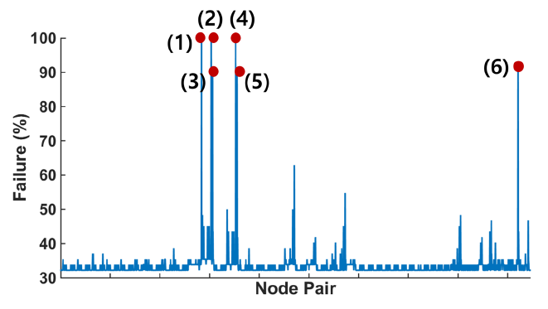
Cascading Failure (Jan 22, 2019)
When 2 nodes fail…
Notes:
So we tested the cascading failure.
We regard the ratio of the failure is the number of failed validators divided by the total number of validators.
So 100% failure means that every node cannot make any decision.
This graph is the result when all pairs of nodes fail in a total of 62 validators.
The result shows that there were 6 cases when the failure rate was above the 90%.
In particular, there were 3 cases when the failure is 100%.

Slide 34
Cascading Failure (Jan 22, 2019)
When 2 nodes fail…
- Any two sdf_validator nodes fail,
then the failure rate is 100%
Stellar was $\left(2,\frac{50}{11}\right)$-FT system.
Notes:
In addition, since if 2 nodes among the total number of validators fail, then the entire network get stuck, we can say that Stellar is currently (2, 50/11)-FT system.

Slide 35
What has changed since the paper was published?
Notes:
After the paper was published, there were some changes in the Stellar network.

Slide 36
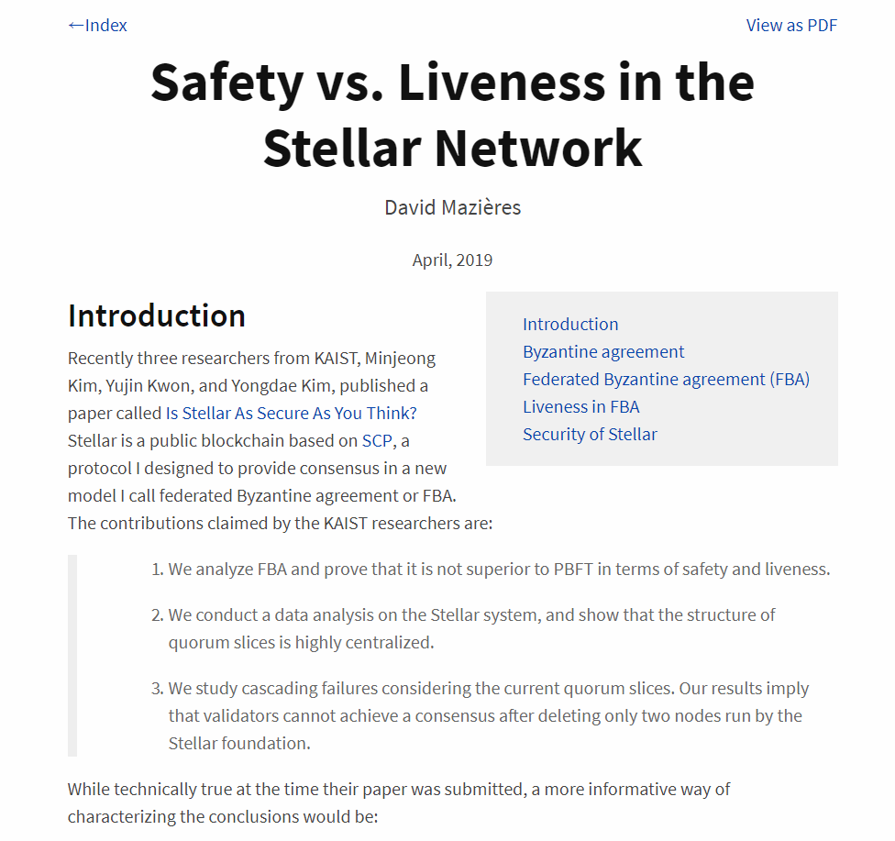
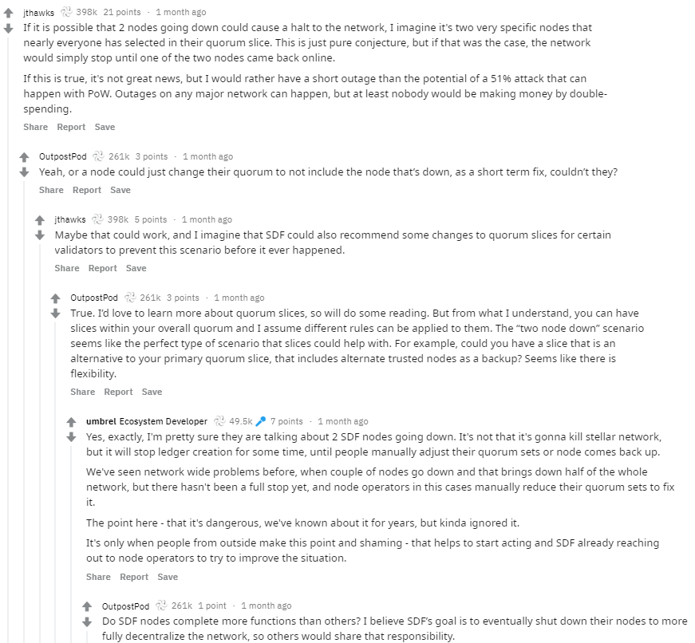
Responsible Disclosure
Notes:
Before publishing the paper, we did responsible disclosure with David Mazieres who is the co-founder of Stellar.
We had many conversations with each other about this issue.
So, he posted the blog about what he thinks as the figure shows.
In addition, there were many discussions about the centralization issues among the validators in the community.
Many of them said that they need to make “safe” structure of quorum slices.

Slide 37
Responsible Disclosure
Is it easy to achieve the safe quorum slice?

Slide 38
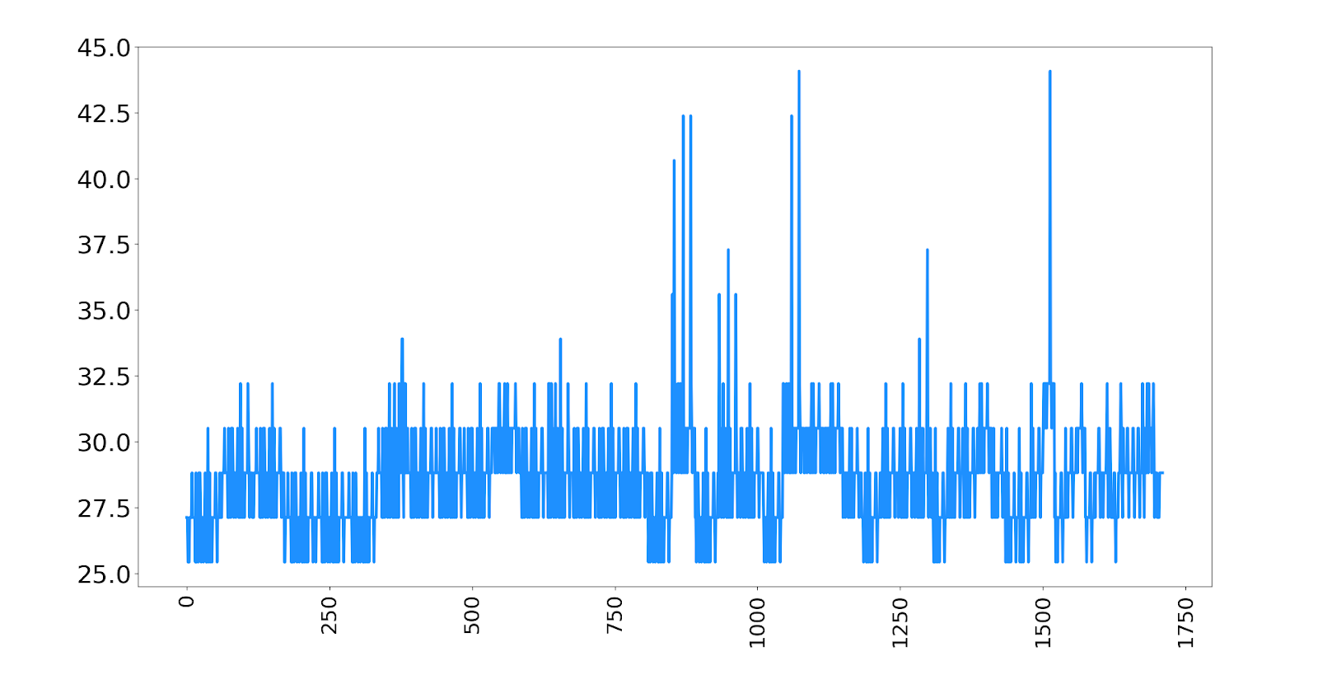
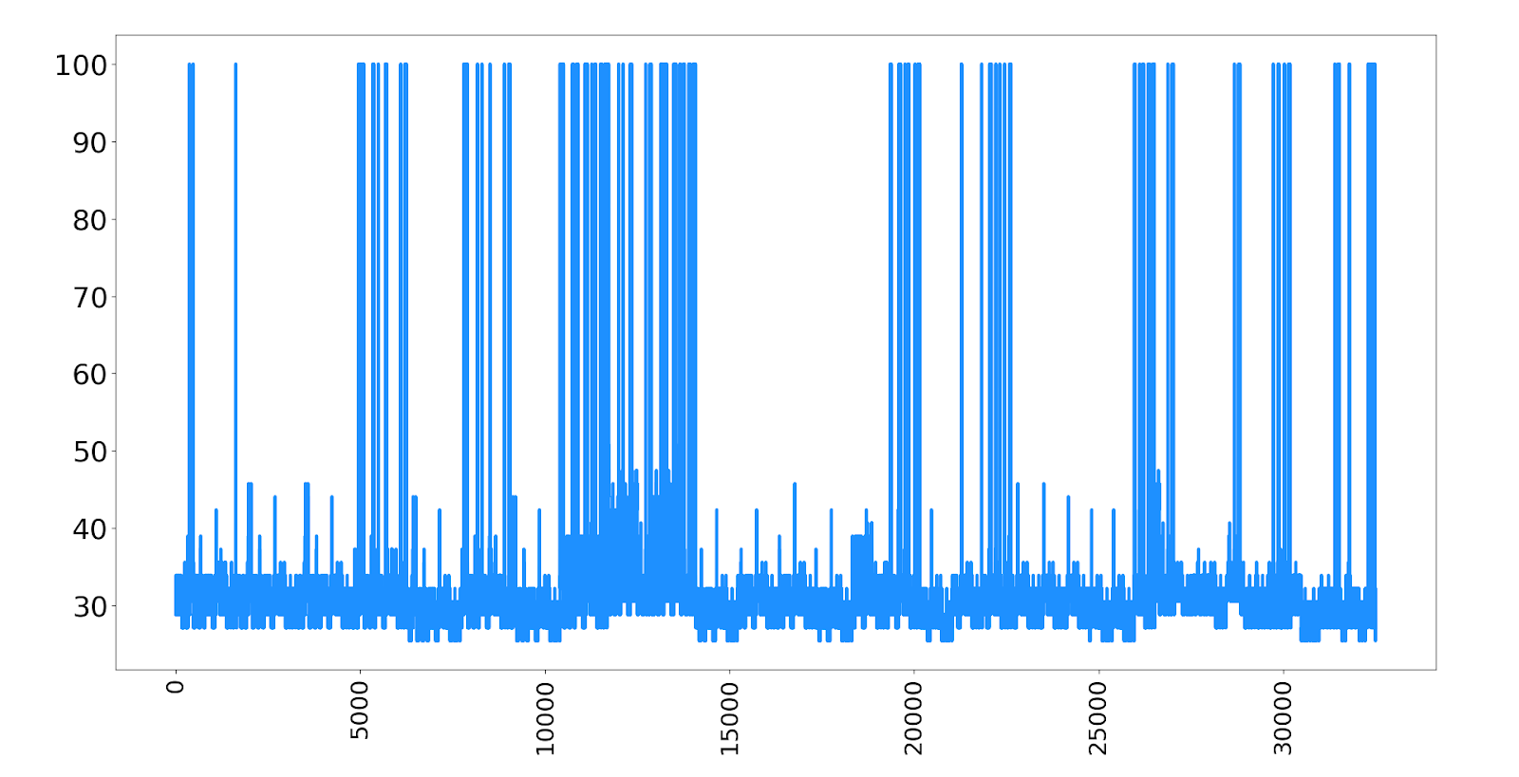
Changes in Stellar (May 1, 2019)
When 2 nodes fail
When 3 nodes fail
251 cases with 3 nodes failure lead to 100% failure of the entire system.
Notes:
After our responsible disclosure and active discussions, many validators including sdf_validator tried to make the quorum slice as decentralized and secure as possible.
As a result, the network became pretty robust against the failure of two nodes.
As you can see, failure of any node pair can not cause more than 45 % failure ratio. However, there were still many cases where the entire network is down when three nodes fail.
This fact indicates that making safe quorum slice which is robust against the cascading failure is not that easy.

Slide 39
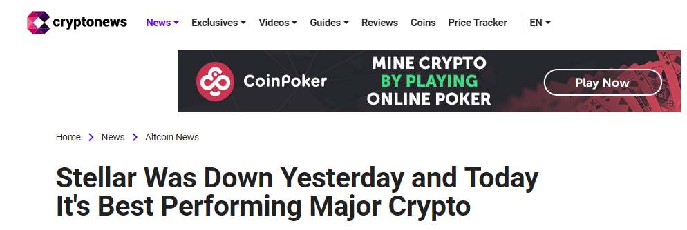
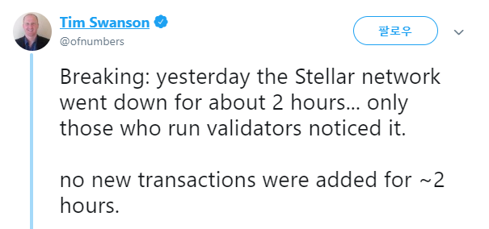
Recently … (May 15, 2019)
Notes:
Then the accident happened eventually. Recently, on May 15th, the Stellar network actually went down for about 2 hours in the real world.

Slide 40
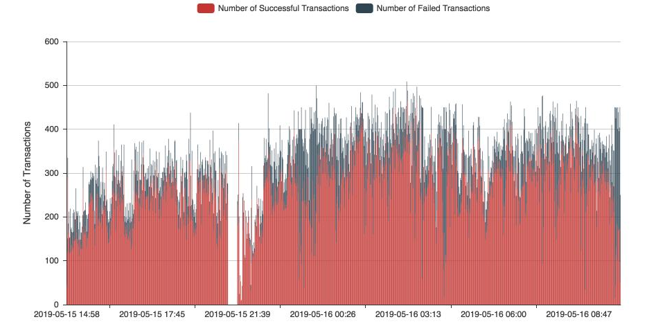
Recently … (May 15, 2019)
By Amun AG twitter
Notes:
This is the graph that represents the number of transactions over the network at that time.

Slide 41
Recently … (May 15, 2019)
By Amun AG twitter
Notes:
As you can see, from 9PM UTC, the number of transactions on the network dropped drastically because of the failure of the entire network. It was revealed that this was caused by the impact of cascading failure as a small number of nodes suddenly went offline.

Slide 42
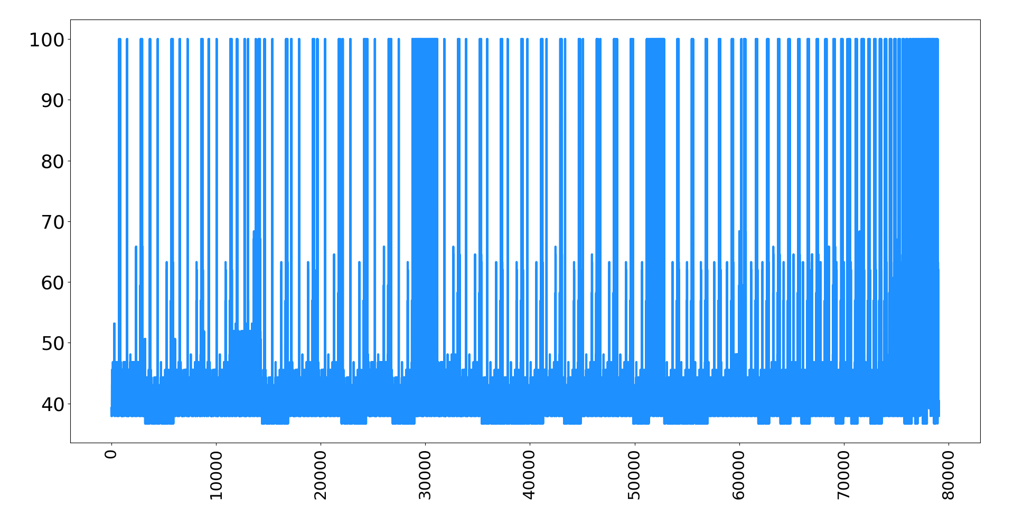
Cascading Failure (May 15, 2019)
When 2 nodes fail
When 3 nodes fail
28 cases when failure of 2 nodes leads to 100% failure ratio!!
Notes:
We analyzed the data right before the accident and found that the structure of quorum slices at that time could fail the entire network with 28 cases of node pair.
It was much worse than that of the studied time.
This shows that individual efforts to decentralize the quorum slices may even weaken the system.
Therefore, it can be seen that it is very difficult to form a safe structure of quorum slices by individual efforts.
What if someone guides validators to make appropriate quorum slice?
Then, it would be hard to say that it is decentralized. It would be much more like private blockchain.
So, after this accident, Stellar recommended validators to include trustable validators such as sdf_validator nodes in their quorum slices. As a result, the situation has returned to the original bad state again.
Therefore, until now, making a safe structure of quorum slices is still an open problem.

Slide 43
Conclusion
Analyzed FBA and proved that FBA is not superior to PBFT
Analyzed the structure of quorum slices → centralized
If any two nodes among the sdf_validator nodes failed, the entire network could be went down.
Stellar was $\left(2,\frac{50}{11}\right)$-FT system.
It did happen in the real world! Individual efforts to further decentralize quorum slices are difficult.

Slide 44
Thank You!
Notes:
When our paper was proposed, many people were interested in it.

