Slide 1
VoLTE Security, Location Privacy
Yongdae Kim
KAIST
SysSec Lab

Slide 2
Cellular Security Publications (Selected)
Location leaks on the GSM Air Interface, ISOC NDSS'12
Gaining Control of Cellular Traffic Accounting by Spurious TCP Retransmission, NDSS' 14
Breaking and Fixing VoLTE: Exploiting Hidden Data Channels and Mis-implementations, ACM CCS'15
When Cellular Networks Met IPv6: Security Problems of Middleboxes in IPv6 Cellular Networks, EuroS&P'17
GUTI Reallocation Demystified: Cellular Location Tracking with Changing Temporary Identifier, NDSS'18
Peeking over the Cellular Walled Gardens - A Method for Closed Network Diagnosis - , IEEE Transactions on Mobile Computing, Vol. 17, No. 10, 2018
Touching the Untouchables: Dynamic Security Analysis of the LTE Control Plane, IEEE S&P 2019
Hidden Figures: Comparative Latency Analysis of Cellular Networks with Fine-grained State Machine Models, HotMobile 2019
Hiding in Plain Signal: Physical Signal Overshadowing Attack on LTE, Usenix Security 2019

Slide 3

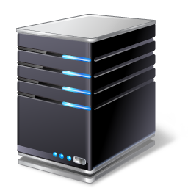

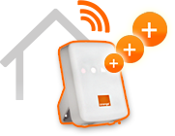



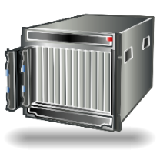



4G LTE Cellular Network Overview
Global Cellular Network
4G Core Network (EPC)
HSS
SGSN
MME
IMS
Billing
Domain
PCRF
HeNB
Firewall
Internet
S-GW
NAT
P-GW
USIM
Signaling
Data Traffic
eNodeB
Data, Signaling
User Equipment
(phone, modem)
SGSN : Service GPRS Support Node
HSS : Home Subscriber Server
MME : Mobility Management Entity
S-GW : Serving Gateway
P-GW : PDN Gateway
PCRF : Policy and Charging Rule Function
HeNB : Home eNodeB
EPC : Evolved Packet Core

Slide 4
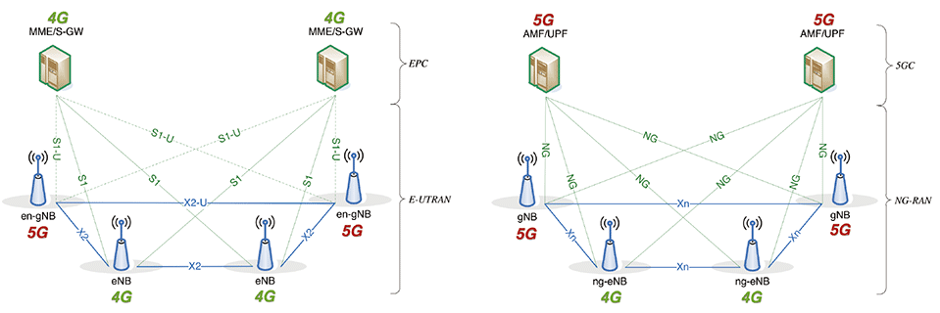
5G NSA vs. 5G SA
gNB (Next generation NodeB), eNB (Evolved Node B), MME (Mobility Management Entity), SPGW (Serving/Packet data network Gateway), HSS (Home Subscriber Server), IMS (IP Multimedia Subsystem)

Slide 5
5G Security?
From control plane security point of view, 5G NSA = 4G LTE!
Still long time left before 5G SA.
So let’s review 4G LTE security for now.
In LTE alone, there are more than 200 vulnerabilities reported.
  Still increasing ☹

Slide 6
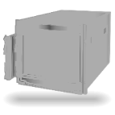
Security Issues in Device & Access Network
3G Network
Femtocell security
Firmware extraction & repackaging
Remote command injection
Eavesdropping of call & SMS
Global Cellular Network
4G Core Network (EPC)
SGSN
HSS
Access Network
MME
Security analysis using SDR
“Fake Base station”: DoS on user device, privacy leak (IMSI), spoofing broadcast channel (i.e. warning message)
“Fake UE”: LTE interception attack, Core network fuzzing
IMS
Billing
Domain
HeNB
PCRF
Internet
3G/LTE modem security
Remote access/command injection
Firmware repackaging
Firewall
S-GW
NAT
USIM
P-GW
USIM security
Reading privacy info. (SMS, Phonebook, cell location)
Get an authentication vector
Exploit other applets
eNodeB
User Equipment
(phone, modem)

Slide 7
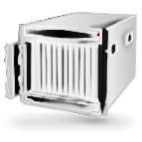
Security Issues in Core Network
Core Network
Charging policy
Overbilling
Free riding
  Zero rating protocol
  TCP Retransmission
Temporary ID Issue
Skip ID Allocation
Same ID Allocation
Bytes Pattern
Location Tracking
Global Cellular Network
3G Network
HSS
SGSN
MME
Distributed
Denial of Service
300Gbps DDoS
IMS
Billing
Domain
NAT
NAT Public IP Disabling
NAT Resource Exhaustion
PCRF
HeNB
Problem Diagnosis
Comparing Signaling
Time Threshold Detection
Signaling Failure
Automatic Analysis
Firewall
Internet
Firewall
TCP-RST DoS
Overbilling
DDoS
Scanning
Fingerprinting
S-GW
NAT
P-GW
USIM
eNodeB
User Equipment
(phone, modem)

Slide 8
Security Issues in Services
Inter-networking
Roaming Service
Eavesdropping
Location Tracking
Privacy leakage
Denial of Service
Fraud
Global Cellular Network
4G Core Network (EPC)
HSS
3G Network
MME
Voice over LTE (VoLTE)
Cell ID Location Tracking
No Encryption/Authentication
Eavesdropping
Accounting Bypass
Network Detach Attack
Call Spoofing/Blocking
Permission Mismatch
Billing
Domain
HeNB
IMS
PCRF
LTE-Rail & Public Security-LTE
Eavesdropping
Remote Denial of Service
Fake Base Station Attack
Proximity Service
Group/Direct Communication
Firewall
Other Networks
S-GW
P-GW
NAT
USIM
eNodeB
User Equipment
(phone, modem)

Slide 9
Cellular vs. Network Security: Why Difficult?
New Generation (Technology) every 10 year
  New Standards, Implementation, and Deployment ➔ New vulnerabilities
Many standard vulnerabilities have not been patched.
  Backward compatibility
Generation Overlap, e.g. LTE CSFB, 5G NSA
  CSFB: 3G, LTE and CSFB vulnerabilities
Cellular networks are different from each carrier and manufacturer in terms of implementations and configurations
  Therefore, vulnerabilities are different ➔ Need for global analysis
Device manufacturers tend to follow carrier’s requirement.
Walled Garden
  Carriers (smartphone vendors) don’t talk to each other about their problem.
  One vulnerability from a carrier will appear in other carriers.

Slide 10
Cellular Security: Special Circumstances
Very few experts who know Cellular Technology and Security
Complicated and huge standards ➔ Hard to find bugs, need large group
Standards are not written in formal languages ➔ Hard for formal analysis
Leave many implementation details for vendors ➔ Bugs
Multiple protocols co-work, but written in separate docs ➔ Analysis complexity
Most of the cellular security analyses have been manual.
New HW/SW tools are needed for each generation.
  Slow/imperfect open-source development
Serious silo effect in carriers, and device vendors

Slide 11


Breaking and Fixing VoLTE: Exploiting Hidden Data Channels and Mis-implementations
SysSec Lab.
Notes:
안녕하세요, 카이스트 시스템 보안연구실 김홍일입니다.
오늘 발표드릴 내용은 LTE 망에서 통화기술로 사용되는 VoLTE를 이용한 공격과 대응방안에 대한 내용입니다.
Good evening.
I’m Hongil Kim from KAIST, Korea.
This is my first time attending C3, and
It’s a great pleasure to present our work in 32C3.
Today, My colleague Dongkwan Kim and I will talk about various vulnerabilities of a newly adopted voice technology in LTE.
Then, we will show you how to exploit and fix these vulnerabilities in operational LTE networks.

Slide 12
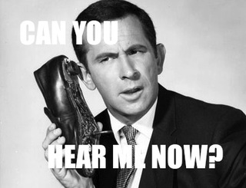
VoLTE = Voice over LTE
Implementation of VoIP on LTE
3G network
  Data and voice are separated
4G LTE network : All-IP based Network
  Both data and voice are delivered as data-flow
Advantages on VoLTE
  For users: high voice quality, faster call setup, better battery life.
  For operators: increase usability, reduce cost, rich multimedia services
Notes:
VoLTE which stands for Voice over LTE is a new voice technology in LTE network.
In case of traditional 2G and 3G network, the delivery network for data and voice is separated.
However, to provide faster data delivery, 4G LTE is implemented into all-IP based network, which means both the voice and data should be deliver on top of IP technology.
Therefore, LTE needs a new voice technology to replace the previous voice call, as a result, LTE adopted VoIP system which is widely used in Internet.
It is similar with SKYPE,
By adopting VoLTE, users can get high quality, faster call setup, and save the device battery,
also operators can increase usability, reduce operaion cost, provide rich multimedia services.
Unlike 3G has separate network for voice and data, LTE has evolved to all-IP based network for faster data delivery.
So, to provide voice in all-IP based network, LTE adopted VoIP system which is widely used in wired network.
먼저 VoLTE에 대해서 간략하게 설명드리도록 하겠습니다.
VoLTE는 Voice over LTE의 약자로 VoIP의 LTE 버전이라고 생각하시면 됩니다.
음성과 데이터가 분리되어있던 3G와는 달리 모든 것을 IP 기반으로 하는 LTE 망에서는 IP 기반의 통화서비스를 지원하기 위해 기존 인터넷망에서 주로 사용하던 VoIP를 도입하게 되었습니다.
VoLTE 적용함으로써 사용자 입장에서는 더 높은 음성 품질과, 짧은 통화 수립 시간을 보장받게 되었고, 통신사 입장에서는 음성과 데이터 서비스를 통합함으로써 망 유지 비용을 줄일 수 있는 장점이 있습니다.
현재 우리나라 3개의 통신사 모두에서 VoLTE를 적용하고 있는데요, 대부분의 사람들은 본인이 쓰는 통화가 VoLTE인지 잘 모르고 있을 것 같습니다.
통신사에서는 VoLTE를 주로 HD voice라 부르고, default로 꺼져있기 때문에 설정에 들어가서 HD voice 켜야 합니다. 위쪽 상태창에 HD voice가 뜨면 VoLTE를 사용할 수 있게 됩니다.

Slide 13


3G
Data
(Packet Switching)
Internet
Voice
(Circuit Switching)
Telephony
Phone
Cell tower
Core network
4G LTE
Data
(Packet Switching)
Internet
IMS
Phone
Cell
tower
Core network
IP Multimedia Subsystem (IMS)
Notes:
Let’s see more details about 3G and 4G to understand how voice technology is changed.
In case of 3G, the core network is separated into two parts: Packet switching and circuit switching
so, the data is delivered by the packet-switching system.
whereas, the voice is delivered by the circuit-switching system.
So, when a user makes a 3G call, then the signaling goes to telephony network through circuit-switching core.
(click)
On the other hand, in 4G LTE networks, it no longer utilizes circuit switching system.
Both the voice and data are implemented with packet-switching core.
And for voice implementation, instead of telephony network, (click) most of the VoIP server functionality is implemented inside an IMS which stands for IP Multimedia Subsystem.
3G망과 LTE망의 차이점에 대해서 좀 더 자세히 살펴보면, 기존의 3G 망의 경우 데이터는 packet switching으로 인터넷과 통신을 하고, 음성은 circuit switching으로 전화국과 통신을 하게 됩니다.
반면에 LTE의 경우, 데이터와 음성 모두 packet switching기반의 IP 통신으로 서비스되는데, 기존의 전화국이 VoLTE를 처리할 수 없기 때문에 IP Multimedia Subsystem이라고 하는 IMS가 새로 들어오게 되었습니다.
이 구간을 좀 더 자세히 살펴보면,

Slide 14



Each service is delivered by bearer
In LTE, all services are delivered data channels, called “bearers”
  Data, Voice, Video, …
Bearer: a virtual channel with below properties
  Based on QCI* value, it determines bandwidth, loss rate, latency (QoS)
  Default bearer: Non Guaranteed Bit rate
  Dedicated bearer: Guaranteed Bit rate
Dedicated bearer for data (HTTP)
Dedicated bearer for VoLTE (RTP)
Default bearer for data (1.1.1.1)
Internet
Default bearer for VoLTE (2.2.2.2)
4G Gateway
IMS
*QCI: QoS Class Identifier
Notes:
In LTE core, all services are delivered as data-flow by using separate bearers.
The bearer is a virtual connection between the device and the core network to support the specific QoS of each service.
As you can see in this figure, 3GPP standards specifies several bearers depending on the service purposes.
Each one has different characteristics such as guaranteed or non-guaranteed bit rate, priority, loss rate and so on.
As you can see here, the bearers for VOLTE service have highest priority, lowest packet delay and loss rate for better performance.
So, when a certain service is turned on, a default bearer is established(이스태블리쉬) with a new IP address. This default bearer generally does not guarantee the QoS but it supports best-effort delivery.
So when the service requires specific QoS, then a dedicated bearer is established within the default bearer. and a new IP address is not assigned for this bearer.
Instead, the traffic through this bearer is typically filtered by protocols and port number.
실제 LTE망에서는 VoLTE뿐만 아니라 모든 서비스들을 bearer단위로 나누고 있습니다. 따라서 기존의 데이터 전송을 위한 default bearer또한 존재하는데요, 각 default bearer별로 하나의 IP를 할당합니다.
그래서 실제 안드로이드 폰에서는 그림과 같이 항상 두 개의 다른 아이피를 가지는 네트워크 인터페이스가 존재합니다. 하나는 data용이고, 다른 하나는 VoLTE용입니다. 위쪽에 보는 IP address는 VoLTE를 위해 열려있는 소켓을 보여주는데요, VoLTE의 기본 포트인 5060으로 바인드 되어있는 것을 알 수 있습니다.
이렇게 망에서는 서비스별로 bearer를 나누어서 관리하기 때문에 VoLTE가 도입되면서 단말과 망 쪽 모두 구현이 복잡해 질 수 밖에 없습니다.

Slide 15
Voice delivery in LTE
Voice is delivered through two bearers
For VoLTE service,
  1. Default bearer: call signaling (control-plane), *SIP
  2. Dedicated bearer: voice data (data-plane), *RTP
Dedicated bearer, port: 1234 (RTP)
Internet
Default bearer, IP addr : 1.1.1.1 (SIP)
4G Gateway
IMS
*SIP: Session Initiation Protocol, *RTP: Real-time Transport Protocol
Notes:
(click) In specific to VoLTE service, two bearers are needed.
when a user turns on VoLTE, a default bearer is established for SIP signaling and a device authenticates itself to the IMS using this default bearer.
After then, if the user makes a VoLTE call, then a dedicated bearer is established for transmitting voice data with a guaranteed QoS.
이동통신망에서는 단말과 망 간에 VoLTE 서비스를 통신을 위해 bearer라는 가상의 채널을 사용합니다. Bearer는 단말과 망 간의 QoS를 만족시키기 위해서 존재합니다.
단말이 맨 처음 망에 접속하게 되면 VoLTE signaling, 즉, control plane message를 위한 default bearer가 만들어지며 새로운 IP를 할당 받습니다. 사용자가 VoLTE전화를 걸면 session initiation protocol이라고 하는 SIP 메세지가 default bearer를 통해 IMS망을 거쳐 signaling이 이루어지며 통화가 수립되면 음성 전달을 위한 dedicated bearer가 형성됩니다.
이 IMS 망 안에는 VoLTE에서 전화 통화를 관리하는 SIP 서버가 존재합니다.

Slide 16
VoLTE makes cellular network more complex
Let’s check potential attack vectors newly introduced in VoLTE
3GPP standards
No Encryption
IMS Bypassing
4G LTE
No Session Manage
Permission Mismatch
4G Gateway
IMS
No Auth
Phone
Cell tower
Free Data Channels
LTE Core
Mobile OS support?
Device HW interface
Accounting infrastructure
Implementation of LTE core
Notes:
Since VoLTE is a totally new voice feature compared to 3G call, adopting VoLTE makes a whole cellular infrastructure more complex.
It involves not only LTE core implementations, but also mobile OS, device hw interface, and even accounting functions.
And if these implementations are not carefully considered, it will cause severe problems.
So we decided to check potential attack vectors which are newly introduced in VoLTE.
As a result, we found several security issues as you can see in this figure.
And these security issues are caused from two fundamental problems. VoLTE accounting and Voice solution in device.
I’ll explain accounting issue first.

Slide 17
#1: VoLTE Accounting
Byte usage
Accounting in 3G
Data (Packet Switching)
Internet
Do operators implement this complicated accounting correctly?
Voice (Circuit Switching)
Telephony
Phone
Cell tower
Time usage
Accounting in 4G (using VoLTE)
Internet
Still time usage
Data (Packet Switching)
IMS
Phone
Cell tower
Unlimited VoLTE call
Byte usage for all services?
Notes:
In case of 3G, the accounting for data and voice is separated by how it is delivered.
So since the data is delivered by packet switching core, it is charged by byte-usage, whereas the voice is charged by time-usage of channel allocation for call.
In case of LTE, as I mentioned before, both the voice and data is delivered as data-flow.
So, It’s natural to apply byte usage for both voice and data.
However, most operators still separates accounting policy for voice and data.
Moreover, they provide unlimited VoLTE calls as a default pricing plan.
This may cause more complicated implementation of accounting function although the delivery network became much simple.
From this, one may ask,
Do operators implement this complicated accounting correctly?
첫번째는 VoLTE의 과금 방식입니다. 기존의 3G망에서는 데이터와 음성이 다르게 처리가 되었는데요, packet switching으로 처리되는 데이터는 사용한 양 만큼 과금이 되었고 circuit switching의 음성의 경우에는 사용한 시간만큼 과금하게 되어있었습니다.
반면 LTE는 모든것이 packet switching으로 처리가 되기 때문에, VoLTE가 3G의 데이터처럼 사용한 만큼 과금이 될 것이라 생각할 수 있지만, 사실은 여전히 시간 단위로 과금이 되고 있었습니다. 또한 VoLTE에 대해서는 무제한으로 사용할 수 있는 서비스를 제공하는 통신사도 많았습니다. 따라서 이런 복잡한 과금 방식이 문제가 발생할 수 있다고 생각하게 되었습니다.

Slide 18

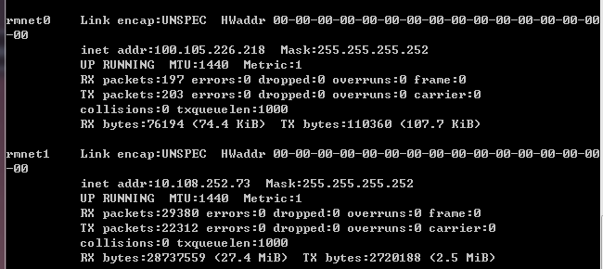


#2: Voice solution in device, LTE
4G LTE Phone
4G LTE network
AP
Voice signaling
Data
Internet
CP
AP
CP
Cell Tower
IMS
Application processor
Running mobile OS (Android)
Running User application
Phone
An app can easily manipulate voice signaling in AP
Can an app make a call without “CALL_PHONE” permission?
Notes:
LTE 기기에서는 VoLTE 기능이 ap에 소프트웨어적으로 구현이 되어서 통화를 하기 위해서는 VoLTE 인터페이스를 이용한 socket통신을 하기때문에
On the other hands, the voice signaling of VoLTE is done by SW in AP which means an malicious user app can easily access the signaling procedure by opening the network socket for voice signaling. Furthermore, unlike 3G call solution, we found that “CALL_PHONE” permission is not required. We could make a VoLTE call only with “INTERNET” permission.
For example, in android system, there are usually two network interfaces called “rmnet0” and “rmnet1”, one is for data service and the other one is for VoLTE service.
By checking llistening port, we can infer that rmnet0 interface is for a VoLTE service since 5060 is a default port for SIP signaling.
This enables a unpriviledged attacker can easily explore the IMS network by sending manipulated call signaling only with “INTERNET” permission.
This problem enables an unpriviledged attacker to manipulate voice signaling procedure only with “INTERNET” permission.
(For LTE capable smartphones generally have two default bearers with different IP addresses: one for data and the other for voice)

Slide 19
Quick Summary of Our Finding
Four free data channels
  Using VoLTE protocol (for all operators)
    SIP tunneling
    Media tunneling
  Direct communication (for some operators)
    Phone-to-Internet
    Phone-to-Phone
Five security issues
  No encryption of voice packets
  No authentication of signaling
  No call session management (DoS on the cellular infrastructure)
  IMS bypassing
  Permission model mismatch (VoLTE call without “CALL_PHONE” permission)
Notes:
This is the summary of our evaluation results.
In total, we found 4 free data channels and 5 security problems.
For each issues, Dongkwan will present the details.
Hi, I’m Dongkwan and let me take over from this part.
Let’s start from the free data channels using VoLTE protocol first.

Slide 20
Attack Implementation in Detail
Caller
Core Network
Callee
AP
AP
SIP
Sender
Media
Sender
SIP
Receiver
Media
Receiver
VoLTE Interface
VoLTE Interface
CP
CP
SIP, RTP
IMS
SIP
Audio Data
(60-100 bytes)
DIAG
Command
Notes:
We implemented both tunneling methods.
Some of you might think that the concept is too simple, but in fact, its actual implementation is not, so,
Let me explain the details.
Left side is the caller’s phone, and right side is the callee’s phone.
We have two senders (click) and two receivers (click) for each tunneling method.
When caller sends data to callee, (click) SIP or RTP packets are transferred through IMS.
SIP packets (click) can be received in AP as normal data packets, but RTP packets are not.
(click) They are firstly handled in CP, and only audio data is passed to AP.
Because the size of this audio data is too small, to fullay utilize the bandwidth, we need to find another way.
While searching the way, (click) we found that there is a DIAG command.
What’s DIAG command?
이 두 가지 방법에 대해서 실제로 구현을 해보았는데요,
왼쪽이 caller의 핸드폰이고 오른쪽이 callee의 핸드폰입니다.
SIP와 media tunneling각각 sender와 receiver가 존재합니다.
Caller가 데이터를 전송하게 되면 SIP와 RTP패킷이 IMS망을 거쳐서 callee에게 전달이 되는데,
SIP 패킷은 receiver가 있는 AP로 바로 전달 되는 반면 RTP패킷은 CP에서 한번 처리가 되고 음성 데이터만이 AP로 올라가게 됩니다. 이때 올려보내는 음성 데이터의 크기가 너무 작기 때문에 bandwidth를 풀로 사용하기 위해서는 다른 방법을 찾아야했습니다.
방법을 찾던 도중 DIAG라고 하는것을 찾아내었는데요,

Slide 21

Free Channel: Direct communication
Phone-to-Internet
  Open a TCP/UDP socket with voice IP
  Send data to the Internet
  E.g. TCP/UDP Socket (Src: voice IP/port, Dst: youtube.com/port)
Internet
Default bearer for VoLTE, 1.1.1.1
4G Gateway
IMS
Notes:
You can just open a socket with the IP address assigned for VoLTE default bearer, and send data to the Internet
VoLTE를 위한 default bearer에 할당되는 IP에 socket을 bind해서 인터넷에 데이터를 보내거나

Slide 22


Free Channel: Direct communication
Phone-to-Phone
  Open a TCP/UDP socket with voice IP
  Send data to callee
  E.g. TCP/UDP Socket (Src: voice IP/port, Dst: callee’s voice IP/port)
Default bearer for VoLTE, 1.1.1.2
Internet
Default bearer for VoLTE, 1.1.1.1
4G Gateway
IMS
Notes:
Or send data to other’s IP addresses for VoLTE default bearer.
In fact, connection between IP addresses for Data transmission is blocked at the gateway,
but as VoLTE is newly adopted, Some operators are not doing well enough.
다른 사용자의 VoLTE default bearer의 IP로 데이터를 보내는 것입니다.
원래 데이터용 IP address끼리의 phone to internet과 phone to phone은 막혀있지만,
VoLTE가 새로 도입되었기 때문에 gateway에서 아직 제대로된 필터링을 하지 못하고 있는 것으로 보입니다.

Slide 23
Overbilling with Direct Communication?
Phone-to-Phone
  Open a TCP/UDP socket with voice IP
  Send data to callee
  E.g. TCP/UDP Socket (Src: voice IP/port, Dst: callee’s data IP/port)
Default bearer for Data, 1.1.1.3
Internet
Default bearer for VoLTE, 1.1.1.1
4G Gateway
IMS
Notes:
You can also think of overbilling other people sending data to their data interface,
But we didn’t actually test this because we only focused on VoLTE itself.
다른 사용자의 VoLTE default bearer의 IP로 데이터를 보내는 것입니다.
원래 데이터용 IP address끼리의 phone to internet과 phone to phone은 막혀있지만,
VoLTE가 새로 도입되었기 때문에 gateway에서 아직 제대로된 필터링을 하지 못하고 있는 것으로 보입니다.

Slide 24

Summary Table
Free Data Channels | Free Channel | US-1 | US-2 | KR-1 | KR-2 | KR-3
Using VoLTE Protocol | SIP Tunneling | ✓ | ✓ | ✓ | ✓ | ✓
 | Media Tunneling | ✓ | ✓ | ✓ | ✓ | ✓
Direct Communication | Phone to Phone | ✓ | ✘ | ✓ | ✘ | ✘
 | Phone to Internet | ✘ | ✓ | ✓ | ✘ | ✘
Weak Point | Vulnerability | US-1 | US-2 | KR-1 | KR-2 | KR-3 | Possible Attack
IMS | No SIP Encryption |  | X | ✓ | ✓ | ✓ | Message manipulation
 | No Voice Data Encryption | ✓ | ✓ | ✓ | ✓ | ✓ | Wiretapping
 | No Authentication | X | X | O | O | X | Caller Spoofing
 | No Session Management | O | O | O | X | O | Denial of Service on Core Network
4G-GW | IMS Bypassing | O | X | O | X | X | Caller Spoofing
Phone | Permission Mismatch | Vulnerable for all Android |  |  |  |  | Denial of Service on Call, Overbilling
: Vulnerable
: Secure
Notes:
To summarize, we found these kind of vulnerabilities, and as I mentioned before four free data channels.
To solve these problems,
정리하자면 아래와 같은 다양한 취약점들을 찾았고, 앞서 설명드린 4개의 free data channel 또한 찾았었습니다.
이런 문제를 해결하기 위해서

Slide 25
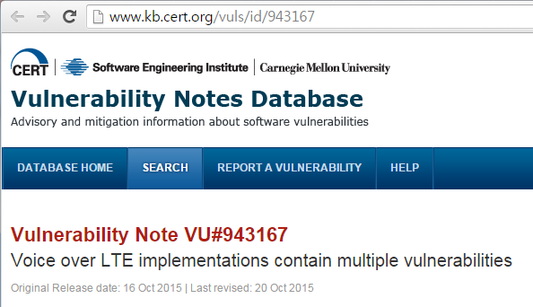
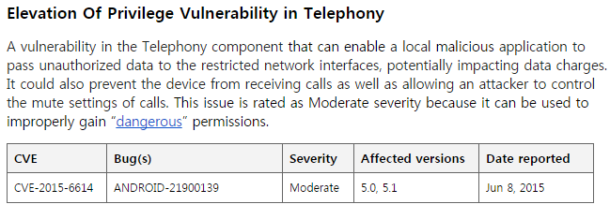

Discussion
Some parts of 3GPP specifications are left to operators
  Several misunderstandings of the operators
  Different implementations and security problems
  Even important security features are only recommendations, not requirement
We reported vulnerabilities to US/KR CERTs, and Google in May
  Google replied “moderate severity”
  All two U.S. operators ACK’ed, but no follow-ups
  Only two among three KR operators have been fixing with us
Notes:
US/KR CERT,
통신사들의 상반된 반응

Slide 26
Conclusion
Newly adopted VoLTE has
  A complex (legacy time-based) accounting
  Delegated voice signal (previously done by CP) to AP
We analyzed the security of VoLTE for 5 operators, and found
  Four free data channels
  Five security problems
All related parties have problems
  3GPP, telcos, IMS providers, mobile OSes, and device vendors
More and more reliance on cellular technology
  Automobiles, power grid, traffic signal, ...
Holistic re-evaluation of security for VoLTE?
Notes:
정리하자면,
새로운 기술은 항상 문제점을 가지고 있습니다. 그런 문제점을 해결하기 위해서 새로운 기술에 대한 보안 연구는 항상 필요하구요. VoLTE가 새로 도입되었는데, 더 많이 deploy되기 전에 보안에 대한 충분한 재고가 필요할 것 같습니다.

Slide 27
GUTI Reallocation Demystified: Cellular Location Tracking with Changing Temporary Identifier
B. Hong, S. Bae, and Y. Kim
NDSS 2018

Slide 28
Location Privacy Leaks on GSM
We have the victim’s mobile phone number
Can we detect if the victim is in/out of an area of interest?
  Granularity? 100 km²? 1km²? Next door?
No collaboration from service provider
  i.e. How much information leaks from the HLR over broadcast messages?
Attacks by passively listening
  Paging channel
  Random access channel

Slide 29
Cellular Network
HSS
GSM Air Interface
ATR
HLR
MS
BTS
VLR
PSTN
MSC
BSC
Notes:
• The Home Location Register (HLR), a database containing the subscription information and location information.
• The Visitor Location Reguster (VLR), in charge of one or multiple areas where mobile stations may roam in and out of. This entity handles the temporary IDs (TMSI) of the mobile stations.
• TheMobileServicesSwitchingCenter(MSC)handlestheregistrationandhandoverformobile stations roaming in and out of the area it is responsible for.
• The Base Station System (BSS) is a network of base station transceivers and controllers re- sponsible for communicating directly with the mobile station. Those equipments are typically what is at a cellular network tower.
• The Mobile Station (MS) is the mobile device carried by the user. It is composed of the actual device and a Subscriber Identity Module (SIM).

Slide 30
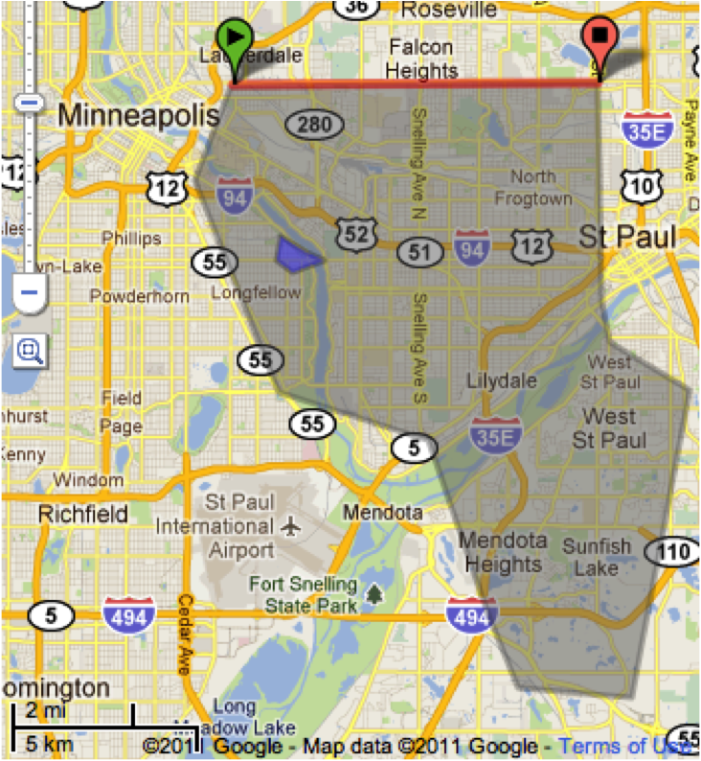
Location Leaks on Cellular Network
IMSI
  a unique # associated with all GSM
TMSI
  Randomly assigned by the VLR
  Updated in a new area
PCCH
  Broadcast paging channel
RACH
  Random Access Channel
SDCCH
  Standalone Dedicated Control Channel
LAC has multiple cell towers that uses different ARFCN
BTS
Paging Request
PCCH
MS
Channel Request
RACH
Immediate Assignment
PCCH
Paging Response
SDCCH
Setup and Data
Notes:
IMSI (International Mobile Subscriber Identity), TMSI (Temporary Mobile Subscriber Identity), LAC (Location Area Code), absolute radio-frequency channel number (ARFCN)
Call the victim to ensure they have their phone on (The network uses an ID unknown to us)
Watermark calls: 2 or 3 calls with known delays in between, Abort each call before completion, 5 seconds after dialing, Paging messages issued, but victim’s phone never rings
Attempt to recover the watermark on the paging channel, Find paging messages with IDs and delays similar to the ones we used
Result
Case 1: watermark on PCCH is heard, The victim is in the same LAC
Case 2: immediate assignment on AGCH is heard “regularly”, The victim is within the same cell tower
Case 3: the RACH traffic from the victim’s phone is heard, They are really close (20 m)

Slide 31
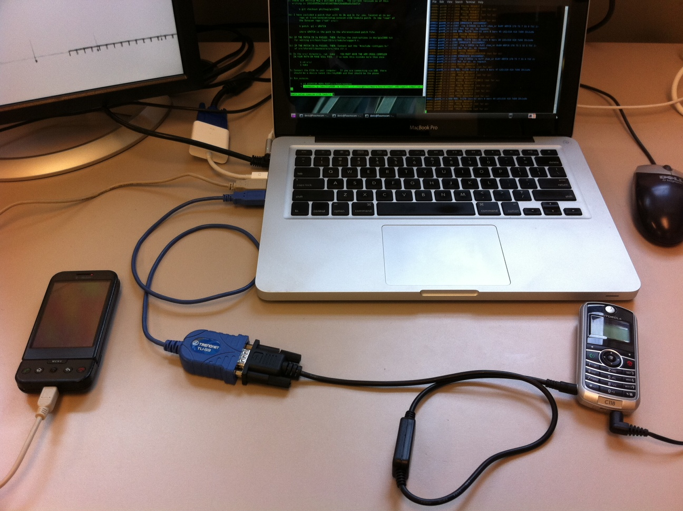
Platform
Serial cable and reprogrammer cable ($30)
VirtualBox running Ubuntu and OsmosomBB software (free)
HTC Dream with custom Android Kernel ($100)
Motorola C118 ($30)

Slide 32
Phone number-TMSI mapping
dt
PSTN
PCH
dt
Time

Slide 33
Silent Paging
Delay between the call initiation and the paging request: 3 sec
Median delay between call initiation and ring: 6 sec

Slide 34
Immediate Assignment
Is IA message sent to all towers
in the same LAC?
How do we identify IA message?
  No identifiable information
Check the correlation between
IA and Paging request
Notes:
The left box plot shows the time difference between the paging request for our target TMSI and the very next Immediate Assignment.
The middle boxplot shows the difference between the TMSI timestamp and the IA messages if we are listening on a different ARFCN.
Finally the last boxplot shows a control by picking a random time and the next IA message.

Slide 35
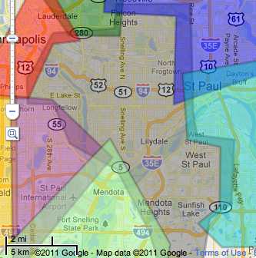
Location Area Code (LAC)
Notes:
Grey area is T-Mobile LAC 747d

Slide 36
Hill Climbing to discover towers

Slide 37
Mapping cell signal strength
Notes:
A cell phone will likely pick the tower that has the highest signal strength (RSSI). This map indicates where that phone might be if they are on a particular tower.

Slide 38
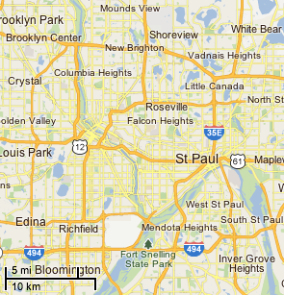
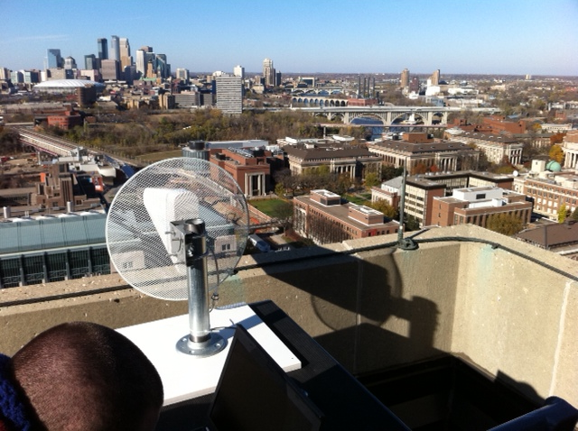
Coverage area with 1 antenna
Downtown Minneapolis
Observer
Yagi
antenna
Towers in this area are
observable with a
rooftop 12 db gain antenna
John’s newly
shaved head

Slide 39
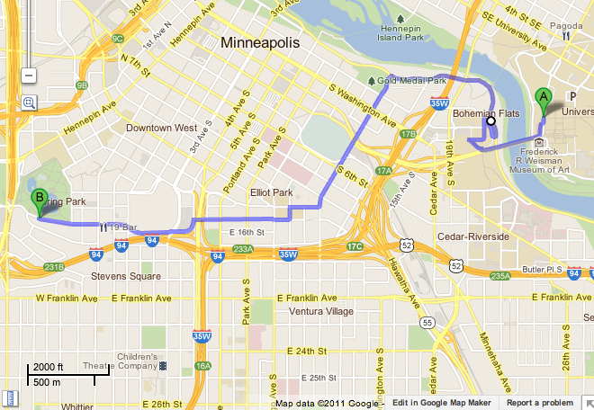
Following a walking person
Observer
End
Start
Approximate areas covered by towers to which the victim’s phone was attached to

Slide 40
Defense of Location Tracking
Temporary Identifier Reallocation
  GUTI Reallocation in LTE
  To prevent between subscriber and ID mapping
Q. Is GUTI Reallocation the solution to existing attacks?
A. It is Yes
But simply changing is not a solution!
Notes:
The simplest solution is to change these temporary identifiers every time a call completes.
And this is already implemented.
LTE introduces a control procedure “GUTI REALLOCATION” to reassign a GUTI.
Now, then, Is GUTI Reallocation the solution to avoid location tracking?
Yes.
But devils in the details.
In the rest of this talk, I will show that GUTI reallocation procedures in different telcos have serious problems.
How?

Slide 41
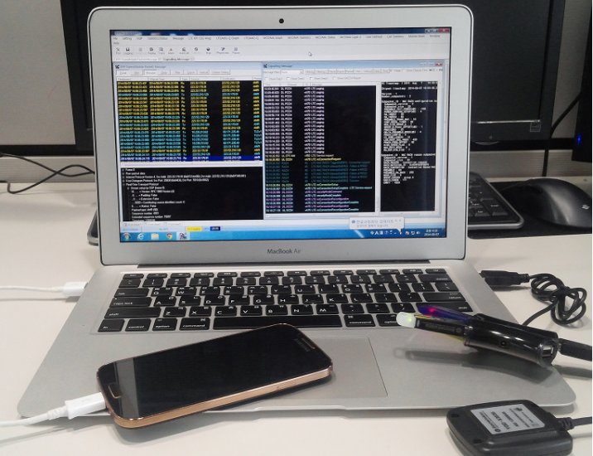
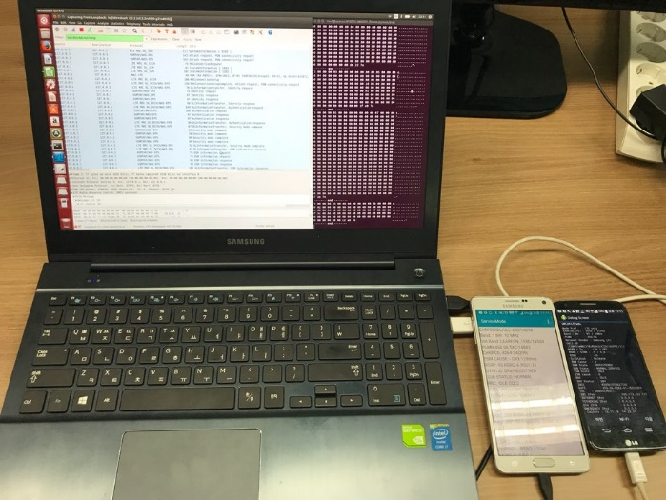
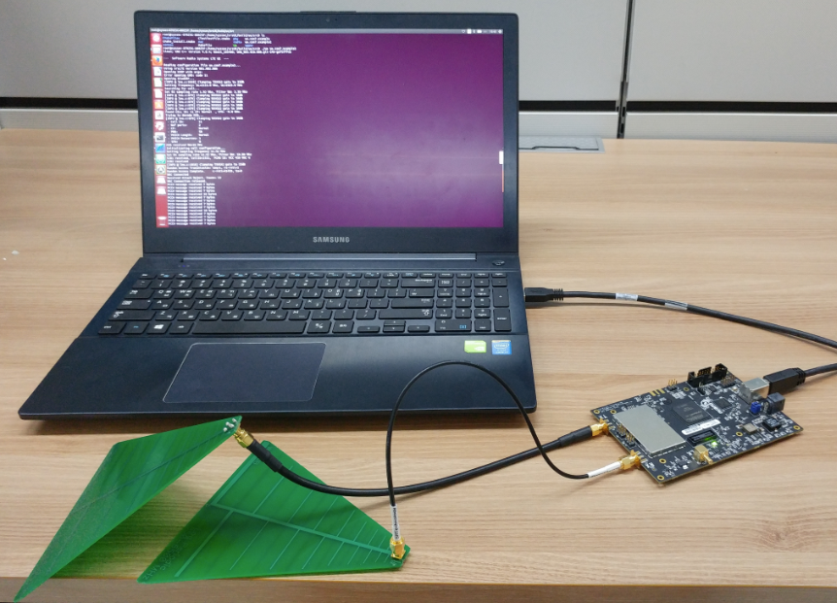
Experiment Setup
Device Analysis
Broadcast Channel Analysis
srsLTE
(open source)
Antenna
USRP B210
Diagnostic Monitor
Signaling Collection and Analysis Tool (SCAT) [1]
Broadcast Channel Receiver
[1] B. Hong, S. Park, H. Kim, D. Kim, H. Hong, H. Choi, J.P. Seifert, S. Lee, Y. Kim, Peeking over the Cellular Walled Gardens - A Method for Closed Network Diagnosis -, IEEE Transactions on Mobile Computing.
Notes:
First, we collected data for traffic analysis.
To do this, we used a few tools.
1. A commercial diagnostic monitor and a tool called SCAT we developed were used to collect and analyze device’s control plane messages.
2. To analyze the paging messages of the broadcast channel, open source library srsLTE and software defined radio USRP B210 were used.

Slide 42
Worldwide Data Collection
Country | # of OP. | # of USIM | # of signalings | Country | # of OP. | # of USIM | # of signalings
U.S.A | 3 | 22 | 763K | U.K. | 1 | 1 | 41K
Austria | 3 | 3 | 807K | Spain | 2 | 2 | 51K
Belgium | 3 | 3 | 372K | Netherlands | 3 | 3 | 946K
Switzerland | 3 | 3 | 559K | Japan | 1 | 2 | 37K
Germany | 4 | 19 | 841K | South Korea | 3 | 14 | 1.7M
France | 2 | 6 | 305K
Data summary
Collection Period: 2014. 11. ~ 2017. 7.
# of countries: 11 # of operators: 28 # of USIMs: 78 # of voice calls: 58K # of signalings: 6.4M
※ OP: operator, USIM: Universal Subscriber Identity Module, Signaling: control plane message
Notes:
Here are the data we collected:
Over a period of about three years, we collected data
from 28 carriers ~~in 11 countries ~~using a total of 78 USIMs.
The total number of voice calls was over 50,000 ~~~and the number of signaling messages were more than 6 million.
Finally, these countries are leaders in telecommunication.
How about the result?

Slide 43
Same vs. Fingerprintable IDs
NDSS’12, ‘16: Same ID → Location Tracking!!
This work: ID Fingerprinting → Location Tracking!!
Notes:
We already know that location tracking is possible if the GUTI is not changed.
In this paper we show that location tracking is possible even for changing temporary identifiers, if

Slide 44
Fixed Bytes in GUTI Reallocation
19 operators have fixed bytes
Allocation Pattern | Operators
Assigning the same GUTI | BE-III, DE-II, FR-II, JP-I
Three bytes fixed | CH-II, DE-III, NL-I, NL-II
Two bytes fixed | BE-II, CH-I, CH-III, ES-I, FR-I, NL-III
One bytes fixed | AT-I, AT-II, AT-III, BE-I, DE-I
AT: Austria, BE: Belgium, CH: Switzerland, DE: Germany, ES: Spain, FR: France, JP: Japan, NL: Netherlands
Notes:
In the experiment, we found that a total of 19 carriers out of 28 carriers fixed some of four bytes in GUTI reallocation.
As you can see, these countries are all developed countries.
Now the attack is very simple. Just look for fixed bytes.
Let’s look at a few examples.

Slide 45
Case I: Netherlands (NL-I)
FF
F
C0
C
80
8
40
4
(a) 1st byte
(b) 2nd byte
FF
FF
C0
C0
80
80
40
40
(c) 3rd byte
(d) 4th byte
Notes:
This figure shows the GUTI reallocation logic of a Dutch carrier for a single customer.
Each figure shows changes of a byte in GUTI.
Can you see something strange?

Slide 46
Case I: Netherlands (NL-I)
FF
F
C0
C
80
8
Fixed Three Bytes
40
4
(a) 1st byte
(b) 2nd byte
FF
FF
C0
C0
80
80
40
40
(c) 3rd byte
(d) 4th byte
Notes:
As you can see, a Dutch carrier fixed 3 of the 4 bytes in the GUTI.

Slide 47
Case II: Belgium (BE-II)
C0
38
36
80
34
40
32
30
(a) 1st byte
(b) 2nd byte
FF
FF
C0
C0
80
80
40
40
(c) 3rd byte
(d) 4th byte
Notes:
Let’s take one more example.
Do you see it?
Yes.

Slide 48
Case II: Belgium (BE-II)
C0
38
36
80
34
40
32
Fixed Two Bytes
30
(a) 1st byte
Monotone Increasing One Byte
(b) 2nd byte
FF
FF
C0
C0
80
80
40
40
(c) 3rd byte
(d) 4th byte
Notes:
This Belgian carrier has two bytes fixed and monotonically increasing one byte.

Slide 49
Fixed Bytes in GUTI Reallocation
19 operators have fixed bytes
Allocation Pattern | Operators
Assigning the same GUTI | BE-III, DE-II, FR-II, JP-I
Three bytes fixed | CH-II, DE-III, NL-I, NL-II
Two bytes fixed | BE-II, CH-I, CH-III, ES-I, FR-I, NL-III
One bytes fixed | AT-I, AT-II, AT-III, BE-I, DE-I
AT: Austria, BE: Belgium, CH: Switzerland, DE: Germany, ES: Spain, FR: France, JP: Japan, NL: Netherlands
Notes:
In summary, out of 28 carriers, 19 carriers use some of the bytes fixed in GUTI reallocation.
How about the rest of the 9 carriers.
I was bit angry and also suspicious, because I know that telcos often make mistakes.
So I tried something different by revisiting 4 carriers.

Slide 50
Stress Testing
No noticeable rule of GUTI Reallocation for some operators
Invoking voice call continuously with a short time
  Two types of test
    Weak stress testing
    Hard stress testing
      Calls at shorter intervals than weak stress test
Notes:
Our approach was stress testing.
The stress test here is simply a way to reduce the time interval between repeated calls.
Hard stress test is a method of calling and hanging without waiting
The result? As you expect ~~~

Slide 51
Stress Testing Result
Force the network to skip the GUTI reallocation
  Perform experiments on US and Korean operators
    Two US and two Korean operators
Network skip
GUTI Reallocation
End weak
stress testing
FF
Operator | Weak Stress Testing | Hard Stress Testing
KR-I | O | O
KR-II | X | O
US-I | X | O
US-II | O | O
C0
80
40
O: Reuse GUTI
X: No noticeable change
Notes:
The network skips GUTI Reallocation.
This figure shows a change in the GUTI value of one Korean operator.
As you can see, suddenly the network skips GUTI reallocation after 10 random assignment.
Note that this values vary.
All of the operators that we conducted stress test showed similar results in reusing GUTIs.
How about the rest of five operators?
Because Yongdae’s funding expired, we could not visit there.
But, I guess the rest will be the same.

Slide 52
Success Rate of our Attack
Required number of calls covering 99% success rate
Notes:
To check if a victim is located, we need different number of calls, because the number of fixed bytes are different.
This figure shows a required number of calls covering 99 % success rate for location tracking.
Even if only two bytes are fixed, we can find a user with less than five calls.

Slide 53
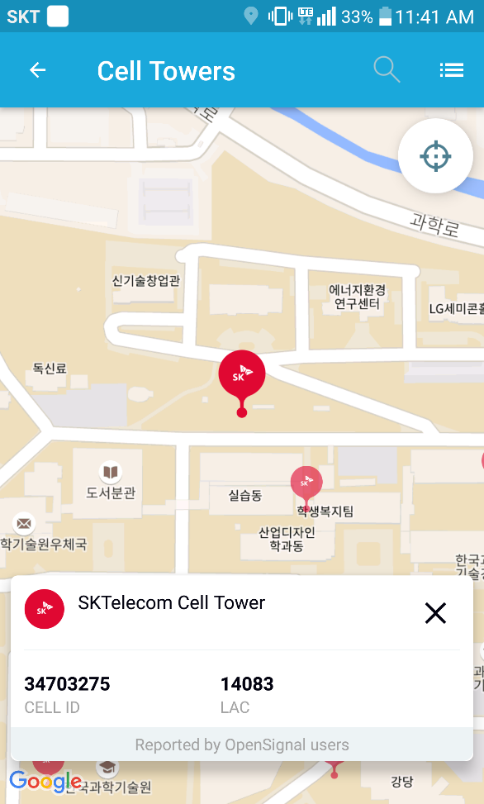
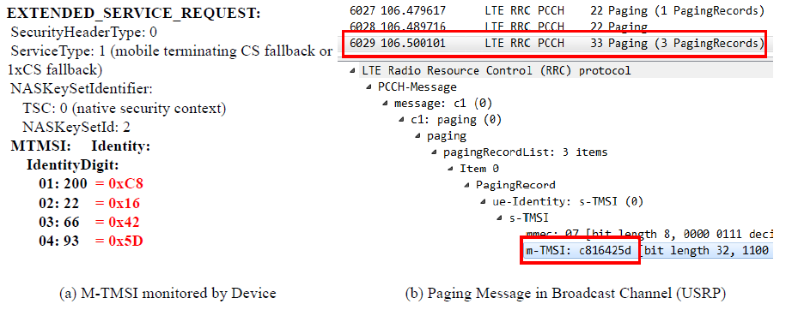
Location Tracking with GUTI
Observation of broadcast channels after call invocation
  Pattern matching (fixed bytes, assigning same GUTI)
  Location tracking (Tracking Area, Cell)
OpenSignal (at KAIST)
Notes:
Using this attack, I checked if Yongdae is at KAIST one day.
These captured messages are observed in device and broadcast channels, respectively.
As you can see, device’s identity and broadcast channel’s identity are the same.
The broadcast channel receiver can capture the GUTI when the user receives the call.
Once I know 1) the operator of Yongdae’s mobile device, and 2) Korean operator’s paging policy and 3) location of base station, as you can see I was able to check Yongdae’s location.
Nowadays, an opensource database such as opensignal reports both cell ID and location code of operators.
How can telcos prevent this attack?

Slide 54
Defenses + Requirements
Frequent refreshing of temporary identifier
  Per service request
Unpredictable identity allocation
  Cryptographically secure pseudorandom number generation
    Hash_DRBG can be used
Collision avoidance
Stress-testing resistance
Low cost implementation
Notes:
GUTI reallocation procedure must be secure.
What are the requirement?
First, temporary identifier must be changed per service request.
Second, identity reallocation logic must be unpredictable.
A lightweight cryptographically secure pseudorandom number generator such as Hash_DRBG could be used.
Of course, ID allocation should not cause collisions and should be resistant to stress testing.
It would also be better if it was implemented at low cost.
For details of our solution, please refer to our paper.

Slide 55
Conclusion
Predictable reallocation logic
  GUTI reallocation pattern
    Fixed bytes (19 operators)
  Same GUTI
    By stress test (4 test cases)
    Assigning same GUTI
Location tracking is still possible in cellular network!
Secure GUTI reallocation mechanism is required
Notes:
Despite previous warning that insecure temporary identifier may break user’s location privacy, the current GUTI reallocation procedure is insecure.
19 of 28 carriers world wide fixes a few byes in GUTI.
4 carriers we revisited were vulnerable to stress testing.
We also proposed a lightweight secure GUTI reallocation logic in our paper.
Thank you for your attention.

Slide 56
Questions?
Yongdae Kim
  email: yongdaek@kaist.ac.kr
  Home: http://syssec.kaist.ac.kr/~yongdaek
  Facebook: https://www.facebook.com/y0ngdaek
  Twitter: https://twitter.com/yongdaek
  Google “Yongdae Kim”

