Slide 1
IS523–2019F
WALNUT: Waging Doubt on Integrity of MEMS Accelerometers with Acoustic Injection Attacks
By Timothy Trippel, Oﬁr Weisse, Wenyuan Xu*, Peter Honeyman, Kevin Fu
20193050 Kil, Myo Joon

Slide 2
Introduction

Slide 3
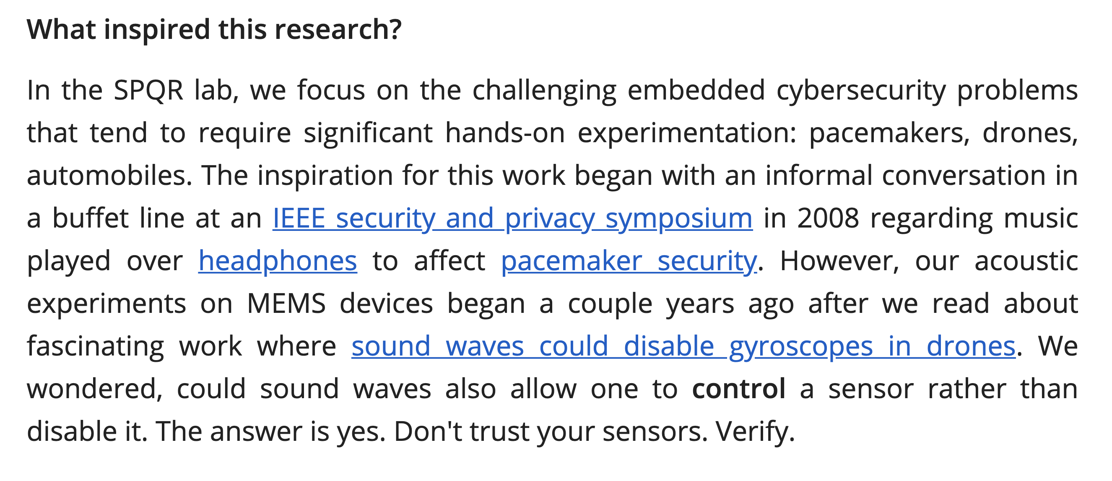
https://spqr.eecs.umich.edu/walnut/

Slide 4
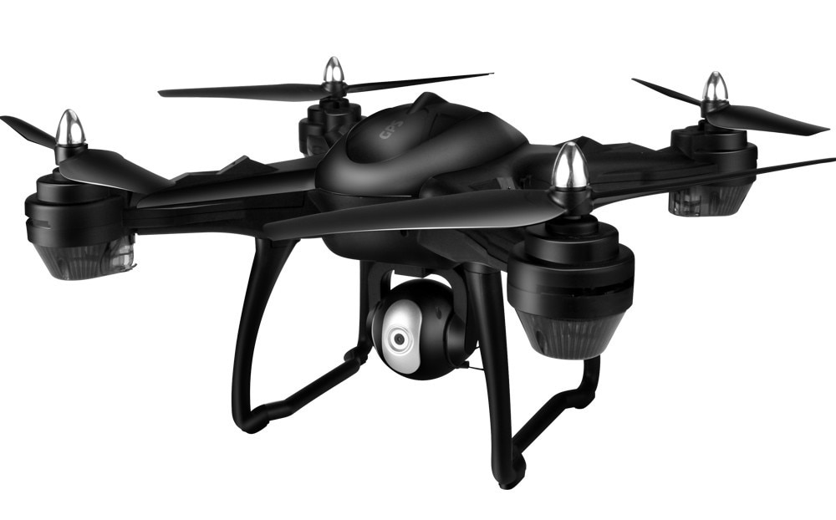
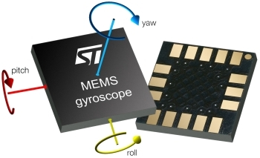
Rocking drone: sensor side channel
Notes:
Rocking drone
Sensor side channel
Micro Electro Mechanical System
MEMS accelerometer가 얼마나 많이 사용되고 있는지: 스마트폰, 자동차, 의료 장치, 드론, IoT 장비,
Millions of accelerometers reside inside smartphones, automobiles, medical devices, anti-theft devices, drones, IoT devices, and many other industrial and consumer applications.

Slide 5
MEMS accelerometer

Slide 6
MEMS: Micro Electro Mechanical System
Notes:
Capacitive MEMS에 대해 설명

Slide 7
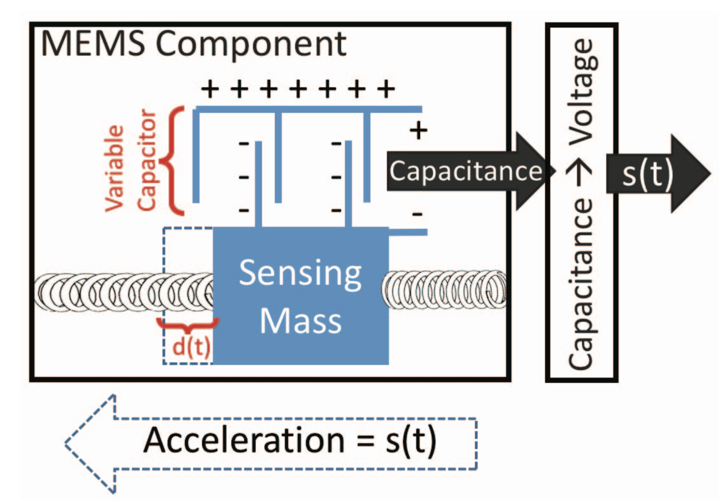
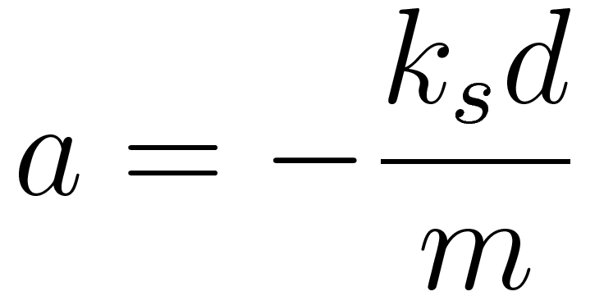
Capacitive MEMS accelerometer
Newton’s 2nd law of motion
Hooke’s law
Acceleration voltage signal

Slide 8
Attack modeling

Slide 9
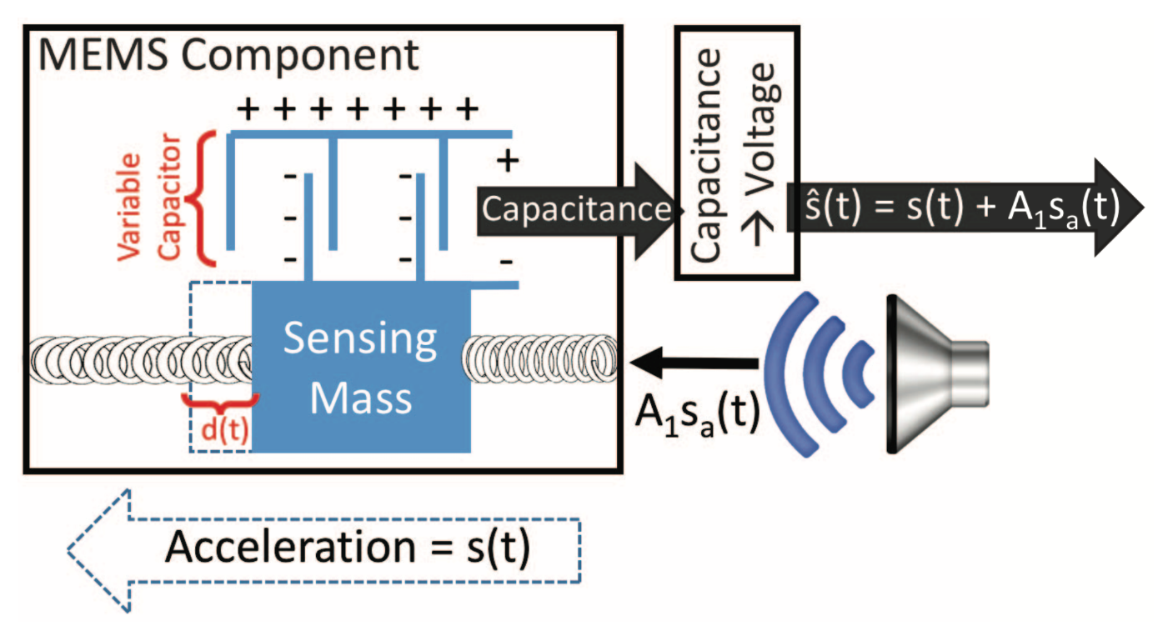
Acoustic injection attack modeling

Slide 10
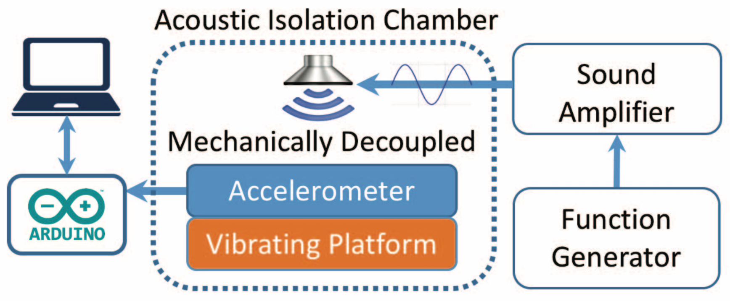
Experiment: Evaluating the model
Notes:
Vibrating platform: vibrating at 70Hz to simulate true acceleration
Sampled by ADC at 7kHz
Placed in an acoustic isolation chamber to avoid external noise
Sound amplifier amplified a 2.9kHz acoustic signal supplied to speaker
Acoustic signal was on/off modulated at 0.5Hz

Slide 11
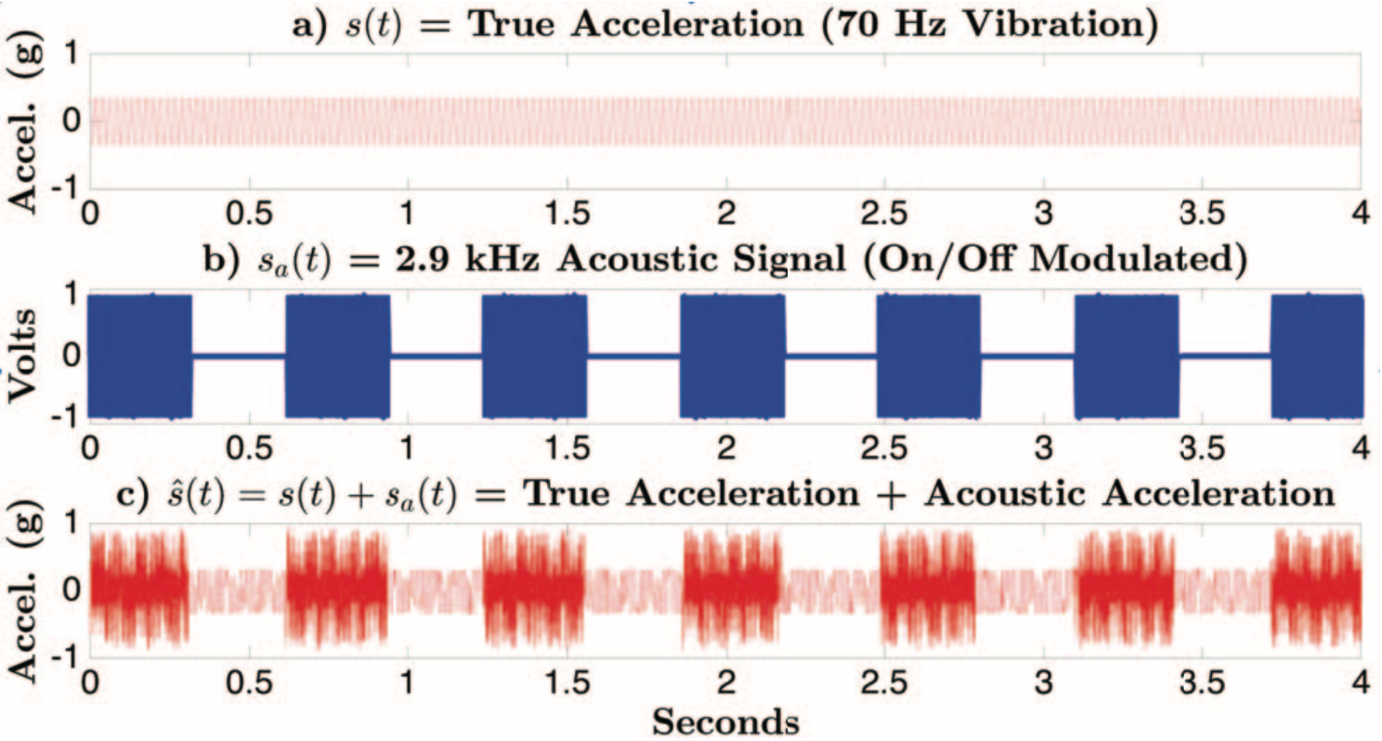
Experiment: Results
Notes:
Measured acceleration is a linear combination of the true acceleration and the artificial acoustic acceleration, proposed by the model.

Slide 12
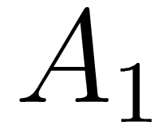
Maximizing the Acoustic Disturbance
Maximize
Resonance
Notes:
센서의 기계적인 공진 주파수와 일치해야 한다
To maximize the acoustic disturbance, based on the model, the attenuation coefficient A₁ should be maximized.
A₁ is maximized when the system is vibrated at its resonant frequencies.
(i.e., achieving maximum displacement of mass with A₁ = 1)
Thus, the acoustic frequency must match the mechanical resonant frequency of the sensor to generate acoustic acceleration.

Slide 13
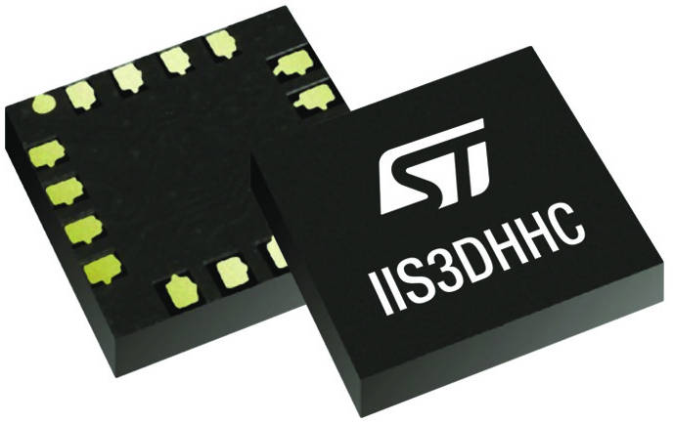
Attack model
Notes:
Attack Scope
Sensor에 acoustic한 영향을 줄 수 있는 거리에서 attack
Sensor Access
거의 동일한 기기를 구할 수 있어야 가능한 attack
타겟으로 하는 MEMS accelerometer의 exact model을 추출할 수 있어야 함
Speaker access
Able to induce sound in any shape in the vicinity of the victim device, at frequencies in the human audible to ultrasonic range (i.e., 2 - 30kHz)

Slide 14
Signal conditioning H/W

Slide 15
Ideal output measurement
Notes:
Ideal한 경우 inject된 acoustic acceleration은 모두 제거 되어야 한다

Slide 16
Nyquist requirement
Suppose the highest frequency component for a given analog signal is f_{max}.
According to the Nyquist Theorem, the sampling rate must be at least 2f_{max}, or twice the highest analog frequency component.

Slide 17
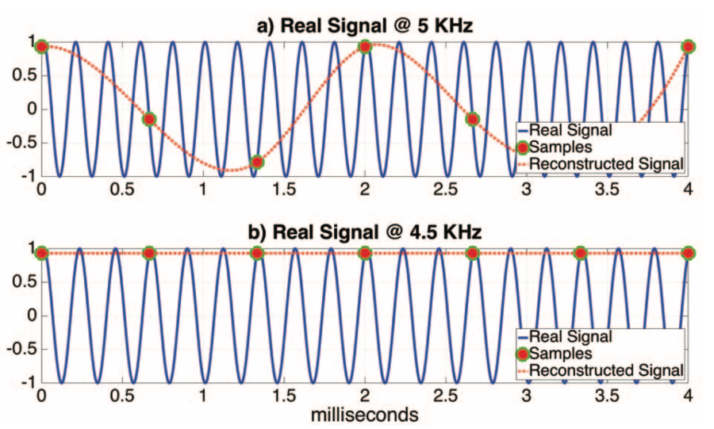
Signal aliasing
Sampling rate: 1.5kHz
Indistinguishable signals due to an inadequate sampling rate

Slide 18
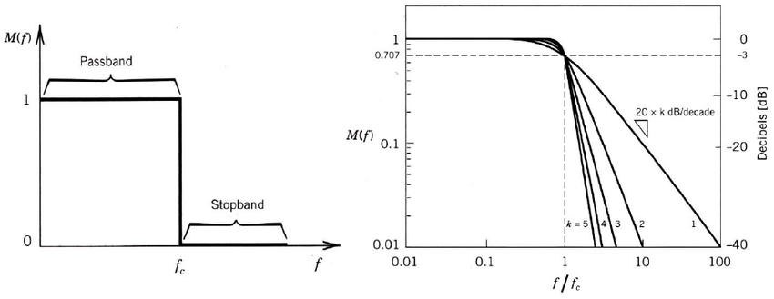
Insecure LPF

Slide 19
Insecure LPF: Fluctuating

Slide 20
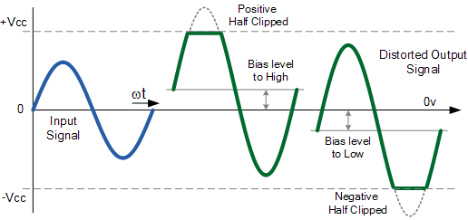
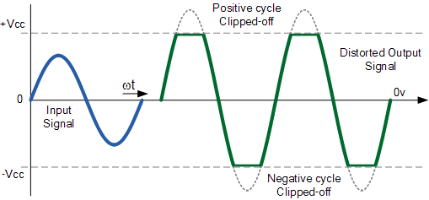
Insecure amplifier

Slide 21
Insecure amplifier: Constant shifted

Slide 22
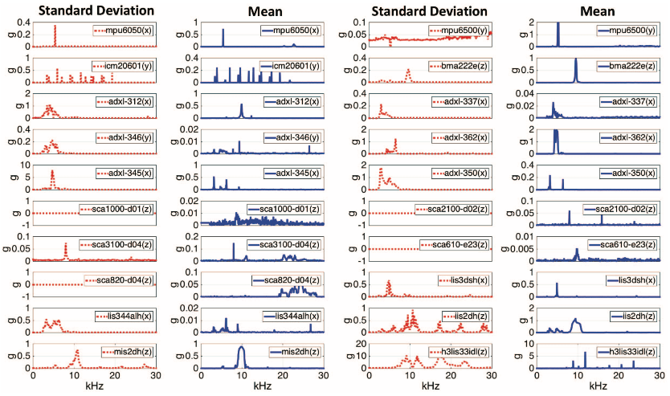
Experiment: Finding resonant frequencies
Notes:
At resonant frequency, the output measurement deviate from normal (i.e., fluctuating (std. dev.) or constantly shifted (mean)).
Peak들이 다 공진 주파수들을 의미 -> 범위를 가질 수도 있음
Fluctuating -> std.dev
Const shift -> mean

Slide 23
Acoustic injection attack

Slide 24
Overview of acoustic injection attacks
Insecure LPF -> fluctuating => output biasing
Insecure amplifier -> constant shifted => output control

Slide 25
Output biasing attack
Stabilizing - Achieved by signal aliasing
Reshaping - Achieved by signal modulation
PM use full amplitude of the carrier signal
AM utilize the upper or lower half of the carrier signal
Notes:
Stabilise fluctuating false measurements into constant measurements
Reshape the desired output signal by modulating it on top of the acoustic resonant frequency
STEP 2: Reshaping
PM allows an attacker to use full amplitude of the carrier signal
AM utilizes the upper or lower half of the carrier signal

Slide 26
Signal aliasing
The signal’s frequency is an integer multiple of the sampling frequency: DC alias

Slide 27
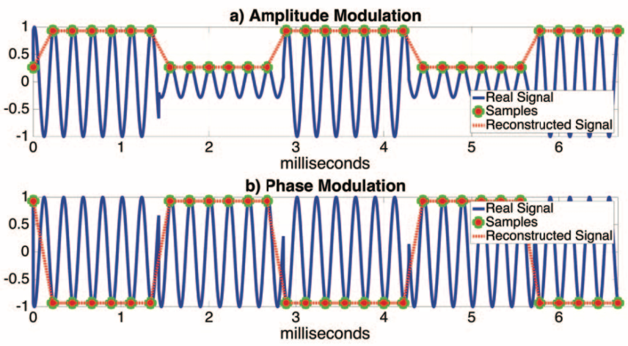
Transmit information signals over carrier signal
Signal modulation

Slide 28
WALNUT: Demo
https://www.youtube.com/watch?time_continue=2&v=C8aZ5nBmKH0&feature=emb_logo

Slide 29
Output biasing attack: Result

Slide 30
Output control attack: Result
No signal aliasing

Slide 31
Attacks on embedded devices

Slide 32
Packaging effects on resonant frequencies

Slide 33
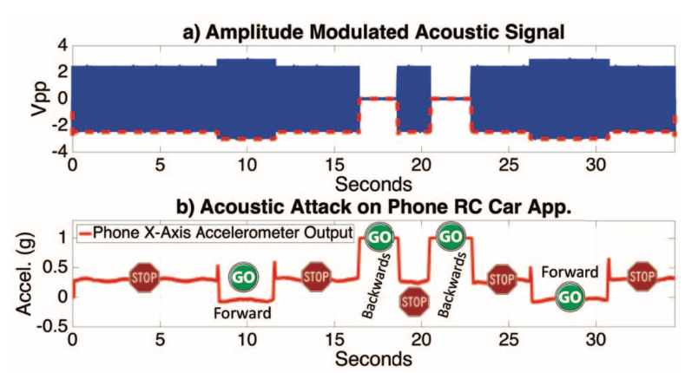
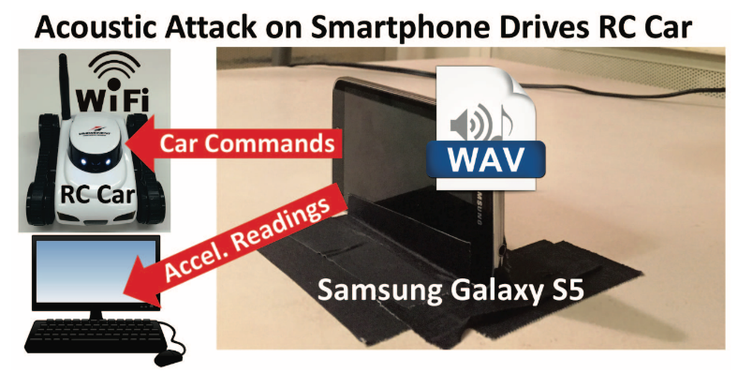
Attack 1: Smartphone controlled RC car
Notes:
Galaxy Smartphones (S5/Note 3)
Lateral movement controls RC car
Internal speaker spoofs accelerometers

Slide 34
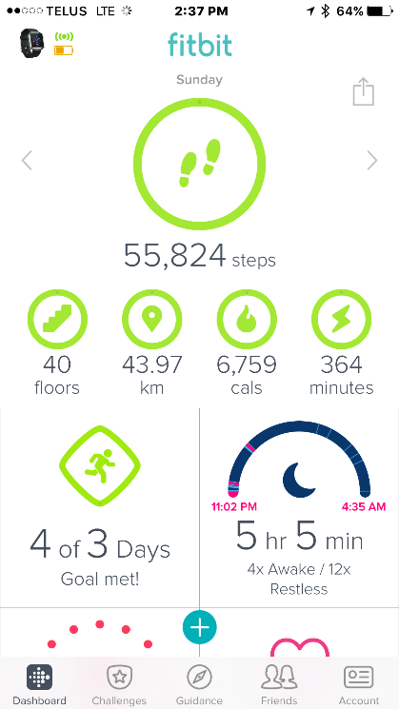
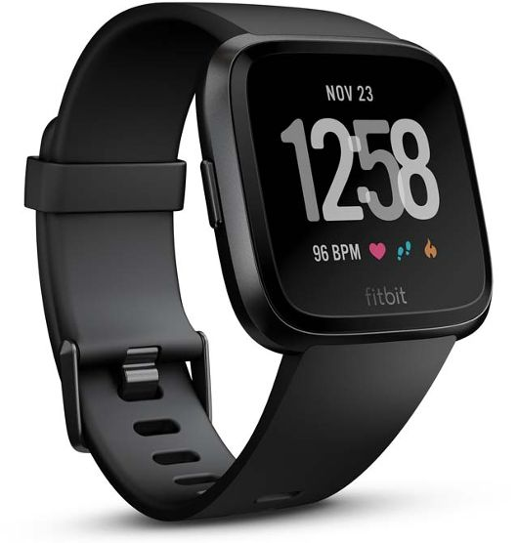
Attack 2: Fitbit
https://www.youtube.com/watch?v=aedOf3cZnEI&feature=emb_logo

Slide 35
Defenses
Notes:
Defense slide 각각의 설명과 관계를 좀 더 잘 나타내고 각각의 한계점도 서술할 것 (slide 26-28)

Slide 36
Defense: H/W defense
LPF (Low Pass Filter)
Add LPF
Lower the cut-off frequency or narrow the transition band
Change physical design
Amplifier
Make tolerant or filter out resonant frequency prior to amp
Acoustic Dampening Materials
Requires an additional space

Slide 37
Defense: S/W defense
Randomized Sampling
Prevents tuning to a resonant frequency to create a DC alias
180° Out-of-Phase Sampling
Creates a simple band-stop filter around resonant frequency
by summing signal with time-shifted version of signal
Notes:
사실 별로 쓸모없음

Slide 38
Related works

Slide 39
Related works
2017, IEEE
2019
2008, IEEE
Pacemaker, software radio attack
WALNUT
Laser-base audio injection
https://lightcommands.com/
Rocking drone
2015, Usenix
Notes:
Timeline 형식으로 walnut 이전과 이후 (laser speaker – kevin fu 참고)

Slide 40
Conclusion

Slide 41
Conclusion
Show the H/W flaws in amp and LPF of the signal conditioning path
Demonstrate analog acoustic injection attacks can damage the digital integrity of the capacitive MEMS accelerometer
Suggest defenses with H/W designs and S/W preventions
Additional Thoughts:
Using additional sensors subtract acoustic interference.
Dynamically adjusting attack based on observed system behavior.
Notes:
Additional thoughts 수정

Slide 42
Q & A
myojoonkil@kaist.ac.kr

