Slide 1
Analysis of an Electronic Voting System
TADAYOSHI KOHNO
ADAM STUBBLEFIELD†
AVIEL D. RUBIN‡
DAN S. WALLACH§
February 27, 2004
Presented by: Aldo Villanueva

Slide 2
Outline
Palm Beach Fiasco
Introducing DRE
History of Diebold
Vulnerabilities of Diebold DRE
Summary

Slide 3
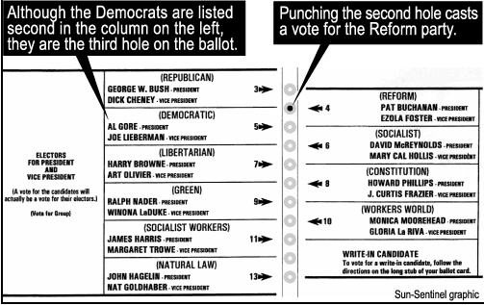
Palm Beach Ballot Fiasco

Slide 4
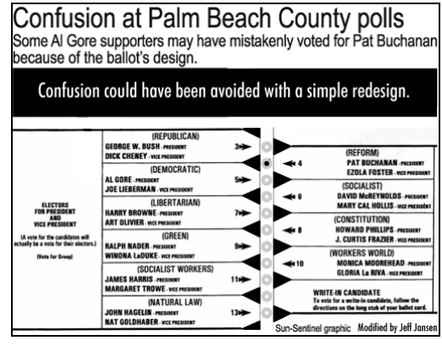
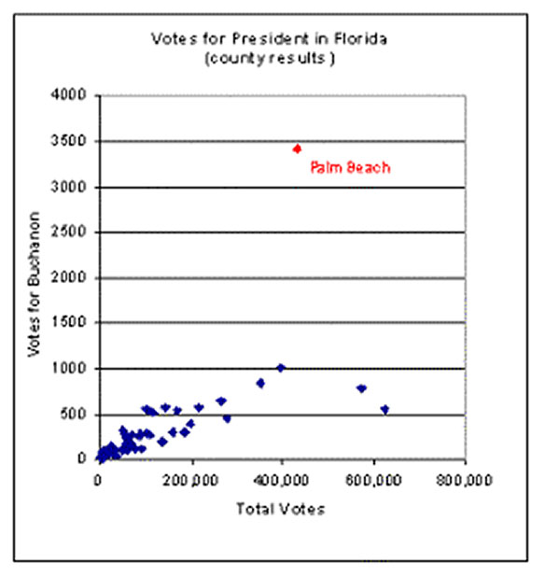
Palm Beach Ballot Fiasco

Slide 5
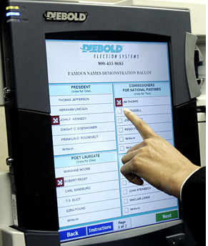
DRE “Direct Recording Electronic”
Eliminate paper ballots from the voting process.
Process:
The voter arrives to the voting place and prove he’s allowed to vote there.
He gets a token (PIN or smartcard).
Enters the token in the voting terminal and votes for its candidate.
DRE System presents the voter’s election and gives a final chance to make changes.

Slide 6
History
1995: I-Mark Systems
1997: Global Election Systems acquired I-Mark
2002: Diebold acquired GES and change the name to Diebold Election System
2006: Diebold removed its name from the voting machines for “strategic” reasons
2007: Diebold changed its name to "Premier Election Solutions"

Slide 7
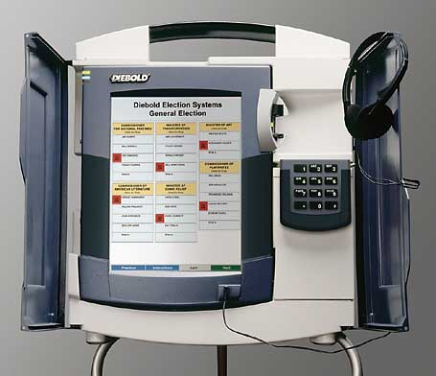
Analysis of the Diebold’s AccuVote-TS DRE voting system
The source code for Diebold’s AccuVote-TS DRE voting system was analyzed.
There were several vulnerabilities found.

Slide 8
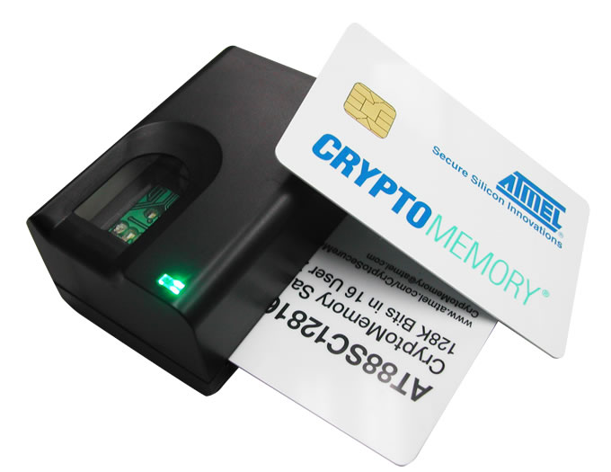
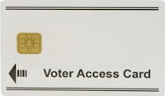
Vulnerability No. 1: Smartcards
The smartcards used in the voting process are very easy to fake since they don’t perform any cryptographic operations.
Attacker could:
Cast multiple votes
End the elections early

Slide 9
Vulnerability No. 2: Tampering
System configuration : impersonating any other voting terminal.
Ballot definitions: changing the order of the candidates only in the interface
Election results: modifying the voting records file stored on the device

Slide 10
Vulnerability No. 3: Impersonating legitimate voting terminals
Voting terminals are configured to upload voting totals to a system after an election.
An adversary able to pose as a legitimate voting terminal to the tabulating authority could report false vote counts.

Slide 11
Vulnerability No. 4: Key management
If an attacker with access to the source code learns the key, he can read and modify voting and auditing records.
In the Diebold system, from the CVS logs, we see this particular key has been used without change since December 1998.

Slide 12
Vulnerability No. 5: Linking voters to their votes
Each vote is written sequentially to the file recording the votes.
It’s easy for the attacker (poll worker) to access the voting records, to link voters with their votes.

Slide 13
Vulnerability No. 6: Audit logs
The whole audit log is encrypted using an insecure method.
At the time that the logging occurs, the log can also be printed to an attached printer.
An attacker could create discrepancies between the printed log and the log stored on the terminal by unplugging the printer (or, by simply cutting the cable).

Slide 14
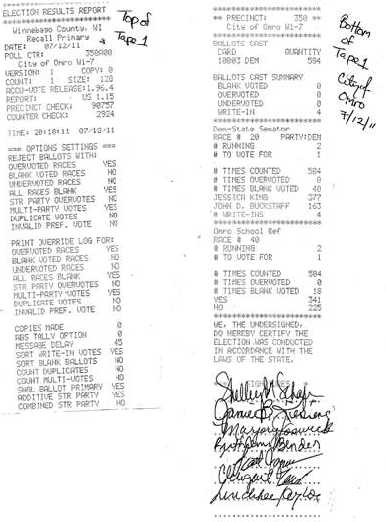

Slide 15
Other vulnerabilities
An attacker can delay the start of an election:
DoS attack against the election management’s server preventing the voting terminals from acquiring their ballot definition in time.
Poor software engineering:
Uses C++
No documentation → Top-to-bottom code review would be nearly impossible.

Slide 16
Summary
Significant security flaws:
Voters can trivially cast multiple ballots
Administrative functions can be performed by regular voters
Threats posed by insiders such as poll workers, software developers, etc.

Slide 17
SECURITY ANALYSIS OF THE DIEBOLD ACCUVOTE – TS VOTING MACHINE
Ariel J. Feldman
J. Alex Halderman
Edward W. Felten
September 13, 2006
Presented by: Jiseong Noh

Slide 18
Outline
Overview of Diebold AccuVote-TS Voting Machine
Design Points
Boot Processes
Vulnerability Points
Attack Scenarios
Mitigation of the vulnerabilities
Conclusion

Slide 19
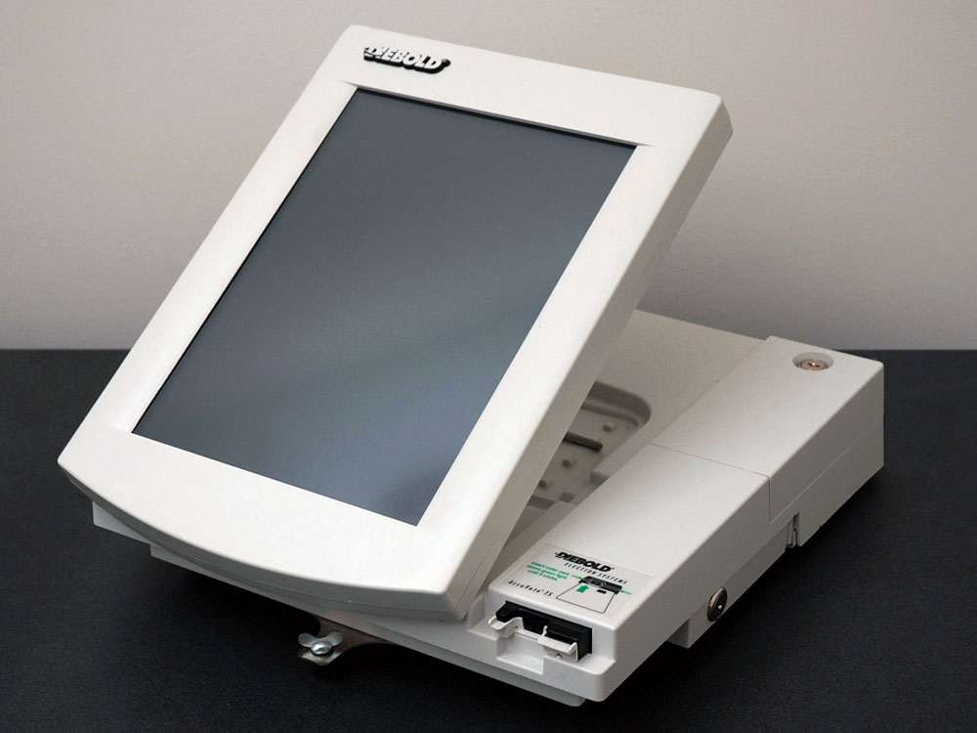
Diebold AccuVote-TS
Manufactured by Diebold Election Systems
Sold to Election Systems & Software in 2009
DRE – Direct Recording Electronic Voting Machine
Voters use machine to cast vote
Machine is used to record the votes
(*) 32% of the USA registered voters used DRE in 2008
About 16 Million voters used Accuvote-TS in 2010
Custom election software runs on top of Windows CE
(*)http://www.electiondataservices.com/images/File/NR_VoteEquip_Nov-2008wAppendix2.pdf)

Slide 20
Design Points
Serial
port
Processor
RAM
Touch Screen
Smart Card Reader
Audio
jack
Removable Flash
Printer
On-board Flash
EPROM
Open to Public
Key Access
Inside Box
http://web.cecs.pdx.edu/~hook/cs491sp08/AccessControlSp08.pdf

Slide 21
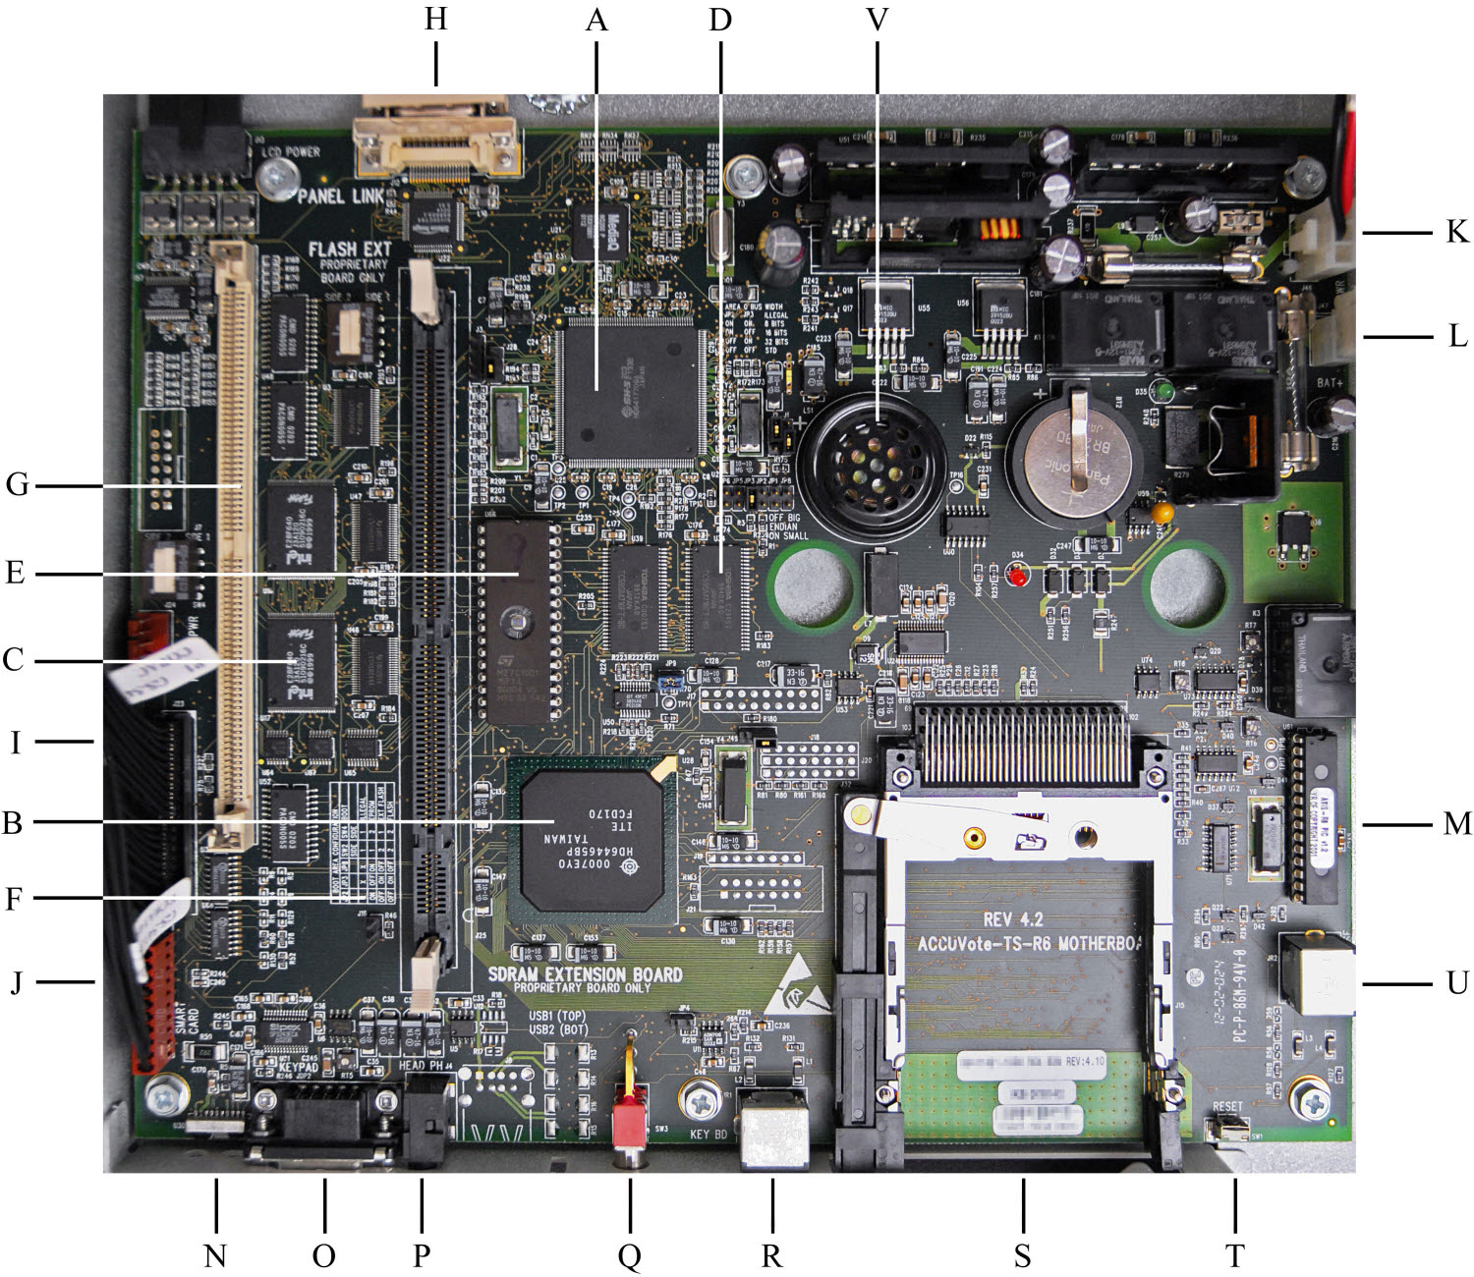
Design Points
(CPU)
(RAM)
Similar to a general-purpose hand-held PC
A CPU, 32MB RAM, 16MB internal flash storage
Touchscreen LCD display
Two PC card slots – one for memory card, other for modem card
OS uses a customized software
Automatically runs Voting Program
Searches for special files in memory card to administer or update the system
Searches for script files with user confirmation
(Flash)

Slide 22
Boot Process
Boot loader loads itself into RAM
Boot Location determined by jumpers on the board
Onboard Flash Memory (default)
EPROM
Ext Flash slot
Boot loader looks for special file names
fboot.nb0: replacement boot loader
nk.bin: replacement of operating system
EraseFFX.bsq: erases file system on-board flash
*** Does not verify file authenticity!

Slide 23
Boot Process
Windows CE image loads and start
Customized task manager
Automatically runs Voting program
If memory card is present and contains explorer.glb
Runs windows explorer instead of voting program
runs script files (. with user confirmation

Slide 24
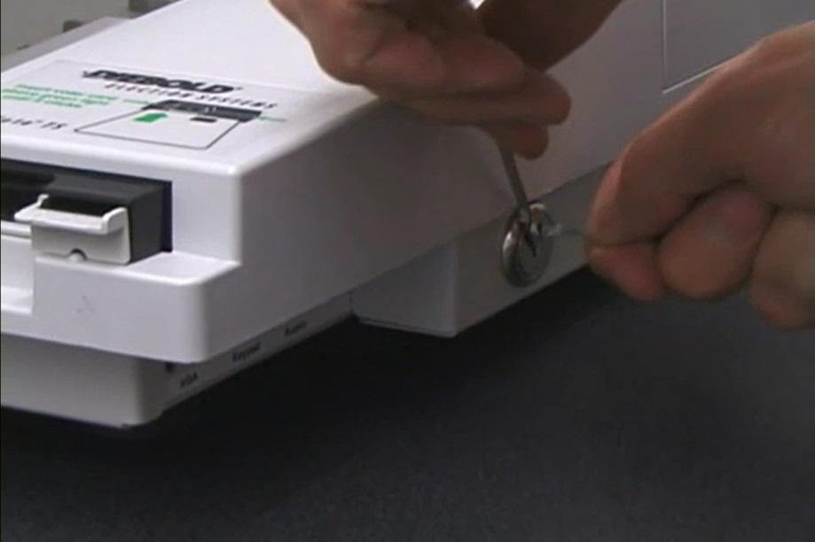
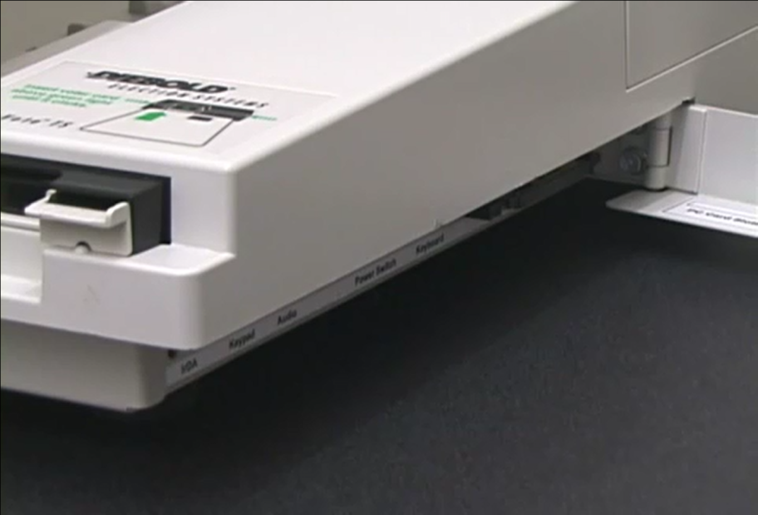
Vulnerability Points (H/W)
Lightweight Lock: easily picked up without a key
Easy Access to Memory Card

Slide 25
Vulnerability Points (H/W)
EPROM(E): Replace EPROM with malware
PC Card Slot(S): Used to replace existing software with malware using Memory Card
Serial Keypad Connector(O): open communication port
Infrared Port(N): open communication port

Slide 26
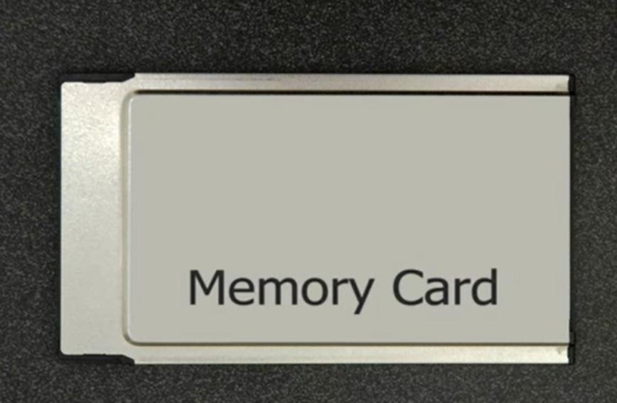
Vulnerability Points (S/W)
Authenticity problem
Never checks to validate the authenticity of files on the memory card on booting or updating software
Buffer Overflow
malformed script files could bypass the confirmation
http://www.cyberdin.com/images/stories/pict5.jpg

Slide 27
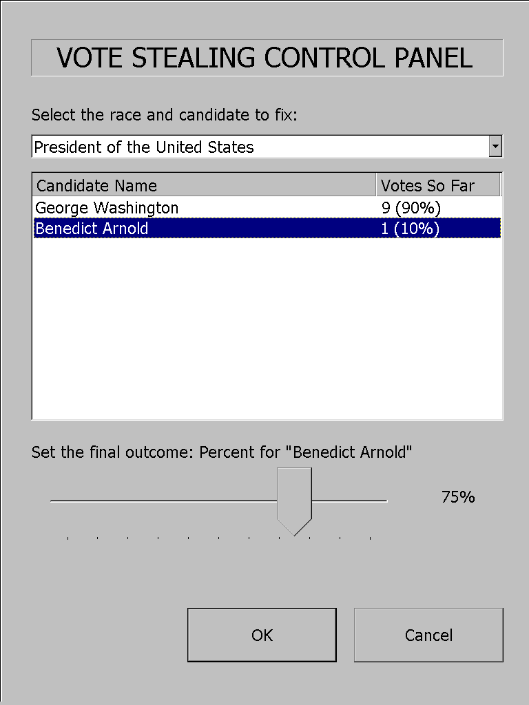
Attack Types
Stealing Votes
Malicious processes runs in parallel with voting program
Change votes for a favored candidate
Total count of votes does not change
Denial-of-Service
Destroys all records of the election
Makes the voting machine inoperable

Slide 28
Delivery of Malicious Code
EPROM
Attack code is placed on an EPROM chip
Attacker replaces the EPROM chip and changes the jumper settings to boot from EPROM
Memory card on PC Card Slot
Attack code is placed on the memory card
Memory card is inserted before voting machine booted
Malicious boot loader containing virus is installed on the machine
The machine is now infected

Slide 29
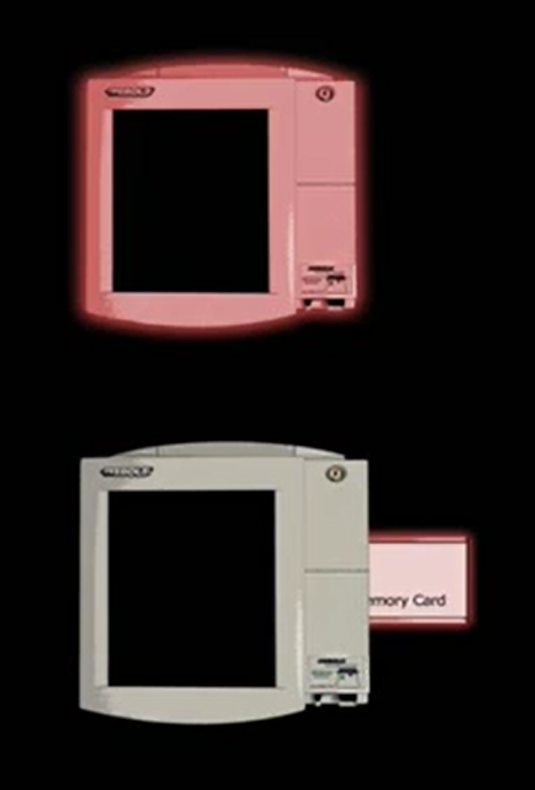
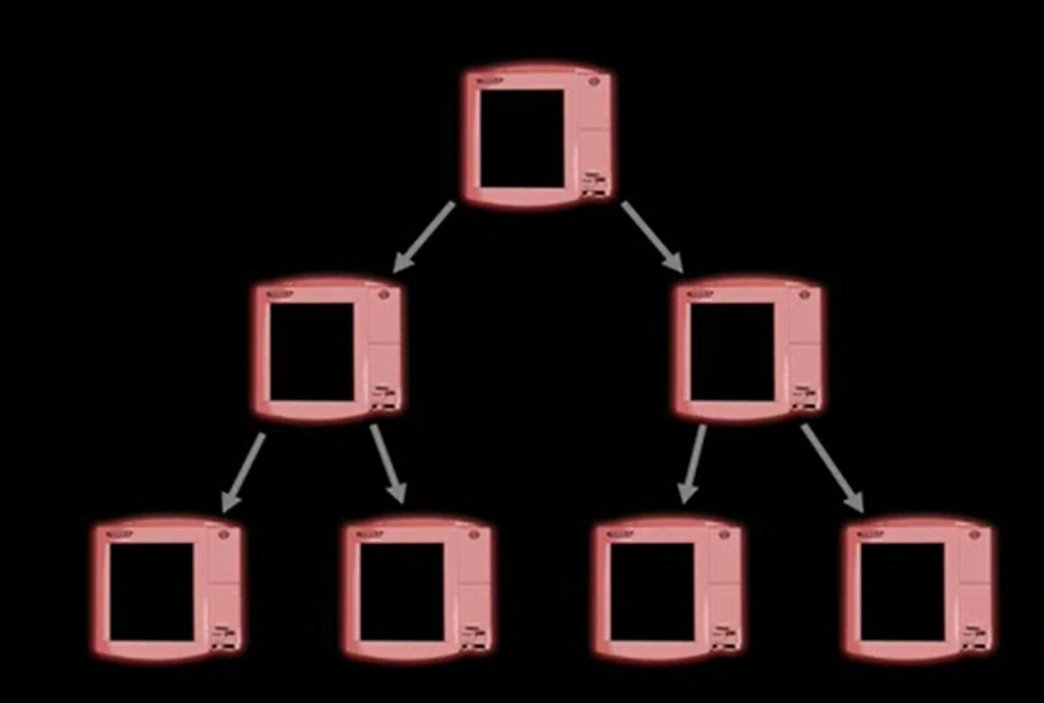
Delivery of Malicious Code
Memory card on PC Card Slot (continue)

Slide 30
Mitigation of Vulnerabilities
Modifications to DRE Software and Hardware
Digitally sign all software updates
Verify the signature of software updates before installing them
Ask user confirmation of any software updates
Use specialized hardware to maintain tamper-proof logs
Physical Access Controls
Sealing the machine and memory card with tamper-evident seals

Slide 31
Summary
DREs are like desktop PC, in the security point of view
Diebold AccuVote-TS has many serious vulnerabilities
Weak physical security
Runs on general-purpose H/W and OS
No way to check if an attack occurred
Virus attack possible – no need for distributed attack
DREs have their advantages; however, they should overcome these problems to make reliable votes

Slide 32
Bankruptcy of Diebold
Papers which criticize DRE, particularly Diebold Systems
2003: Analysis of an Electronic Voting System
2004: Trusted Agent Report Diebold AccuVote-TS Voting System
2006: Security Analysis Of The Diebold AccuVote - TS Voting Machine
Bad Reputation → Changed the name multiple times
May 19, 2010 Dominion Voting Systems acquired
Premier Elections Solutions.

Slide 33
Conclusions
Voting equipment vendors say closed-source nature of the systems makes them more secure.
Authors think that an open process would result better.
The best solution will be a computerized voting system with ballot paper.

