Slide 1
English Shellcode
J. Mason, S. Small, F. Monrose, G. MacManus
CCS ’09
Presented by: Eugenie Lee

Slide 2
0x01. Introduction
“code injection attack”
Manipulate Program counter (EIP in x86) : to disrupt the intended behavior (ex: return-to-libc attack)
Run the code delivered by attacker : SHELLCODE
Return-to-libc attack
‘libc’ is a shared library in Linux system. It contains useful functions such as system( ). By overwriting return address, attacker can disrupt code execution flow to functions in libc instead of making shellcodes.
Notes:
그냥 EIP조작해서 실행경로 바꾸기 vs 삽입한 특정 machine code로 의도대로 실행하기
Shellcode에 대한 설명 : just launches a command shell
Return to libc attack은 shellcode없이 victim의 library에 있는 useful gadget을 활용해서 공격하지만, 공격자가 의도한 함수를 사용하는 방법도 있음->shellcode!

Slide 3
0x01. Introduction (cont’d)
Shellcode: directly executable machine code
Detect its presence
Prevent its execution
Shellcode
A machine code to launch a command shell(ex. /bin/sh)
It should be executed independently, so it use Linux system call to start a new command shell
Notes:
Shellcode는 natively executable code, machine code랑 다를게 없음 원칙적으로
Automated inspection of user input, system memory, or network traffic for content that appears to be executable
방어 방법에 대해서는 조금 이따 더 자세히
Protective measure를 더 어렵게 하기 위해 polymorphic shellcode도 등장

Slide 4
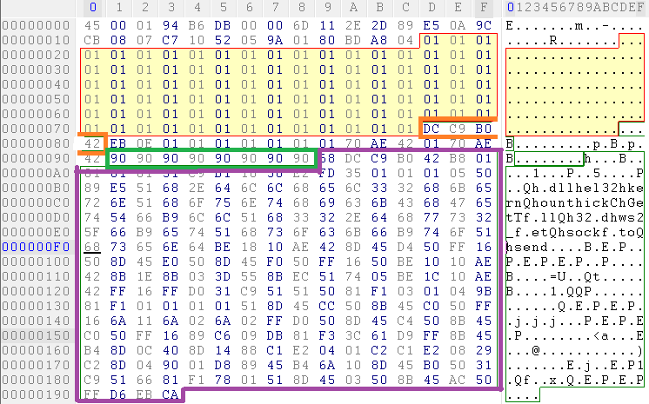
0x01. Introduction (cont’d)
Standard attack template of traditional buffer overflow attacks (in code injection attack)
NOPsled + shellcode + address of shellcode
Fill buffer to overflow
Overwritten return address
NOPsled
Slammer worm
Payload with exploit
Notes:
Shellcode는 natively executable code, machine code랑 다를게 없음 원칙적으로
Automated inspection of user input, system memory, or network traffic for content that appears to be executable
방어 방법에 대해서는 조금 이따 더 자세히
Protective measure를 더 어렵게 하기 위해 polymorphic shellcode도 등장

Slide 5
0x01. Introduction (cont’d)
Polymorphic Shellcode
‘decoder’ – to enable the encoded portion of payload to be executable form →NATIVELY EXECUTABLE
How to prevent getting shellcode as a input?
Shellcode has a ‘strange’ letters (non-ascii letters)
Notes:
Shellcode는 natively executable code, machine code랑 다를게 없음 원칙적으로
Automated inspection of user input, system memory, or network traffic for content that appears to be executable
방어 방법에 대해서는 조금 이따 더 자세히
Protective measure를 더 어렵게 하기 위해 polymorphic shellcode도 등장

Slide 6
0x02. Arms races
limit the range of accepted byte-values by alphanumeric or just certain character sets
ex. isalnum, strspn
Limit the set of operations available in an attack
Solution: use encodings to convert original shellcode
Alphanumeric shellcode
Convert payloads to be consists of only letters and digits
Can be stored as unsuspected contexts
Smaller than other character sets like Unicode, UTF-8
Need an alphanumeric decoder
Notes:
Strspn: Get span of character set in string
Alphanumeric shellcode : the encoding engine이 bt의 powershell이나 metasploit에 있음
의심받지 않게 저장이 됨 뭐 파일명이나 디렉토리이름이나 아님 그냥 스트링처럼
애초에 아스키라서 한글자에 한바이트 = 다른 캐릭터셋보다 크기면에서 유리

Slide 7
0x02. Arms races (cont’d)
Detect the attack using the shellcode structure
Fail to ban the attack which is not constrained to the layout
contemporary researches are based on the idea ‘Shellcode is fundamentally different in structure than non-executable payload data’
Notes:
Nopsled, shellcode, address로 왜 구성되는지 잠깐 설명
저 틀을 이용해서 공격을 찾긴 하는데 모든 공격이 저런 모양은 아님
Shellcode가 다형성이거나 복잡한 형태의 공격일 경우
다음 페이지부터 지금까지의 대응책에 대해서 더 자세히 알아보자

Slide 8
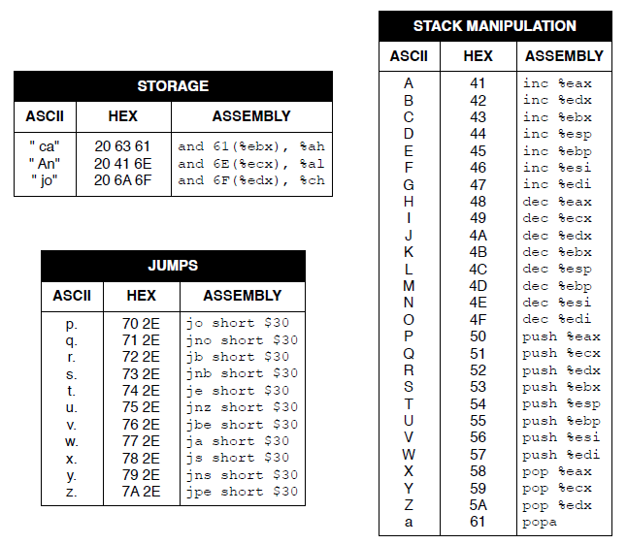
0x03. English shellcode
Machine instruction seemed like ASCII character
Notes:
Machine instruction은 원래 series of byte임 opcode와 operand로 구성됨. 근데 이걸 적어놓고 보면 경우에 따라서는 ascii처럼 보임. English shellcode를 만드는 과정은 여기서 시작함
이게 그런 example들중의 하나. 모든 instruction이 그런건 아니지만 몇몇 instruction은 글자처럼 생김

Slide 9
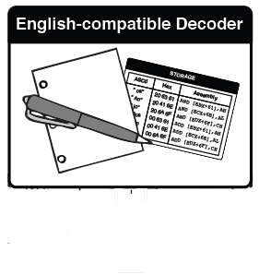
0x03. English shellcode - generation
1
2
3
4
Make a list to categorize English-compatible instructions by behavior
Write a decoder which can make exploit using only instructions from the list
Three general types of instructions for multiple variants of English shellcode from the same payload
NOPs
Operation that affect generally but no interfere with decoder
Affect both machine state and decoder but no net effect
Notes:
Categorize English-compatible instructions by behavior like instructions of jump, boolean operation, or stack manipulation
The decoder intermediate results may similar to alphanumeric shellcode because it only can use some ascii instructions to make a payload. But further, we will make a strings of English works which can work as a shellcode, so we will continue to next step.

Slide 10
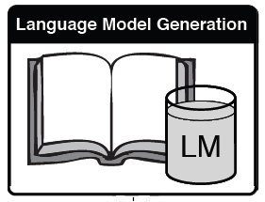
0x03. English shellcode - generation
1
2
3
4
With n-gram model, generate and train it with large set of English text
Notes:
N-gram model: n-gram is a contiguous sequence of n items from a given sequence of text or speech.
More than 50,000 Wikipedia articles and 27,000 books from the Project Gutenberg is used for large set of English text to train a model

Slide 11
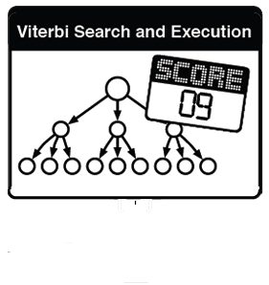
0x03. English shellcode - generation
1
2
3
4
Use numerical values to indicate the strength of each candidates (Viterbi search)
Traverse the language model to find strings of word that score the highest possible value
Notes:
If candidate string produces same net effect of the first instruction of the decoder when it is executed, the score is 1. If it produces two instructions in a row, then it is score 2.
Viterbi search is used to reconstruct the most probable sequence.

Slide 12
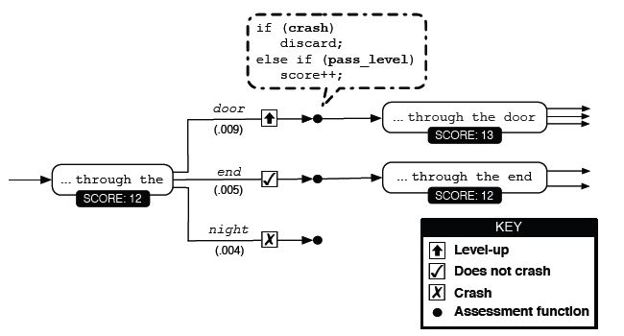
0x03. English shellcode - generation
Notes:
For each candidate word, concate it to the string and execute the string in a sandbox. If it crashes, discard it. If the addition successed to execute next instruction, the score++. If it does not crash but yield no further execution of instruction, the score remains.
The candidate which use unpredictable data or unpredictable setting on flags may lead to undesirable result or even crash, it also discarded.
We keep top m samples by greedy algorithm. By doing this, encode more instruction on payload with fewer words is prefered.

Slide 13
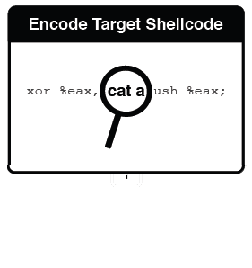
0x03. English shellcode - generation
1
2
3
4
To encode the original payload, continue to sample strings and get functionally equivalent encoded string from the original shellcode.
Notes:
If candidate string produces same net effect of the first instruction of the decoder when it is executed, the score is 1. If it produces two instructions in a row, then it is score 2.
Viterbi search is used to reconstruct the most probable sequence.

Slide 14
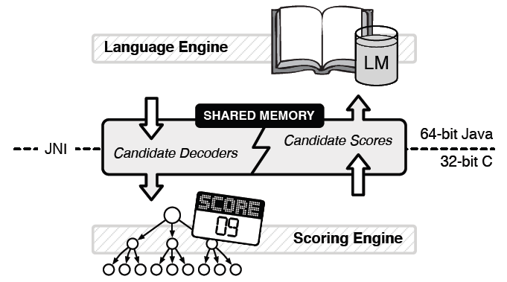
0x03. English shellcode – auto generate
Monitoring with ptrace API of Linux
Notes:
Scoring engine은 executor(각 단어 candidate를 실행함)랑 watcher(evaluate the candidate behavior)로 구성됨. 이 monitoring은 ptrace(process trace) API로 실행됨(프로세스가 어떻게 움직이며, 어떤식으로 데이타를 읽고 쓰는지, 어떤에러를 내는지 추적)
Language engine이랑 Scoring engine은 공유메모리로 communicate함. Language engine이 potential solution을 주면 Scoring engine이 점수를 내줌.

Slide 15
0x03. English shellcode – optimize
Monitoring with ptrace API of Linux
Too arduous task to check every expand
Monitored direct execution
No need to ptrace
Two sets of machine state and switch
No single-step execution in every instruction → investigate only when flags are changed or memory beyond the current point is changed
Notes:
Since ptrace traces how all process works, and it necessarily needs several times of switching between kernel mode and user mode.
사실 language engine이나 scoring engine이 넘겨받는 대상은 같은거임 – 한 프로세스가 두가지 일을 하면 안될까?
Maintain two sets of machine state and switching between them to change execution roles(each have their own register and stack but share only memory associated with state switching and candidate solution)
이렇게 optimize했더니 쉘코드 만드는게 12배 빨라짐ㅋ

Slide 16
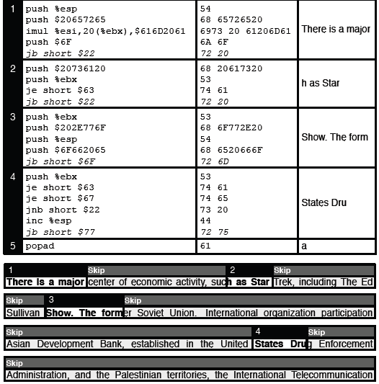
0x04. Evaluation
Exit(0)
Notes:
No considering for better quality(fluency?) of English in this shellcode(out of scope)

Slide 17
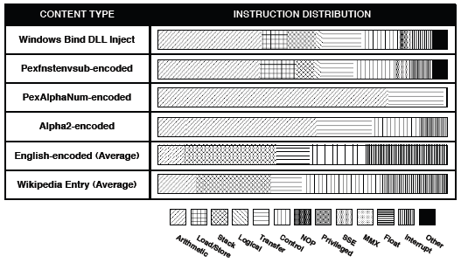
0x04. Evaluation (cont’d)
‘Shellcode need not to be different in structure than non-executable payload data’
Notes:
To verify the main idea of this paper that ‘Shellcode need not to be different in structure than non-executable payload data’, the figure shows compare among original shellcode and so on.

