Slide 1
Exploiting Open Functionality in SMS-Capable Cellular Networks
20123550
Chang-Jae Lee
Some of the slides and figures were borrowed from the author’s slides

Slide 2
Intro
SMS(Short Message Service):
a short text message transmission(asynchronous)
Can be delivered via internet
Extremely popular
69 million in a day (UK)

Slide 3
More Terminologies
Cellular Network
Radio Network or infrastructure
Base Station
Cellular towers
Channel
A frequency cellphone comm. are Tx-ed
Sector
A cell region covered by fixed channels

Slide 4
SMS in Cellular Network

Slide 5
SMS in Cellolar Network(cont’d)

Slide 6
SMS in Cellolar Network(cont’d)

Slide 7
SMS in Cellolar Network(cont’d)

Slide 8
SMS in Cellolar Network(cont’d)

Slide 9
SMS in Cellolar Network(cont’d)

Slide 10
SMS in Cellolar Network(cont’d)

Slide 11
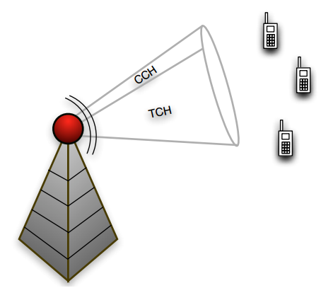
The “Air Interface”
Traffic Channel(TCh)
For voice traffic
Control Channel(CCh)
For signaling btw BS and phones
…and for SMS messages
CCh was not designed for SMS

Slide 12
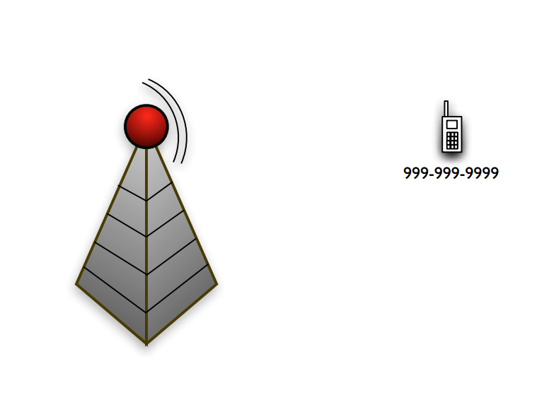
The “Air Interface”(cont’d)
Stand-alone Dedicated CCh
(Figures)

Slide 13
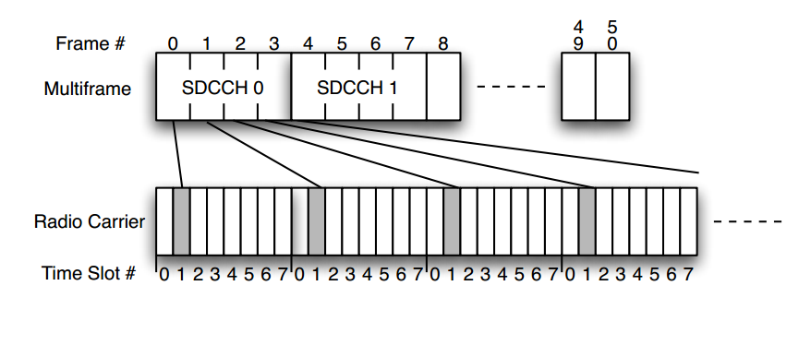
The “Air Interface”(cont’d)
Time Division MUXing of GSM
8 time slot/Ch
PCh, SDCCh: embedded in CCh
(2 * # of channels) of SDCCh

Slide 14
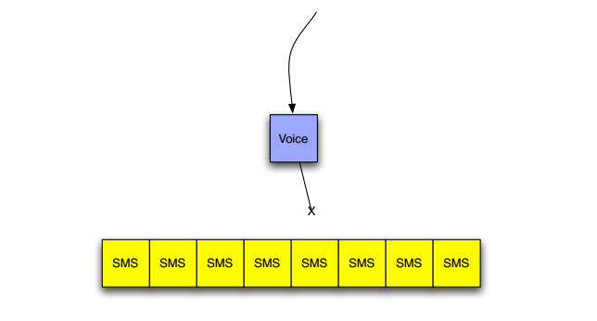
The “Air Interface”(cont’d)
Once SDC Channel is full with SMS, call setup is blocked
An adversary’s goal: fill the cell network with SMS traffic

Slide 15
Vulnerability Analysis
Profiling attributes
…by GSM Gray-box testing
About implementation specific specs
Example: How many SMS/hr per SDCCh?
How are SMS messages stored?

Slide 16
Vulnerability Analysis(cont’d)
Phone capacity
Slowly inject messages to target phone
Result
30~50 messages can be stored(old phones)
~500 messages exhaust battery(high-end ones)

Slide 17
Vulnerability Analysis(cont’d)
Injection vs Delivery rate
Result: large imbalance between two
Many sites provides bulk SMS sending
~1000s msgs/sec can be sent

Slide 18
Vulnerability Analysis(cont’d)
Interface regulation
Check limitations on Providers’ web interfaces
IP-based(AT&T, Verizon), session cookies(Sprint)
Spam filtering drops cannot be found
30~35 msgs/sec can be sent usually

Slide 19
Gray-box Test Summary
Some msgs injected would be lost
Msgs can be injected 100s times faster than can be delivered
Interfaces have some anti-triggers against mass injection
Conclusion: an attacked should be distributed & multi-targeted

Slide 20
Hit-List
Need a Hit-List for multi-targeted
How to get a Hit-List
1) Web scraping
2) Worms Get recent call list, etc
3) Search Internet for NPA/NXX DB

Slide 21
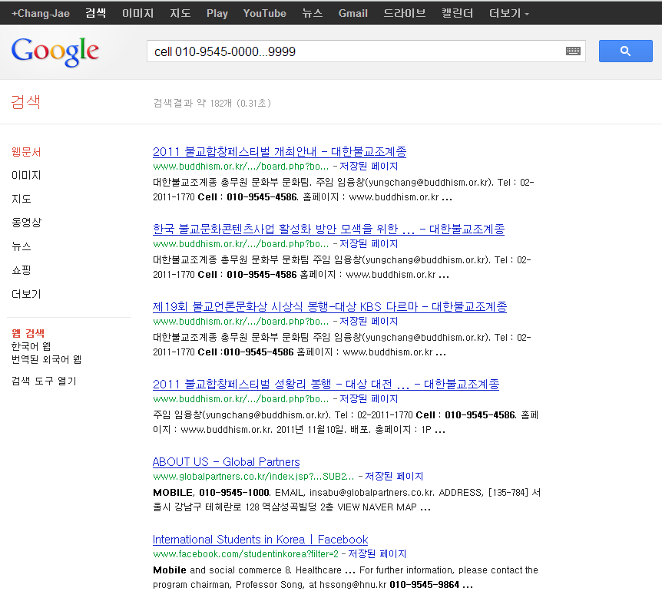
Hit-List(cont’d)
Web scraping
Google like 999-999-0000…9999

Slide 22
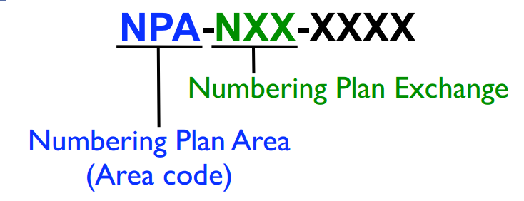
Hit-List(cont’d)
NPA/NXX DB search
Prefix can be identified via target area

Slide 23
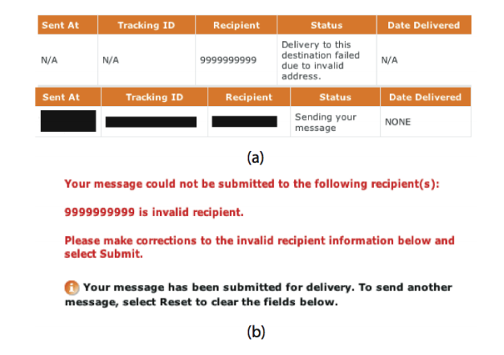
Hit-List(cont’d)
SMS sending sites also gives info.
Provider web interfaces checks if the destination number is valid

Slide 24
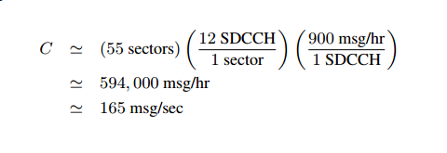
Area Capacity
Capacity can be calculated:
Manhattan case is here:
C = (sectors/area)*(SDCCHs/sector)*(throughput/SDCCH)

Slide 25
Area Capacity(cont’d)
1 msg = 1500 bytes(max length)
165 msgs/sec = 1933.6 kb/sec
Cable modem: ~768 kb/sec
Can be 193.36 kb/sec with multi-send interface

Slide 26
Attack Scenario
Hit-List with 2500 numbers
Average ~50 msgs for device buffer
8 dedicated channels
1 message in 10.4 sec (per phone)
About 8.7 min to fill buffers

Slide 27
Attack Scenario(cont’d)
Saturate queues
Messages exceeding saturation levels are lost
SMSC queue: ~500 msgs
Device: 30 ~ 50 msgs

Slide 28
Attack Aftermath
Messages are gone!
Also messages are delayed
Some devices lose even more data
(when full, delete old read messages)
Battery depletion expected

Slide 29
Solution for the Attack
Separate queues for control & SMS
Limit rates
Next Generation Network

Slide 30
Conclusion
Cellular network is a critical resource in social or economic structures
External devices’ misuse can be fatal

