Slide 1
Cellular Network 1II
Yongdae Kim
KAIST

Slide 2
Let Me Answer That for You
- Exploiting Broadcast Information in Cellular Networks
Nico Golde, Kevin Redon, Jean-Pierre Seifert
Some of the slides and figures were borrowed from the author’s slides

Slide 3
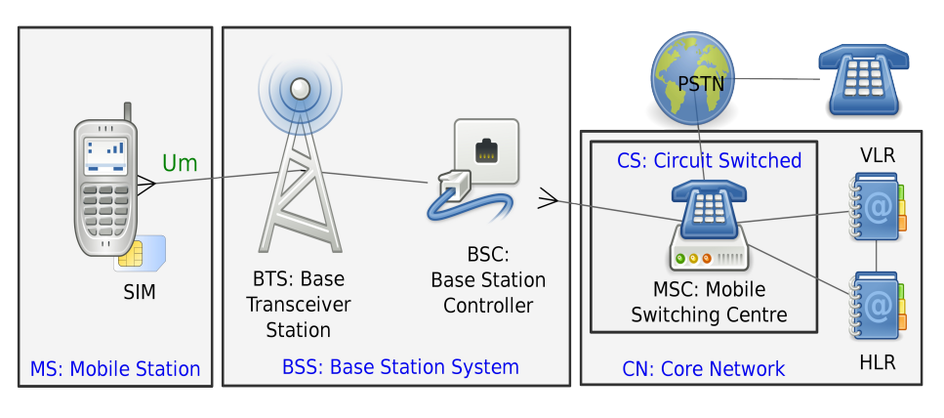
GSM Architecture

Slide 4


Paging
to notify an incoming service
Paging request(broadcasting)
Identity
(TMSI/IMSI)
Every phone can see every paging request!
All phones
All BTSs

Slide 5


Paging
Paging request on the PCH (braodcasting)
Identity Match!
Initial channel request (RACH)
Phone
Immediate Assignment (AGCH)
BTS
Tune to allocated channel
Paging response message (SDCCH)
Authentication, Ciphering, Service Delivery

Slide 6

Win the race? Hijacking Services
Paging request
Phone
BTS
To impersonate a victim we need :
  victim’s identity
  credentials stored in the SIM
we can hijack the MT service :
  get the SMS
  receive the call
Respond with wrong information → DoS
Adversary

Slide 7



Getting victim mobile identities
Identity
(TMSI/IMSI)
Victim
adversary
Phone calls
BTS
Paging request(braodcasting)
For TMSIs:
  Call victim, drop call early (3.7 seconds) → not ring, but being paged!
  Rinse and repeat → Evaluate monitored data
For IMSIs:
  Use a HLR query service
monitoring

Slide 8


Hijacking delivery – Encryption
Need session Key Kc
A5/0 → No encryption
Most use A5/1 → Broken (e.g. 26C3/27C3)
  – Kraken + OsmocomBB phones/airprobe
  can crack session key (Kc) in seconds
A5/2 → Broken (1999)
50% of tested networks only authenticate in 10% of the services
Assume no encryption and insufficient authentication
weak Encryption !

Slide 9
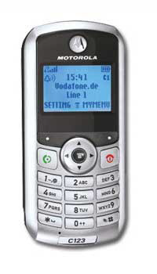
Experimental Setup
Free Software/Open Source mobile baseband firmware: OsmocomBB
  L1 on the phone, L2/L3 on the computer
  L1 <- > L2/L3 via UART serial connection
  but not fast at all
Completely implemented as Layer1 firmware
  Ported L2/L3 to Layer1
  Runs solely on the phone → very fast
Motorola C123

Slide 10
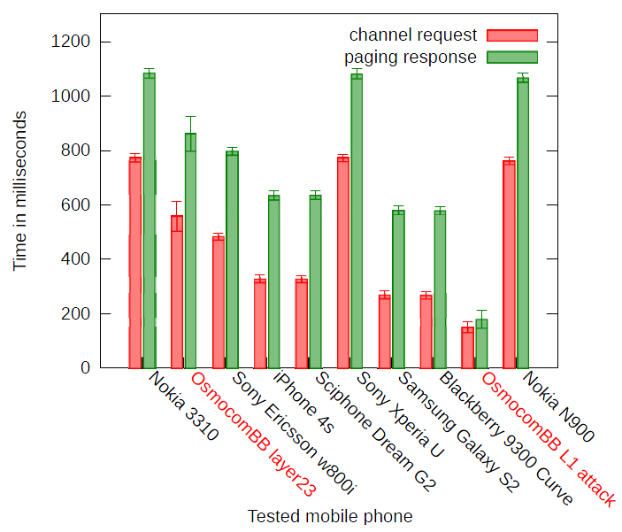
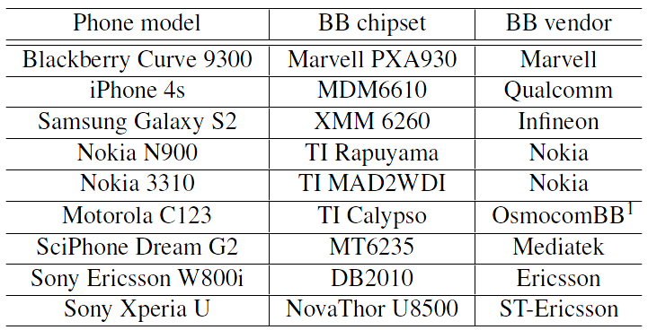
How fast is the “average” phone?

Slide 11
Attacking large areas
Paging broadcasted on all BTSs within a location area
Respond to all paging requests faster → DoS to all subscribers in that area
What is the size of a location area?
What is the amount of paging requests to answer?

Slide 12
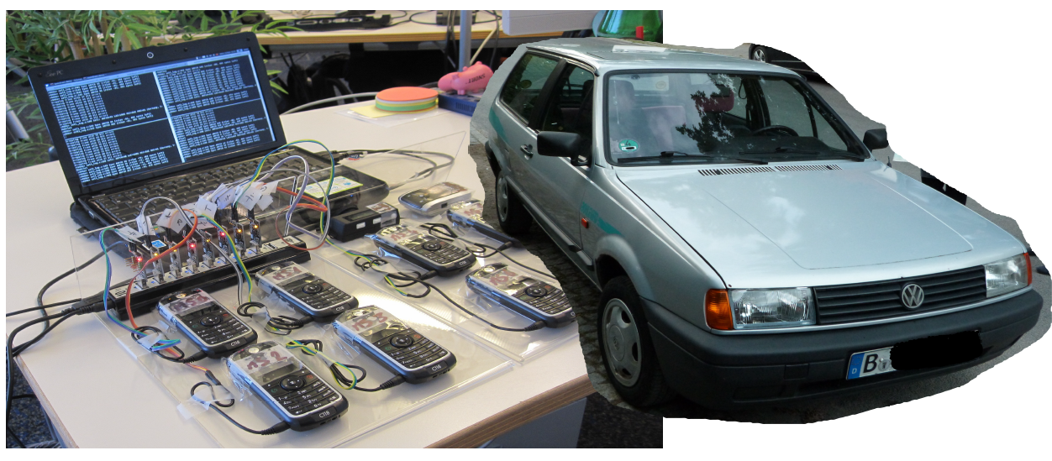
How large is a Location Area?
Location Area Code(LAC) broadcast on the BCCH
2 people + GPS loggers + OsmocomBB cell_log phones + car

Slide 13
Location Areas – Berlin/Vodafone
Location Area
Average : 200㎢
Berlin : 100 – 500㎢
Non-city : 1000㎢

Slide 14
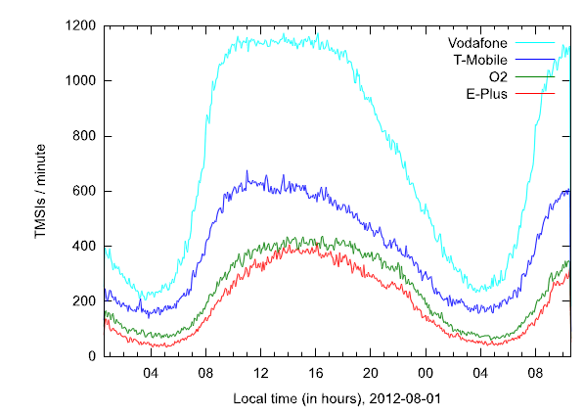
Attacking Location Areas - Activity
Camp on location areas and log paging
Measured all 4 operators over 24 hours, same time and location

Slide 15
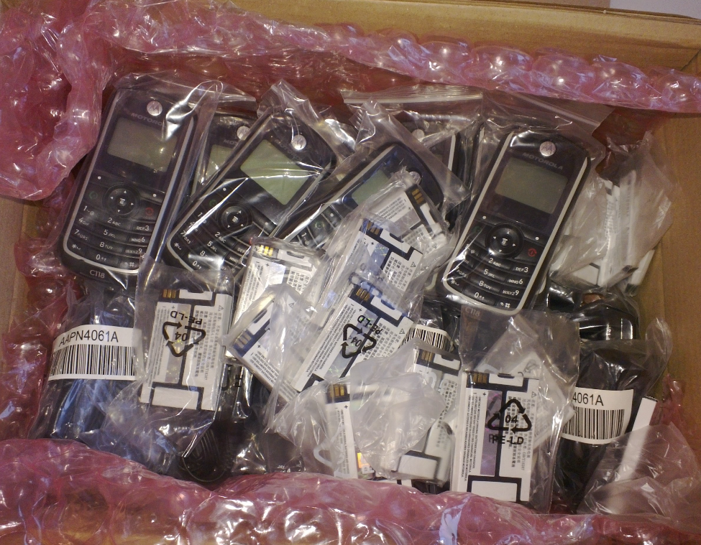
Paging requests to answer
For a small operator (E-Plus) 415 TMSIs in paging / minute → ~11 phones are required
Phones are cheap! (5~20 €)

Slide 16
Summary
Hijacking MT services
Targeted DoS attacks against single subscriber
DoS within Large geographical regions
MT services need 100% authentication
Active attackers (malicious phones) need to be considered by standardization bodies

Slide 17
Gaining Control of Cellular Traffic Accounting by Spurious TCP Retransmission
Younghwan Go, Jongil Won, Denis Foo Kune*,
EunYoung Jeong, Yongdae Kim, KyoungSoo Park
NDSs 2013

Slide 18
3G/4G Accounting System Architecture
Charging Data Record (CDR)
  Billing information (e.g., user identity, session elements, etc.)
Record traffic volume in IP packet-level
Question:
Should we account for TCP retransmissions?
$
NodeB
BS
3G UMTS
RNC
S-CDR
G-CDR
SGSN
GGSN
NodeB
CGF
UE
Internet
Target Server
eNodeB
S-GW
P-GW
4G LTE
MME
RAN
CN
Notes:
Then let’s first look at how the cellular ISP charges your data traffic. Here’s the architecture of the cellular ISP.
When the client UE communicates with the target server, the packets flow through the ISP core network’s SGSN/S-GW & GGSN/P-GW.
The information for billing, CDR, is stored in the two GSN/GWs during communication, then is transferred to the billing system where the actual accounting takes place.
And the basic unit for accounting is byte-per-byte IP packets.
Alright. So we now know that all IP packets flowing through the ISP are accounted.
Then here’s a question that we want to ask. Should the ISPs charge for retransmissions?

Slide 19
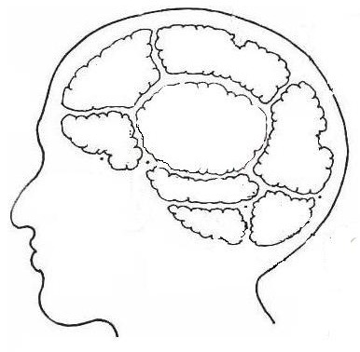
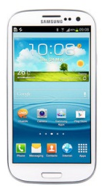
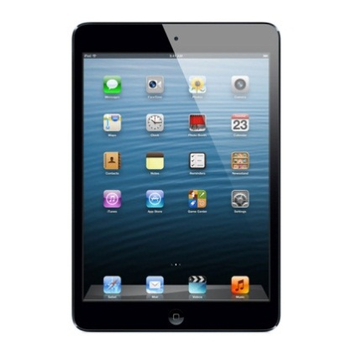
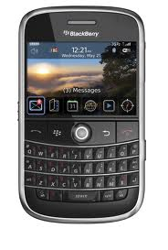
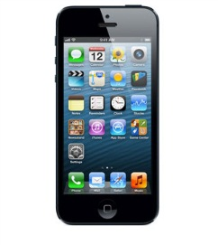
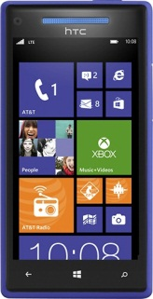
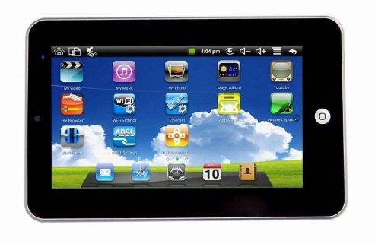
Cellular Subscriber’s Brain
Network condition
is not my concern
Volume = File size
Pay for
application layer
data only!
What’s
TCP
Retrans-mission?
ISP is evil
Equal pricing
Not fair
I don’t
care
Notes:
Let’s look at subscriber’s view on charging TCP retransmissions.
The main argument is that they should be charged for only the application layer data, which is the size of the content.
I don’t care what happens in the network. If this guy and I both watched the same movie content, we should be charged the same.

Slide 20

Cellular Provider’s Brain
Retransmission =
another IP packet
Require system update
TCP retransmissions
still consume
resources
Notes:
Then how about the cellular ISPs.
In their perspective, TCP retransmissions still consume their cellular network resources. To them, it’s just another IP packet.
Moreover, it would require a system that can accurately detect retransmission packets. They know that’s complex.
And… of course… not charging TCP retransmissions would mean losing money.
Then let’s see how much retransmission actually occurs in the real-world.

Slide 21


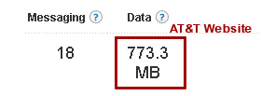
TCP Retransmission Accounting Policy
Retransmission test setup*
Test Process
  Client: download a file via wget
  Server: retransmit packets via raw socket
  Compare captured volume with charged
  volume provided by ISP
Cellular ISP
wget
raw
socket
  *Towards Accurate Accounting of Cellular Data for TCP Retransmission
  HotMobile 2013
Notes:
Now then next task is to check whether the ISPs account for retransmissions or not. We setup a following experiment. The details of this experiment can be found in the HotMobile paper.
We have a client device which downloads a file from our modified HTTP server through the cellular network.
The server would then create retransmission packets by using a raw socket and sends them to the client.
For analysis, we capture the packets in the client and compare with charged volume provided by ISPs.

Slide 22
TCP Retransmission Accounting Policy
Tested 12 ISPs in 6 countries
ISPs (Country) | Policy
AT&T, Verizon, Sprint, T-Mobile (U.S.) | Blind
Telefornica (Spain) | Blind
Telefonic/OS (Germany) | Blind
T-Mobile (England) | Blind
China Unicom, CMCC (China) | Blind
SKT, KT, LGU+ (South Korea) | Selective
Vulnerable to “usage-inflation” attack!
Vulnerable to “free-riding” attack!
Notes:
We run the test for 12 ISPs in 6 countries.
Through the test, we find that all countries we investigated except South Korea adopt a “blind” accounting policy that accounts for all IP packets regardless of TCP retransmission. In contrast, all three ISPs in South Korea enforce a “selective” policy that does not charge for retransmission packets.
As we explained before, the rationale behind the “blind” accounting policy is that the ISP network should be responsible only for the IP layer functionalities while retransmission in the transport layer is regarded as an end-node issue. However, from a client’s perspective, this could be unfair as she might have to pay for the packets that were discarded before reaching the application layer. That is, the subscribers have to pay for any packet that passes through the billing system regardless of whether it reaches the application on the client device or not.
So we see that ISPs choose their own policies depending on their reasons.
However, we find that all ISPs, no matter what policy they follow, are either vulnerable to “usage-inflation” or “free-riding” attack where a malicious attacker can either overcharge the victim client’s data bill or bypass ISP’s accounting system to use the network for free.

Slide 23

Retransmit after FIN
Ignore client’s FIN/RST to prevent TCP teardown
  Utilize full bandwidth to overcharge the usage
Some ISPs allow attacks even after 4 hours!
$
Overcharge Victim UE
Packet 1
Wired Internet
$
Cellular Networks
Packet 2
$
Packet 3
Request
Packet 1
FIN
Packet 3
Packet 2
Packet 3
Packet 3
$
Packet 3
Malicious Server
$
Core Network
Victim Client
Packet 3

Slide 24
Free-riding Attack
Tunnel payload in a packet masquerading as a retransmission
  ISPs with selective accounting policy inspects TCP header only
Tunnel TCP Packet
Wired Internet
Cellular Networks
$
Fake TCP Hdr
Packet 1
Packet 2
Packet 1
Fake TCP Hdr
Packet 2
Packet 1
Packet 1
Packet 3
Packet 2
Fake TCP Hdr
Packet 3
Request
Fake TCP Hdr
Packet 2
Fake TCP Hdr
Packet 3
Packet 3
Fake TCP Hdr
Destination
Server
TCP Tunneling
Proxy
Core Network
Malicious UE
Notes:
Next, if the cellular ISPs decide to exclude retransmission packets from billing, an adversary can launch a “free-riding” attack against them by tunneling the actual payload in a retransmission packet. This is possible since the ISP only inspects the TCP header. This is pretty intuitive since to validate the retransmission, the ISP would have to buffer all payloads for future comparison, which is not easy.
This is how the attack works.

Slide 25
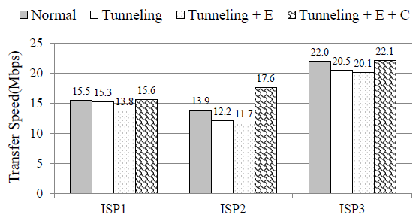
Attack Optimizations
Packet encryption
  Evade tunnel header detection
Packet compression
  Increase data transfer speed
Notes:
To evade the tunnel header detection by the accounting system, vtund encrypts the payload of all tunneled packets using RC4.
Optionally, it also applies packet compression using the LZO algorithm which is popular for real-time packet compression/decompression.
We use SpeedTest app to measure the download throughputs from a server located in Seoul, South Korea.

Slide 26

Demo

