Slide 1
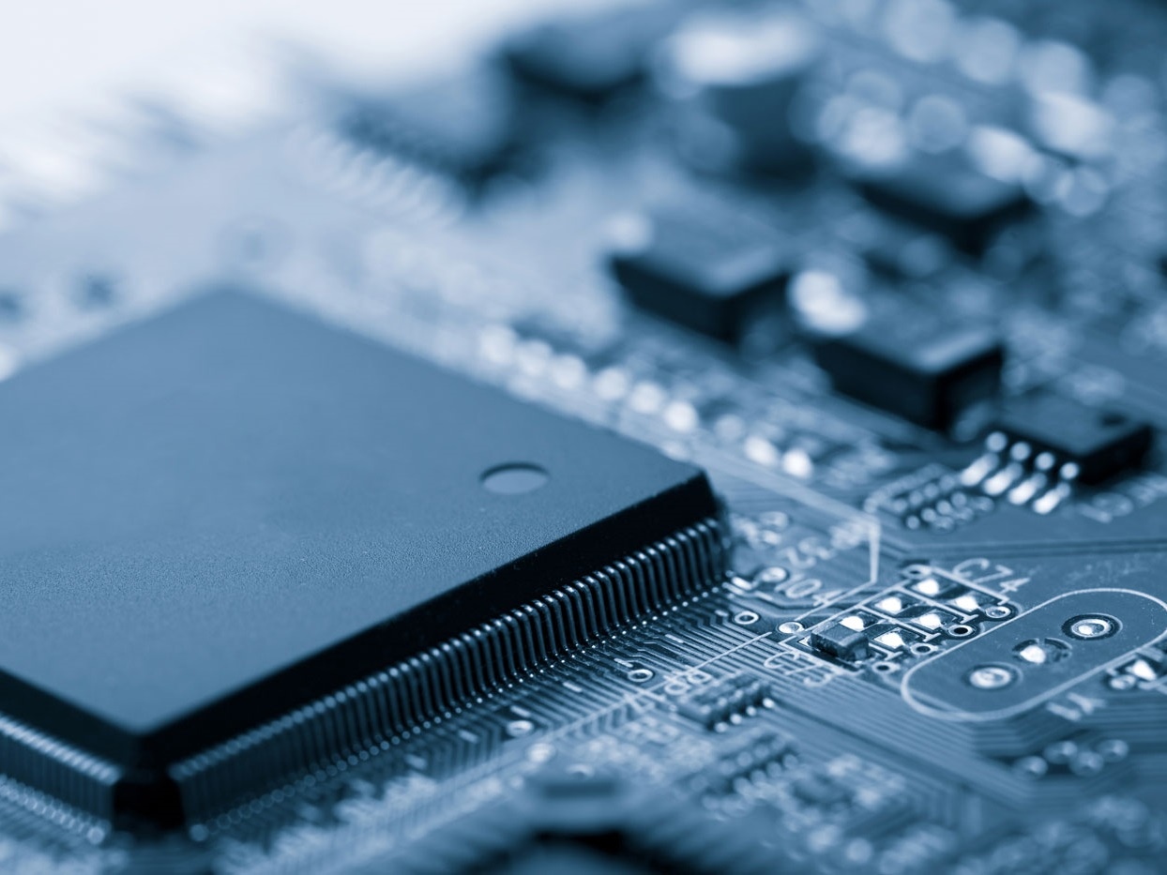
Embedded Device Analysis for Security Research
EE515/IS523, Security 101: Think Like an Adversary
2016. 09. 27.
System Security Lab.

Slide 2
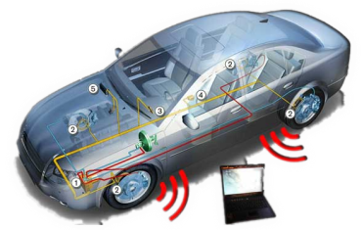
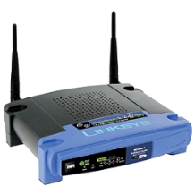
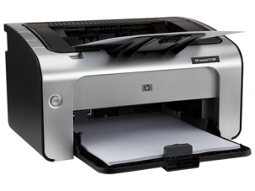
Embedded Devices
“Embedded device” from Wikipedia
“Embedded devices” as security research objects
Every electric devices except desktops and laptops
Usually connected to networks

Slide 3
What’s Difference?
 | Embedded device | Personal computer
Purpose | Specific purpose | General purpose
Operating system | Various (no OS, Linux, VX Works…) | (mostly) Windows
Architecture | Various (ARM, PowerPC, AVR, 8051…) | (mostly) Intel x86
User interface | Poor (limited input and output) | Rich (monitor, keyboard, mouse…)
Static analysis object | Firmware files, ROM image, flash image… | Application files, system files
Dynamic analysis | Hard (not even possible) | Easy (Olly dbg, Win dbg, GDB…)
Hardware analysis | Required (to extract something) | Not required

Slide 4
An Approach for Embedded Device Analysis
Gathering information
Public info.
(e.g., googling, datasheet)
Existing works
(e.g., CVE, conference, etc.)
Creating exploit
Attack scenarios
Using info.
Extracting firmware
Hardware analysis
Firmware analysis (Static)
Vulnerabilities
Finding interfaces
Access to interface (Dynamic)
Proof of Concept (PoC)
Today’s topic
Finding vulnerabilities

Slide 5
Preparing for embedded device analysis
Step 0 ~ 3

Slide 6
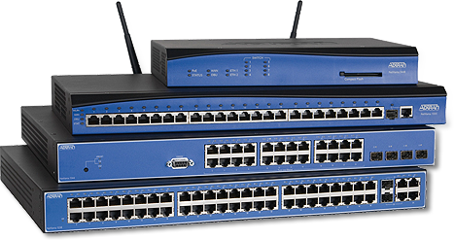
You’ve Got an Embedded Device
I need zero-day vulnerabilities IN A SEMESTER.
With LOVE…

Slide 7
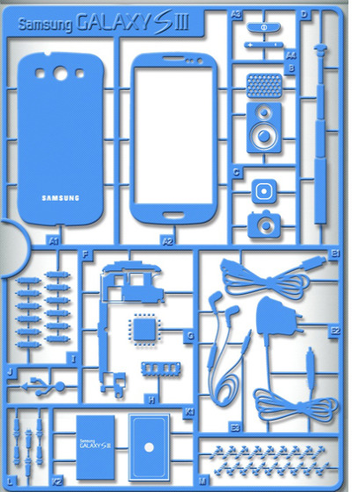
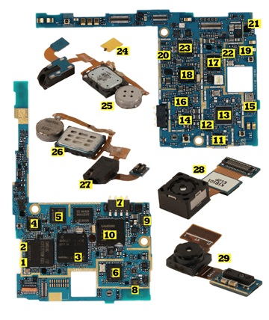
Step 0: The Beginning
Tear down
(not always reversible)

Slide 8
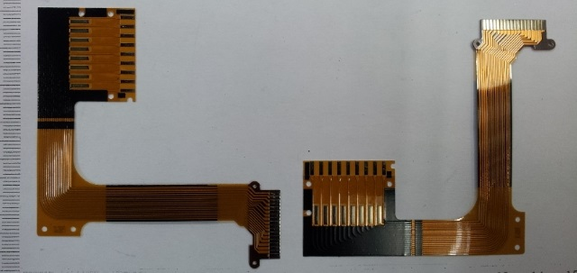
Step 0: The Beginning
Tear down
Read user manuals & check normal functions (just observe & log some outputs)
Then, tear down “carefully”
https://www.ifixit.com/Teardown
(e.g., film cables)

Slide 9
Step 1

Slide 10
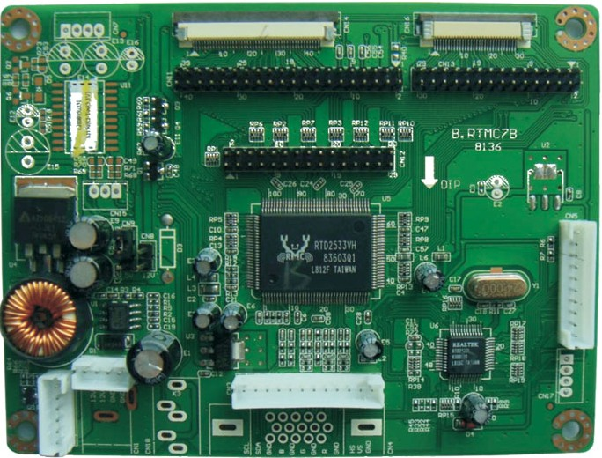
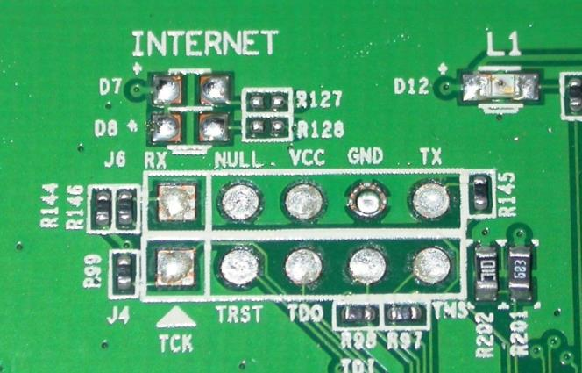
Step 1: Hardware Interfaces
Goal: Extracting useful data
(texts, interfaces, etc.)

Slide 11
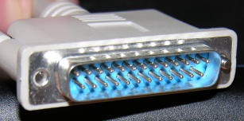
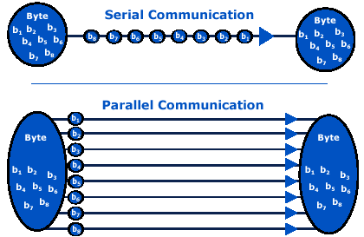
Step 1: Hardware Interfaces
Parallel communication
LPT (Line Printer Terminal) parallel port
Serial communication
Ethernet
UART
I2C
SPI
JTAG

Slide 12
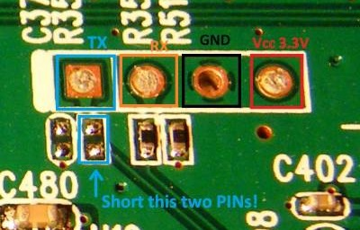
Step 1: Hardware Interfaces
UART (Universal Asynchronous Receiver/Transmitter)
6 pins = VCC, TX, RX, GND, (CTS, RTS)
(optional) Flow control using CTS (Clear To Send) & RTS (Ready To Send)
1:1 communication
Baud rate = usually 9600 or 115200
For RS-232, RS-422, RS-485, etc.
Tools: Putty, PySerial, etc.

Slide 13
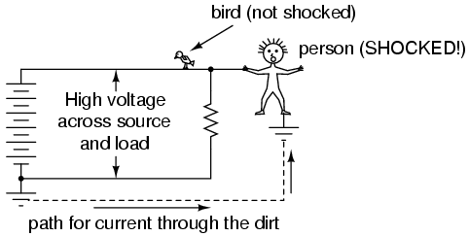
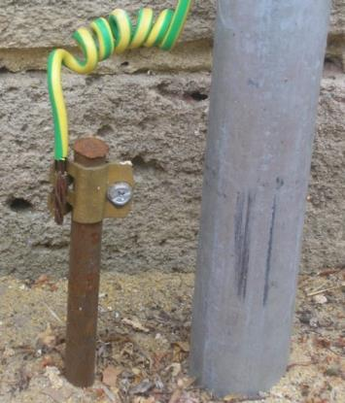
NOTE: GND
GND symbols
Ground or Earth or Common
The reference voltage in “an” electrical circuit (not 0V!!)
A relative (not absolute) concept
Proper GND for wired communications
Where is
the ground?
5V
Batt.
10V
Load
5V
Batt.

Slide 14
NOTE: GND for Comm.
5V
10V
Communication
processor
5V
Batt.
5V
Batt.
Communication
processor
10V
Load
10V
Load
GND
5V
5V
Batt.
5V
Batt.
-5V
GND
Cannot
communicate
HIGH = 5V
LOW = -5V
HIGH = 10V
LOW = 0V

Slide 15
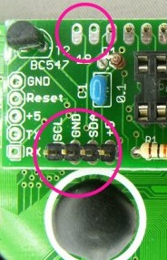
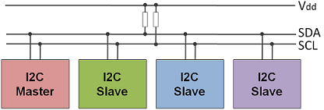
Step 1: Hardware Interfaces
I2C or IIC (Inter Integrated Circuit, Two-Wire Interface)
4 pins = VCC, SDA (Serial Data), SCL (Serial Clock), GND
Multi-master/slave bus (made by Philips Semi.)
Among digital chips on the same board (e.g., MPU & EEPROM)
Protocol (http://i2c.info/i2c-bus-specification)
Tools: Arduino with “wire” library
Pull-up resistors
Up to 128 slaves

Slide 16
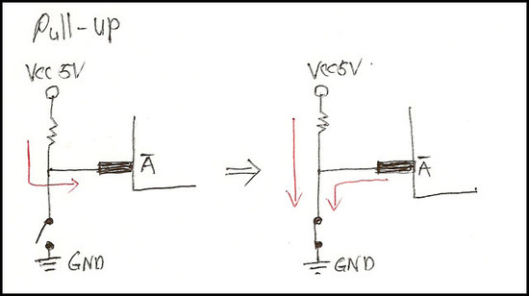
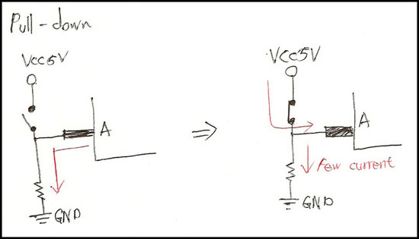
NOTE: Pull-Up/Down Resistor
PIN status
HIGH = VCC
LOW = GND
Floating = Undefined (i.e., opened)

Slide 17
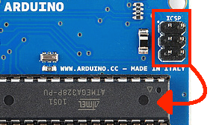
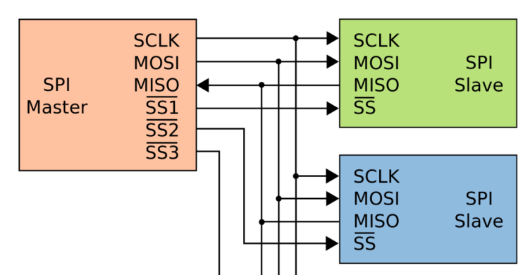
Step 1: Hardware Interfaces
SPI (Serial Peripheral Interface)
6 pins = VCC, SCLK, MOSI (Master Out/Slave In), MISO (Master In/Slave Out), SS (Slave Select), GND
Four-wire serial bus (made by Motorola)
1:n communication using SS
For fusing firmware, etc.
Tools: commercial SPI programmer, Arduino with “SPI” library

Slide 18
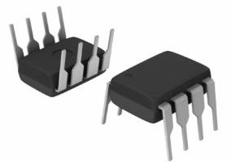
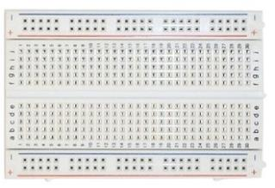
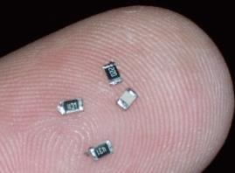
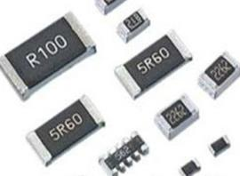
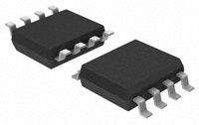
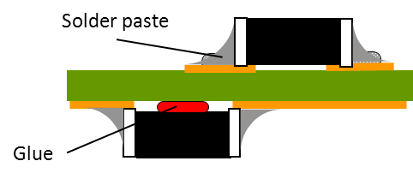
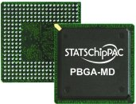
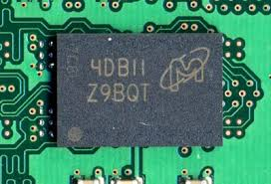
NOTE: Mounting Type
DIP (Dual In-line Packages)
SMD or SMT (Surface Mount Devices/Technology)
BGA (Ball Grid Array)

Slide 19
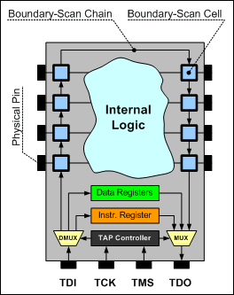
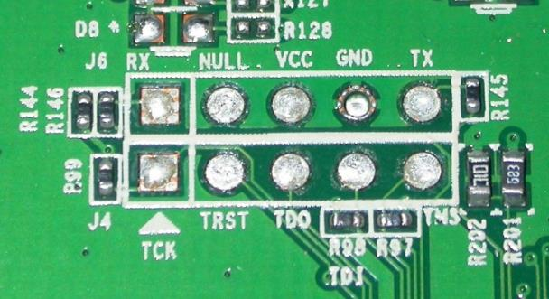
Step 1: Hardware Interfaces
JTAG (Joint Test Action Group)
8 pins = VCC, TMS (Test Mode Select), TCLK (Test Clock), TDO (Test Data Out), TDI (Test Data IN), TRST (Test Reset), RESET, GND
For debugging and flashing firmware
Tools: commercial JTAG debuggers

Slide 20
Step 2

Slide 21
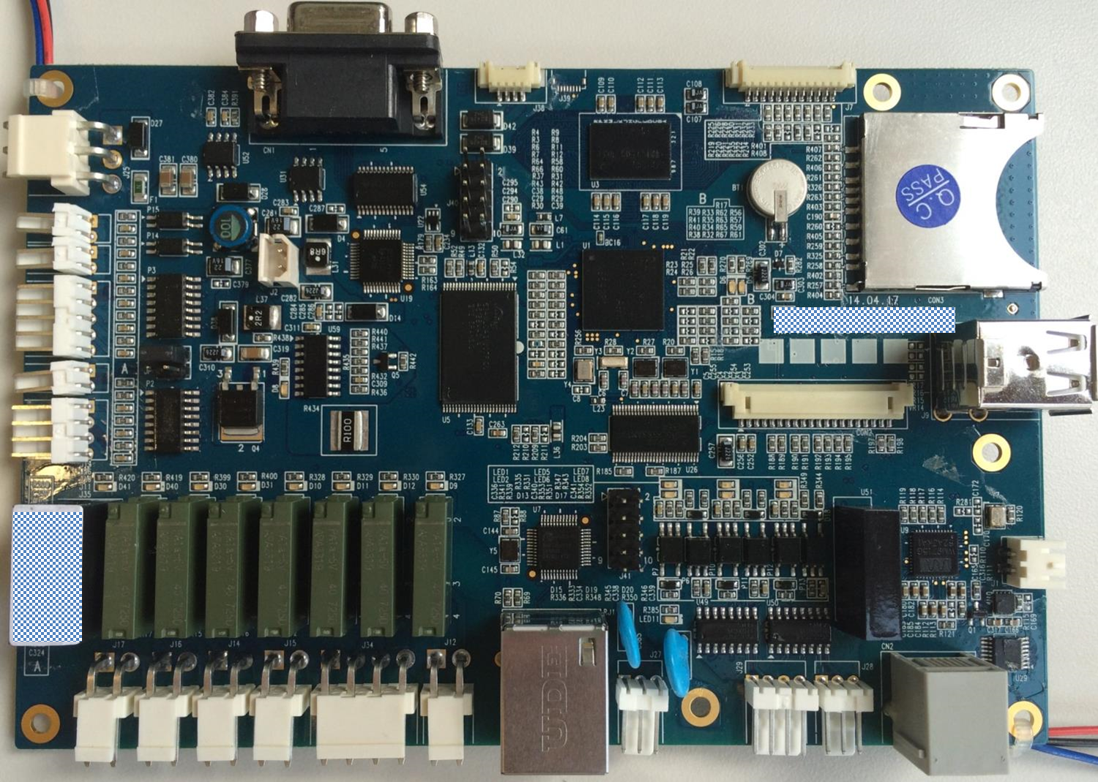
A company’s device
Samsung K4X1G323PE
1G DDR RAM
TI MAX3243
3V-to-5V RS232 Line Driver
TI TL16C2550
1.8V-to-5V Dual UART
Samsung S3C6410
ARM1176 Processor
SPANSION
NAND Flash
Memory (4G)
???
TOSHIBA TLP291-4
Programmable Controller
WM9715
Audio and
Touchpanel CODEC
DAVICOM DM9000BI
Ethernet Controller
Sipex SP232E
RS232 Line Driver
TI MAX3232
3V-to-5V RS232
Line Driver

Slide 22
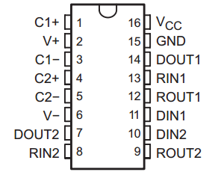
Step 2: Access to HW Interface
Datasheet (e.g., TI MAX3232 RS-232 Line Driver)
Features
Pin map/assignment/configuration
Pin description
Application schematic or layout example

Slide 23
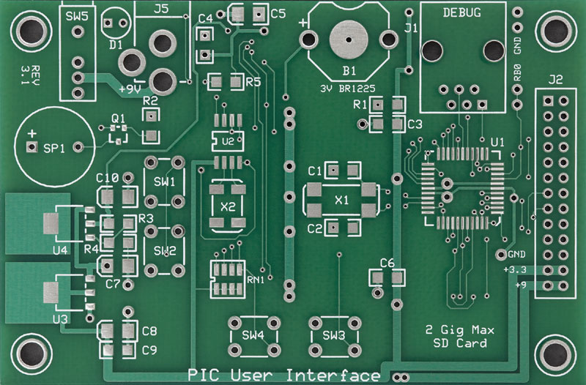
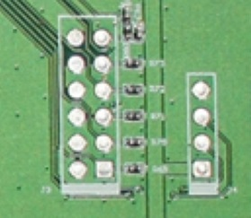
Step 2: Access to HW Interface
Tracing PCB routing (using your eyes or multi-meter)
GND
(by copper pour)
Letters and figures = silk layer

Slide 24
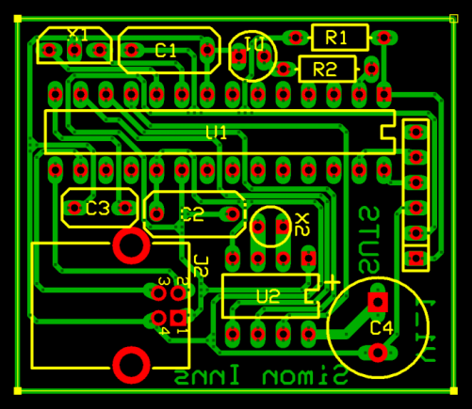
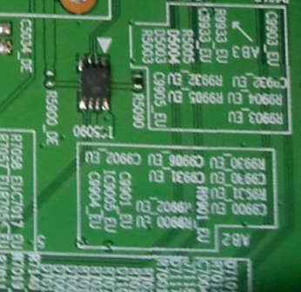
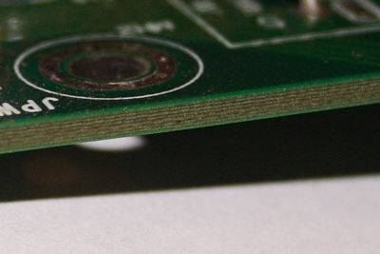
NOTE: PCB
PCB (Printed Circuit Board)
PCB artwork
Letters and figures = silk layer

Slide 25
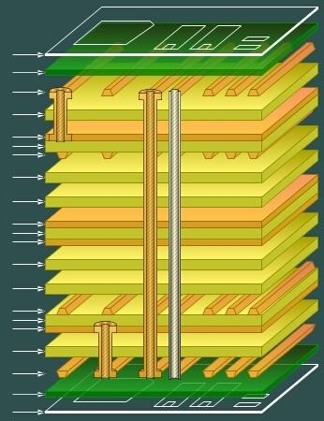
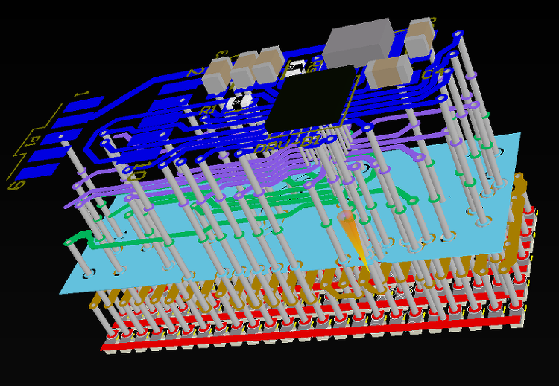
NOTE: PCB
Smart phone
PCB (Printed Circuit Board)

Slide 26
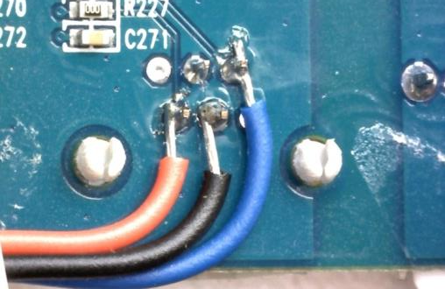
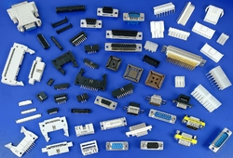
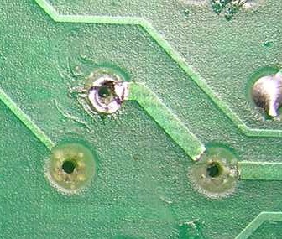
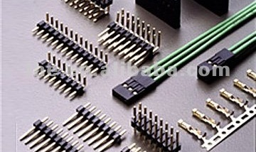
Step 2: Access to HW Interface
Physical access
Soldering
Using connectors
Be careful…

Slide 27
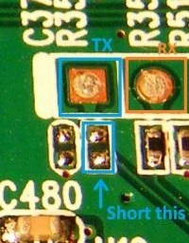
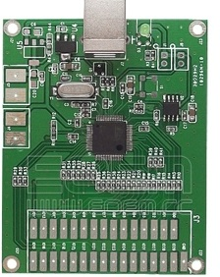
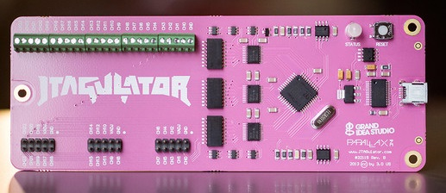
Step 2: Access to HW Interface
Logical access
Using test tools (Jtagulator or JTAG finder)
Or just connect, and observe until…
Can be disabled temporarily or permanently ☹
Can be disabled by software or hardware ☹
JTAG Finder
Jtagulator

Slide 28
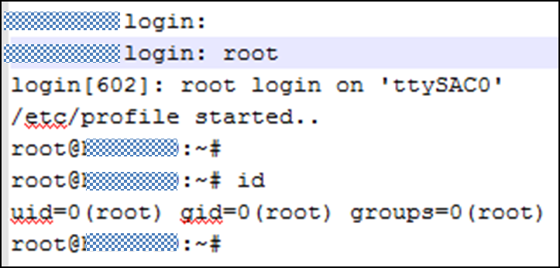
Step 2: Access to HW Interface
UART
Booting message (CPU and memory info.)
Bootloader access
Shell with or without login
I2C: memory read/write
SPI: memory read/write
JTAG: dynamic debugging, memory read/write, etc.
A company’s device

Slide 29
Step 2: Access to HW Interface
Download on the Internet (previous model or series)
Firmware extraction
Through external storage (USB, SD-Card, etc.)
Useful tools in the original system
ftp(d), tftp(d), netcat or nc, telnet(d), etc. ( “/bin/busybox”)
Cross-compile some tools & put them in the target system
Memory dump

Slide 30
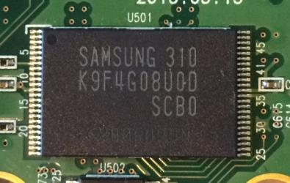
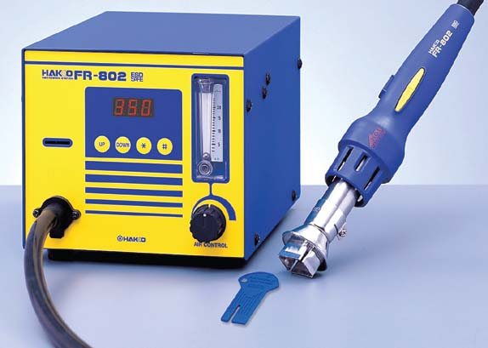
Step 2.5: Direct Access
Flash memory dump
Soldering jumper cables on the PCB
De-soldering (chip off) using soldering irons or rework station
Rework Station

Slide 31
Step 2.5: Direct Access
Ex) Samsung NAND flash memory on “a” device
Using a programmable MPU module (commercial AVR module, Arduino Mega, Bus pirate, etc.)
K9F1208U0C
Memory socket
Memory socket

Slide 32
Step 2.5: Direct Access
PIN name | PIN description
I/O0~7 | DATA INPUTS/OUTPUTS
CLE | COMMAND LATCH ENABLE
ALE | ADDRESS LATCH ENABLE
CE/ | CHIP ENABLE
RE/ | READ ENABLE
WE/ | WRITE ENABLE
R/B/ | READY/BUSY OUTPUT
Read ID operation (0x90 command)
Implement this !!

Slide 33
Step 3

Slide 34
Extracted file system
Extracted binary
No
Packed or compressed
Encrypted
Unknown (customized)
IDA Pro?
Yes
Yes
Yes
File system?
Googling?
No
No
No
No
Hex-Rays?
Decrypt?
Yes
Yes
* or ???
But, every binary is different…
(architectures, devices, manufactures, standards, etc.)

Slide 35
Step 3: Basic Firmware Analysis
Automatic analysis (using tools)
Binwalk
Firmware Modification Kit (FMK)
Manual analysis (using your brain and luck)
Finding patterns or signatures
Binwalk example
(B company’s device)

Slide 36
Step 3: Basic Firmware Analysis
Manual analysis example
C company’s firmware = single BIN file
Header size
Repeated pattern
File sequence
number
File size

Slide 37
Step 3: Basic Firmware Analysis
13 images
Three Yaffs (Yet Another Flash File System) images (VMS Alpha executable)
One CD-ROM image and others

Slide 38
Step 3: Basic Firmware Analysis
Filename
Yaffs image file
File content

Slide 39
Step 3: Basic Firmware Analysis
Pattern
16 byte data per every “0x800” byte
Page header
Always 0x00001000 (4 byte)
Object ID (4 bytes)
Page sequence number (4 bytes)
Page length (4 bytes)

Slide 40
Step 3: Basic Firmware Analysis
Basic check list
Strings (readable info. for human)
Useful messages or numbers, hardcoded ID/PW, and hidden commands…
Booting sequences
Init.d, rcS, and shell scripts running in booting sequences…
External interfaces
Socket (parameters), bind (port), and listen (status)…
External USB memory, SD-Card…
Updates
Fixed IP addresses, URL or PATH
Configurable conditions for updating
ETC.

Slide 41
Good Luck to Your Projects

Slide 42
How About Wireless Spoofing

Slide 43
Q&A

