Slide 1
DolphinAttack: Inaudible Voice Commands
Guoming Zhang, Chen Yan, Xiaoyu Ji, Tianchen Zhang, Taimin, Zhang and Wenyuan Xu
Zhejiang University
Presenter : Hojoon Yang

Slide 2
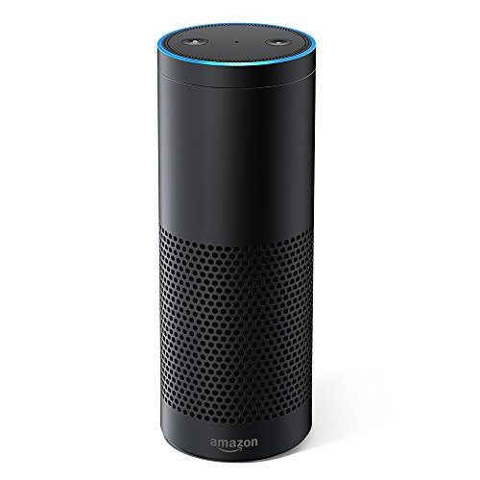
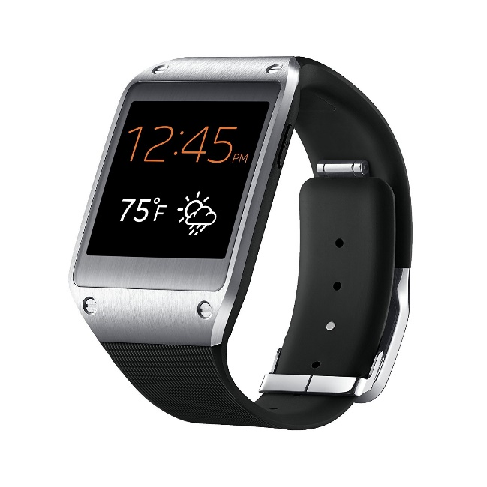
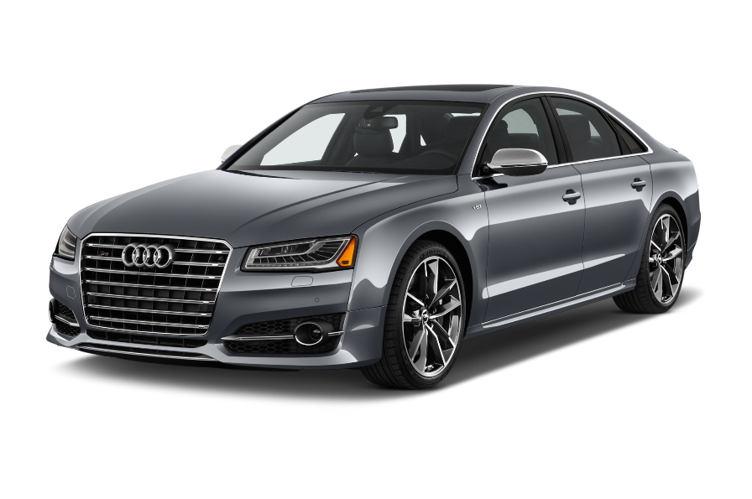

Slide 3
Today:
“Okay google, Text YDK I’m going on vacation tomorrow”
“Okay google, Call YDK”
“Okay google, Open Gmail”
“Okay google, Go to security101.kr”
“Okay google, Set alarm for 10 a.m.”
…

Slide 4
In the near future?
“Okay google, pay hojoon $100”
“Okay google, open the door”
“Okay google, unlock the car”
“Okay google, start the car”
“Okay google, set my home temperature at 60 degree”
…

Slide 5
Voice channel opens up new possibilities for attack
Is voice more secure than fingerprint? Is current implementation of voice recognition secure?

Slide 6
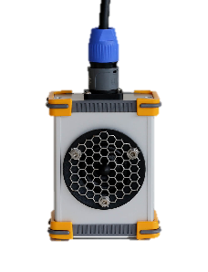
Threat model
What should I do?
“.....”
?

Slide 7
1. Audible and Intelligible
“Okay Google!”

Slide 8
1. Audible and Intelligible
“Okay Google??”
“Okay Google!”

Slide 9
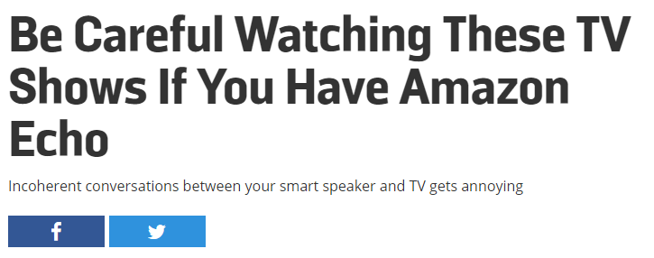
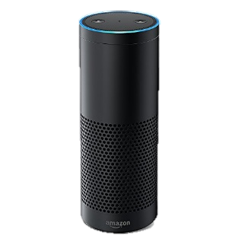
2. Audible But Not Intelligible
Can you play dollhouse with me and get me a dollhouse?

Slide 10
2. Audible But Not Intelligible
“Cocaine Noodle!”

Slide 11
2. Audible But Not Intelligible
“Cocaine Noodle = Okay Google”
“Cocaine noodle….?”
“Cocaine Noodle!”

Slide 12
2. Audible But Not Intelligible
“*%$&@*$&@*##”

Slide 13
2. Audible But Not Intelligible
“hmm..”
“*%$&@*$&@*##”

Slide 14
Command 1 : “Okay google”
Command 2 : “Okay google, Open xkcd.com”

Slide 15
3. In-Audible
“Okay Google!”

Slide 16
3. In-Audible
“…..”
“Okay Google!”

Slide 17
Related work
 | Human intelligible? | Machine Intelligible? | Works well?
Audible Voice command | Yes | Yes | ☹
Audible Voice command | No | Yes | ☺
In-Audible Voice command | No | Yes | ☺☺
Cocaine Noodles: Exploiting the Gap between Human and Machine Speech Recognition, USENIX WOOT 2015
Hidden Voice Commands, USENIX 2016

Slide 18
Background
Voice Capture System
ADC
Voice signal
Microphone
Amplifier
Low Pass Filter
$$s(t)$$
$$f<20kHz$$
Voice Recognition System

Slide 19
Background
Voice Capture System
ADC
Voice signal
Microphone
Amplifier
Low Pass Filter
$$s(t)$$
$$f<20kHz$$
$$S(f)$$
Human voice is baseband signal which is$f<2kHz$
0
2k
$$f$$

Slide 20
Background
Modulation
$$s\left(t\right)→m\left(t\right)=\left(s\left(t\right)+1\right)cos(2πf_{c}t)$$
$$S(f)$$
$$M(f)$$
0
2k
$$f$$
0
22k
24k
26k
$$f$$

Slide 21
Background
Voice Capture System
ADC
Modulated voice signal
Microphone
Amplifier
Low Pass Filter
$$m(t)$$
$$f<20kHz$$
$$M(f)$$
$$m\left(t\right)=\left(s\left(t\right)+1\right)\cos\left(2πf_{c}t\right), where f_{c}>20kHz$$
Hmm…Its impossible.
0
22k
24k
26k
$$f$$
Cocaine noodle Author

Slide 22
Previous work [61] considers it impossible to receive voices above 20 kHz.
But… It works!
Since most speech recognition systems apply band-stop filters to attenuate signals that fall outside of the range of human speech and require a minimum power level for parsing speech, the adversary does not attempt to construct a covert audio channel that cannot be perceived by the human ear.
DolphinAttack
DolphinAttack Author
Hmm…Its impossible.
Cocaine noodle Author

Slide 23
Background
Voice Capture System
ADC
Modulated voice signal
Microphone
Amplifier
Low Pass Filter
$$m(t)$$
$$f<20kHz$$
$$M(f)$$
$$m\left(t\right)=\left(s\left(t\right)+1\right)\cos\left(2πf_{c}t\right), where f_{c}>20kHz$$
0
22k
24k
26k
$$f$$
Cocaine noodle Author

Slide 24
Non-linearity
Voice Capture System
ADC
Voice signal
Microphone
Amplifier
Low Pass Filter
$$s(t)$$
$$f<20kHz$$

Slide 25
Non-linearity
$$x$$
$$y$$
ADC
Voice signal
Microphone
Low Pass Filter
$$s(t)$$
$$f<20kHz$$
$$y=Ax$$
$$y=A∗s(t)$$
$$y=Ax+Bx^{2}$$
$$y=A∗s\left(t\right)+B∗s{\left(t\right)}^{2}$$
Nonlinearity term

Slide 26
Non-linearity
$$x$$
$$y$$
ADC
$$y′$$
voice signal
Microphone
Low Pass Filter
$$y′′$$
$$s(t)$$
$$f<20kHz$$
$$y=Ax+Bx^{2}$$
$$y=As\left(t\right)+Bs{\left(t\right)}^{2}$$
$$y^{′}={As(t)+Bs(t)}^{2}$$
$$s\left(t\right)→s\left(t\right)+\frac{s{\left(t\right)}^{2}}{1000}≈s(t)$$
Voice Recognition System
$$y′′={As(t)+Bs(t)}^{2}$$
$$A=1,B=\frac{1}{1000}$$
$$s\left(t\right)+\frac{s{\left(t\right)}^{2}}{1000}≈s(t)$$

Slide 27
Non-linearity
Voice Capture System
ADC
Modulated voice signal
Microphone
Amplifier
Low Pass Filter
$$m(t)$$
$$f<20kHz$$

Slide 28
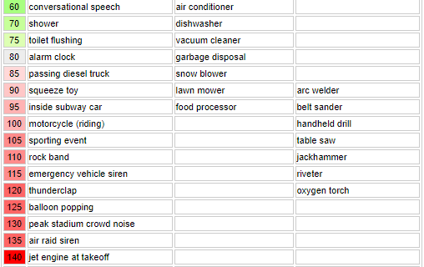
Non-linearity
$$s\left(t\right)→s\left(t\right)+\frac{s{\left(t\right)}^{2}}{1000}≈s(t)$$
$$A=1,B=\frac{1}{1000}$$
$$m\left(t\right)→\frac{1}{1000}∗\frac{1}{2}{\left(s\left(t\right)+1\right)}^{2}$$
$$→\frac{1}{2}{\left(s\left(t\right)+1\right)}^{2}$$
Voice signal
$$s(t)$$
$$As\left(t\right)+Bs{\left(t\right)}^{2}$$
$$As\left(t\right)+Bs{\left(t\right)}^{2}$$
The received SPL for the ultrasound is measured at
10 cm away from the Vifa [9] speaker and is 125 dB.
ADC
$$x$$
$$y$$
$$y′$$
Modulated voice signal
Microphone
Low Pass Filter
$$y′′$$
$$m(t)$$
$$f<20kHz$$
$$y=Ax+Bx^{2}$$
$$y=Am\left(t\right)+Bm{\left(t\right)}^{2}$$
$$m\left(t\right)=\left(s\left(t\right)+1\right)\cos\left(2πf_{c}t\right), where f_{c}>20kHz$$
$$y={A\left(s\left(t\right)+1\right)cos⁡(2πf_{c}t)+B\left(s\left(t\right)+1\right)}^{2}\cos^{2}{(2πf_{c}t)}$$
Voice Recognition System
$$y={B\left(s\left(t\right)+1\right)}^{2}\cos^{2}{(2πf_{c}t)}={\frac{B}{2}\left(s\left(t\right)+1\right)}^{2}(1+\cos\left(2π\left(2f_{c}\right)t\right)$$
$$y^{′}=y′′={\frac{B}{2}\left(s\left(t\right)+1\right)}^{2}$$
$$s(t)≠\frac{1}{2}{\left(s\left(t\right)+1\right)}^{2}$$
Does it really work?

Slide 29
Can you distinguish?
$s\left(t\right)$ vs ${\frac{1}{2}\left(s\left(t\right)+1\right)}^{2}$
원본
Nonlinear term

Slide 30
Are we done?
No, we have an authentication problem

Slide 31
Siri knows who the owner is
User-dependent activation
Siri does not be activated by the non-owner voice.
Even in-audible voice is not much different.
$$m\left(t\right)=\left(s\left(t\right)+1\right)\cos\left(2πf_{c}t\right), where f_{c}>20kHz$$
$$s\left(t\right) should be owner voice.$$
ANY SOLUTION?

Slide 32
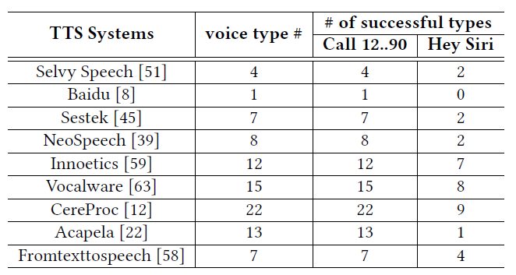
Solution #1
Brute force
Device is trained by Google TTS engine.

Slide 33
Solution #2
Concatenative Synthesis
When an attacker recorded owner’s sentences except “Hey Siri”
ㅎㅣ
ㅋㅔ이크
헤이

Slide 34
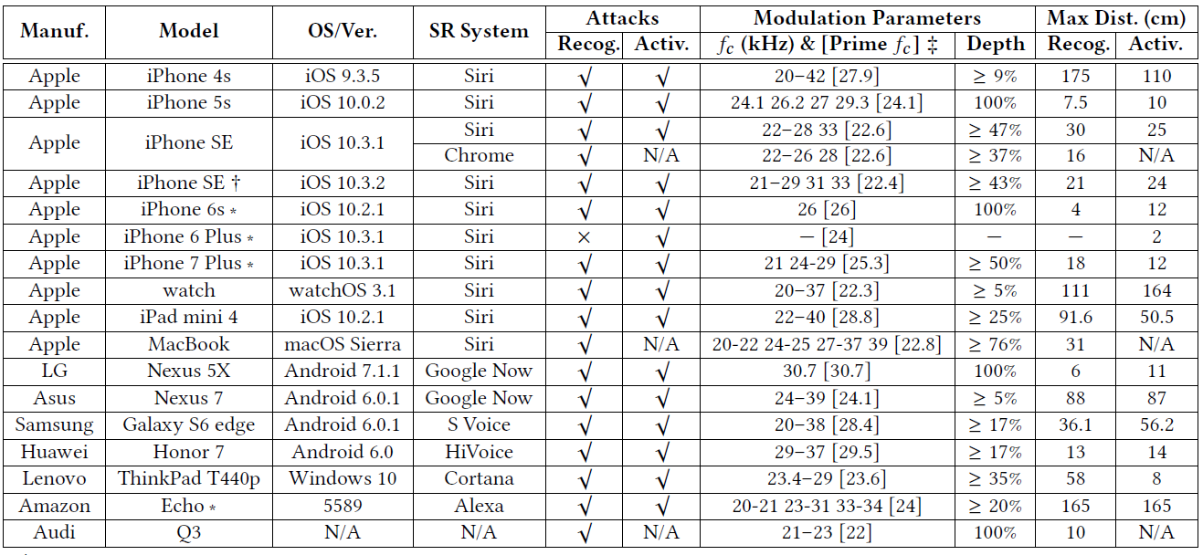
Evaluation

Slide 35
Hardware defense #1
Voice Capture System
ADC
Low Pass Filter
Microphone
Amplifier
Low Pass Filter
$$f<20kHz$$
$$f<20kHz$$
Modulated voice signal
$$m(t)$$
Voice Recognition System

Slide 36
Hardware defense #2
$$y^{′′}=−s\left(t\right)+s\left(t\right)=0$$
$$y=m\left(t\right)+m{\left(t\right)}^{2}$$
$$y^{′}=−s\left(t\right)+m{\left(t\right)}^{2}$$
Voice Capture System
X
ADC
$$y$$
$$y′$$
$$y′′$$
Microphone
Amplifier
Low Pass Filter
$$f<20kHz$$
Modulated voice signal
$$m(t)$$
Voice Recognition System

Slide 37
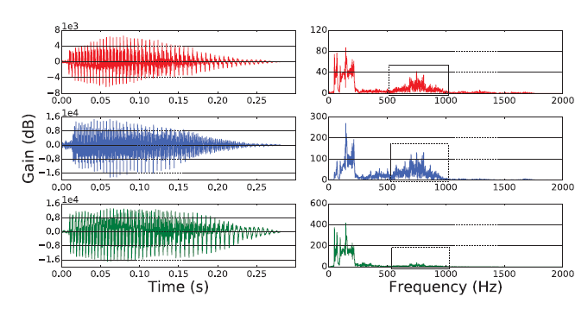
Software defense
Original
Recorded
Recovered

Slide 38
Conclusion
Authors find …
Inaudible voice attack is possible.
Amplitude Modulation
Nonlinear component
Do Not Trust The Paper TOO MUCH. Be critical.

Slide 39
Limitation and Future work
Poor defense.
Starbucks siren order
Authentication solution is non-sense.
Attack distance is not very long.(max. 1m)
Attack needs high power signal.
Attack can be exposed by device response

