Slide 1
Using Frankencerts for Automated Adversarial Testing of Certificate Validation in SSL/TLS Implementations
Written by Chad Brubaker, Suman Jana, Baishakhi Ray, Sarfraz Khurshid, Vitaly Shmatikov
Presented by Seungeon Lee

Slide 2
Content
Motivation
SSL/TLS and Server Authentication
Generating FrankenCerts
Evaluation
Discovered Vulnerabilities
Conclusion
Notes:
Introduce each content.

Slide 3
Many SSL Softwares
GNUTLS
Notes:
Is there anybody who have used SSL in your life?
Is there anybody who does not use internet banking.
It is not a shame. You can love your cash.
As we can see here, many people uses Internet banking, but they don’t know that it is consist of SSL.
They only remembers Active X.

Slide 4
Motivation
Do those SSL softwares operate all correctly?
Nobody knows.
Then, make a testing tool for SSL softwares!
How can we test all these implementations?
By differential Testing
Notes:
The motivation of the paper starts from a question, “Do those SSL softwares operate all correctly?”
The answer is “Nobody knows”
Therefore, in this paper, the author make a testing tool for SSL: softwares.
Explain each challenge based on the text written in the slide.

Slide 5
What is Differential Testing?
openSSL
GnuTLS
Input
Comparison
.
.
.
MatrixSSL
Notes:
Same input, Compare, if different

Slide 6
Why Differential Testing?
The protocol is written in natural language.
Not with specific input-output matching
Hard to decide whether the code sniffet is erroneous or not.
Implementations are huge.
Ex) OpenSSL: more than 600 K lines.
- Let’ s assume a monster that need only 15 seconds to debug a line.
- > 2500 Hours -> 104 Days
Several people develops together.
- There is no perfect expert.
How about other Blackbox Testing?
Naive approaches are already done. (Developers are not that much stupid)
Needs an automated testing system.
Software Testing
Blackbox Testing
Whitebox Testing
Input, Output Test after
Code Analyzation
Code Analyzation
after
Input, Output Test

Slide 7
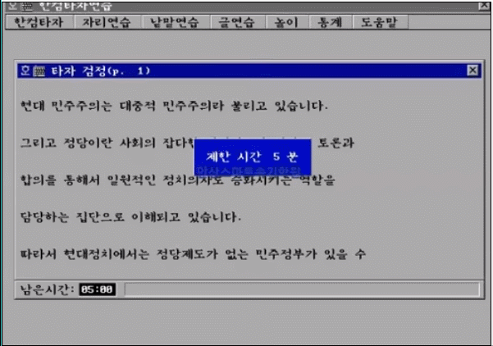
Challenges in (Blackbox) Testing
Challenge1: Test Input Generation
Naive random automation cannot make useful input
Manual creation needs too much effort
Challenge2: Test Result Analysis
Is the accepted certificate valid?
Is the reason of rejection correct?
Can benefit from differential testing!

Slide 8
So, What is SSL?

Slide 9
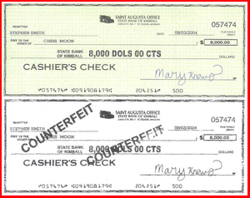
SSL/TLS Protocol
SSL: Secure Sockets Layer Protocol (From Netscape)
TLS: Transport Layer Security Protocol
Standardization: Bunch of RFCs
Prevent eavesdropping, tampering, message forgery in a communication of server and client.
Notes:
SSL stands for secure sockets layer protocol.
It is initially implemented by Netscape.
After a while, it was standardized with bunch of RFCs, and its name was changed to TLS, which stands for Tranport Layer Security Protocol.
Therefore, TLS is more correct name.
Whatever, the purpose of SSL/TLS protocols is to prevent eavesdropping, tampering, and message forgery in the network.

Slide 10
SSL/TLS Protocol
Client
Server
SYN
SYN ACK
Server Authentication
ACK
ClientHello
ServerHello
Certificate
Certificate
Validation
. . .
Notes:
This is a simple picture that describes SSL/TLS protocols.
As you can see at the blue boxes, SSL/TLS protocol is usually run on TCP protocol.
After the handshake of TCP, the SSL/TLS starts its handshake with client hello.
Then, the server sends serverhello with its certificate which is used in server authentication.
In this paper, and In this presentation, we will focus on this certificate and server authentication.

Slide 11
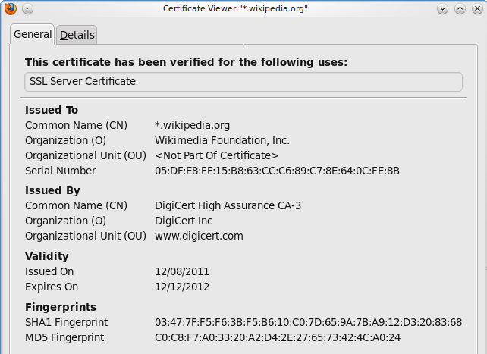
Certificate
Refered from Sangok Park’s slides in EE515/IS523 16’
Binds public key and subject
Issued by trusted third party
Based on X.509 standard
Notes:
This is the example form of a certificate.
It is consists of serveral components, but the important parts are these things, the issuer and the subject.
The subject is the field that represents what this certificate is for, and the issuer is the field that describes what CA issued this certificate.
There are three basic features of certificates, the first is that a certificate binds public key and subject as you can see in this example.
The second thing is that usually a certificate is issued by trusted third party.
And the last thing is that most of them are based on X.509 standard.

Slide 12
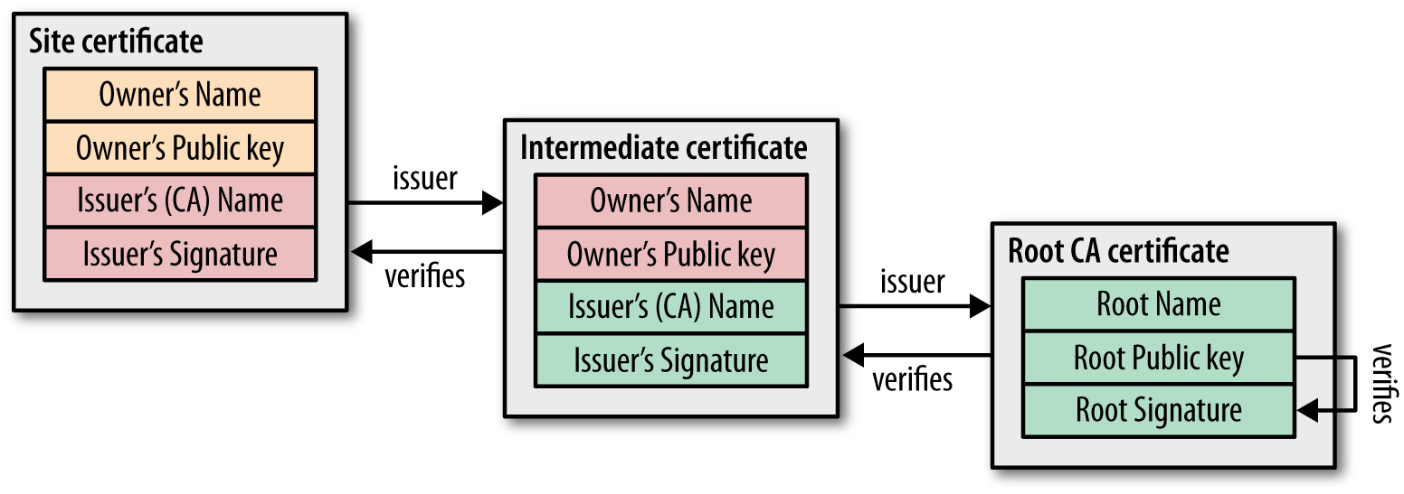
Certificate Validation – Chain of Trust
Refered from Sangok Park’s slides in EE515/IS523 16’
(Leaf Certs)
Root CAs
Notes:
In this slide, I will explain about the certificate validation of SSL/TLS.
The step of validation is usually called as chain of trust, because it is proceeded with chain of certificates.
So, here is the example picture of validation.
At first, the targeted server sends its certificate to client.
Then, the client looks for the issuer in the site certificate, and verifies the site certificate from the issuer.
However, as the client cannot still trust the issuer, it try to verify the issuer with its certificate to another higher-level issuer.
After this chain of issuers, the client finally get the root CA certificate which could be verified by itself.
Usually this root CA certificates are included in the operating system.
And this is the list of the most popular root CA companies which distribute root certificates.

Slide 13
Features in Validation
“not valid before” & “not valid after” : Indicate the valid period
For version 1 and 2, client must verify if the certificate came through out-of-band means
“CA bit” : Indicate whether the certificate can act as a root or intermediate one
“path length” : Indicate the number of intermediate CAs between the leaf and the current
“name constraints” : Restrict the subject name that following certificate should hold
“key usage” & “extended key usage” : The purpose of this certificate
“Authority Key Identifier” : Inform what key should be used for validation among multiple keys.
“CRL distribution points” : The information about certificates to be revoked
Basic
Constraints
Critical
Non-Critical
Extensions:
Only for Version 3
If client cannot recognize or understand critical extension,
the certificate is rejected.
Notes:
In the validation steps, there are several features to check.
The first one is..
<Explain about 1~8 with the content in the slide>
I explained total eight features which are introduced in the paper.
However, some features are not used by the version of the certificate.
These features in the green box are extensions, only used for version 3.
And these two blue ones are basic constraints which are essential extension for version 3.
These red ones are critical extensions, and these purple extensions are non-critical.
The difference between the critical extensions and the non-critical extension is that if a critical extension is activated but the client could not recognize or understand it, the client reject the certificate.

Slide 14
Hostname Verification
Server
Issuer : B
Issuer : C
. . .
Issuer : Z (Root CA)
subject name: A
subject name : B
subject name : Z
ClientHello
Common Name
Chain of trust
Validation Complete!
Check !
Client
Domain Name
DNS Server
IP Address
Notes:
This the big picture of whole TLS protocol scenario.
At first, the client asks a DNS server about the ip address with the domain name.
Then, it receives the ip address from DNS server, then sends client hello to the address.
When the server gets the client hello, it sends its certificate back to the client.
The client conduct the server authentication by chain of trust.
After the validation, the client finally checks that the domain name it originally required is same with the “Common Name” field or “SubjectAltName”.
This step is called hostname verification.
After whole these steps, now the client trusts the server that it is the site which the client originally intended to access.

Slide 15
Now, Let’s go back to the paper...

Slide 16
Existing Testing Practices
Most of SSL software tests with a handful of valid certificates
Missing the chance that the invalid certificates would discover flaws
Insufficient number of test set.
Although FIPS 140-2 tested OpenSSL, NSS and MatrixSSL, there are still vulnerabilities
(FIPS 140-2 : US government computer security standard used to approve cryptographic modules)
Notes:
Actually, the SSL software developers tried some testing to their implementation, of course.
However, they just tested with a handful of valid certificates, which is insufficient in the quantity, and the quality.
Also, FIPS 140-2, which is one of US government standard, tested some implementations, but this paper presenst vulnerabilities of them.

Slide 17
Generating Input
How can we make many inputs in the certificate form?
Collect parts from valid certificates.

Slide 18
“Seed” Collecting
To generate inputs for testing, the valid certificates, seeds, are needed.
Scan the Internet and attempt an SSL connection to every host listening 443
Total 243246 certificates while 23.5% is expired and 0.02% is not yet valid.
23698 certificates are in X.509 version 1 while 4974 are expired.
437 certificates are in X.509 version 4 which does not exist
Notes:
Before making test inputs, we need to collect “seeds” which would be the basis of those inputs.
The seeds need to be valid certificate, because we want test inputs which could be parsed in a grammar of X.509.
The author of this paper scann the Internet and attempt SSL connections to every host which is listening 443, HTTPS port.
With this brute-force way, they could find this number of certificates while 23.5% is expired and 0.02 % is not valid yet.
There are some interesting discovery in this samples that many of them are in X.509 version 1 which could be activate the vulnerability of the implementations that would be introduced later.
Also, some of certificates are in version 4, which does not even exist!
The authors expect that this is the mistake of users though.

Slide 19
Generating Frankencerts
Requirement
(1) Parsed as X.509 Certificate
(2) The functionality should be rare or wrong case
-> Syntactically correct, semantically wrong
Example
(1) Syntatic Constraint : Version must be an integer
(2) Semantic Contraint : If version != 2, extensions must be NULL
Then what happens if version !=2 but extensions != NULL?
Version
Serial Number
Signature Algorithm Identifier
Issuer Name
Validity Period
Subject Name
Public Key Information
Issuer Unique ID
Subject Unique ID
Extensions
Notes:
As we collected seeds, now it is the time to make test input, FrankenCerts.
For these FrankenCerts, there are two requirements.
First, it should parsed as X.509 certificate, and this is why we collected certificates in valid form as the seeds.
Second, the test input set should include some samples whose functionality is rare or wrong.
To sum up, we need the samples which are syntactically correct, but semantically wrong.
Here is the example for it.
If we say about syntactic constraint, it would be like this “Version must be an integer”
and if we say about semantic constraint, it would be like “If version is not 2, extensions must be NULL.”
Then what happens if version is not 2, but extension are not NULL?
This is the sort of test input that this paper wants to generate.

Slide 20
Generating Frankencerts
Generate a certificate by choosing parts randomly from seeds.
Exception
(1) Generates new RSA key
(2) Changes the issuer for creating chains
Validity issue about extensions including corner case could be tested.
Notes:
To make the required test inputs, the paper presents the way for generation.
The author of paper chose parts randomly from the seeds, and generated certificate by composing them.
And this is why the name of this test input is “FrankenCert”.
While making FrankenCerts, there are two exceptions.
The first exception is to generate new RSA key for each FrankenCert for distinction.
And the second exception is to change issuers for creating the chain of trust.
With FrankenCerts made by this method, validity issue about extensions including corner case could be tested.

Slide 21
Generating Synthetic Mutations
How about the case that the grammar of certificate is wrong?
With a Frankencert, replace all extension values to
Random String and NULL Character.
Why NULL?
-C string parser usually stops at NULL character.
Notes:
The paper also presents generating synthetic mutations.
They wanted to make test inputs for the case that a implementation has a problem with the certificate written in wrong grammar.
For this case, the author first make a FrankenCert, and then replace all its extension values to random string and NULL character.
The reason that they also tries null character is because most of C string parser usually stops at NULL character.
This was the explanation about generating synthetic mutations, however,, there is no mention about this at evaluation result in the last part of the paper.

Slide 22
Evaluation Setup
FrankenCert
FrankenCert
. . .
0
1
0-34-1
34
. . .
Notes:
So, this is the setup of the evaluation that the paper presents.
First, clients with each implementation sends client hello to the server.
Then, the server sends a frankencert to each client.
The client will respond to the server about FrankenCert whether it is correct or not.
If the responses of clients are different, the server saves the result including error code.

Slide 23
Evaluation Analysis Method
208 discrepancies are found by testing 8,127,600 FrankenCerts among 14 implementations.
The source codes are manually analyzed.
In this evaluation,
There is no false positives.
But there are several false negatives.
The flaws in the codepath that frankencerts does not trigger (Syntatic Flaws)
The case that all implementations made the same mistake
An implementation rejects an invalid certificate for the wrong reason
-> Solved by analyzing reported error codes.
For the analysis of error reporting,
The paper limits the scope to browsers as all implementations have different mechanism.
Notes:
For the evaluation, the paper explains about its analysis method to the result.
The paper says that it found 208 discrepancies by testing 8127600 FrankenCerts among 14 implementations.
For those 208 discrepancies, they manually analyzed the source code.
Also, there are some things to keep in mind about this evaluation.
<Explain with content in the slides>
false positive : no error yes found
false negative: yes error not found

Slide 24
Discovered Vulnerabilities (1)
Vulnerability: Incorrect checking of basic constraints for version 1 certificate
MatrixSSL
Just skip checking for version 1 or 2
GnuTLS
Intended to trust only root CA for version 1 , but there is an implementation mistake
Possible Security Issue:
Man-in-the-Middle Attack
Any server certified by the same root can act as a rogue CA.
Issue fake certificates for maliscious Internet domain.
Notes:
The first vulnerability that this paper discovered is that implementations checks basic constraints incorrectly for version 1 certificates.
This vulnerability is found in two implementations, MatrixSSL and GnuTLS.
For MatrixSSL, it just skip checking for version 1 or 2.
For GnuTLS, it intended to trust only root CA for version 1, but there is an implementation mistake.
With this vulnerability, an attacker may attack the client by man-in-the-middle attack as any server certified by the same root can act as a rogue CA.
It can issue fake certificates for any maliscious Internet domain.

Slide 25
Discovered Vulnerabilities (2)
Vulnerability: Incorrect checking of name constraint
GnuTLS, MatrixSSL, CyaSSL ignore name constraints.
Possible Security Issue:
Unauthorized CA (which has a different name) can issue certificates
Notes:
The second vulnerability is incorrect checking of name constraint.
GnuTLS, MatrixSSL, CyaSSL ignore name constraints.
This may allow unauthorized CA can issue certificates.

Slide 26
Discovered Vulnerabilities (3)
Vulnerability: Incorrect checking of key usage
PolarSSL, GnuTLS, MatrixSSL, CyaSSL does not check key usage properly.
Possible Security Issue:
Unauthorized CA (which has a different purpose) can issue certificates
Notes:
The third vulnerability is incorrect checking of key usage.
PolarSSL, GnuTLS, MatrixSSL, CyaSSL does not check key usage properly.
Similar to name constraint, this vulnerability may allow unauthorized CA can issue its certificates.

Slide 27
Discovered Vulnerabilities (4)
Vulnerability: Incorrect error reporting
Bad Issuer (I): No valid chain of trust
Bad Name (N): Server domain name is wrong
Expired (E): The certificate is expired.
Safari7 returns only E in IE, IEN, NE case.
Chrome (Linux) returns only E in IE, N in IEN case.
Opera (Linux) and Opera (Mac) returns only E in NE case.
Possible Security Issue:
The user would override the E warning in the case of I or N.
Security Severity
I > N > E
Notes:
The fourth vulnerability is about the error reporting.
The paper classified errors in three cases: bad issuer, bad name, and expired.
Bad issuer is the case that there is no valid chain of trust, and bad name is the case that server domain name is wrong in hostname verification step.
Expired is the caset that the certificate is expired.
The bad issuer case is the most severe, and than bad name, and then expired.
However, if the SSL/TLS implementation reports weaker security issue in the case of severe security threat, the user may proceed their job in the browser.
<Explain about the browser who reports wrong response>

Slide 28
Discovered Vulnerabilities (5)
Other Vulnerabilities
Incorrect checking of time
PolarSSL
Accepting certificates with unknown critical extensions
GnuTLs, CyaSSL, MatrixSSL
Accepting certificates with weak hash functions
MD5 : OpenSSL, PolarSSL, CyaSSL, MatrixSSL, OpenJDK, BouncyCastle, Firefox, WebKit, Opera
Short keys
Most implementations
Notes:
There are more miscellaneous vulnerabilities in the paper, and I collected them here.
<Explain with slide contents>

Slide 29
Related Works – Previous Work
The Most Dangerous Code in the World: Validating SSL Certificates in Non-Browser Software [CCS 12’]
Amazon EC2 Java library, Amazon & PayPal merchant SDK, and other android apps
The root causes are badly designed SSL APIs and incorrect usage of them
Implementing TLS with Verified Cryptographic Security [IEEE Symposium on Security and Privacy 13’]
Encrypted TLS connection
Provide APIs to implement applications
Testing system virtual machines [ISSTA 10’]
Test virtual machines by differential testing.
Notes:
As SSL and TLS has a long history, there were many researches about improving SSL/TLS.
Among them, I picked up two works which seems to be most related to this work.
The first one is <Dangerous Code paper name>
This paper was present in CCS 12’ and Some authors participated on both this work and also the FrankenCert.
This work is about many SSL/TLS applications exploits SSL/TLS implementation incorrectly due to badly designed APIs.
The second work is presented at IEEE symposium on security and privacy 13’.
It is about encrypting TLS connection (even the hello message) for more security.

Slide 30
Related Works – Work after This Work
Guided Differential Testing of Certificate Validation in SSL/TLS Implementations [ESEC/FSE 15’]
Similar with Frankencert
Diversify seed certificate by Markov Chain Monte Carlo sampling. (mucert)
Reported additional 357 discrepancies
Securing SSL Certificate Verification through Dynamic Linking [CCS 14’]
Offer immediate solution to vulnerabilities in legacy SSL code.
Hooks SSL API call and conduct hostname validation and certificate validation with recent version.
RandIR: differential testing for embedded compilers [SCALA 16’]
Test embedded compilers by differential testing.
Notes:
After FrankenCert, many researchers got shocked and motivated to work on this area deeply.
The first work that I want to introduce is <Name of Guided~> presented in <The conference>
It is basically doing similar things with Frankencert, but it asserts that it can do better.
It diversified seed certificate by Markov Chain Monte Carlo sampling, and reported additional 357 discrepancies.
The second work is about protecting SSL/TLS connections from vulnerabilities unveiled by FrankenCert.
It hooks the SSL API call and conduct SSL/TLS with latest version which fixed the vulnerabilities.

Slide 31
Conclusion
Differential Testing is a strong weapon to find vulnerabilities from huge implementations.
In the paper, SSL/TLS implementations were tested by differential testing, and indeed there have been vulnerabilities.
The paper presents Frankencert, which is an efficient input generating method for differential testing
Notes:
Explain the conclusion based on the slide content.

