Slide 1
Mining Your Ps and Qs: Detection of Widespread Weak Keys in Network Devices
Originally from:
N. Heninger, Z. Durumeric, E. Wustrow, J. A. Halderman
USENIX Security ‘12
Presenter: Seongkwang Kim
Notes:
Hello. My name is Seongkwang Kim. This is a presentation of this week’s paper, mining your ps and qs: detection of widespread weak keys in network devices by Heninger, Durumeric, Wustrow, and Halderman. This paper was presented in USENIX Security 2012.

Slide 2
Introduction

Slide 3
Cryptography and Randomness
Cryptography requires good randomness
A key generation needs a good random number generator
Randomness
M
C
Enc
Dec
KeyGen
PK
SK
PK, SK
M
C
If SK=000…0 or 111…1?
Notes:
In cryptography, many schemes claim their security assuming the randomness is ideal. Suppose the secret key is generated among 00000 and 11111. Then anyone can break this scheme. So, it is very important to have good randomness.

Slide 4
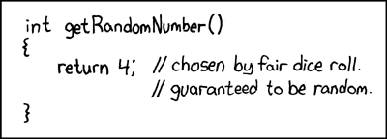
Not Enough Randomness
System without a monitor
Headless or embedded devices
Low entropy when just booted
Defective implementation
Degree of randomness
Focus
Notes:
There are some reasons for bad randomness. First one is headless or embedded devices. Normal computer gather its randomness from input sources such as mouse, keyboard, and time of boot. But headless or embedded devices cannot gather its randomness because they have no such input sources.
The second reason is the low entropy case. Here you may consider the term “entropy” as a degree of randomness. Even for normal computers, when they are just booted, they have no randomness because they have no time to gather its entropy.
The third one is defective implementation. Here is an example. If someone implement random number generator defectively, cryptography becomes totally defective.
This paper deals with bad randomness causing critical security problems in headless or embedded devices. This paper DOES NOT deal with bad randomness from bad algorithms.

Slide 5
Background
Notes:
Before we move on to the main topic, we briefly remind you some simple crypto backgrounds.

Slide 6
RSA
modulus
Notes:
Here is a detail of vanilla RSA. P and q are prime numbers. N is called modulus. Encryption is modular exponentiation of e and decryption is modular exponentiation of d. For the secret key, p and q are not mandatory but they are used for fast decryption.

Slide 7
RSA
It is very hard to find and from
But finding the GCD* of and is easy
We will collect Ns from the Internet and GCD them
*GCD: Greatest Common Divisor
Notes:
Usually, factorizing modulus by itself is hard. But computing the GCD of two numbers is known to be easy. Authors tried to collect millions of moduli from the Internet and to factorize by computing GCDs of them.

Slide 8
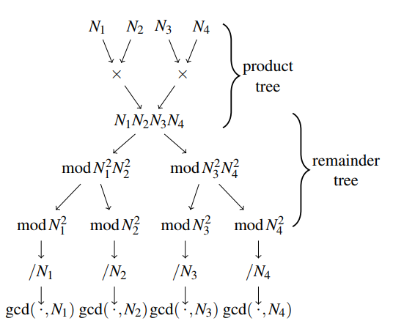
Efficiently Computing GCDs
Quasi-linear time algorithm by Bernstein
30 years 5.5 hours
Notes:
Before Naively, this several million modulus needs so long time to be computed for GCDs. The authors deployed Bernstein’s algorithm to compute the GCDs fast. It took only 5.5 hours.

Slide 9
DSA (Digital Signature Algorithm)
prime and is a generator of a subgroup of order
PK=
SK=
Signature
Ephemeral key
Notes:
Here is a detail of DSA. DSA is the acronym of digital signature algorithm. DSA also uses two primes p and q. With the secret key x, the public key y can be computed by g^x mod p. Here we have to focus on the ephemeral key k. The ephemeral key is randomly generated and should be used once only.

Slide 10
DSA
It is very hard to recover from
But if the ephemeral key is known, then
If the same ephemeral key is used for two signatures, then
We will collect signatures from the Internet and find ephemeral keys
Notes:
Recovering the secret key x from the public key y is as hard as the discrete logarithm problem. But similarly to RSA, if the ephemeral key is known or use of the same ephemeral key is known, the secret key can be calculated. The authors tried to collect signatures from the Internet and find ephemeral keys by the above method.

Slide 11
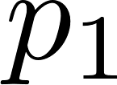
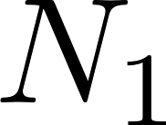
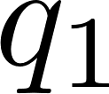
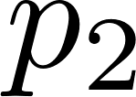
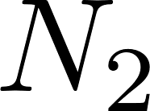
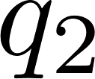
Bad Randomness & Bad Crypto (RSA)
Secure
RNG
Secure
RNG
Notes:
We give a simple diagram to explain how a bad randomness induces a bad crypto. When there are two secure RNG generate primes, then all the primes are different with high probability. Then the gcd of two moduli is 1. The attacker fails.

Slide 12
Bad Randomness & Bad Crypto (RSA)
Insecure
RNG
Insecure
RNG
Notes:
When two insecure RNG generate two primes, one of prime factor can be the same. Then the gcd of moduli is not 1. The attacker can factorize both of the moduli.

Slide 13
Bad Randomness & Bad Crypto (DSA)
Insecure
RNG
With the same ephemeral key k
Notes:
If one insecure random number generator generates the same ephemeral key, then the attacker can compute the secret key in this way.

Slide 14
Methodology
&
Vulnerability
Notes:
Then how could the authors find these devices with poor random number generators?

Slide 15
Collecting Public Keys
Finding hosts
Nmap from EC2
25 hosts, <25 hours
Retrieving keys
Event Driven Process
3 hosts, <48 hours
Parsing certs
OpenSSL, database
Port 443 (HTTPS) | Port 22 (SSH)
29 million hosts | 23 million hosts
Port 443 (HTTPS) | Port 22 (SSH)
13 million hosts | 10 million hosts
Certificates
6 million certificates (2 million browser-trusted)
Notes:
First, authors collected significant number of public keys. To do that, authors run 25 hosts within 25 hours in EC2 region (Virginia, California, Japan, Singapore, and Ireland). The authors implement certificate fetcher for TLS and concurrently handshaking client for SSH. They scanned about 29 million hosts for TLS and 23 million hosts for SSH. Among the scanned hosts, 13 million for TLS and 10 million for SSH completed protocol handshakes. And there are only about 6 million distinct certificates. Only 6 million certificates from 13 million hosts? What’s going on?

Slide 16
Repeated Keys
61% of the TLS hosts and 65% of the SSH hosts served the same key
 | Port 443 (HTTPS) | Port 22 (SSH)
Live hosts | 12.8 million | 10.3 million
Distinct RSA public keys | 5.6 million | 3.8 million
Distinct DSA public keys | 6241 | 2.8 million
Notes:
By the result of this scanning, there are plenty of repeated keys. The percentage here is computed by the number of live hosts subtracted by number of distinct public keys over the number of distinct public keys. Is it always vulnerable?

Slide 17
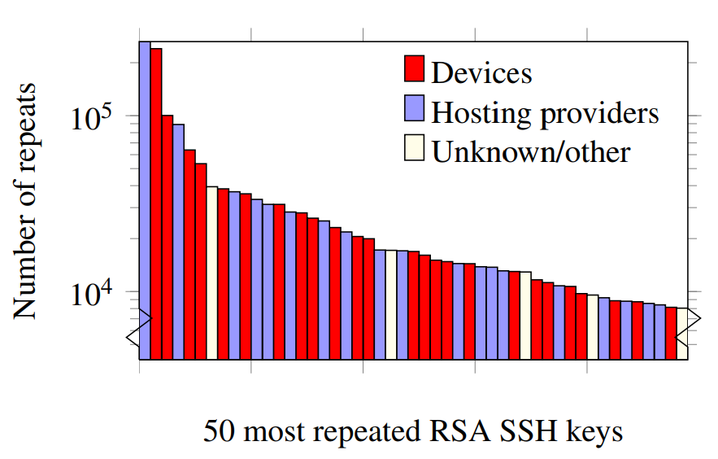
Repeated Keys
Not all repeated keys are vulnerable
Shared hosting situation
Same organization served distinct certificates with the same key
Notes:
No. Not all repeated keys are vulnerable. There are a lot of same key use by the hosting providers. Or some certificates are belonging to one organization like Google. These are not vulnerable. These are not the case we consider.
Here is a graph with the number of repeated keys and its reason. Note that this graph is log scale. There are two kinds of reasons: which are devices and hosting providers.

Slide 18
Vulnerable Repeated Keys
Default keys
Repeated keys due to low entropy
Factorable RSA keys
Repeated DSA ephemeral keys
Notes:
Here are some vulnerable reasons of repeated keys. The first one is the manufacturer-default key. At least 5% of TLS hosts are vulnerable with this reason. The second reason is repeated keys due to low entropy. If a machine is in a low entropy condition, then the machine has smaller key pool than expected. So, it is probable to repeat some keys. Such repeated keys induce factorable RSA keys and repeated DSA ephemeral keys. Repeated ephemeral keys causes the recovery of the secret key of DSA.

Slide 19
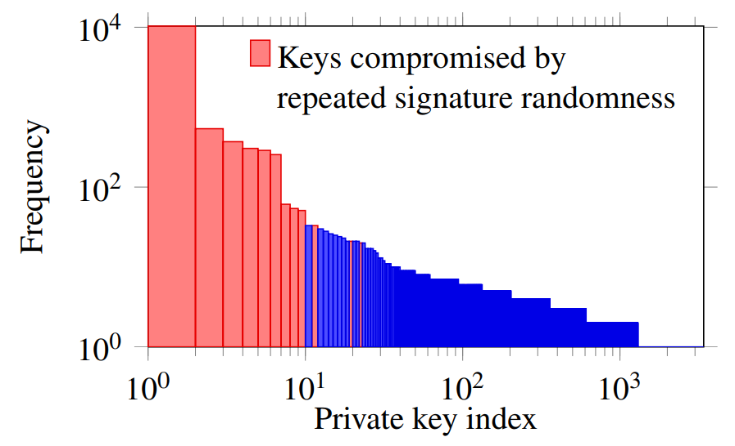
Vulnerable Repeated Keys
Notes:
Here is a graph with DSA repeated keys. As you can see, repeated keys appear in the early indices. It is because the entropy is low when a machine is just booted.

Slide 20
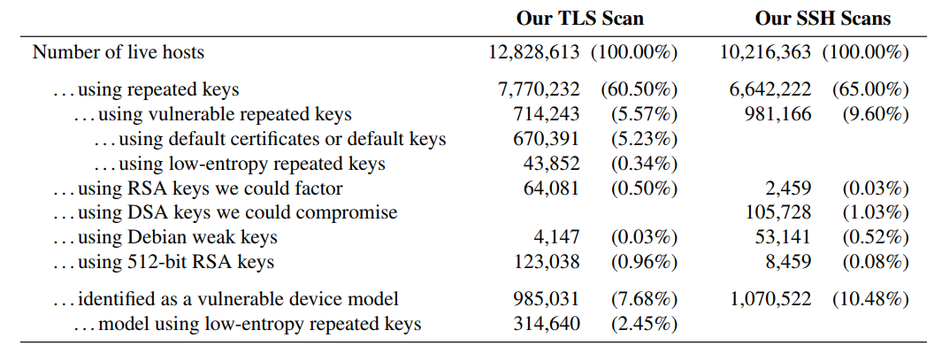
Summary of Vulnerabilities
Possible
vulnerabilities
Real
vulnerabilities
Notes:
This is a summary of vulnerabilities until now. These are the numbers of possible vulnerabilities. The number of repeated keys which is considered vulnerable, such as default keys or low entropy case. These are the number of real vulnerabilities. These are not only considered vulnerable, but recovered their secret keys. You can see the considerable fraction is really vulnerable.

Slide 21
Experimental
Investigation
Notes:
I think this is enough for a good paper, but the authors did not stop here. After the authors found the vulnerabilities by scanning, they set up an experiment and investigate how the low entropy affect to the key generations.

Slide 22
Linux Entropy Pools
Input Sources
Extracts entropy
Blocking Pool
Input Pool
/dev/urandom
Nonblocking Pool
Should not be used for cryptographic use!
When a process reads from /dev/urandom
Notes:
It is how /dev/urandom works. Nearly everything in Linux uses /dev/urandom. The document says that /dev/urandom should not used for cryptographic reason! But application developer think it is good enough. /dev/urandom maintains three entropy pools: Input pool, blocking pool, and nonblocking pool. First, fresh entropy from input sources is mixed into the input pool. If there is a call for /dev/urandom, then blocking or nonblocking pool extract entropy from the input pool. When the input pool has not enough entropy, blocking pool blocks but nonblocking pool does not.

Slide 23
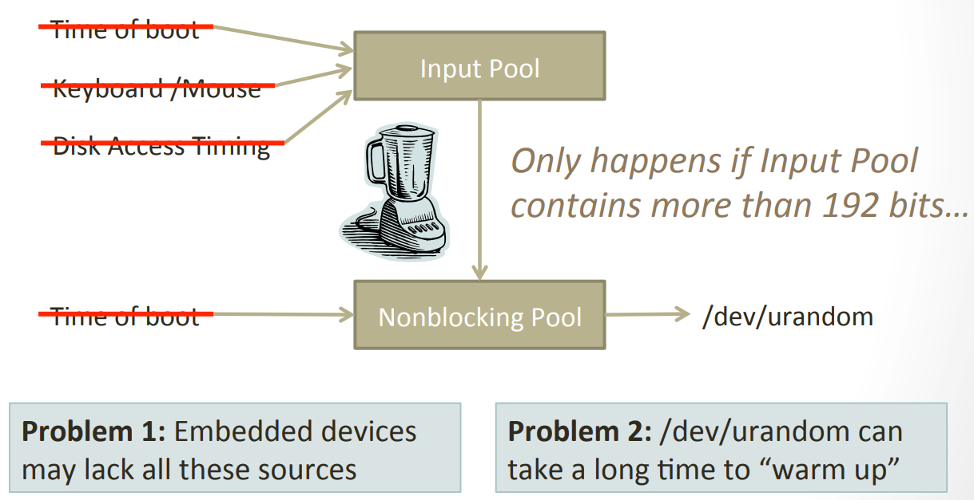
Linux Weak Entropy
Nearly everything uses /dev/urandom
Notes:
So, the nonblocking pool extracts entropy in the input pool immediately. It makes problem. Embedded devices may lack all the input sources. And even a normal computer with those input sources needs long time to warm up.

Slide 24
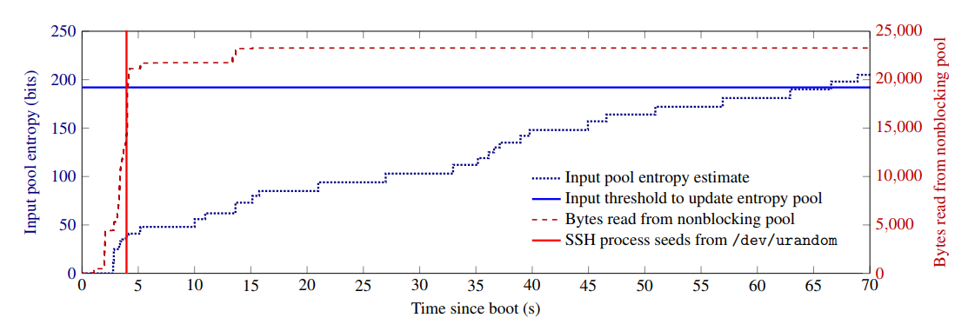
Boot-Time Entropy Hole
Ubuntu server 10.04 test system
Notes:
Here is a graph of warming up time. The red vertical line is the timing that SSH process reads from /dev/urandom. Then nonblocking pool outputs required bytes immediately. It is the red-dotted line. For the blue horizontal line, it is needed entropy to update the input pool. It is 192 bits. You can see that the blue-dotted line gradually increases. It is the estimated entropy of the input pool. After 66 seconds, the input pool can collect enough entropy.

Slide 25
OpenSSL
/dev/urandom
Process ID
Entropy pool
RSA KeyGen
User ID
The current time
Notes:
Another experiment is the factorable RSA key generation of OpenSSL. The following diagram describes the entropy pool of the OpenSSL RSA key generator. The entropy pool reads from /dev/urandom, process id, user id, and the current time. The authors focused on the current time because other things can be made same. The unit of the current time is second.

Slide 26
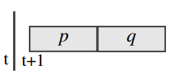
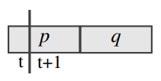
Factorable RSA in OpenSSL
Same keys
Different keys
Same p
Notes:
The authors tried to generate the same secret key. Since the key generator receives the current time as an input, they tried to generate two keys in the same time. If p and q are generated in the same second, then two key generation generates the same key. If the clock ticks during p is generated, then the two keys are all different. If the clock ticks during q is generated, then p is same but q’s are not same.

Slide 27
DSA Signature in Dropbear
If OS had not collected enough entropy when started, it remains its deficiency.
It causes the same ephemeral keys
Notes:
Dropbear is a popular light-weight SSH implementation. It has a peculiar vulnerability. Since its DSA implementation re-collects entropy from hash value of a counter, it collects no additional randomness until counters overflow. It causes the same ephemeral keys.

Slide 28
Related Work
&
Future Work
Notes:
Here we introduce some related works and after works.

Slide 29
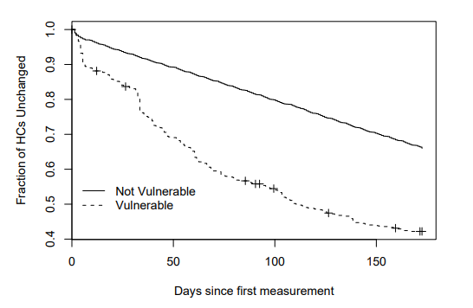
HTTPS Survey
This work (2012)
Eckersley,
Burns
(2010)
Yilek et al.
(2009)
Holz et al.
(2011)
Durumeric et al.
(2013)
Durumeric et al.
(2014)
Durumeric
(2017)
Tracked replacement time for certificates
affected by Debian weak key bug
Scanned 50,000 TLS servers over several months
Yilek, Scott, et al. "When private keys are public: results from the 2008 Debian OpenSSL vulnerability." Proceedings of the 9th ACM SIGCOMM Conference on Internet Measurement. ACM, 2009.
Notes:
This paper is kind of an Internet-wide HTTPS survey. Yilek et al. tracked replacement time for the Debian weak key bug certificates. You can see the graph shows that the vulnerable certificates were frequently replaced.

Slide 30
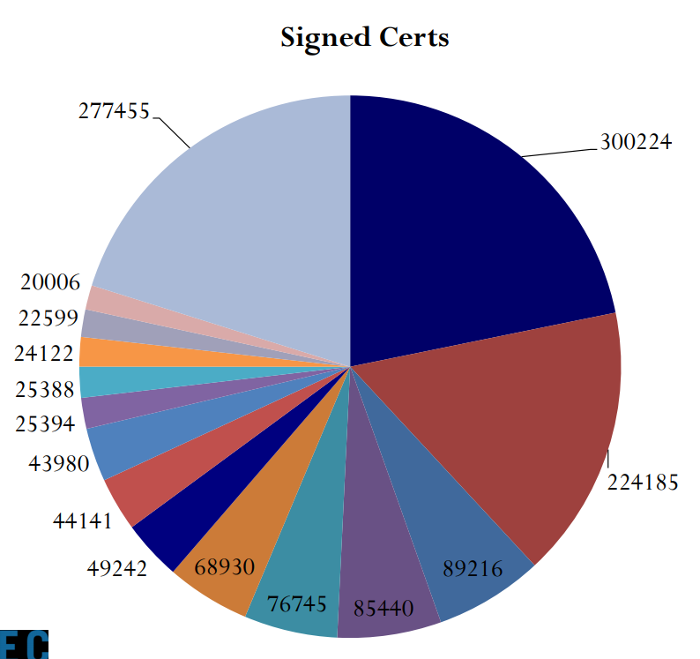
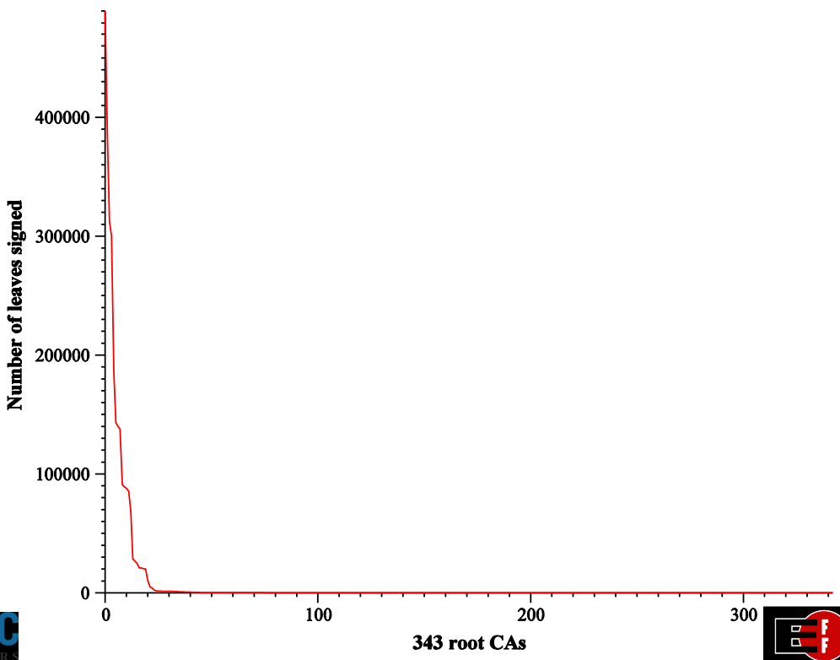
HTTPS Survey
This work (2012)
Eckersley,
Burns
(2010)
Yilek et al.
(2009)
Holz et al.
(2011)
Durumeric et al.
(2013)
Durumeric et al.
(2014)
Durumeric
(2017)
They built an SSL observatory
Massive CA certificate survey
Recorded 1,377,067 valid leaf certs
Eckersley, Peter, and Jesse Burns. "An observatory for the SSLiverse." Talk at Defcon 18 (2010).
Notes:
In 2009, Eckersley and Burns built an SSL observatory. They surveyed CA certs massively. The first graph is about the fractions of root CA. And the second graph is about the number of leaf certs in each root CAs.

Slide 31
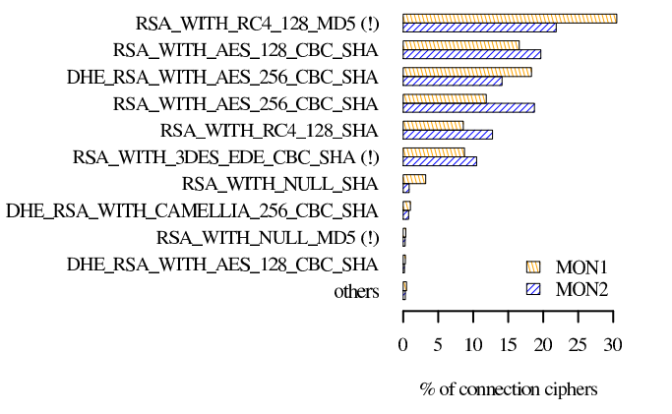
HTTPS Survey
This work (2012)
Eckersley,
Burns
(2010)
Yilek et al.
(2009)
Holz et al.
(2011)
Durumeric et al.
(2013)
Durumeric et al.
(2014)
Durumeric
(2017)
Scanned popular HTTPS servers
1.5 year, 1,000,000 certs
Focusing on CA infrastructure
Found repeated keys
Holz, Ralph, et al. "The SSL landscape: a thorough analysis of the x. 509 PKI using active and passive measurements." Proceedings of the 2011 ACM SIGCOMM conference on Internet measurement conference. ACM, 2011.
Notes:
In 2011, Holz et al. surveyed CA infrastructure. They scanned popular HTTPS servers along 1.5 years. They first found repeated key issues but neglected it. The graph is about which kind of cryptos are frequently used.

Slide 32
HTTPS Survey
This work (2012)
Eckersley,
Burns
(2010)
Yilek et al.
(2009)
Holz et al.
(2011)
Durumeric et al.
(2013)
Durumeric et al.
(2014)
Durumeric
(2017)
Introduced Zmap
It scans the entire IPv4 address space in under 45 min with 98% coverage
By just one machine
Durumeric, Zakir, Eric Wustrow, and J. Alex Halderman. "ZMap: Fast Internet-wide Scanning and Its Security Applications." USENIX Security Symposium. Vol. 8. 2013.
Notes:
In 2013, Durumeric et al. introduced a fast scanning tool Zmap. Note that Durumeric is one of the author of this paper.

Slide 33
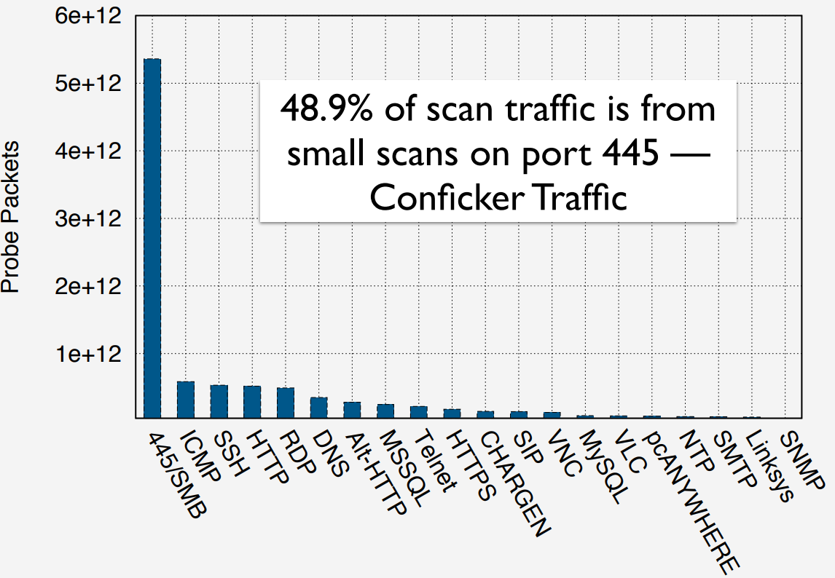
HTTPS Survey
This work (2012)
Eckersley,
Burns
(2010)
Yilek et al.
(2009)
Holz et al.
(2011)
Durumeric et al.
(2013)
Durumeric et al.
(2014)
Durumeric
(2017)
Survey of Internet-wide scan
Zmap shifted the scanning landscape
Large scanning became common
Durumeric, Zakir, Michael Bailey, and J. Alex Halderman. "An Internet-Wide View of Internet-Wide Scanning." USENIX Security Symposium. 2014.
Notes:
In 2014, Durumeric et al. surveyed of Internet-wide scans. They claimed that the Zmap they made shifted the scanning landscape. The graph is about scan traffic. The left-most one is conficker traffic.

Slide 34
HTTPS Survey
This work (2012)
Eckersley,
Burns
(2010)
Yilek et al.
(2009)
Holz et al.
(2011)
Durumeric et al.
(2013)
Durumeric et al.
(2014)
Durumeric
(2017)
He graduated University of Michigan by this doctoral dissertation
Durumeric, Zakir. "Fast Internet-Wide Scanning: A New Security Perspective." (2017).
Notes:
Durumeric graduated with this topic.

Slide 35
Weak Entropy and Cryptography
This work (2012)
Bauer,
Laurie
(2004)
Ristenpart,
Yilek
(2010)
Howgrave-Graham,
Smart
(2001)
Bernstein et al.
(2013)
Bos et al.
(2014)
Boldyreva et al.
(2017)
Can compute the private key from a fraction of the bits in ephemeral key
Howgrave-Graham, Nick A., and Nigel P. Smart. "Lattice attacks on digital signature schemes." Designs, Codes and Cryptography 23.3 (2001): 283-290.
Notes:
One of the main topic of this paper is the effect of weak entropy on cryptography. In 2001, Howgrave-Graham and Smart computed the private key of DSA from a fraction of the bits in ephemeral key.

Slide 36
Weak Entropy and Cryptography
This work (2012)
Bauer,
Laurie
(2004)
Ristenpart,
Yilek
(2010)
Howgrave-Graham,
Smart
(2001)
Bernstein et al.
(2013)
Bos et al.
(2014)
Boldyreva et al.
(2017)
Computed the pairwise GCDs of 18,000 RSA keys from the PGP web
Goldberg, Ian, and David Wagner. "Randomness and the Netscape browser." Dr Dobb's Journal-Software Tools for the Professional Programmer 21.1 (1996): 66-71.
Notes:
In 2004, Bauer and Laurie computed the pairwise GCDs of 18,000 RSA keys from the PGP web

Slide 37
Weak Entropy and Cryptography
This work (2012)
Bauer,
Laurie
(2004)
Ristenpart,
Yilek
(2010)
Howgrave-Graham,
Smart
(2001)
Bernstein et al.
(2013)
Bos et al.
(2014)
Boldyreva et al.
(2017)
Virtual machine reset attack
Virtual machine is induced to produce the same ephemeral key after reset
It was fixed by hedged cryptography
Ristenpart, Thomas, and Scott Yilek. "When Good Randomness Goes Bad: Virtual Machine Reset Vulnerabilities and Hedging Deployed Cryptography." NDSS. 2010.
Notes:
In 2010, Ristenpart and Yilek suggested the virtual machine reset attack. Virtual machine also had the weak entropy problem when it is reset.

Slide 38
Weak Entropy and Cryptography
This work (2012)
Bauer,
Laurie
(2004)
Ristenpart,
Yilek
(2010)
Howgrave-Graham,
Smart
(2001)
Bernstein et al.
(2013)
Bos et al.
(2014)
Boldyreva et al.
(2017)
Factorize some of the Taiwanese smart card public key
Bernstein, Daniel J., et al. "Factoring RSA keys from certified smart cards: Coppersmith in the wild." International Conference on the Theory and Application of Cryptology and Information Security. Springer, Berlin, Heidelberg, 2013.
Notes:
In 2013, Berstein et al. factorized a fraction of the Taiwanese smart card public key. He noted that he started this research as a class project but the result went in the unexpected direction.

Slide 39
Weak Entropy and Cryptography
This work (2012)
Bauer,
Laurie
(2004)
Ristenpart,
Yilek
(2010)
Howgrave-Graham,
Smart
(2001)
Bernstein et al.
(2013)
Bos et al.
(2014)
Boldyreva et al.
(2017)
Found many repeated keys in ECDSA
There are many Bitcoin signatures which use the same ephemeral key
Bos, Joppe W., et al. "Elliptic curve cryptography in practice." International Conference on Financial Cryptography and Data Security. Springer, Berlin, Heidelberg, 2014.
Notes:
In 2014, Bos et al. found many repeated keys in ECDSA. They claimed that 59 Bitcoins are vulnerable under this condition.

Slide 40
Weak Entropy and Cryptography
This work (2012)
Bauer,
Laurie
(2004)
Ristenpart,
Yilek
(2010)
Howgrave-Graham,
Smart
(2001)
Bernstein et al.
(2013)
Bos et al.
(2014)
Boldyreva et al.
(2017)
Founded new security notions for real-world situation
New concept can synthesize fresh random bits by hashing all of inputs
Huang, Zhengan, et al. "Hedged Nonce-Based Public-Key Encryption: Adaptive Security Under Randomness Failures." IACR International Workshop on Public Key Cryptography. Springer, Cham, 2018.
Notes:
In 2017, Boldyreva et al. founded new security notions for real-world crypto use. The concept was introduced by Bellare at 2008. This new idea can synthesize fresh random bits by hashing all of inputs.

Slide 41
Conclusion
Notes:
Finally, here is a conclusion.

Slide 42
Defenses
More entropy sources
Add hardware sources
Kernel collects more aggressively
Better communication between applications and OS
/dev/urandom isn’t providing the service people need
Created public key check service for end users
Notes:
To mitigate this attack, we need more entropy sources. Needs more hardware sources. And kernel needs to collect more aggressively. The applications and OS need to communicate for the security. End users need to check a created public key.

Slide 43
Conclusion
There are a lot of repeated public keys on the Internet
Some of them are vulnerable
Shared keys (5.6% of TLS, 9.6% of SSH)
Factorable RSA keys (0.5% of TLS, 0.03% of SSH)
Repeated DSA randomness (1.0% of SSH)
Secure random number generation is still difficult
Notes:
There are a lot of repeated keys. And some of them are vulnerable. A considerable fraction of keys are real-vulnerable. Secure random generation is still dif

Slide 44
Tip of the Iceberg
Probably mainly see devices without real-time clocks
RTC may mask serious entropy problem
Possible targeted attack
Guess time of first boot and compute key

Slide 45
For OS developers:
OS should maintain a secure PRNG that refuses to return until enough entropy
Communicate entropy conditions with apps
Test RNGs thoroughly on diverse platforms
For library developers:
Default to the most secure configuration
Crypto libraries can take specific steps to prevent weak entropy
For application developers:
Generate keys on first use, not on install or first boot
Heed warnings from OS and libraries
For security and crypto researchers:
Secure randomness remains unsolved in practice
More attention on weak entropy condition is needed
Notes:
Here are some lessons. OS should maintain a secure PRNG that refuses to return until enough entropy is collected. OS should communicate with applications for entropy condition. OS developers need to test RNGs thoroughly on diverse platforms.
Library developers should not alter the configuration for the security. And need to make some preventing step in Libraries.
Application developers need to be aware of first boot. And also communicate for entropy condition.
Security and crypto researchers need to make a secure randomness in practice.

Slide 46
Thank you

