Slide 1
Security Analysis of the
Diebold AccuVote-TS Voting Machine
EVT '07
A. Feldman, J. Halderman, and E. Felten
Presenter
Jinseob Jeong
This file is originally written by Dawon Park and Donhwan Kwon,
Revised by Jinseob Jeong
Notes:
Hello, I’m a Jinseob Jeong and Ph.D student of system security LAB.
I will talk about the paper titled “Security Analysis of the diebold accuvote-ts voting machine”.
As you expect, this paper mainly deals with security problem of particular voting machine.
It is released in September 2006, exactly 12 years ago.
and published in 2007 at Usenix Electronic Voting Technology workshop
(next)

Slide 2
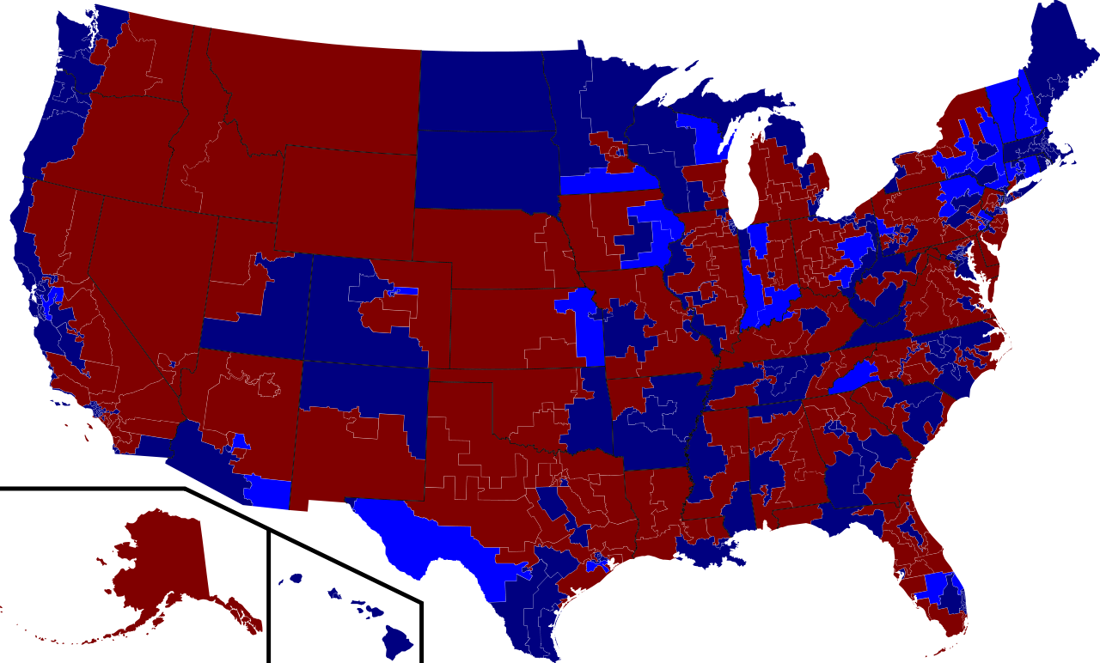
United States elections, Nov 2006
Party |  | % | Vote
 | Democratic | 52.3 | 42,338,795
 | Republican | 44.3 | 35,857,334
Notes:
In November 2006, there were United States general elections. This paper was released in two month before the elections. Nevertheless the Accuvote-TS was used in these elections. You will see later that this machine is vulnerable in vote stealing attack. If a real attack had taken place? How about?? Of course, it would be terrible.
That’s why, the Constitute of the United States is based on democracy. So the democracy is the most valuable property of America. If there is any attempt to rig a election, it would be considered as a terrorism to the democracy. The authors wanted to protect the democracy from these attacks.
(next)

Slide 3
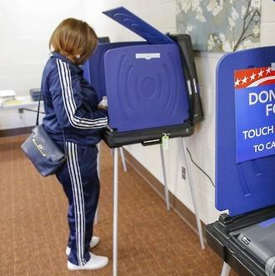
Voting
Paper-based
Voting
Electronic
Voting
Notes:
There are two types of voting.
Because this is the graduate class, maybe all of you have ever been to the polling booth.
You have to focus on this side, not this pretty girl. Today’s topic is electronic voting.
In Voting Process, Confidentiality and Integrity, plus availability plus authentication are important. Actually most of security issues are related and critical. This paper mainly deals with integrity problem of voting machine, and plus some of its availability.
If there is any possibility that the electronic data is modified by an attacker, can you trust the result?
(next)

Slide 4
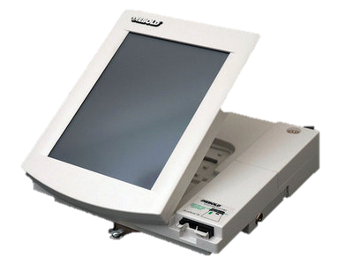
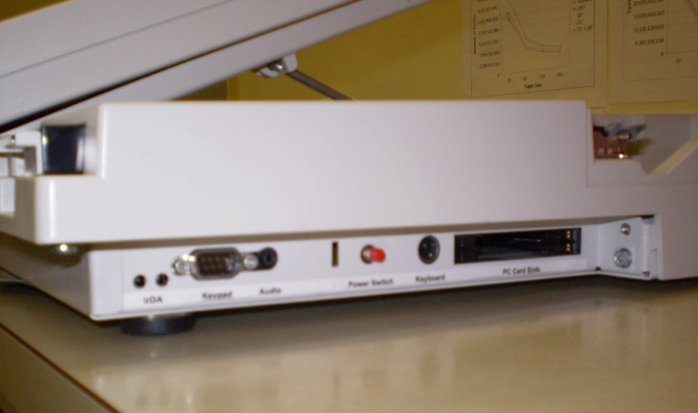
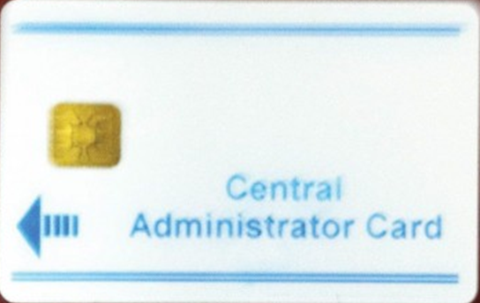
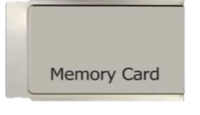
AccuVote-TS Voting Machine
Software
Software
Windows CE
Direct Recording Electronic
(DRE)
Notes:
//2// This is the target machine. I’ll show you some features of the Diebold voting machine in next few slides.
The system architecture is like this. The machine’s hardware is DRE, Direct Recording Electronic, which is basically a general purpose computer. And Windows CE is an operating system. Here CE means Compact Edition, light weight version, which is designed for handheld devices. And a specialized software is running on windows CE. But even malicious software can also run without detection.
12 years ago, the most popular windows version was..(Anybody knows?) windows XP, whose security was not great. Even worse, Windows CE has some features of Windows 95/98.
(click)The machine’s ID card slot is right here. 3 types of ID cards are used: administrator, voter and supervisor card.
(click)There’s also memory card slot here, which is covered by side door and the side door has a lock. This memory card is used to update program or store election data. So its access control is very very important issue.
However the key of the side door can be found on an open market of furniture shop. By searching alphanumeric number of the key, you can buy the exactly same one. Or you can copy the key from hardware shop. Even without a key you can also unlock by using simple locksmithing tool within few seconds. OK, if you don’t have any key or locksmithing tool, you can use just your screwdriver. Maybe normal screwdriver would be OK, not the star-head shape or triangular head shape something like that.
Anyway you can access the machine’s hardware. I’ll show you this later again.
Remember that one of the attack scenario is injecting malware by using this memory card.
(next)

Slide 5
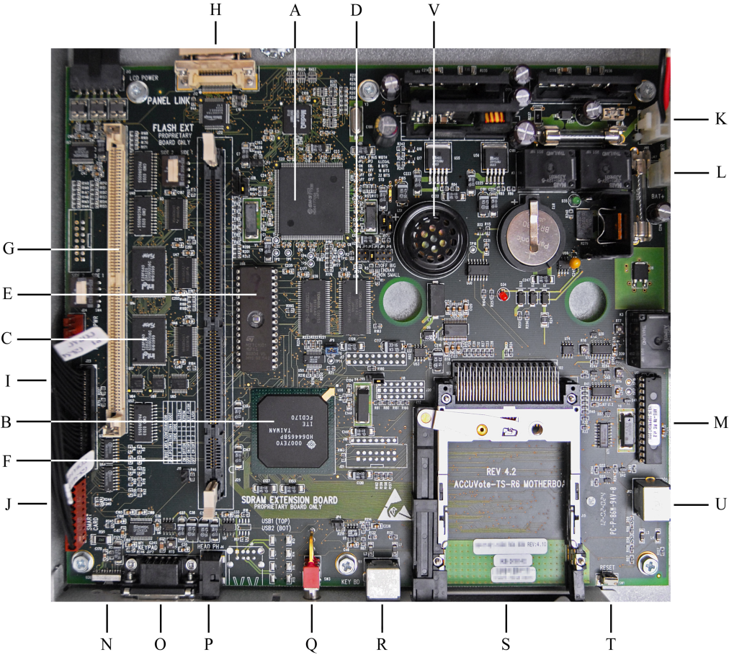
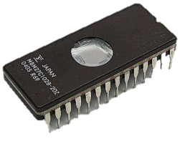
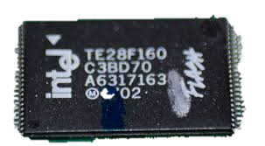
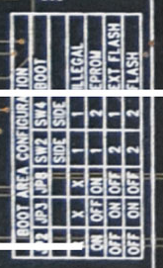
AccuVote-TS Voting Machine
Notes:
//3//
Now let’s go into the machine. If you have a screwdriver, as I said before, you can access this main board.
You can see an on-board Flash memory in the green circle. And EPROM in the red circle, and memory card slot and removable memory card in the yellow circle. And jumpers and its configuration table in the blue circle.
Normally in the default mode, boot sequence starts from this on-board flash memory.(green) Then the bootloader loads operating system Windows CE. and then Windows starts voting program “Diebold BallotStation”
By switching this jumpers you can change the booting device. You have three options, boot from on-board flash memory or boot from EPROM, or boot from External flash memory.
At this point, where is “External flash memory”? Anyone knows where it is?? In the yellow circle? In fact, external flash memory is not here, It’s little bit confusing, but the external flash memory is different from the this memory card. External flash memory is not related with today’s attack. So it’s better to forget.
Actually boot from memory card(Yellow) is optional of normal boot sequence. It is similar to USB booting mode of personal computers. So jumper change is not needed to boot from memory card.
Anyway this is the whole picture about the Accuvote’s hardware.
To summarize this page, normal boot starts from on-board flash memory and memory card booting is optional. And to boot from EPROM you have to change the jumper configuration.
(next)

Slide 6
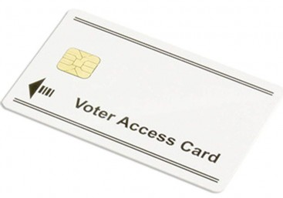
AccuVote-TS Voting Machine
Pre-Download
Pre-Election
Local network
Phone line
Serial cable
Download a list of
races and candidates
GEMS server software
accumulator
mode
Logic and Accuracy testing
Checking tally is correct.
memory
card
MODE
Election
Post-Election
Voter access card
(valid -> invalid)
On-board Flash memory,
Flash memory card
Local network
Accumulator mode
Notes:
//4//
OK, Let’s go to the software part. This slide shows what operations are provided by “Ballot Station”. It has 4 operation modes, each of them corresponds to the different phase of the election process.
First, to prepare elections, election definitions are loaded to the machine. Here, the election definition file contains list of races and the list of candidates.
Second, after election definitions have been installed, Ballotsation enters pre-lection testing mode. Pole workers perform logic and accuracy test and check tally is correct.
Third, during elections voters use “voter card” and after voting the voter cards are changed to invalid. The voting results are stored both on-board flash memory and memory card.
Finally, to end the election, pole workers insert an “ender card”. Then the software stops election mode and enters post election mode. In post-election mode, pole workers print out the results and compare total numbers of votes and numbers of signed voters in the list. If it does not match, they will suspect a problem. If it is OK, election results are transferred to the central tabulator.
(click) One of the machine can be operated in accumulator mode, it sums up the result and sends summary to the central machine.
It was a brief overview of software.
(next)

Slide 7
Attacker’s Goal
Notes:
Now it’s time to break.
I’ll show you a video.
It’s almost magic show.

Slide 8
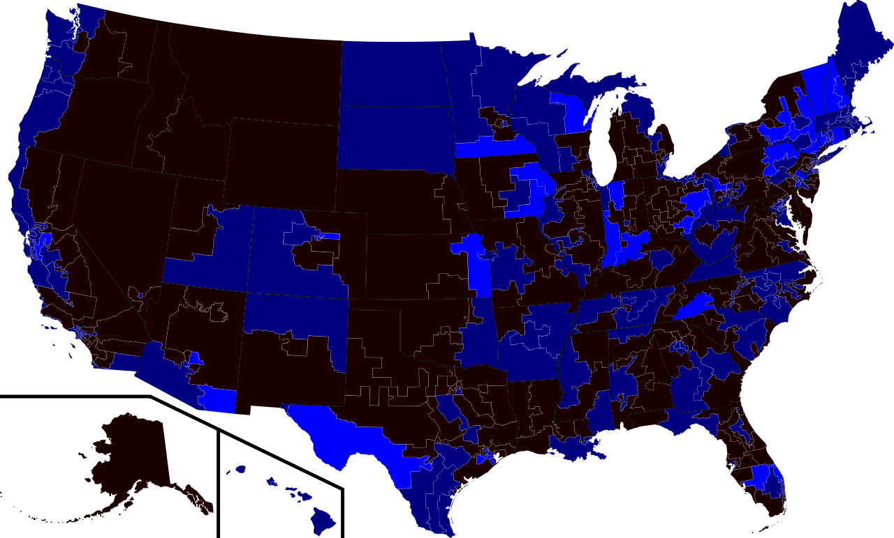
Attacker’s Goal
Vote Stealing
Denial of Service
Party |  | % | Vote
 | Democratic | 52.3 | 42,338,795
 | Republican | 44.3 | 35,857,334
5% (4,048,777)
Party |  | % | Vote
 | Democratic | 47.3 | 38,290,018
 | Republican | 49.3 | 39,906,111
Party |  | % | Vote
 | Republican | 49.3 | 39,906,111
 | Democratic | 47.3 | 38,290,018
Notes:
//5//
Let’s think about the attackers goal. If you want to rig a elections, what will you do? Answers are aleady here.
The first one, as you have seen in the previous video, is vote stealing. This goal is moving some portions of votes from an opponent to the favored candidate. Then you can flip the result.
(click)
(click) The another option is denial of service attack. This attack erase all data and make machine inoperable. For example, it can be conducted on republican supported area like this.
(click) To avoid detection, this attack can be triggered by a special event or certain time, so before the trigger everything looks normal.
These two types of attacks can be implemented as malware. Create your own malware then secretly install it and run in the background.
It’s a perfect plan. Wow!
(next)

Slide 9
Vulnerability
Direct Installation
Easy to physically access to the motherboard
- EPROM chip, removable memory card, power button
Source of bootloader code is changeable
- EPROM chip / On-board flash memory / Memory card
Not verify authenticity of files
- fboot.nb0, nk.bin, EraseFFX.bsq, explorer.glb, .ins file
Spreading Virus
Removable memory card can spread out virus
- Used for multiple machine, rewritable memory
Notes:
//8//
To design a malware, we need to know the vulnerability. They have found several vulnerabilities. To install a malware on the target, attacker must access storage element and replace the software with a crafted one.
First vulnerability, physical access to the motherboard is easy. You can use the key or locksmithing tool or screwdriver.
Second, You can change the source of bootloader to what you want You can boot from EPROM or boot from on-board flash memory or boot from memory card.
Third, No verification. Fboot.nb0 is bootloader, nk.bin is kernel image, ErasFFX.bsq is file system eraser, explorer.glb is windows explorer and *.ins is script files. When updating these important system files, the bootloader checks only the file names.. It dose not confirm the integrity of contents
By exploiting these vulnerability, attackers can inject the modified files into the machine.
Another vulnerability issue is spreading virus. Because not all the target machines are connected to network, spreading virus through the memory card is very useful. Consider that the memory card is used to update program or to store election definitions or to collect voting data. So memory cards should be inserted to the machine at least once before the elections and one memory card is used to several machines. This makes self spreading virus to copy itself from the machine to the memory card and also from the memory card to the machine. The number of infected machines will increase over time.
To summarize this page, you can access to memory card and bootloader replace software without verification. And after install once, virus can infect several machines. Oh my God.
(next)

Slide 10
Attack Scenario – installing malware
Notes:
The attack starts from storage element.
This video shows how to access the storage element of voting machine.

Slide 11
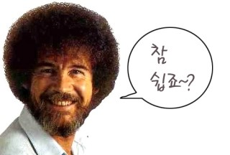
Attack Scenario – installing malware
① Replace EPROM chip
Create EPROM chip
Open the machine
Install it, and reboot
② Insert Memory Card
Determine source of bootloader code
Notes:
//9//
This is again the accuvotes mainboard. There are two channels for injecting malwares. It’s EPROM and Memory card.
If you are an attacker, what will you choose? Number 1 EPROM and number 2 memory card. Please raise your hand. Number 1 or Number 2??
(click) First route is EPROM. Make a malicious EPROM chip and open the machine and replace the EPROM chip and then reboot the machine. But this approach takes several minutes, Because you have to open the whole case to access EPROM.
(click) So this attack is more difficult to act when another person stays with you.
The second route is memory card.
(click) Just open the side door and replace the memory card. It looks like a regular operation.
The more attractive attack approach is the second one. We will go deep into the second attack.
(next)

Slide 12
Attack Scenario – installing malware
Bootloader in
On-board flash
Bootloader copies itself to RAM
Look for memory card in PC slot
Fboot.nb0
Exist?
Y
Copies fboot.nb0 to
On-board flash
N
Does not verify
authenticity
of these files
Nk.bin
Exist?
Y
Replace OS image on
On-board flash
N
EraseFFX.bsq
Exist?
Erase entire file system area of flash
Y
N
Cont.
Notes:
Let’s look at more details about boot sequence.
Initial boot sequence starts from on-board flash memory. The bootloader is copied from on-board flash memory to main memory, RAM. Before starting application, the bootloader looks for memory card containing update files. If there are no update files, bootloader continue to run application program “Ballotstation”.
On the other hand, if there are update files, they copy them. It checks for new bootloader, Windows image file, and file system eraser. This process is originally designed to update software. However, in its update process the bootloader checks only file names and does not verify their authenticity.
As a result, an attacker can replace these files with malicious programs of the same name.
This story continues in next slide.
(next)

Slide 13
Attack Scenario – installing malware
Cont.
Uncompress OS in
On-board flash,
copy to RAM
Removable memory
Exist?
Run BallotStation
(Voting software)
N
Y
Jump to OS kernel
Explore.glb
Exist?
Y
Invoke
Windows Explorer
Runs Filesys.exe
.ins file
Exist?
Runs
Shell.exe
Device.exe
Gwes.exe
Taskman.exe
Y
Automate update
Mounting file system
On-board flash : \FFX
Memory card: \StorageCard
RAM(root): \
Accept without any authentication
Notes:
The next step is kernel process.
After operating system starts, it executes some processes. To launch malware silently, attackers modified “device.exe” and “taskman.exe”
Device.exe which is called “device manger” mounts file system. It normally mounts file system on the on-board flash memory. However attackers modified “device.exe” to mount file system on the root, which means RAM. As you know RAM is volatile memory, so after reboot, no signs of attack remains.
(click)
Another kernel process “taskman.exe” normally executes BallotStation program, however it also has some vulnerabilities. If a memory card exists, taskman.exe invoke windows explorer(explorer.glb) and also some kinds of script files (*.ins).
(click)
“Explore.glb” and “*.ins” script files are also accepted without authentication. It just check the file name or its extension. If an attacker replaces these also, he can run many combinations of attack what he want.
(next)

Slide 14
Attack Scenario – stealing vote
Insert a Memory Card
Suspend
BallotStation
Open
Result file
15sec
Resume
BallotStation
N
Rigged race?
Steal Vote
Y
N
Election mode?
N
Select Candidate
New Ballot?
Y
Y
Notes:
//15//
We are almost done. This is the stealing votes operation.
The vote stealing attack program suspends normal "BallotStation" program and open the vote result file. Before modifying the data it checks some conditions, whether it is a rigged race and whether it is in a election mode and whether new ballot has been cast. If all conditions are passed then malware modifies the results file. After vote stealing it resume the BallotStation. Malware repeats this process every 15 seconds.
This is all about the attack. We are now understanding how to access to the important hardware, and how to design a malicious program, and how to inject it. and then what will be happened.
(next)

Slide 15
Mitigation
S/W & H/W modification
- Code signing & signature verification
- Person confirm for software updates
- Not use rewritable storage -> tamper-proof logs, records
Physical access control : broken seal cause DoS
Parallel testing : simulation pattern, secret knock
Effective certification system : Strong Certification
Software independent design : printout paper ballot
Notes:
//16//
Now It’s time to think about the defense. There are some mitigations. Both Software and Hardware modification is urgent. Software should be redesigned. Digital signature of software and its verification is required. And also software update by authorized person is needed. But only software modification is not perfect.
Because the storage elements is not tamper-proof hardware. So it must be replaced to the specialized hardware capable of tamper-proof functions.
As you guess, actually Diebold designers did not take into account serious security issues and relied only on the poor mechanical lock. it was the most tragic point.
Physical access control also has limitation. We could use tamper-evident sealing to detect footprint of opening the side door. This is the tamper-evident sealing.
(click) Actually I bring a some this kinds of seal. If you attach once, and after removal some patterns are appeared in the sealing. How about use this tamper-evident sealing on the side locker?? Is it perfect? Maybe not? Why??
It makes easy to commit a denial of service. Because the broken seal make the machine’s data untrustable. So it has limitation.
(click)
Parallel testing means sampling test of voting machine in election mode. However parallel testing is challenging in making simulated voting realistic. Otherwise vote stealing software can distinguish the difference between real vote and simulated vote. This is similar to Volkswagen scandal.
(click) In Volkswagen’s case, the manufacturer detected the difference between test mode and real driving. So in our case, if there are any difference between simulated voting and real voting, attackers can be exploit it.
(click) Or if a insider within the pole workers perform a secret knock, this parallel testing can be useless.
The another mitigation is certification. Actually the Diebold machines were certified successfully. What’s wrong? What happened? The certification was only focused on reliability not security. The authors say that the certification on the security aspect must be stronger.
Software independent design is also possible. This means making it redundant and double checking. One method is that printout the individual vote, and make each voter to confirm their vote. And then collect the printout votes as conventional paper voting. Stealing both results is extremely difficult. But this approach cancel out the benefit of electronic voting in time and money.
(next)

Slide 16
Conclusion
H/W & S/W encompassing study of a widely used DRE
Demonstration of vote-stealing and virus spreading
Warning for large scale fraud
Proving H/W architecture limitation of the target
Notes:
//18/
This is conclusion.
All the aspect of voting machine are studied.
And actual vote-stealing demonstration is performed.
So they give wanring for large scale fraud.
However to make the voting machine more secure, hardware modification is essential.
(next)

Slide 17
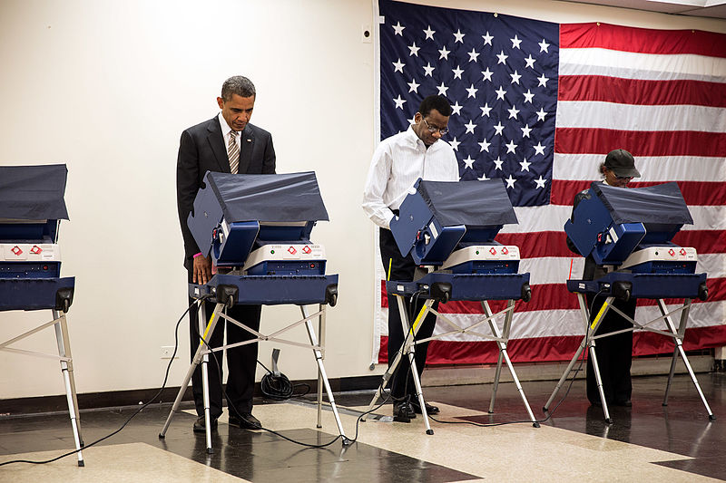
Limitation & Future work
General attack idea -> Attack through network
Malicious action of voters : copy card or re-enable invalid card
Physical access is not so easy during voting
Notes:
//19//
We can think about the limitation and future work.
In this paper, the network issues are not handled. The machine transmits the accumulated result to the central tabulator using network or modem. So network problem is another security issue.
And this paper mainly deals with storage element and software vulnerability, which is basically pole worker’s responsibility. However the voters also can be a potential attacker. The voter cards are used several times for different voters. If one of the voters have small card copy machine or card re-enable machine in his pocket. Then multiple voting is possible.
This paper also have limitation,
(click) as you see in this picture, physical access is not so easy during the vote.
(next)

Slide 18
Another Story – Diebold
`03
`03
`02
Kohno et al.
- Numerous security flaws in software.
Maryland
SAIC “High risk of compromise”
RABA, confirmed Kohno’s findings.
`03
“None of them offered the public a detailed technical description.”
Ohio, Compuware
- DRE systems high-risk security problems.
`06
`06
Harri Hursti
Hardware & compiled boot-loader
Problems with software update
Feldman, Halderman, Felten
Reverse engineer hardware & software
Confirmed earlier studies by demo
Notes:
//21//
I will show you a more story about Diebold. Diebold was established in 1859. Its major business is Automatic Teller Machine, and had 32% market share in last year.
Diebold started voting machine business in 2002, after M&A of Global election system. Diebold payed $24.7 million for M&A.
(click) In 2003, the first major study of these machines was published by Kohno. He acquired BallotStation source code and found numerous security flaws of it.
(click) And also in the same year SAIC and RABA also found and confirm the same results.
(click) And ohio Compuware studied on DRE and they also found several high risk security problems.
In spite of these findings and many concerns about accuvote’s vulnerability, surprisingly Diebold did not take any action. Actually they denied the reports and kept going their business without any improvement.
(click) In2006, Harry Hursti studied on Diebold AccuBassic subsystem. They found several new vulnerabilities. Especially,they succeeded to install malwares by exploiting the update mechanism.
And finally this paper was released in 2006,
(click) After this paper the CEO of Diebold resigned in the end.
(next)

Slide 19
Another Story – Diebold
`07
David Wagner, California
TTBR(Top to Bottom Review)
“Deep architectural flaws”
Buffer overflow, weak cryptography
`07
Ohio
Project EVEREST
“Yet more vulnerabilities”
`09
`10
Election Systems & Software
Take over
Dominion Voting System
Take over
Notes:
//23//
The study continued in 2007.
(click) David Wagner did top to down review and found deep architectural flaws
(click) And ohio reported that there remains more vulnerabilities.
Finally, the government filed a suit $2.6 million, and canceled certification.
(click) In 2008, there was a proposal to sell the entire DieBold for $ 2.6 billion.
In 2009 Diebold sold Voting machine business part for only $ 5 million.
(click) Remind that Diebold payed about 5 times of money when they buy Global Election System.
(next)
We can get a lesson from this story. If you don’t mind security, no one can trust you. You may loose everything.

Slide 20
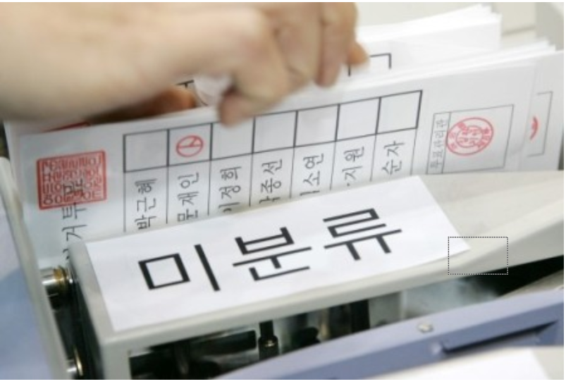
Electronic voting in Korea
Secure?
OOO
OOO
Notes:
I have additional slide for Korean voting.
(click) The first example is actually not a electronic voting. Anyway the electronic ballot counters are used in post-election process. This picture shows that legitimate ballot is transferred to unclassified box. I’m not sure it is just an error or evidence of attack. But there have been controversies for a long time. For any reason, we know that high error rates makes the machine untrustable.
(click) Mobile voting is widely used in elections of representative of political party. But mobile voting may have voter authentication issues and plus vote selling issues. This article says that the ID number and security code of some voters are transferred to another voter by SMS. That means that proxy voting is possible.
(click) The last example is that the audience voting system, which is used in famous competition TV program, was messy.
(click) Security should be a top priority in electronic voting machines. Dou you agree that it is secure nowadays?
(next)

Slide 21
Thanks
Notes:
That’s all.
Any Questions?

