Slide 1
USENIX 2019 @ Santa Clara, US
The KNOB is Broken: Exploiting Low Entropy in the Encryption Key Negotiation Of Bluetooth BR/EDR
Daniele Antonioli¹, Nils Ole Tippenhauer², Kasper Rasmussen³
¹Singapore University of Technology and Design (SUTD) ²CISPA Helmholtz Center for Information Security ³University of Oxford
Presenter: Jaemin Shin
Slides mostly borrowed from Daniele Antonioli
Daniele Antonioli
The KNOB is Broken: Exploiting Low Entropy in the Encryption Key Negotiation Of Bluetooth BR/EDR
1

Slide 2
Bluetooth
- Pervasive wireless technology for personal area networks
- E.g., mobile, automotive, medical, and industrial devices
Motivation 2

Slide 3
This paper not about BLE, but about Bluetooth Classic!
BLE (Bluetooth Low Energy)
- Started at Bluetooth 4.0 specification
- Open source implementation available in Linux drivers
- Security at various perspectives has been explored on BLE
- Mike Ryan, Bluetooth: With Low Energy comes Low Security (USENIX WOOT ‘13)
- Kassem Fawaz, Kyu-Han Kim, Kang G. Shin, Protecting Privacy of BLE Device Users
(USENIX Security ‘16)
Motivation 3

Slide 4
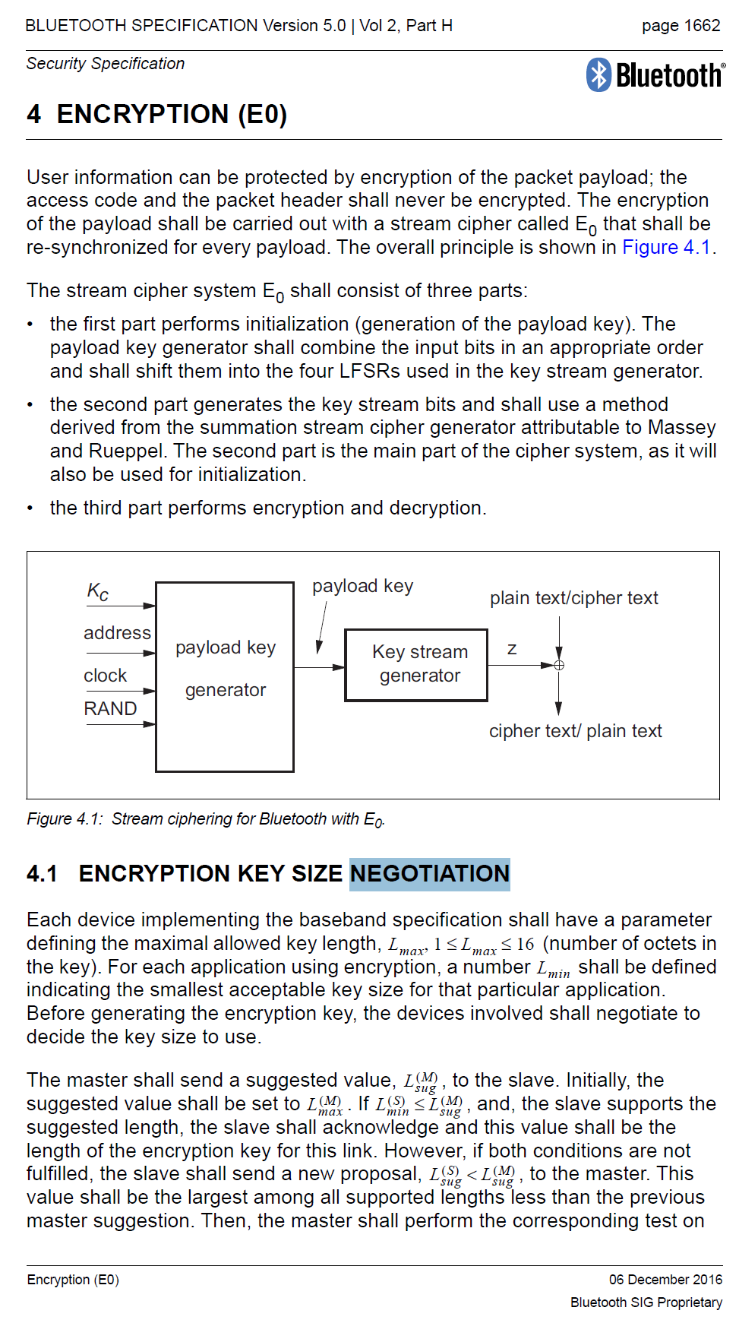
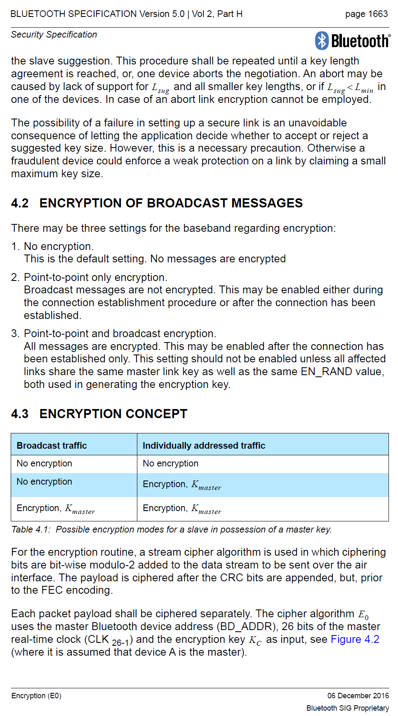
This paper not about BLE, but about Bluetooth Classic!
Bluetooth BR/EDR (or Classic)
- Open but complex specification
- No public reference implementation
- Unexplored!!
- Uses custom security mechanisms at the link layer
Motivation 4
Notes:
Basic Rate / Extended Data Rate

Slide 5
Bluetooth Security Mechanisms
Motivation 5

Slide 6
Bluetooth Security Mechanisms
Motivation 5
Notes:
Elliptic Curve Diffie Hellman
Challenge-response authentication

Slide 7
Bluetooth Security Mechanisms
Motivation 5

Slide 8
Bluetooth Security Mechanisms
Motivation 5

Slide 9
Bluetooth Security Mechanisms
Motivation 5

Slide 10
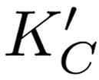
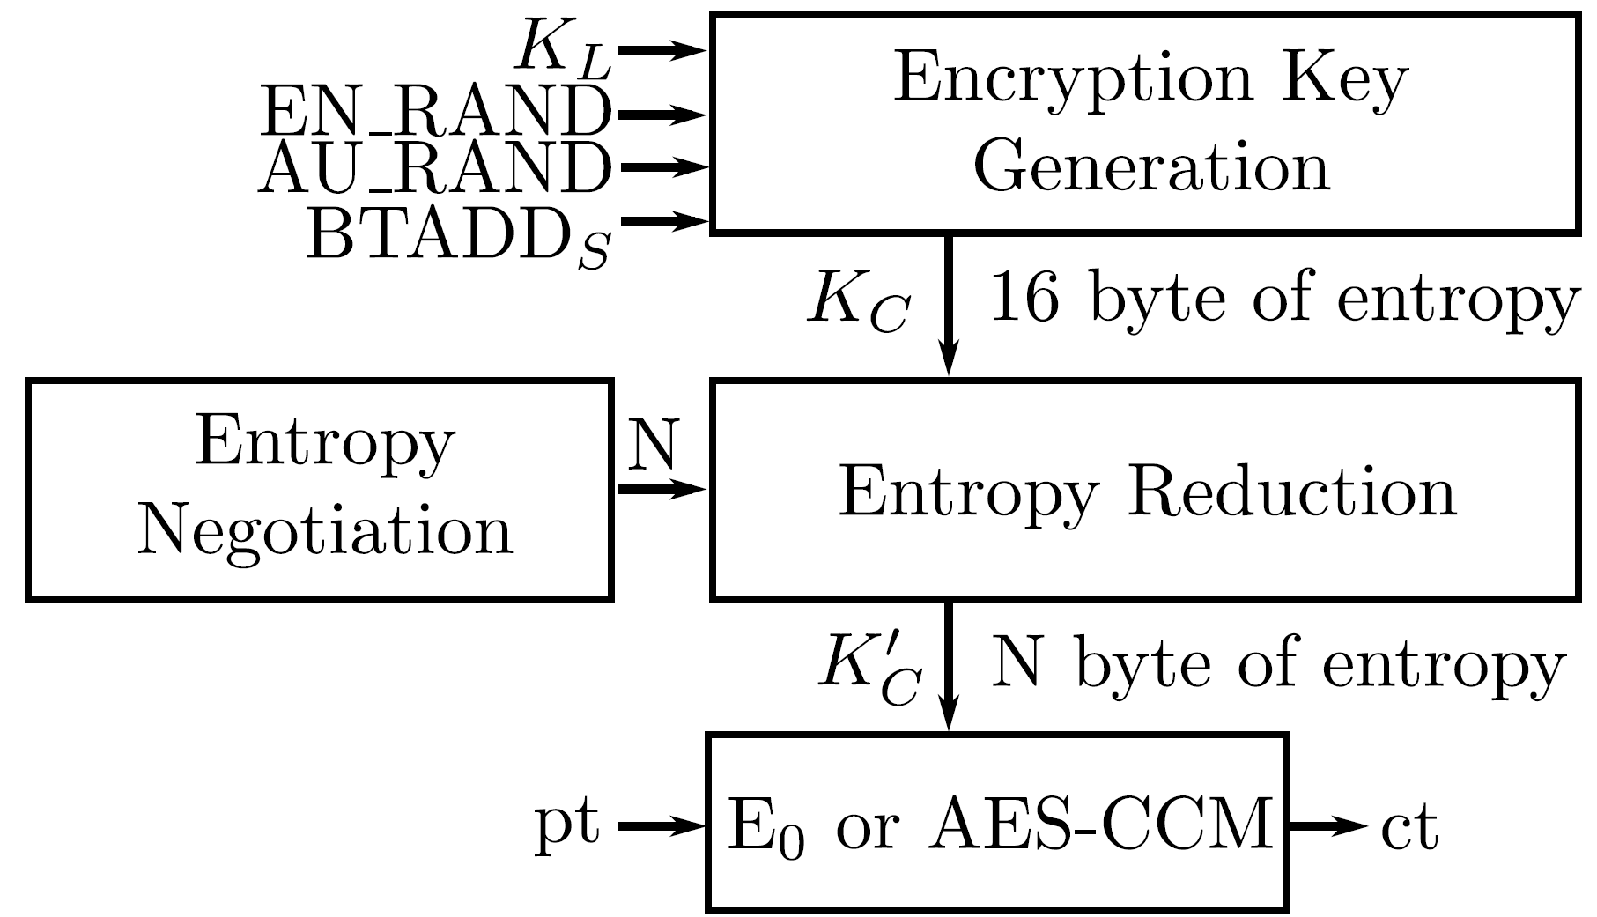
Encryption Key Negotiation Of Bluetooth (KNOB)
- Paired devices negotiate an encryption key ( ) upon connection
KNOB 6

Slide 11
Encryption Key Negotiation Of Bluetooth (KNOB)
- Paired devices negotiate an encryption key ( ) upon connection
Bluetooth allows with 1 byte of entropy and does not authenticate Entropy Negotiation
KNOB 6

Slide 12
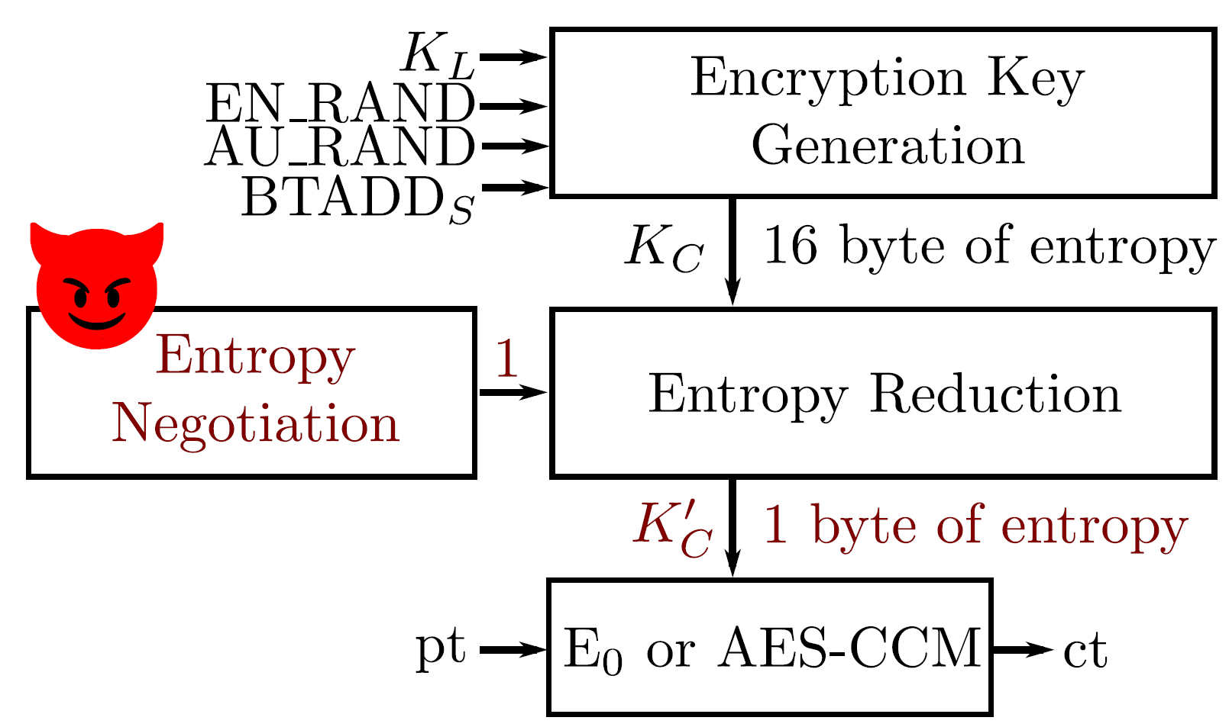
Our Contribution: Key Negotiation Of Bluetooth (KNOB) Attack
- Our Key Negotiation of Bluetooth (KNOB) attack sets N=1, and brute forces
⁻ Affects any standard compliant Bluetooth device (architectural attack)
⁻ Allows to decrypt all traffic and inject valid traffic
⁻ Runs in parallel (multiple links and piconets)
KNOB 6

Slide 13
KNOB Attack Stages
Alice and Bob securely pair in absence of Eve
KNOB 6

Slide 14
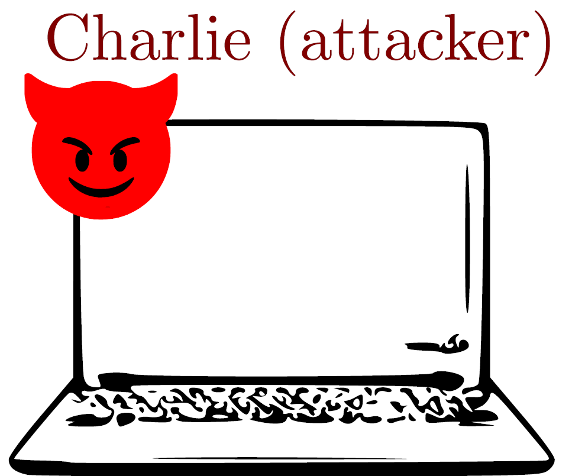
KNOB Attack Stages
Alice and Bob securely pair in absence of Eve
Alice and Bob initiate a secure connection
KNOB 6

Slide 15
KNOB Attack Stages
Alice and Bob securely pair in absence of Eve
Alice and Bob initiate a secure connection
Charlie makes the victims negotiate an encryption key with 1 byte of entropy
KNOB 6

Slide 16
KNOB Attack Stages
Alice and Bob securely pair in absence of Eve
Alice and Bob initiate a secure connection
Charlie makes the victims negotiate an encryption key with 1 byte of entropy
Charlie eavesdrop the ciphertext and brute force the key in real time
KNOB 6

Slide 17
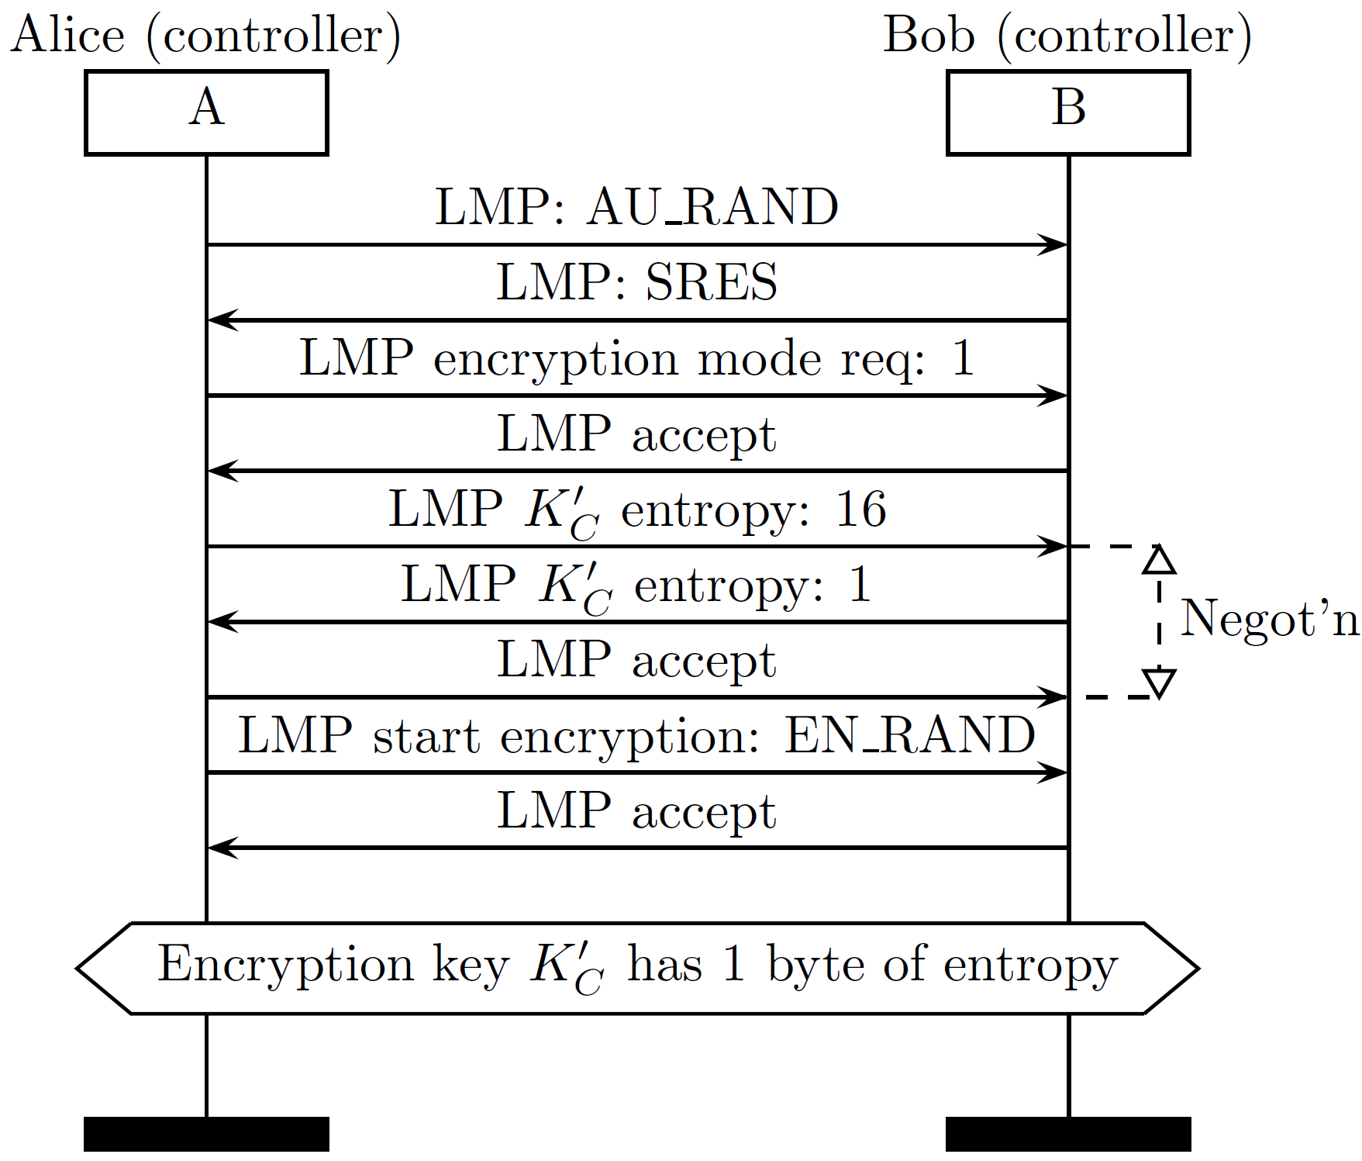
Bluetooth Entropy Negotiation
- Entropy negotiation is neither integrity protected nor encrypted
⁻ N between 1 and 16
LMP 7

Slide 18
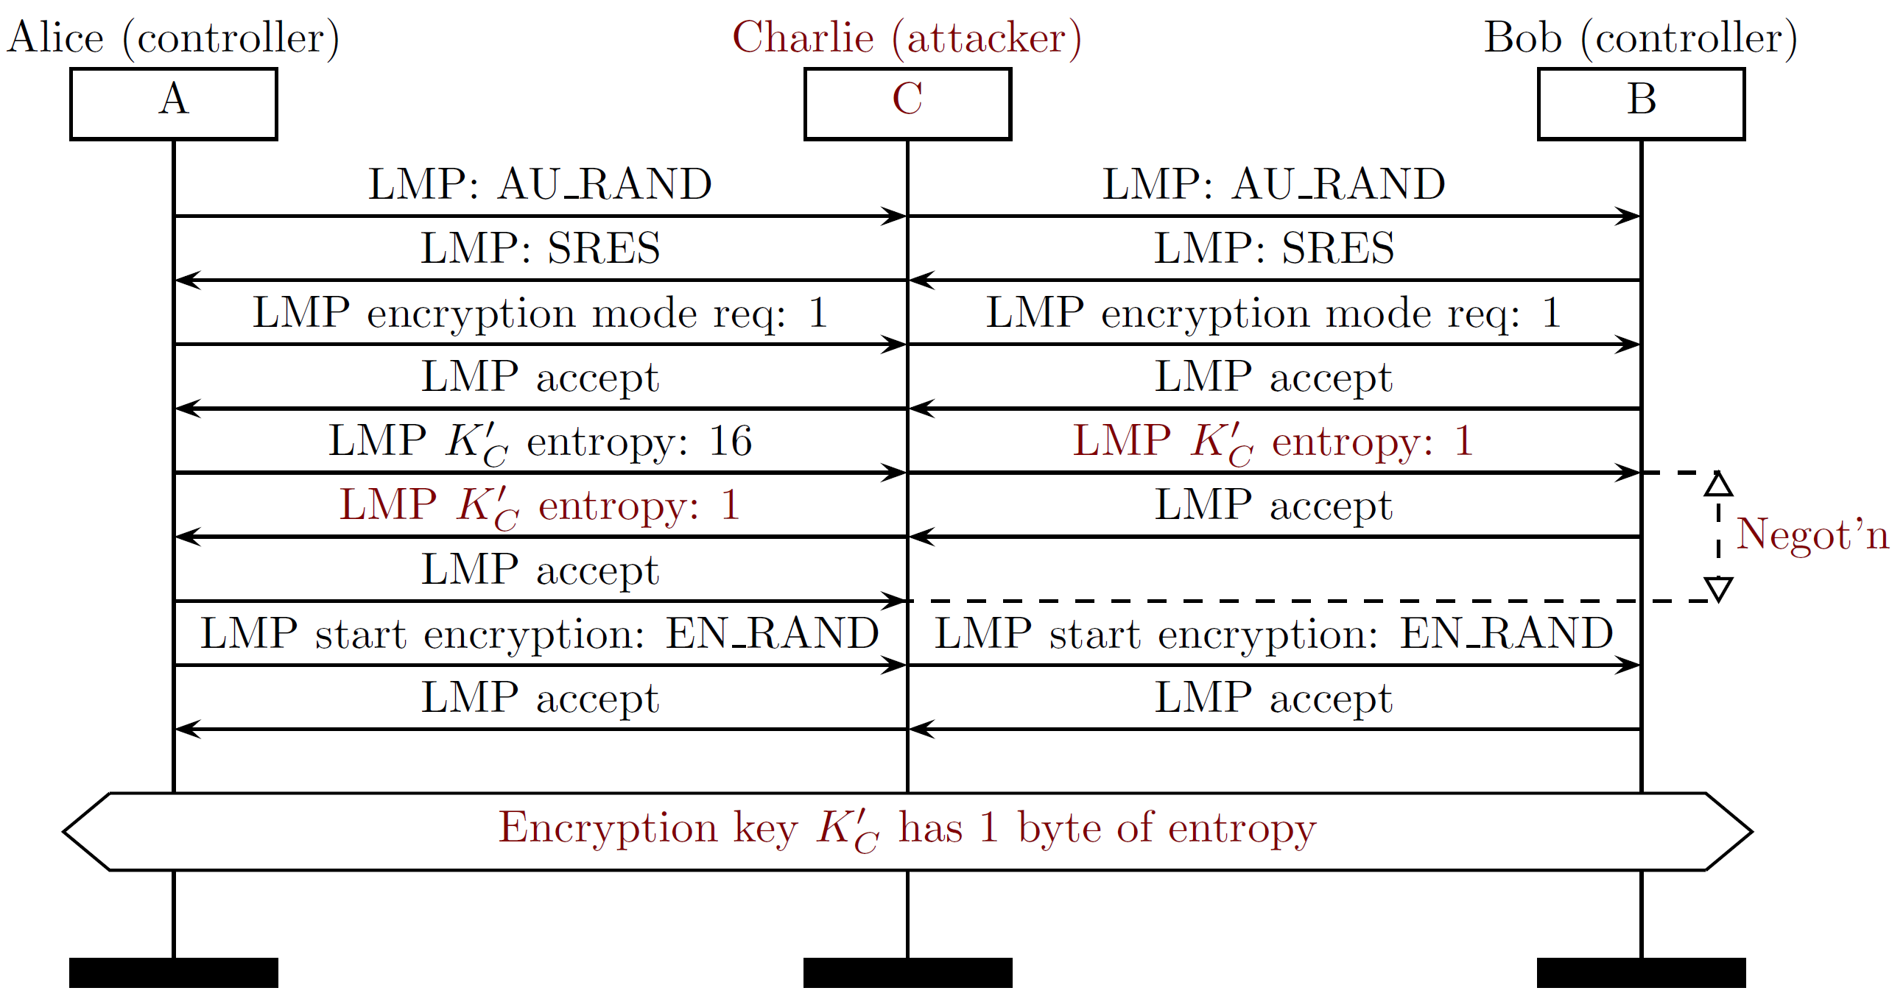
Adversarial Bluetooth Entropy Negotiation
- Charlie sets N=1 ( ’s entropy), LMP is neither integrity protected nor encrypted
LMP 8

Slide 19
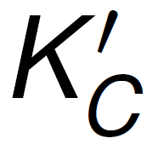
Brute Forcing the Encryption Key in Real Time
- Alice and Bob use an encryption key ( ) with 1 Byte of entropy
⁻ Charlie brute forces within 256 candidates (in parallel)
- space when entropy is 1 byte
⁻ AES-CCM: 0x00 . . . 0xff
⁻ E₀: (0x00 . . . 0xff) x 0x00e275a0abd218d4cf928b9bbf6cb08f
Daniele Antonioli
The KNOB is Broken: Exploiting Low Entropy in the Encryption Key Negotiation Of Bluetooth BR/EDR
Brute force 9

Slide 20
KNOB Attack Scenario
- Attacker decrypts a file exchanged over an encrypted Bluetooth link
⁻ Victims: Nexus 5 and Motorola G3
⁻ Attacker: ThinkPad X1 and Ubertooth (Bluetooth sniffer)
Evaluation 10

Slide 21
Vulnerable chips and devices (Bluetooth 5.0, 4.2)
Bluetooth chip | Device(s) | Vulnerable?
Bluetooth Version 5.0 Snapdragon 845 | Galaxy S9
Snapdragon 835 | Pixel 2, OnePlus 5 | C
Apple/USI 339S00428 | MacBookPro 2018 | C
Apple A1865 | iPhone X | C
Bluetooth Version 4.2 Intel 8265 | ThinkPad X1 6th | C
Intel 7265 | ThinkPad X1 3rd | C
Unknown | Sennheiser PXC 550 | C
Apple/USI 339S00045 | iPad Pro 2 | C
BCM43438 | RPi 3B, RPi 3B+ | C
BCM43602 | iMac MMQA2LL/A | C
= Entropy of the encryption key ( ) reduced to 1 Byte
Evaluation 11

Slide 22
Vulnerable chips and devices (Bluetooth 4.1 and below)
Bluetooth chip | Device(s) | Vulnerable?
Bluetooth Version 4.1 BCM4339 (CYW4339) | Nexus5, iPhone 6 | C
Snapdragon 410 | Motorola G3 | C
Bluetooth Version ≤ 4.0
Snapdragon 800
Intel Centrino 6205 Chicony Unknown Broadcom Unknown Broadcom Unknown Apple W1
LG G2
ThinkPad X230 ThinkPad KT-1255 ThinkPad 41U5008 Anker A7721 AirPods
C C C C C
*
C= Entropy of the encryption key ( ) reduced to 1 Byte
* = Entropy of the encryption key ( ) reduced to 7 Byte
The KNOB is Broken: Exploiting Low Entropy in the Encryption Key Negotiation Of Bluetooth BR/EDR
Evaluation 12

Slide 23
KNOB in Bluetooth core spec v5.0 (page 1650)
“For the encryption algorithm, the key size (N) may vary between 1 and 16 octets (8-128 bits). The size of the encryption key is configurable for two rea- sons. The first has to do with the many different requirements imposed on cryptographic algorithms in different countries - both with respect to export regulations and official attitudes towards privacy in general. The second reason is to facilitate a future upgrade path for the security without the need of a costly redesign of the algorithms and encryption hardware; increasing the effective key size is the simplest way to combat increased computing power at the opponent side.”
https://www.bluetooth.org/DocMan/handlers/DownloadDoc.ashx?doc_ id=421043
Discussion 13

Slide 24
KNOB Attack Disclosure and Countermeasures
- We did responsible disclosure with CERT and Bluetooth SIG (CVE-2019-9506) - KNOB discovery in May 2018, exploitation and report in October 2018
- Many industries affected, e.g., Intel, Broadcom, Qualcomm, ARM, and Apple
- Legacy compliant countermeasures
- Set 16 bytes of entropy in the Bluetooth firmware
- Check N from the host (OS) upon connection
- Security mechanisms on top of the link layer
- Non legacy compliant countermeasures
- Secure entropy negotiation with K_{L} (ECDH shared secret)
- Get rid of the entropy negotiation protocol
Discussion 14

Slide 25
Related Work
The security and privacy guarantees of Bluetooth were studied since Bluetooth v1.0.
Several attacks on the Secure Simple Pairing (SSP) protocol
Several attacks on various implementations of Bluetooth (Android, iOS, Windows, Linux)
Several attacks on security of the ciphers used by Bluetooth
→ KNOB attack works regardless of security guarantees / target platform / cipher !
Dennis Mantz et al., InternalBlue – Bluetooth Binary Patching and Experimental Framework (ACM MobiSys 2019)
Discussion 14

Slide 32
Notes:
The
most important capabilities of InternalBlue are:
• modifying arbitrary memory regions including Read Only
Memory (ROM),
• run arbitrary code in the context of the running firmware,
• send arbitrary HCI commands to the chip,
• establish connections to non-visible devices, and
• enable monitor mode and injection for the Link Manager
Protocol (LMP).
We perform
the following security demos and contributions with InternalBlue:
• test for user interaction behavior of pairing devices without
input and output capabilities [29],
• test for a known ECDH pairing vulnerability [13],
• Media Access Control (MAC) address filter within LMP to
improve security,
• emulation framework to fuzz malicious payloads and trace
their call graph, and
• discovery of a severe security vulnerability (CVE-2018-19860)
that allows to crash various Broadcom Bluetooth firmwares
and execute a subset of functions within them.

Slide 33
Discussion
Using the attack over-the-air is not easy
Both devices need to be Bluetooth BR/EDR
An attacker would need to be within range of the devices while they are establishing a connection.
“The attacking device would need to intercept, manipulate, and retransmit key length negotiation messages between the two devices while also blocking transmissions from both, all within a narrow time window”
The encryption key would need to be successfully shortened and then brute forced to crack the decryption key.
The attacker would need to repeat this attack every time the devices paired.
Discussion 14

Slide 34
Conclusion
We propose the Key Negotiation Of Bluetooth (KNOB) attack
⁻ Reduces the entropy of any encryption key to 1 Byte, and brute forces the key
⁻ Affects any standard compliant Bluetooth device (architectural attack)
⁻ Allows to decrypt all traffic and inject valid traffic
⁻ Runs in parallel (multiple links and piconets)
We implement and evaluate the KNOB attack
⁻ 14 vulnerable chips (Intel, Broadcom, Apple, and Qualcomm)
⁻ 21 vulnerable devices
Provide effective legacy and non legacy compliant countermeasures
For more information visit: https://knobattack.com
Conclusions 15

Slide 35
Conclusion
We propose the Key Negotiation Of Bluetooth (KNOB) attack
⁻ Reduces the entropy of any encryption key to 1 Byte, and brute forces the key
⁻ Affects any standard compliant Bluetooth device (architectural attack)
⁻ Allows to decrypt all traffic and inject valid traffic
⁻ Runs in parallel (multiple links and piconets)
We implement and evaluate the KNOB attack
⁻ 14 vulnerable chips (Intel, Broadcom, Apple, and Qualcomm)
⁻ 21 vulnerable devices
Provide effective legacy and non legacy compliant countermeasures
For more information visit: https://knobattack.com
Thanks for your time! Any Questions?
Conclusions 15

