Slide 1
IS523 PAPER REVIEW
CHANGHUN SONG

Slide 2
CONTENTS
Background
Setting
Exploitation
Mitigation
Conclusion

Slide 3
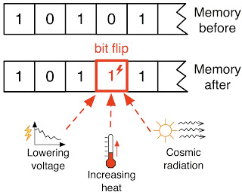
00
Introduction
IF YOU CAN FLIP ARBITRARY BIT?

Slide 4
00
Introduction
Writable Permission bit: 1bit (R/W bit)

Slide 5
01
Background
Exploiting the DRAM rowhammer bug to gain kernel privileges
Mark Seaborn, sandbox builder and breaker with contributions by Thomas Dullien, reverse engineer
2015 Blackhat

Slide 6
01
Background
Flipping Bits in Memory Without Accessing Them: An Experimental Study of DRAM Disturbance Errors
Yoongu Kim, Ross Daly, Jeremie Kim, Chris Fallin, Ji Hye Lee,
Donghyuk Lee, Chris Wilkerson, Konrad Lai, Onur Mutlu)
2014 ISCA

Slide 7
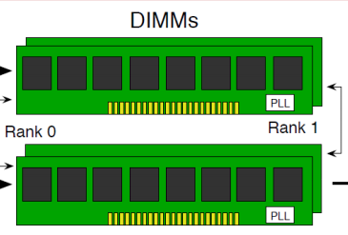
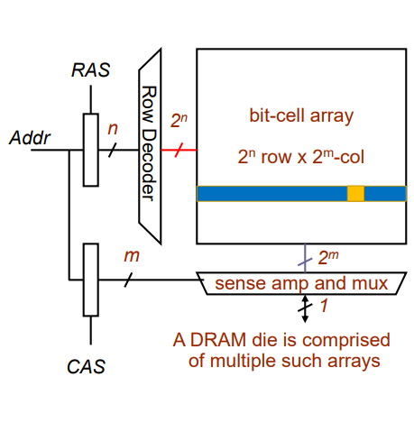
01
Background
Bank
MAIN MEMORY

Slide 8
01
Background
5 Basic Commands
ACTIVATE
READ
WRITE
PRECHARGE
REFRESH

Slide 9
01
Background
5 Basic Commands
ACTIVATE
READ
WRITE
PRECHARGE
REFRESH

Slide 10
01
Background
5 Basic Commands
ACTIVATE
READ
WRITE
PRECHARGE
REFRESH
WRITE DATA TO BANK

Slide 11
01
Background
5 Basic Commands
ACTIVATE
READ
WRITE
PRECHARGE
REFRESH
REFRESH ALL CHARGE

Slide 12
01
Background
WHAT IS ROW HAMMER??

Slide 13
01
Background
ROW 1
ROW 2
ROW 3
ROW 4
ROW 5
ROW 6
ACTIVATE 3
WRITE 3
PRECHARGE
REPEAT
…
…

Slide 14
01
Background
ROW 1
ROW 2
ROW 3
ROW 4
ROW 5
ROW 6

Slide 15
01
Background
code1a:
mov (X), %eax // Read from address X
mov (Y), %ebx // Read from address Y
clflush (X) // Flush cache for address X
clflush (Y) // Flush cache for address Y

Slide 16
02
SETTING
DIFFERENT ROW BUT IN THE SAME BANK

Slide 17
02
SETTING
/proc/{PID}/pagemap shows physical address mapping
“HUGE” Page (More than 2MB)
2MB covers multiple rows in DRAM
The attacker picked two addresses Y = X + 8Mbytes

Slide 18
02
SETTING
1. PICK random more than 2 address from “HUGE” page
2. Execute row hammer attack
3. Find number of bit flips
4. GET adjacent row set

Slide 19
02
SETTING
ROW 1
ROW 2
ROW 3
ROW 4
ROW 5
ROW 6
DOUBLE SIDE ROW HAMMERING

Slide 20
03
Exploitation
Native Client (NaCl) escape in Sandbox of Chrome
bit flip in validated-to-be-safe code
Kernel Privilege Escalation
bit flip in page table entries (PTEs)

Slide 21
03
Exploitation
Native Client (NaCl) Exploit
andl $~31, %eax // Truncate address to 32 bits
// and mask to be 32-byte-aligned.
addq %r15, %rax // Add %r15, the sandbox base address.
jmp *%rax // Indirect jump.
CHANGE REGISTER

Slide 22
03
Exploitation
Native Client (NaCl) Exploit
andl $~31, %ecx // Truncate address to 32 bits
// and mask to be 32-byte-aligned.
addq %r15, %rax // Add %r15, the sandbox base address.
jmp *%rax // Indirect jump.
SANDBOX ESCAPE
13 % Exploitable Bit Flip

Slide 23
03
Exploitation
Native Client (NaCl) Exploit
Where??
movabs $0xf4f4f4f40ceb050f, %rax
20ea2: 0f 05 syscall
20ea4: eb 0c jmp ... // Jump to next hidden instr
20ea6: f4 hlt // Padding

Slide 24
03
Exploitation
Kernel Privilege Escalation
Writable Permission bit: 1bit (R/W bit) ➔ 2 %
Physical Page Number: 20 bits on 4GB Physical Memory ➔ 31%
USE THIS

Slide 25
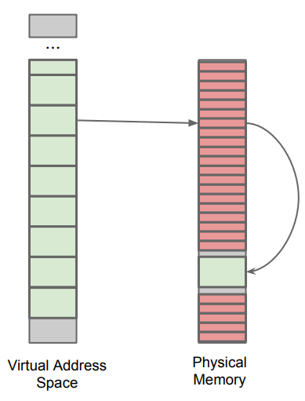
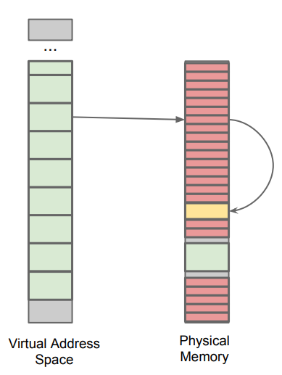
03
Exploitation
Kernel Privilege Escalation
Bit Flip

Slide 26
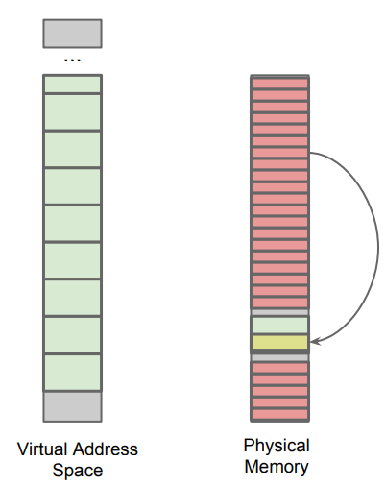
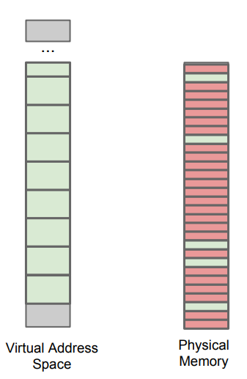
03
Exploitation
Kernel Privilege Escalation
Useless bit flip
Fragment the file

Slide 27
04
Mitigation
NaCL
- Disallow CLFLUSH instruction
2. Linux Kernel
ECC code
Target Row Refresh
Speedup Refresh Rate

Slide 28
04
Mitigation
NaCL
- Disallow CLFLUSH instruction
2. Linux Kernel
ECC code
Target Row Refresh
Speedup Refresh Rate

Slide 29
04
Mitigation
NaCL
- Disallow CLFLUSH instruction
SIMPLE SOLUTION → Unable to access DRAM consecutively

Slide 30
04
Mitigation
NaCL
- Disallow CLFLUSH instruction
2. Linux Kernel
ECC code
Target Row Refresh
Speedup Refresh Rate

Slide 31
04
Mitigation
2. Linux Kernel
ECC Code | Target Row Refresh | Speedup Refresh Rate
Expensive 1bit – correctable 2bit – detectable > 3bit - undetectable | Refresh DRAM row from counter threshold LPDDR4 applied | Speedup Refresh Rate of DRAM BIOS configuration do this

Slide 32
05
Conclusion
Current
Row hammer
(2015)
DRAMMER
(2016, Android)

Slide 33
05
Conclusion
Current
Row hammer
(2015)
SGX-BOMB
(2017, intel SGX)
DRAMMER
(2016, Android)

Slide 34
05
Conclusion
Current
Row hammer
(2015)
SGX-BOMB
(2017, intel SGX)
DRAMMER
(2016, Android)
SGX-BOMB
(2017, intel SGX)

Slide 35
05
Conclusion
Current
Row hammer
(2015)
SGX-BOMB
(2017, intel SGX)
Throw Hammer
(2018, network)
DRAMMER
(2016, Android)
SGX-BOMB
(2017, intel SGX)

Slide 36
05
Conclusion
Software-level sandboxing is easy to bypass using hardware bugs
Bit Flip is enough to privilege escalation exploit
Hardware vendor should aware security issues

Slide 37
05
Q&A
Q&A

Slide 38
PONYBUHAGOM
THANK YOU
PONYBUHAGOM.TISTORY.COM/NUMBER

