Slide 1
It’s all in your head(set): Side-channel attacks on AR/VR systems
Yicheng Zhang, Carter Slocum, Jiasi Chen and Nael Abu-Ghazaleh, USENIX Sec’23
Presenter: Yuanxin Pang

Slide 2
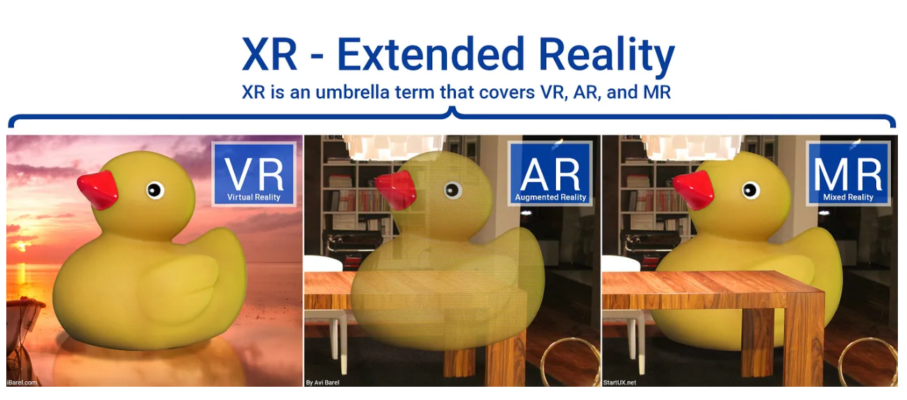
Cited from : https://medium.com/startux-net/the-differences-between-vr-ar-mr-27012ea1c5

Slide 3
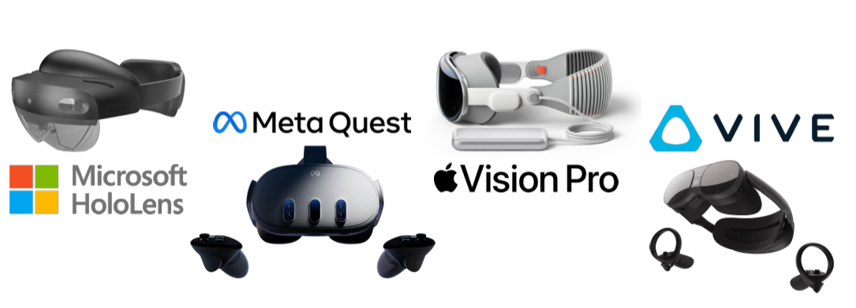
AR/VR products
Various products: commercial AR/VR devices for consumer & industrial use
Huge market
Notes:
: USD 59,755.4 Million in 2024, which is expected to witness a CAGR of 22.0% during 2025–2030, to reach USD 200,868.5 Million by 2030.

Slide 4

Security concerns
Download software from the store and run them concurrently
  Multi-app scenario
Interact with the virtual and real world
  Expose sensitive information
    Interactions with the system
    Other applications
    Environment
Side-channel attack!
  Noninvasive
  physical properties
Notes:
This application space presents a number of unique challenges because it lies at the intersection of the physical and digital worlds. AR/VR applications augment the physical world and can expose sensitive information about the activities of users [25, 58, 60], their interactions with the system [16], or the environment itself [19,22,57]
In this paper, whether side-channel attacks are feasible threat vectors affecting AR/VR headsets

Slide 5
Related work
[GPU Side-channel attack on other systems]
Rendered Insecure: GPU Side Channel Attacks are Practical. Hoda Naghibijouybariet al. [CCS ‘18]
  Browser fingerprinting
[Software-based information leakage on AR/VR devices]
Location-leaking through network traffic in mobile augmented reality applications. Gabriel Meyer-Lee et al., [IPCCC’2018]
  Probe the network traffic information to infer the location of the victim user in a crowd-sourced AR app.
OVRSEEN: Auditing Network Traffic and Privacy Policies in Oculus VR. Rahmadi Trimananda et al.,. [Sec’22]
  Sensitive information can be reconstructed from VR network traces.
[MR information leakages requiring physical access]
Vrspy: A side-channel attack on virtual key-logging in vr headsets. Abdullah Al Arafat et al., [VR’21]
  Keystrokes can be inferred by WiFi CSI side-channel information, vision and sensor-based side-channel leakages.
[Side-channel attacks via micro-architectural hints]
VRowHammer: A Retrospective. Onur Mutlu and Jeremie S Kim., [Trans. Comp.-Aided Des. Integ. Cir. Sys.’19]
  Attack on DRAM
Notes:
On GPU/CPU side channel attack
AR/VR applications and systems are significantly different in terms of the nature of the workloads as well as the characteristics of both the hardware and the run-time on the headsets.
2. none of these works investigate performance counters as a source of information leakages as we do.
the attacks we propose in this work do not require physical access to the hardware.

Slide 6
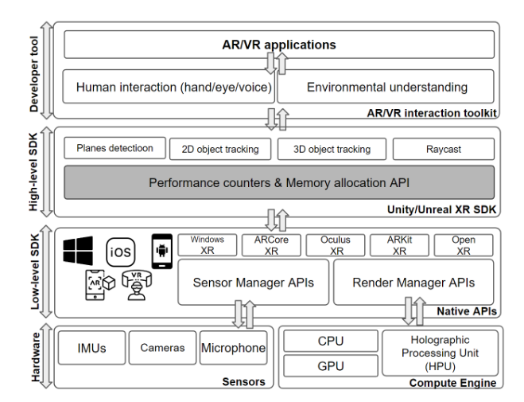

AR/VR Systems Architecture
Notes:
we focus on performance counters related to rendering and thread time, as they are common across AR/VR devices, no matter their hardware capabilities.
Easy to access

Slide 7
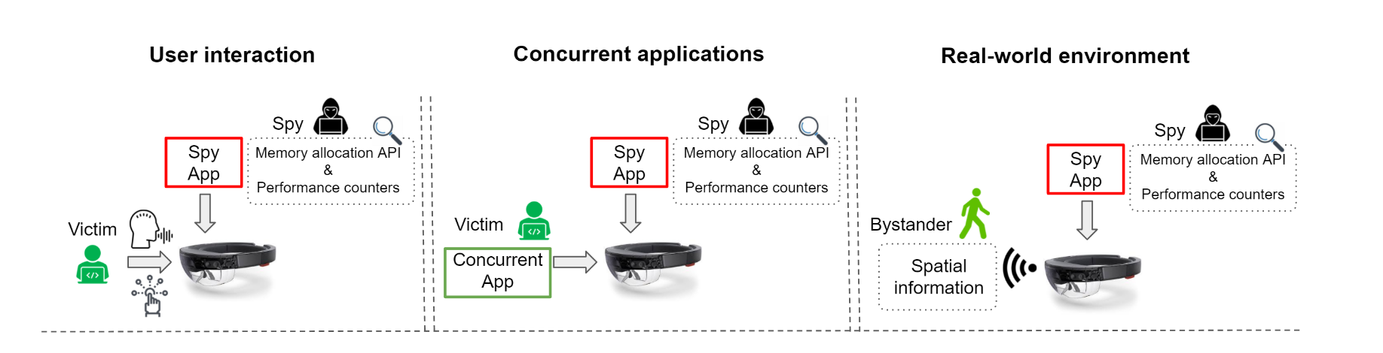
Threat Model: Software Side-channel Attack
A malicious program runs in the background
  A normal user-space application
  Standard application-level permissions
  No physical access
  Periodically probes performance counters & memory allocation APIs
Attack scenarios
Notes:
第一句这里：
each application likely needs information about the environment for rendering and potentially also to provide the opportunity for the user to interact with the environment. Thus, even though the applications may be isolated in the user’s field of view/display, it is unclear how to set up permissions without interfering with usability.
So As a result, they observed on the spy application running in the background and it has access to various APIs in the high-level SDK, such as plane detection, which is shared with other applications.
Three attack scenarios are considered in this work.

Slide 8
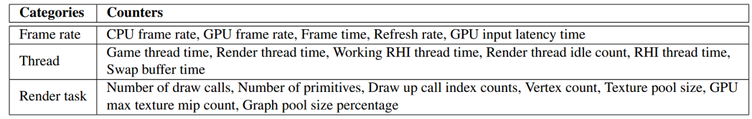
Available leakage vectors
Memory allocation API
  Unity: “AppMemoryUsage”
  Unreal : “CurrentRendertargetMemorySize”, “CurrentTextureMemorySize”
Performance counters
Affected by contention
Notes:
Both the Memory Allocation API and Performance Counters are provided by the Unity and Unreal XR SDKs. They update values every frame, allow applications to monitor their own resource usage, and are indirectly influenced by user inputs or other applications, enabling potential side-channel effects.
Memory Allocation API: Tracks memory usage based on visible objects in AR/VR applications. Accessible to all applications, even in the background, with user-level permissions.
Performance Counters: Provide categorized resource monitoring to optimize application performance. Applications can only access their own performance metrics.

Slide 9
Experimental setup
Two representative headsets
  Microsoft Hololens 2 (AR) - Windows XR SDK
  Meta Quest 2 (VR) - Oculus XR SDK
Spy app implemented on both engines
  Runs as a normal user-space application in the background
  No special permissions
  Only the spy and victim running
10 volunteers * 30 minutes
3 Attack scenarios and 5 attacks

Slide 10
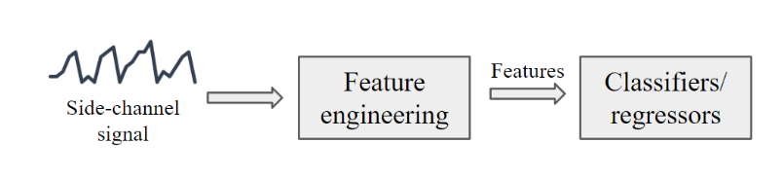
Attack Workflow
Data collection
  training (80%) and evaluation (20%)
Feature engineering
  Generate statistical features from time-series data
  Rank and filter strongly relevant ones based on the p-value
Classification/Regression
  KNN, DT, RF, LightGBM and Voting classifier/regressor
  Metrics
    Classifiers: F1 score, Precision and Recall (Rec)
    Regressor: Mean Absolute Error

Slide 11
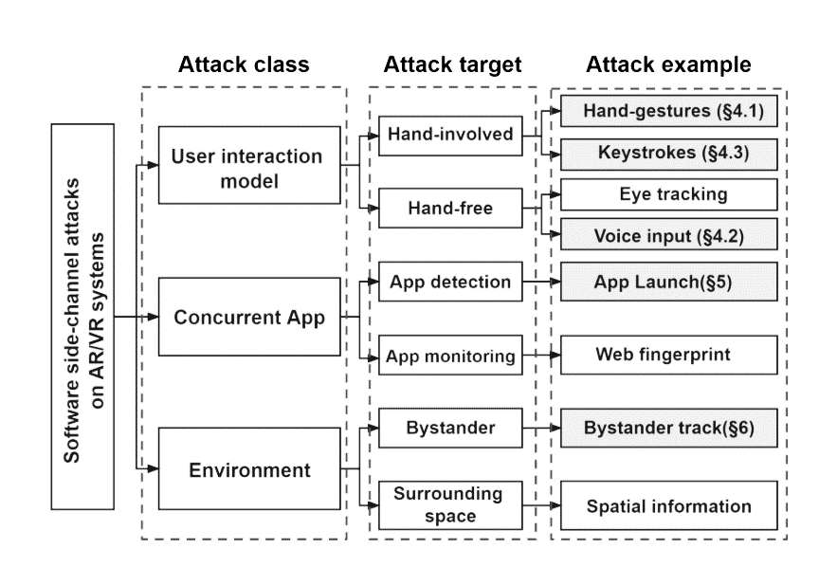
Attack Overview
Taxonomy of software side-channel attacks on AR devices.
Notes:
We demonstrate five side-channel attacks:
Inferring victims’ hand gestures and voice commands via rendering performance counters (§4.1, §4.2).
Monitoring victims' keystrokes (§4.3).
Detecting and identifying launched applications (§5).
Estimating the presence and distance of an approaching person (§6).

Slide 12
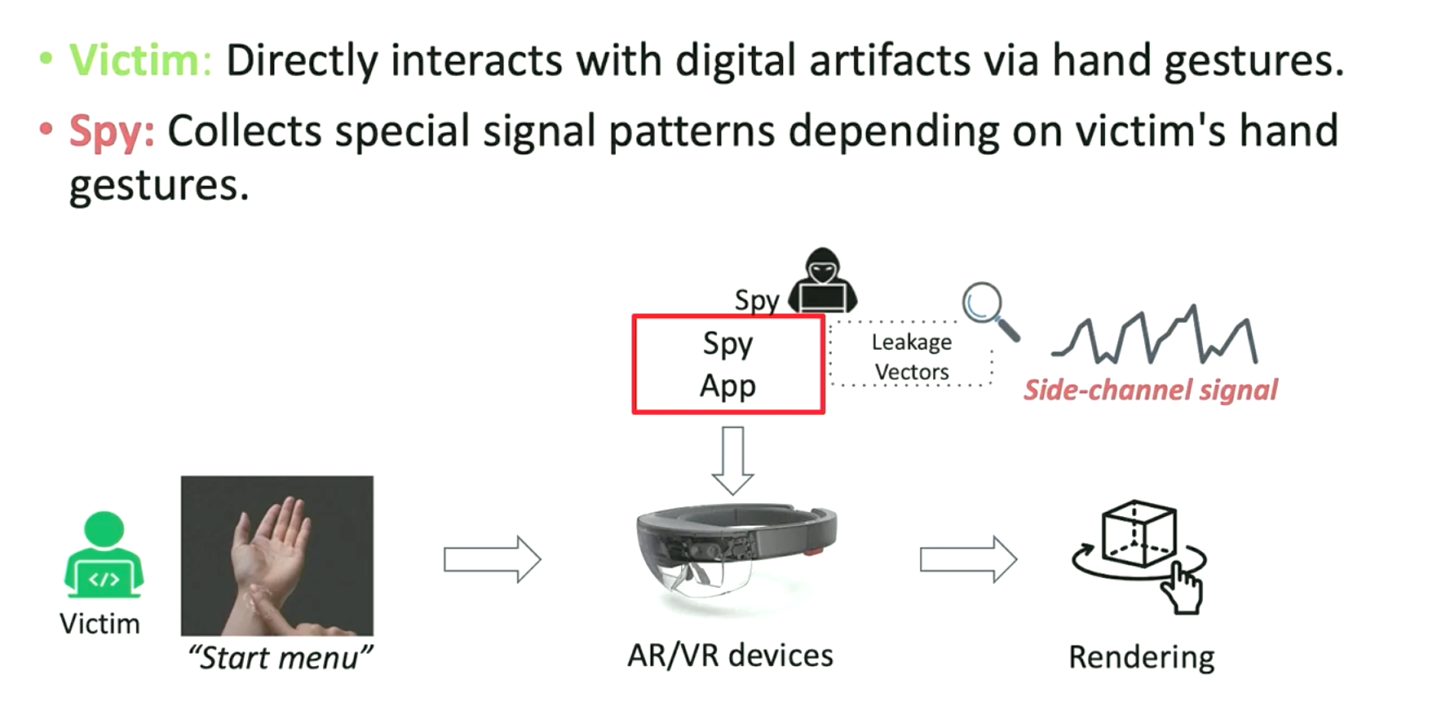
Attack 1: Hand gestures inference
Notes:
演示操作：
They choose 5 most popular gestures, touch, start menu, air tap, scale up and scale down
Touch 直接去指并且指到 using index fingers
Airtap : To select distant holograms pointed to by the hand ray, the user needs to pinch her thumb and index finger together and release them quickly after that.
Change the color

Slide 13
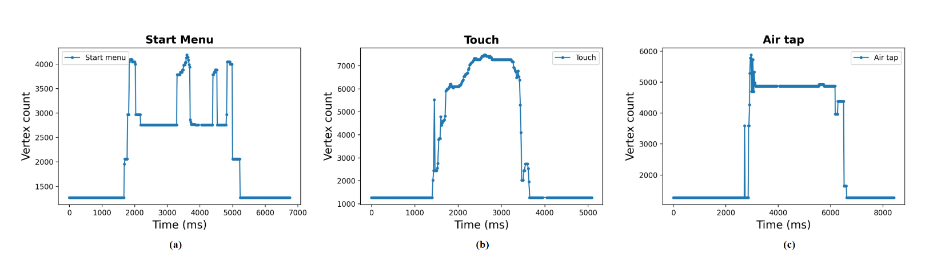
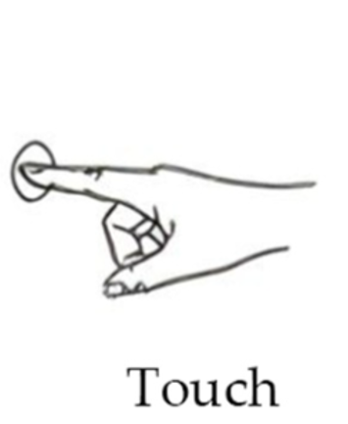

Performance Counter Trace
Notes:
变换的原因：the value of Vertex count is stable at around 1000. However, when the user starts to interact with the device via hand gestures, the AR/VR device needs to render the hands in the immersive world, resulting in the sudden increase of Vertex count.
陡峭的原因：Touch and Air tap involve interaction with a 3D object while Start menu does not, the peak of Vertex count of Start menu is less than other two gestures

Slide 14
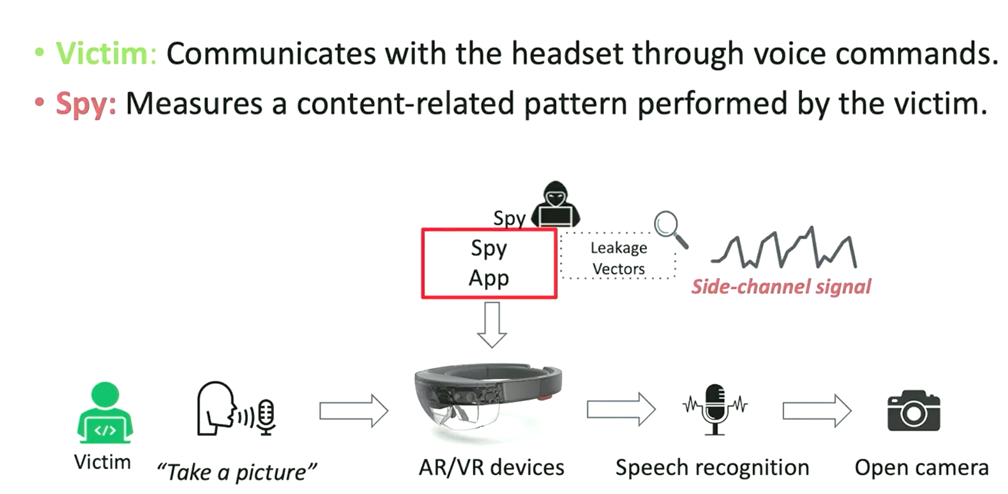
Attack 2: Voice commands inference

Slide 15
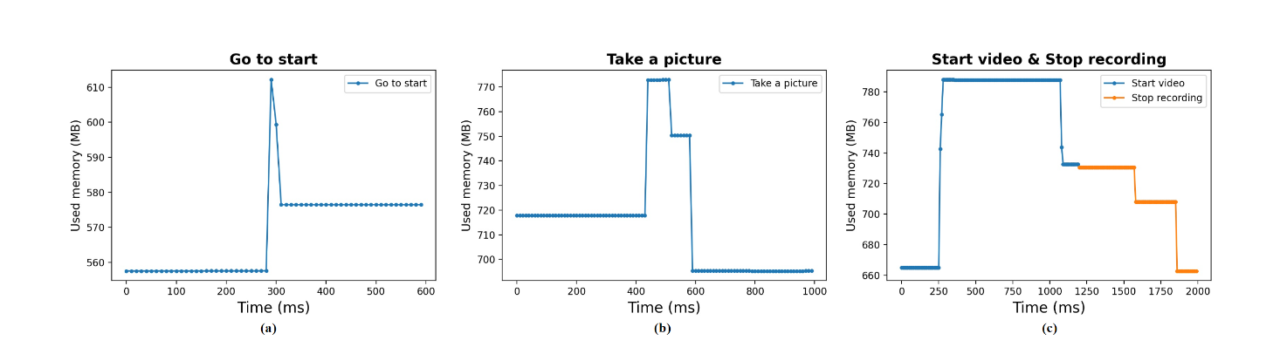
Performance Counter Trace
Notes:
有增加的原因：
We conjecture it is because the triggered voice command may be allocated to a shared buffer with the background spy program.

Slide 16
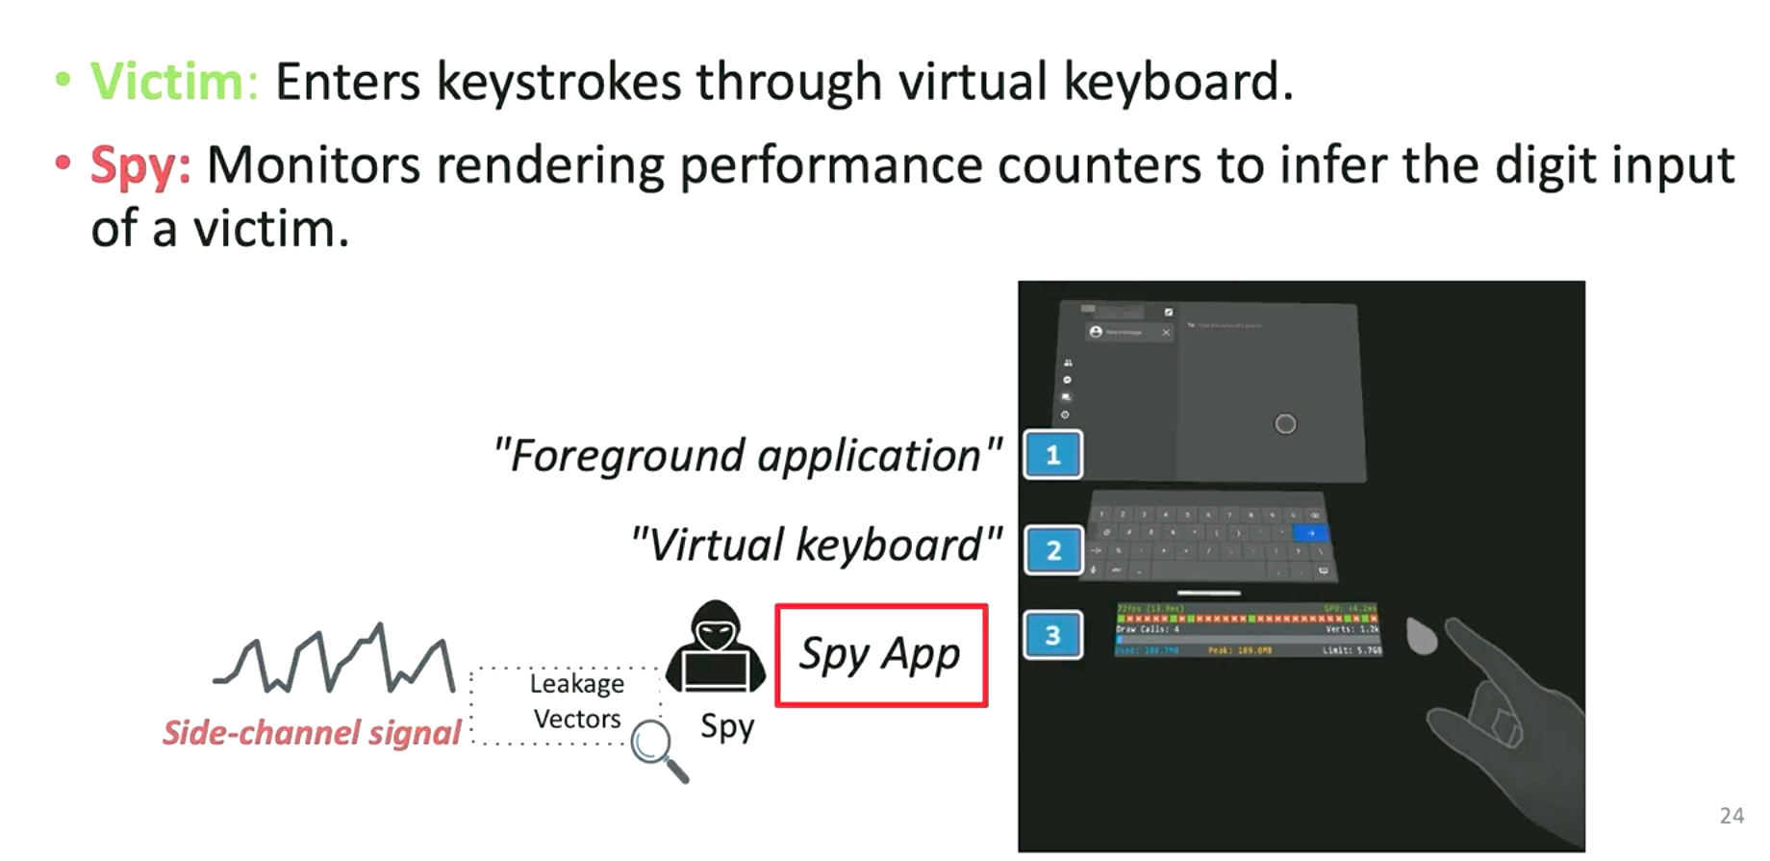
Attack 3: Keystroke monitoring
Notes:
因为用户在输入的时候要根据不同的目的移动手和手指

Slide 17
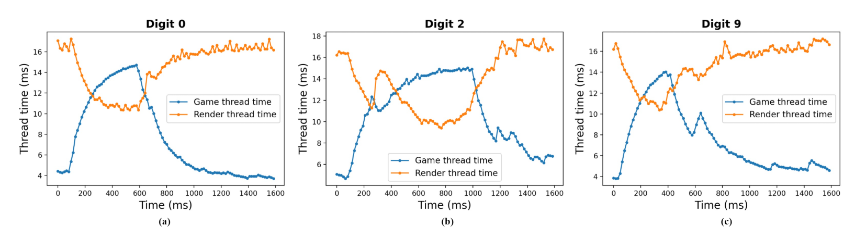
Performance Counter Trace
Notes:
解释指标：
The game thread is responsible for most application logic, while the render thread is activated to render new frames
可以发现：
Game thread time counter increases while the Render thread time counter decreases simultaneously.
推测：
A possible explanation of this counter behavior pattern changes when AR/VR devices detect the touch gesture, it consumes some resources to keep tracking the hand movement. Since the game thread time reflects the time used for spy application logic, it may be preempted by the hand-tracking task. Also, rendering threads of the spy application may skip updating because of resource contention.

Slide 18
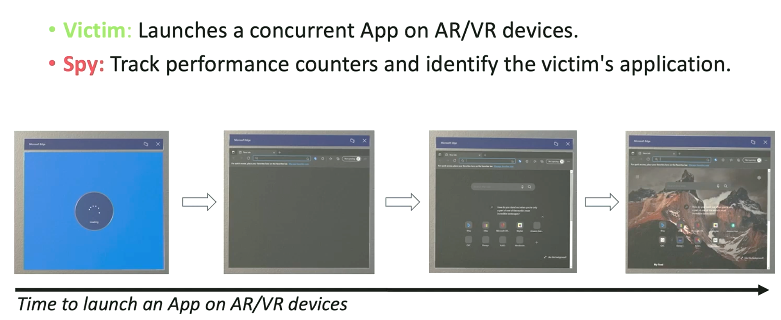
Attack 4: Concurrent app fingerprinting
Notes:
目的：infer the launch and identify a concurrent application.

Slide 19
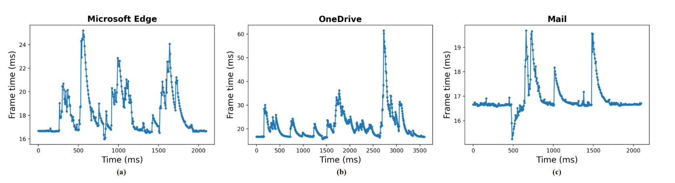
Performance Counter Trace
Notes:
Quest 2 headset不可以, 因为 only a few applications (such as Facebook Messenger or Meta chat) are allowed to open in the foreground with other applications, although this may change in the future.
Frame time 变化的原因：
When a foreground application is running, it intensifies competition with the spy program, causing the spy app's CPU/GPU frame latency to increase.

Slide 20
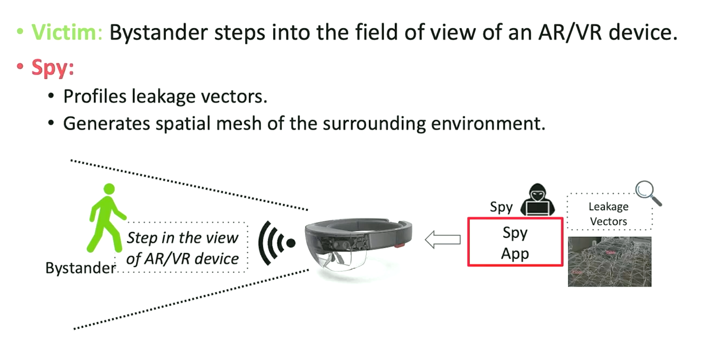
Attack 5: Bystander ranging
Notes:
这项攻击只对Hololens的AR系统相关因为AR系统需要现实世界的信息，而VR是完全immersive的；Hololens提供相应的SDK可以去generate spatial mesh representations of the real-world environment 并且不需要多余的权限
profile the rendering performance counters cause it create additional contention by forcing the results of the spatial processing to be rendered.
实验者以恒定的速度从不同的距离进入视野并出去

Slide 21
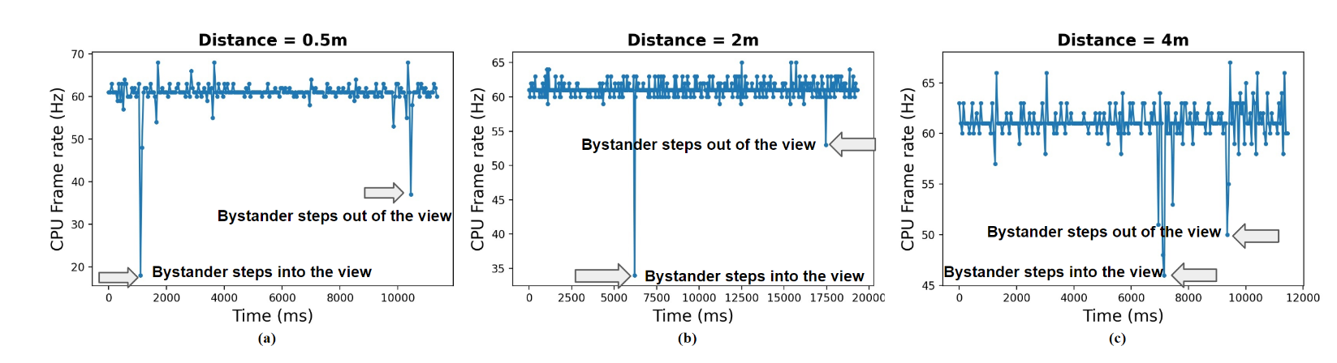

Performance Counter Trace
Will it still affect in a varying environment?
Notes:
Q？
Paragraph a:
the Hololens’ spatial processing detects the bystander and generates a mesh to cover the bystander, causing CPU frame rate to decrease from around 60 to 18；而在走出去的时候 the mesh is discarded immediately for the removed spatial surfaces. During this mesh removal process, we notice that CPU frame rate also decreases, from 60 to 37.
Compared different distances:
The distance of a bystander also has an impact, with two intuitive observations:
Closer objects are prioritized for rendering, so their impact decreases earlier.
Due to perspective projection, closer objects appear larger, causing a greater decrease (e.g., 50 decreases vs. 40 decreases vs. 30).
但是该攻击也有局限性，他的环境是指定的已知的，they wonder 如果在改变的环境里面呢，这个攻击还有效吗？

Slide 22

Evaluation
Robustness to Noise
    Example of Attack1 : Hand gestures inference
    Using “Start menu” gesture : SNR = 10.51
    No gesture : SNR = 6.90
  High resilient to noise
Notes:
Specifically, they collect five traces of CPU frame rate and compute the average SNR with other apps (Microsoft Store, Microsoft Edge, and 3D Viewer) running in the background.
Without interference, for the Start menu gesture, the measured SNR is 10.51 indicating a high-quality channel. While in the presence of noise the calculated SNR decreases to 6.90, this value is still high, indicating resilience to noise. In particular, an SNR value greater than 1 is considered to be exploitable in recent literature

Slide 23
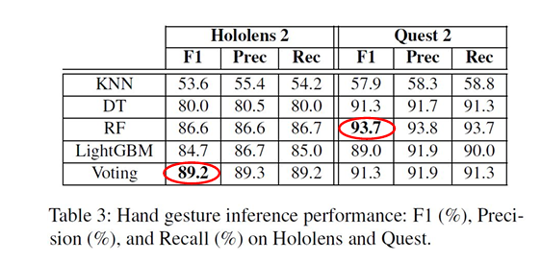
Evaluation
All classifiers reach 89.2% ~ 93.9% correctness (F1 score)
  Example for Attack 1: Hand gestures inference

Slide 24
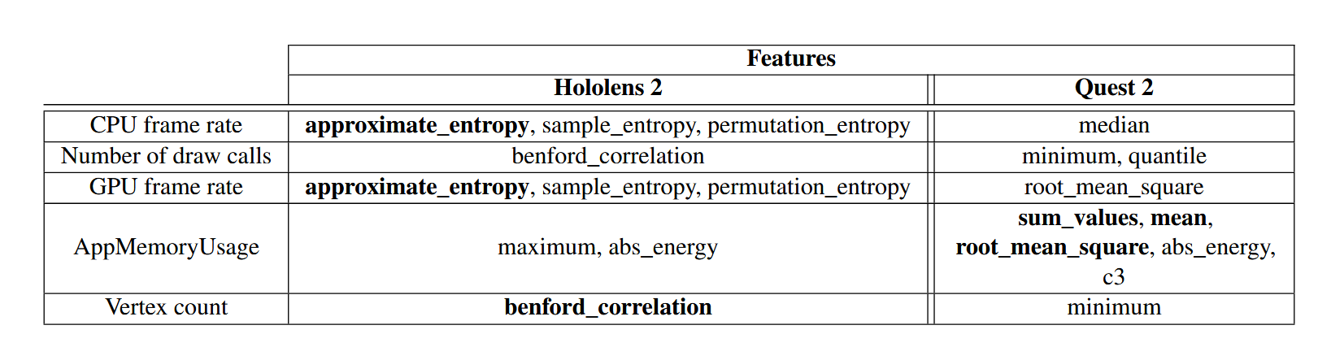
Evaluation
Most relevant features may vary due to different settings
  Example for Attack 1: Hand gestures inference
Notes:
hardware configurations 不一样，Hololens 2 hardware setting different 有一个多余的HPU 去加速渲染
The AppMemoryUsage is more sensitive when different hand gestures are triggered on the Quest than the Hololens.

Slide 25
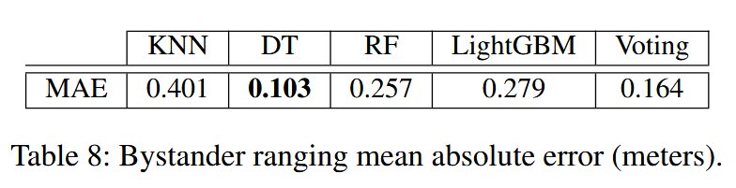
Evaluation
Precise estimation
  Example for Attack 5: Bystander Ranging
Notes:
decision tree performs best, with mean absolute error of 10.3 cm, showing that the attack can estimate bystander distance with high accuracy.

Slide 26
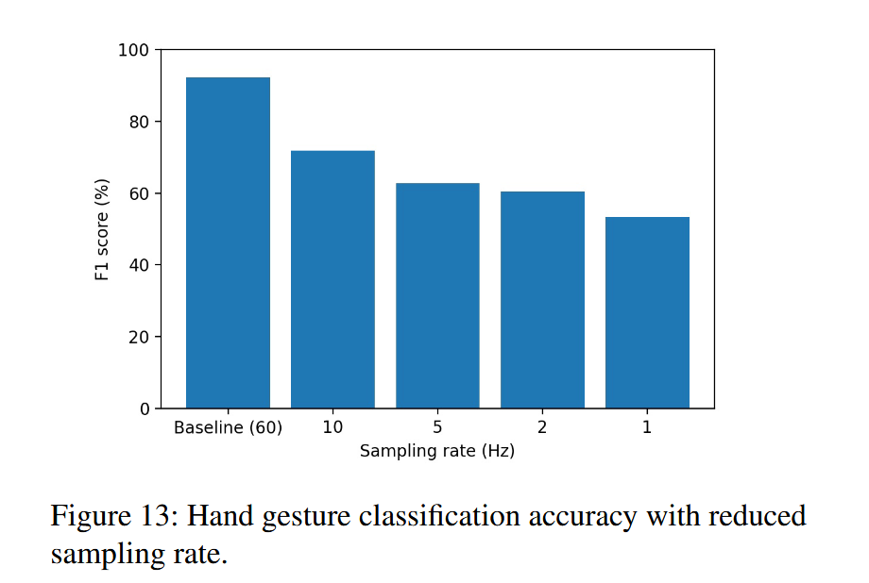
Defenses
Access control on APIs & performance counters
  Completely block access to potentially leaky APIs & counters (impractical)
  Limit the precision or rate of performance counters
  Permissions-based system
Monitor abnormal monitoring or contention
  False positives and overheads
Notes:
第一个不切实际的原因： legitimate applications sometimes rely on these APIs for online performance tuning
第二个不好的原因： 虽然F1分数下降了，但是there remains some signal can be used to infer sensitive information even at low sampling rates.
第三个方法： delegate responsibility to the user to set permissions for what APIs each app can access through an explicit permissions management system。不好的地方：
this pushes the responsibility of determining when these performance counters can be accessed by different apps to the user, who may be unclear on the consequences of granting such permission and lack informed consent. Moreover, there may be technical difficulties vin implementing a permissions system and providing the appropriate user interface.
Monitor：
由于Several of the proposed attacks rely on creating contention on the shared resources，比如使用一些monitor API去生成time series data。所以有没有可能monitor this behavior to detect the presence of such behavior (for example, by hooking the leaky APIs or using hardware support。 Once such behavior is detected, different defenses could be triggered to interfere with the ability of the spy to carry out the attack. As with other intrusion detection systems, false positives and overhead are potential drawbacks of this approach.

Slide 27
Future Direction
Privacy for multi-user AR/VR systems
Better profiling system for AR/VR
  Various Environments for bystander detection
Side-channel attacks via micro-architectural hints. (e.g., CPU, GPU, HPU, system memory)
  Rowhammer attacks on DRAM
Notes:
https://ar-sec.cs.washington.edu/research.html

Slide 28
Follow up study
[Side-channel attack on AR/VR systems]
Shiqing Luo et al. Eavesdropping on Controller Acoustic Emanation for Keystroke Inference Attack in Virtual Reality. [NDSS’24]
  First placement-flexible acoustic attack in VR, which leverages hand controller clicking sounds to infer keystrokes. No need for software downloading.
Anh Nguyen and Xiaokuan Zhang and Zhisheng Yan. Penetration Vision through Virtual Reality Headsets: Identifying 360-degree Videos from Head Movements. [Sec ‘24]
  First contactless side-channel attack leveraging VR head movements to identify 360 videos viewed.
Zhuolin Yang et al. Can Virtual Reality Protect Users from Keystroke Inference Attacks? [Sec ‘24]
  A novel side-channel attack that exploits avatar hand motion telemetry in shared VR environments to infer typed content.
[Privacy for multi-user AR/VR systems]
Nair et al. Unique Identification of 50,000+ Virtual Reality Users from Head & Hand Motion Data [Sec’23]
  Identification attack on 50k+ VR users from biomechanical data.
Nair et al’. Going Incognito in the Metaverse: Achieving Theoretically Optimal Privacy-Usability Tradeoffs in VR [UIST’23]
  Differential privacy to obscure sensitive attributes on demand.

Slide 29
Conclusion
First side-channel attack using render performance counters on AR/VR systems
Three attack scenarios
  5 end-to-end side-channel attack
Mitigation based on limiting the precision or rate is not effective
Notes:
Add my opinion

Slide 30
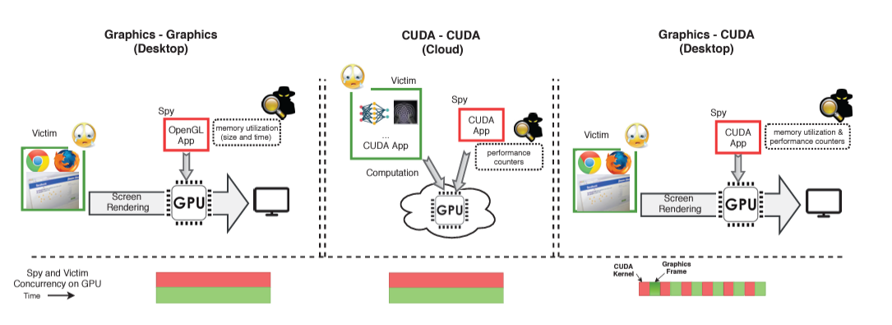
Limitations
  Implementing the attack from another system
    Rendered Insecure: GPU Side Channel Attacks are Practical. Hoda Naghibijouybariet al. [CCS ‘18]
  Attack environment is quite fixed
    bystander distance estimation
  Root cause of the pattern
    Blackbox machine learning. Interrupts?
    Cook, Jack and Drean et al.There's Always a Bigger Fish: ML-Assisted Side-Channel Attack[ISCA’21]
Notes:
What can we do when we know the most relevant features? Can we go deeper in to the interrupts?

Slide 31
Thanks!

Slide 32
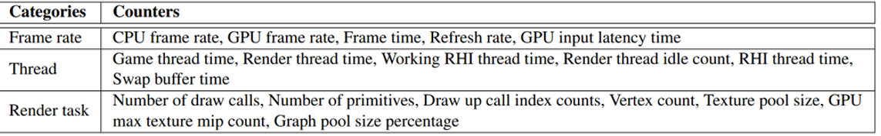
Q&A – Good questions
Taeha Kim
VR/AR devices, including wearable devices, collect and process personal information from users through various sensors. They also connect to a main device via channels like Bluetooth to exchange data. Could these distributed characteristics be leveraged to enhance robustness against side-channel attacks?
Wonyoung Kim
Certain attacks, like the bystander distance estimation, rely heavily on CPU frame rate signatures. Do you think similar patterns could emerge with other types of performance counters, such as energy consumption or heat dissipation, in AR/VR devices?
Zunnoor Fayyaz Awan
The authors seem to have considered comparatively isolated scenarios. If several applications were running concurrently, several changes were continuously occurring in the field of view, or the user was using multiple types of input actively, would such inference attacks still be realistic?
Pierre Noyer
Would it be possible to use, for example, machine learning to increase the success rate of the different attacks?
Notes:
It may help, cause more characteristics will make the spy hard to get all the data at once. Each device can handle specific tasks and only share necessary information, reducing the attack surface.; they can have different permissions; but it would be complicated and require the different parts communicate securely
Would help, but as in this attack, they focus visible service each application provides for the system, it means they care about the graphics part. Permission/ 会不会太麻烦，因为现在的优化可能让他们很难看出不一样
No，因为没有控制变量很难预测，如果互相影响，可能会产生新的pattern。
Yes，因为他提到了一个使用分类器，我刚刚也提到这里的machine learning像一个黑河攻击。对于攻击和防御来说，如果有什么可以帮我们分析哪些指标在怎样的环境下产生了什么样子的变化更好。

Slide 33
Q&A – Best questions
Donghyo Bang
Can the proposed solutions, particularly permissions-based access and API monitoring, scale effectively in multi-user or collaborative AR/VR environments where multiple applications and users interact simultaneously? What challenges might arise in such scenarios?
Yubin Lee
Are performance counters necessary for certain applications? Do you think there are good reasons why Microsoft and Meta made the decision to allow access to performance counters for any apps that want to?
YoungHyo Kang
The paper assumes that the spy application is already installed on the device and is transmitting related information externally. On smartphones, application access permissions must be approved by the user, and various app stores strive to ensure the safety of applications. It is reasonable to expect that similar environments will be applied to VR/AR devices as well. In this context, can the assumptions of this attack model be considered valid?
Notes:
1. challenges: Complex Permissions / Dynamic Interactions/ Data Privacy /false positives
2. Nec: Performance Optimization/Resource Management:User Experience: why: Developer Flexibility; more developers to build applications for their platforms; standardize how applications interact with the hardware,
3.

